Slide 1
Clustering and Segmenting Los Angeles Communities Through K-Means Unsupervised Machine Learning
Cameron Olson
github.com/olson996/Coursera_Capstone

Slide 2
Introduction
Could I find the neighborhoods that match my level of income in Los Angeles and choose one that matches my venue interests?
Main Goals:
Cluster visualizations of the neighborhoods in Los Angeles.
Segment communities through un-supervised machine learning.
Use Foursquare's API to get venues around a community, and cluster Los Angeles communities with the housing price of the area and its top venues nearby.
The venue categories can be found here.

Slide 3
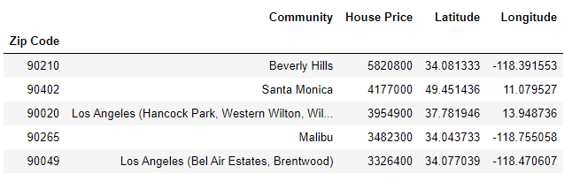
Data
The data used in this research report is provided by the Los Angeles Almanac, https://www.laalmanac.com.
The data includes the zip code, community name, and average price of a single-family home.
We use the requests, beautiful soup, and panda libraries to web scrape
The coordinates of the neighborhoods will be needed to research the top venues for each zip code and geopy handles this for us.
265 rows, 5 columns

Slide 4
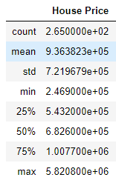
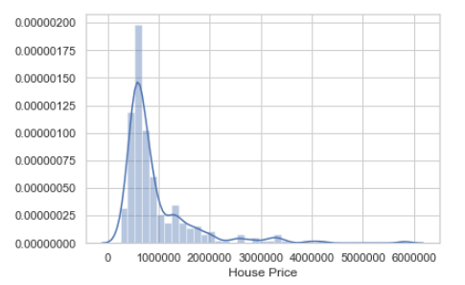
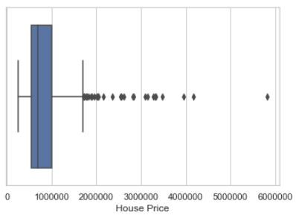
Exploratory Analysis

Slide 5
Exploratory Analysis cont.
75% of the data is around one million dollars or less.
There are 28 zip code communities that meet the criteria of an outlier being greater than 1.7 Million
The distribution is positively skewed from well known and high-priced real estate in locations like Beverly Hills and Santa Monica.
Most zip codes average single-family homes around $600,000

Slide 6
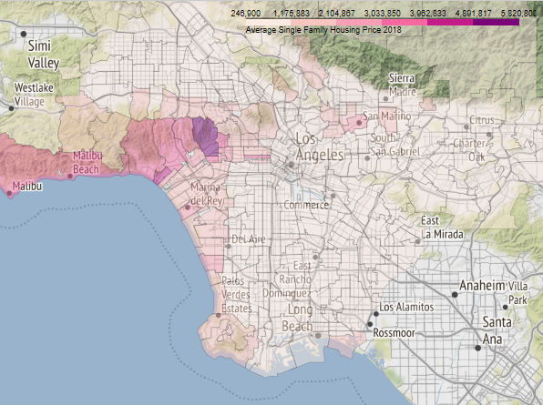
Choropleth of Los Angeles Housing Price

Slide 7
Choropleth Insights
The average housing price for 265 zip codes is $936,382.26
Beverly Hills is an outlier and is significantly higher than the rest of the area.
The more expensive single-family housing prices are higher along the west coast .
Price increases with altitude around Hollywood Hills and over the valley as well.

Slide 8
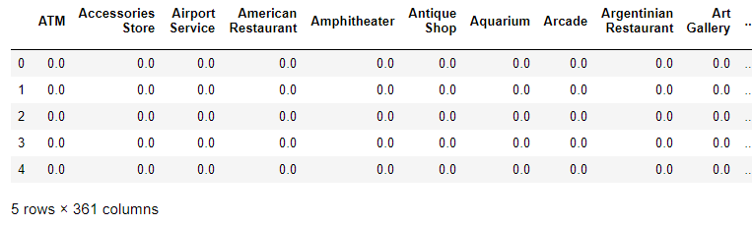
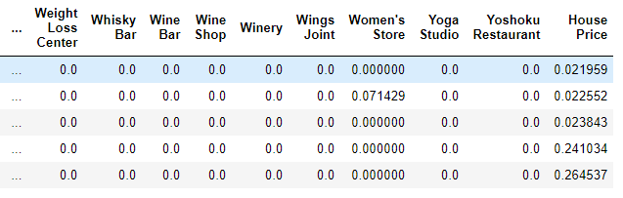
K-Means Clustering
We performed unsupervised learning using k-means clustering using k=6.
Foursquare API is used to find the top frequent venues for each community.
We fit the model with normalized housing price and non-normalized housing price combined with the frequency table
The table below illustrates the features that the model clusters on.

Slide 9
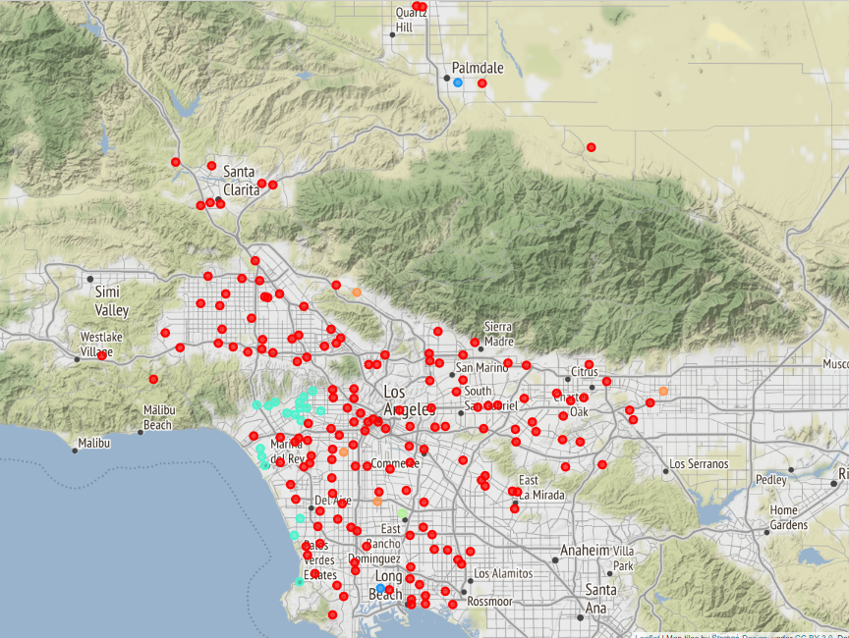
Normalized Housing Clusters

Slide 10
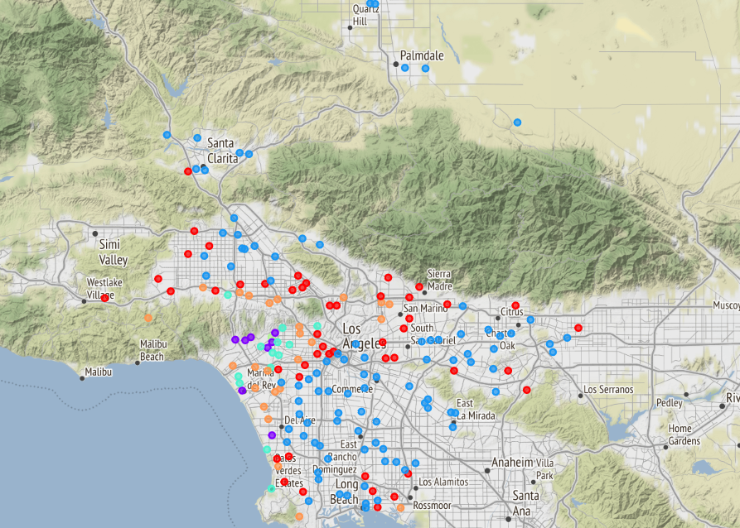
Non-Normalized Housing Clusters

Slide 11
Results
When not normalized K-Means assigns greater weight to the housing
Non-Normalized cluster pattern resembled choropleth map.
The normalized example does cluster the higher mean priced housing areas, it fails to cluster the lower mean priced ones.

Slide 12
Conclusion
The data is skewed and when normalized this significantly changes the way that K-Means clusters the data
Non-Normalized K-Means allows housing price to outweigh venue frequency completely.
There is a large disproportionality among average single-family housing prices in communities around LA.
Be sure to check out the report Word Document for detailed results including the top common venues among the non-normalized and normalized clusters!

