Slide 1
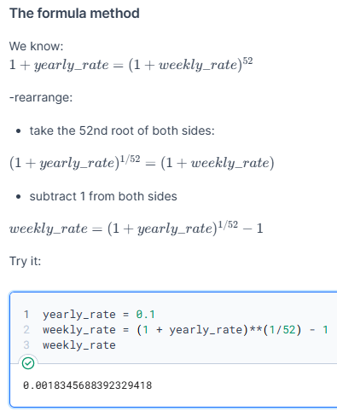
Answer to exercise
‘wk2_1_intereesting’ – ‘for extra cool points’

