Slide 1
Web engineering
Introduction

Slide 2
Web engineering
sofie.beerens@thomasmore.be
Agreements labs
Prepare lab exercises!!!
Complete unfinished exercises at home!!
Agreements theory
Online:
recorded lectures with short exercises on Canvas
weekly online session for question
On campus:
bring laptop fully loaded to lectures

Slide 3
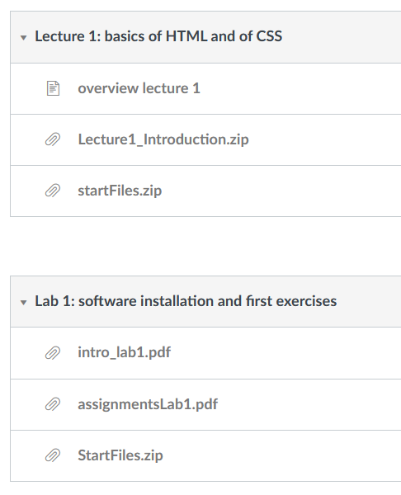
CANVAS
Web Engineering
Slides presented in lectures
Starting files for lab exercises

Slide 4
Web engineering: content
HTML & CSS
Javascript
Jquery
XML
….

Slide 5
load
6 x 30 hours = 180 hours
5 x 12 hours lect/lab = - 60 hours
At home = 120 hours
Lots of info in very short time period: practice a lot at home!!!

Slide 6
Evaluation June
Theory:
100%: written, closed book
Lab:
60%: practical exam on a computer where the student can use his/her own course material and the help files available on the computer.
40%: create website about your project
submit to canvas before 16/05/2020 at 23:59h
demonstrate during lab exam (depending on COVID situation)
The course is evaluated on the basis of 2 evaluation activities, i.e. a theory examination and a lab examination. Each evaluation activity evaluates separate learning objectives. The theory exam evaluates the learning objectives (1) and (2). The lab exam evaluates the learning objectives (3) - (6). If the student obtains a score of <7 on one of the evaluation activities, the student can obtain a maximum of 9/20 for the entire course.

Slide 7
Evaluation august / Sept
Theory:
100%: written, closed book
Lab:
60%: practical exam on a computer where the student can use his/her own course material and the help files available on the computer.
40%: improve the website submitted in june the student contacts the lecturer in order to find out what needs to be improved demonstrate during lab exam (depending on COVID situation)
The course is evaluated on the basis of 2 evaluation activities, i.e. a theory examination and a lab examination. Each evaluation activity evaluates separate learning objectives. The theory exam evaluates the learning objectives (1) and (2). The lab exam evaluates the learning objectives (3) - (6). If the student obtains a score of <7 on one of the evaluation activities, the student can obtain a maximum of 9/20 for the entire course.

Slide 8






Browsers AND text editors
Notepad++ / Visual Studio Code / WebStorm
Remark: no visual editor needed!
Browsers:

Slide 9
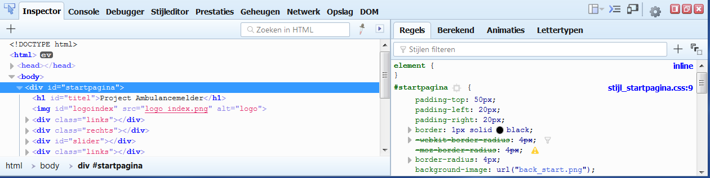
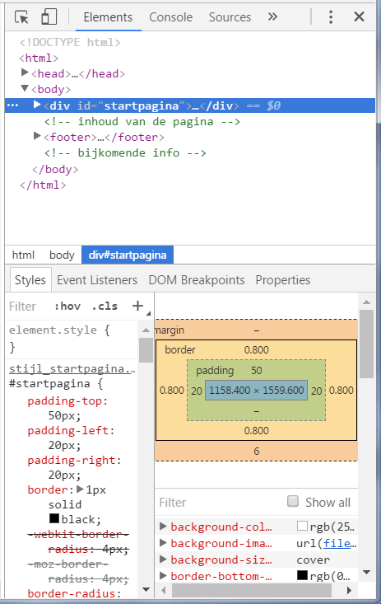
inspector / Console

Slide 10
Help
www.w3schools.com/:
lessons & examples
http://validator.w3.org/:
HTML validator
http://jigsaw.w3.org/css-validator/
CSS validator
http://www.stackoverflow.com
developer community

