Slide 1
Web engineering
Introduction

Slide 2
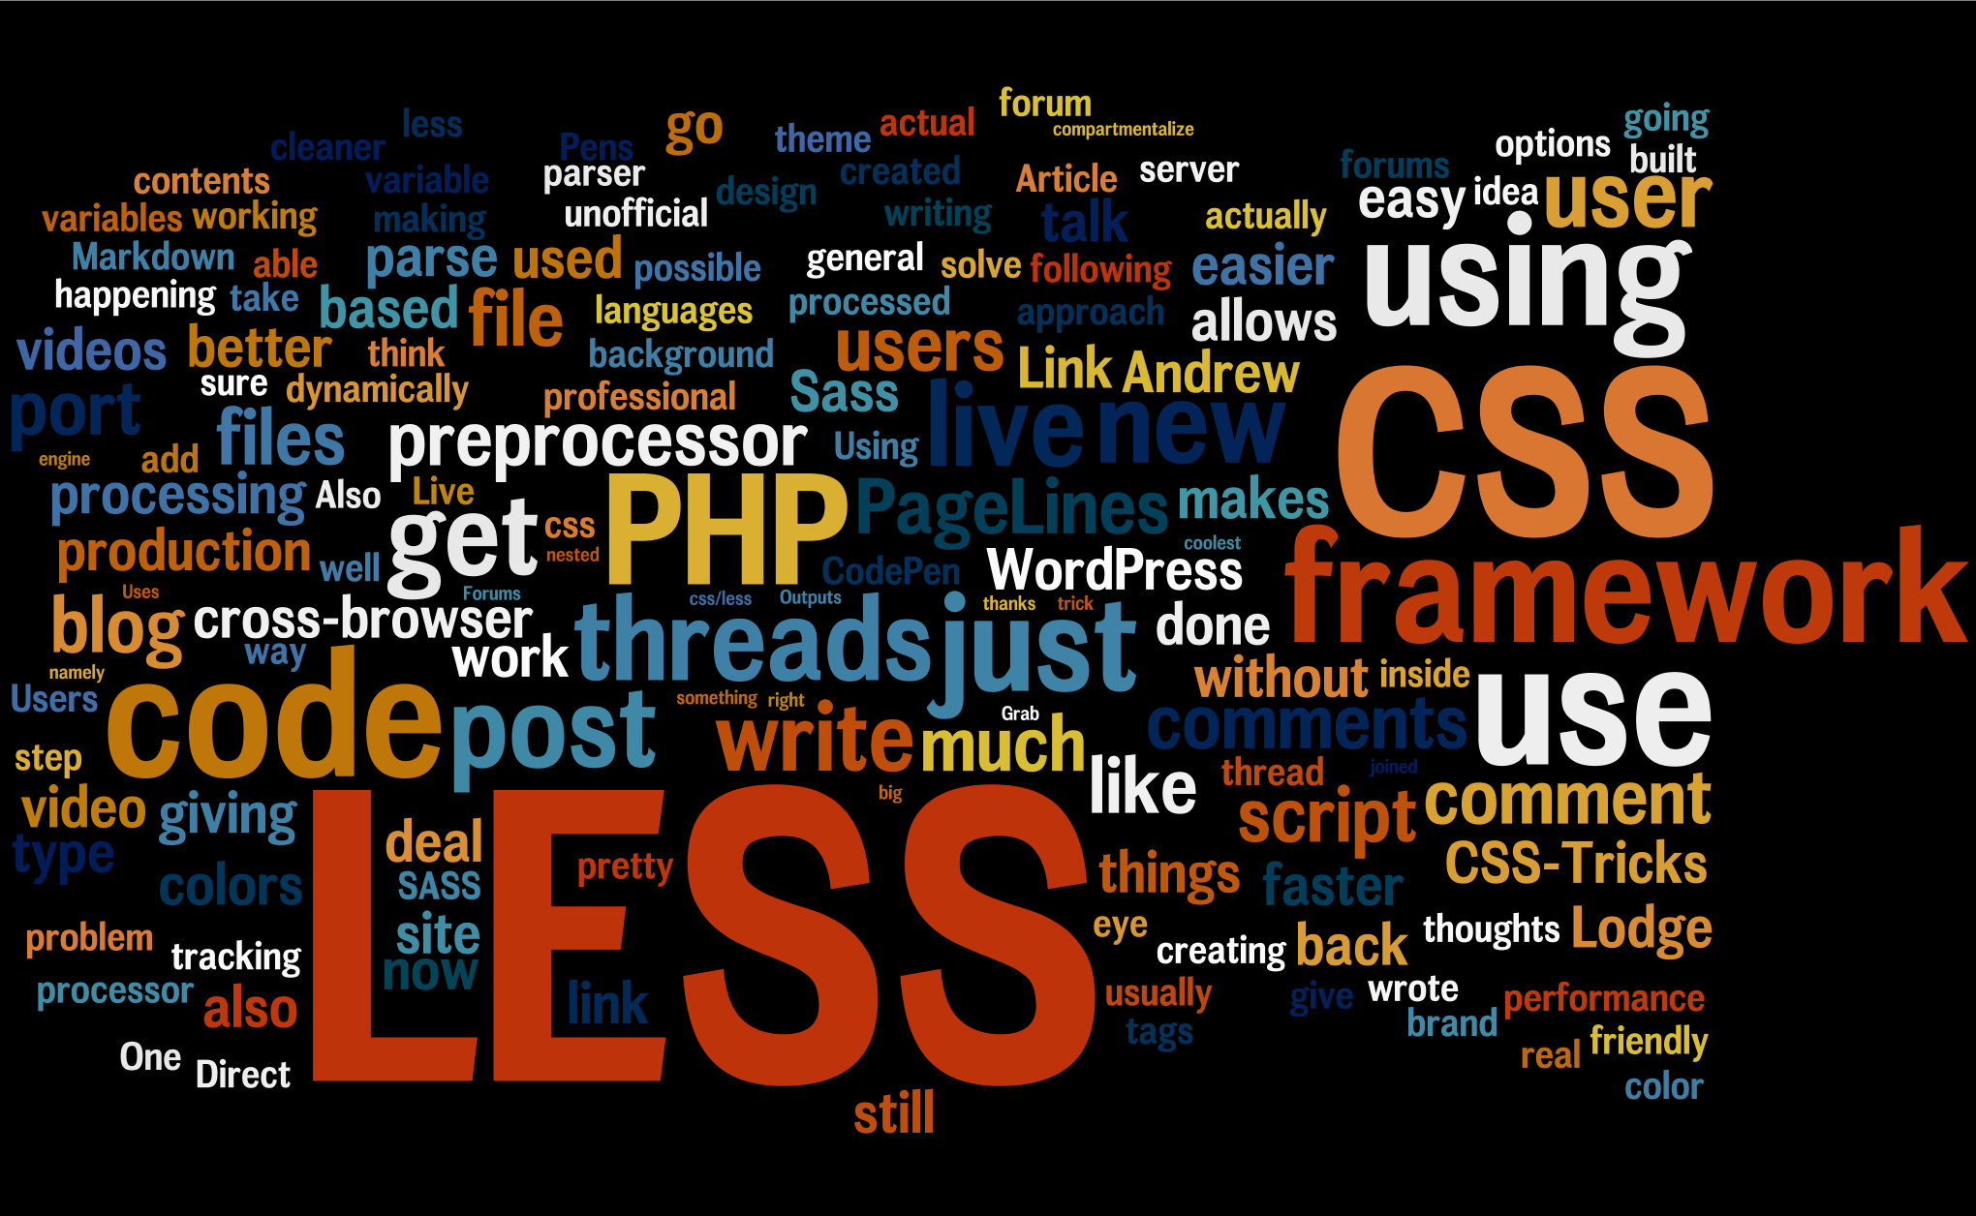
Web engineering
Email: joris.hens@lessius.eu

Slide 3



www
Website
= coherent collection of web pages
Hypertext
= text with links
Platform-independent: Windows, Apple, Linux,...
Notes:
Website is build as a coherent collection of web pages.
A web page contains hypertext
The www is platform-independent (independent of the operating system van the user) web pages need to be platform-independent too!

Slide 4
Browsers
browser:
Interprets entered address and communicates with the server to retrieve file
Shows retrieved file on the screen
Converts the source code of the file to a readable page
adres
Internet
html

Slide 5


Which browser?

Slide 6
Market share?
W3Schools:
http://www.w3schools.com/browsers/
Wikipedia:
https://en.wikipedia.org/wiki/Usage_share_of_web_browsers

Slide 7
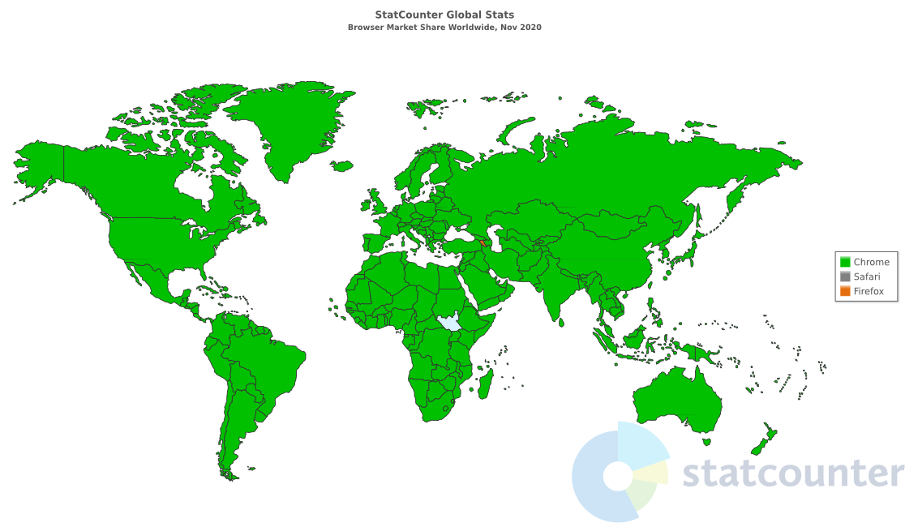
Market share?

Slide 8
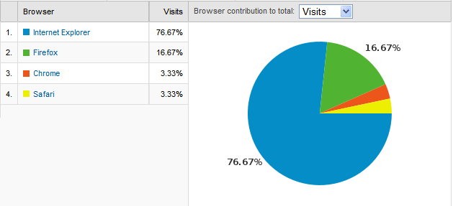
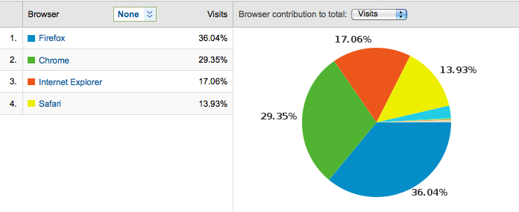
Which site is a site about
computer applications
and which site is that of
a clothes shop?
Difference in target
audience?
Notes:
Depending on your target audience, the market share of the different browsers can be very different => check!

Slide 9
HTML: Hypertext Markup Language
not a programming language !
coding agreement => describes structure
pure ASCII
platform-independent
composed of tags and text
example
Notes:
Toen HTML eerst ontstond => heel veel wildgroei in tags => standaardisering tot HTML4.01

Slide 10
XHTML: extensible Hypertext Markup Language
Conform XML:
standard for describing application- and system-independent electronic text (see later)
= HTML that meets stricter requirements of XML
tags always in lowercase
each starting tag also requires an end tag
can be validated (http://validator.w3.org/)

Slide 11
3 versions of XHTML
XHTML-Strict: no formatting allowed in the page! (Must be in separate CSS file)
XHTML-Transitional: small amount of formatting allowed in the page (transition to strict)
XHTML- Frameset: frames
specify doctype:
Tell browser what to expect
example
Notes:
UTF-8 = Unicode Transformation Format – 8
Universal encoding agreement where for each character there is an associated number represented in UTF - 8 binary with at least 8 bits.
Advantage utf -8: for Western languages, ordinary numbers and letters require the smallest storage space.

Slide 12
HTML5
successor of HTML4.01, XHTML and HTML DOM
based upon HTML, CSS, DOM and Javascript
<!doctype html>
example
Can also be validated
New elements, e.g. <video>, calendar, date, …
Notes:
DOM = Document Object Model = hierarchical structure of the webpage. It defines the way a document and all elements in that document are accessed and manipulated.

Slide 13
Tools
Windows
free: Notepad++, Scite, WebStorm (student license), Visual Studio Code, …
paying: Dreamweaver
Mac
free: Text Wrangler, Scite, WebStorm (student license), Visual Studio Code, …
paying: Dreamweaver, Espresso, Smultron, Sublime Text 2
This course: Visual Studio Code / WebStorm

Slide 14
CSS
Design
external stylesheet
.css
all style info entire website in 1 document
easier to make changes
web pages load faster (style sheet cache)
Allows the creation of optimized style sheets for smartphone, screen, …
example
Notes:
Cascading Style Sheets
design = font, color, background, alignment, …

Slide 15
CSS3
To be combined with HTML5
extra features
validate:
http://jigsaw.w3.org/css-validator/
Pay attention to the inherent style settings of your target browser!!!
This course: HTML5 + CSS/CSS3
Notes:
internet explorer / edge sometimes deviates from the standards

Slide 16
Scss / sass
Use of variables, nesting, … to improve the transparency of your CSS files, to allow for easier maintenance
=> Must be compiled into a css file to use in the browser.
=> Not for this course

Slide 17
Javascript
Scripting language build-in in browser
Add Interactivity to web page
check forms
add animations
example
Client side scripting: executed on user PC
Server side scripting: executed on server (e.g. PHP)

Slide 18
jQUERY
JavaScript framework:
write more, do less
fluent movements
example

Slide 19
summary
1. HTML = structuring data on a page
2. CSS = design the page
3. Javascript: interaction with the page
4. jQuery: Javascript framework
5. XML: data transfer

Slide 20
