Slide 1
Web engineering
Basics of HTML

Slide 2
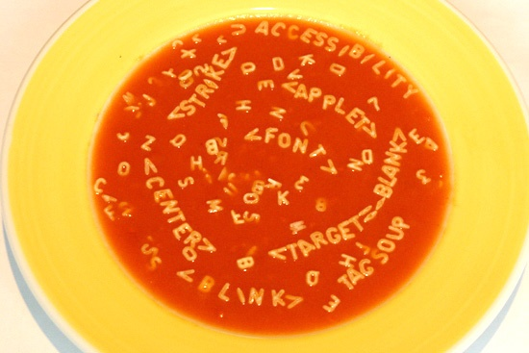
Basis of every website: TAGS
“don’t make TAGSOUP”

Slide 3
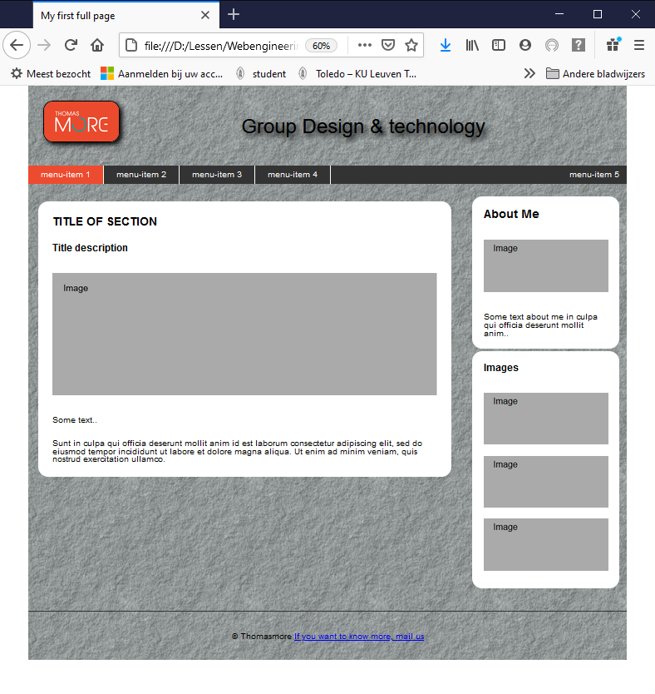
HTML
header
content
HTML = STRUCTURE
with CSS
navigation
footer

Slide 4
HTML: tags
Tag: short code typed into a text file to create the structure of the web page
Open tags <br /> or <hr />
2. Container tags
<p>paragraph</p> <h1>title</h1>
use small letters (not mandatory in html5 but advisable)
open
close
open
close

Slide 5
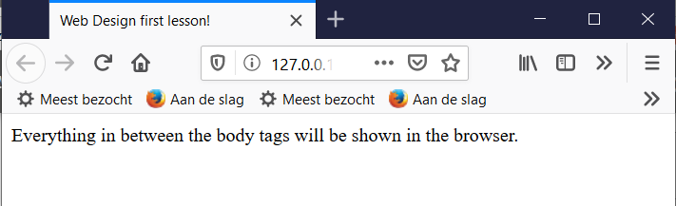
Basic structure HTML page
<html> -> start of the web page
<head>
<meta charset="utf-8" />
<title> Web Design first lesson! </title>
</head>
<body>
-> the "body" of the web page, here comes the real content
</body> </html> -> this ends the web page

Slide 6
HTML5 template
<!doctype html>
<html>
<head>
<meta charset="UTF-8" />
<title>HTML5 template</title>
<link href="style.css" rel="stylesheet" />
</head>
<body>
</body>
</html>

Slide 7


Slide 8
Tags: attributes
E.g.: place titel in middle of the page?
<h1 class="center">my title</h1>
specified in the start tag
space needed between tag and attribute
multiple attributes possible
name attribute written in small letters
key/value pairs with value in between double quotes
empty attributes: <hr />
REMARK: formatting must be done in stylesheet

Slide 9

paragraphs (paragraphs.html)
<p>place all paragraph text here</p>
After the paragraph a white line is automatically created
<p>Attention! A white line is always created!</p><p>Attention! A white line is always created!</p> <p>Attention! A white line is always created!</p>

Slide 10
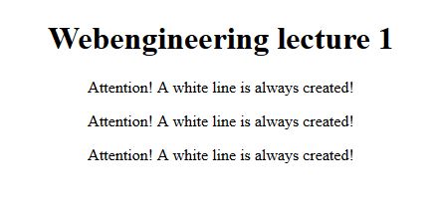
Divisions (divisions.html)
<div>place all elements in div here</div>
Is a block level element
Allows to assign attributes to larger portions of text / multiple elements
E.g.: center several paragraphs and title at once

Slide 11
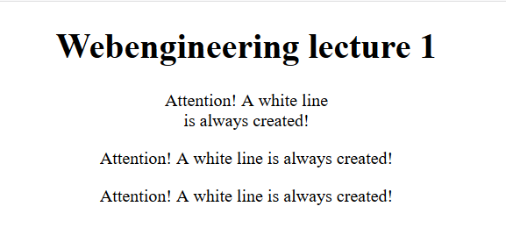
Break, new line (break.html)
<br />
no white line

Slide 12
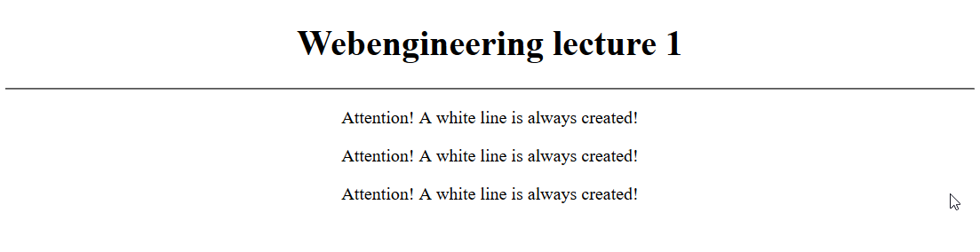
Horizontal line (horline.html)
<hr />
horizontal line

Slide 13
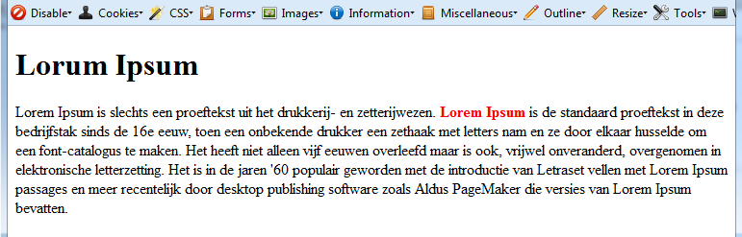
<span> </span> (span.html)
inline element
Difference compared to block level element like <div></div>: no white line was added.
<span> used to selected a small part of the text
Tip: need a lot of text to test quickly? www.lipsum.com

Slide 14

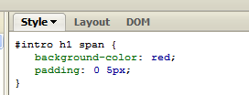
example <span>
<h1>Also <em>your</em> company<br />is in <span>danger</span>
In CSS:

Slide 15
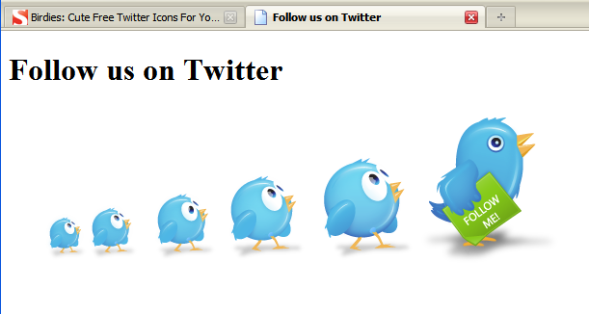
Images (images.html)
Tag: <img />
Attribute: src-> path to the file?
Attribute: alt -> text to show if image not found
<img src=“Image_Twitter.jpg” alt=“Follow us on Twitter” />
image: http://www.smashingmagazine.com/2009/06/24/birdies-cute-free-twitter-icons-for-your-blog/

Slide 16
Tag: <pre>
Pre-formatted text
example:
<pre>
#include &lt;stdio.h&gt;
void main()
{
printf("Hello world\n");
}
</pre>

Slide 17
other tags
<strong> … </strong> | important text. Usually shown in bold.
<em> … </em> | emphasized text. Usually italicized.
<b> … </b> | Defines bold text.
<cite> … </cite> | Quotes and titles of articles or books
<blockquote> … </blockquote> | Longer quotes
<var> … </var> | To show variable-names in program-listings
<dfn> … </dfn> | Represents the defining instance of a term
<code> … </code> | Defines a piece of program code
<samp> … </samp> | Defines sample output from a computer program
<abbr> … </abbr> | Defines an abbreviation or an acronym
<embed> … </embed> | Defines a container for an external (non-HTML) application
More tags: www.w3schools.com/tags

Slide 18
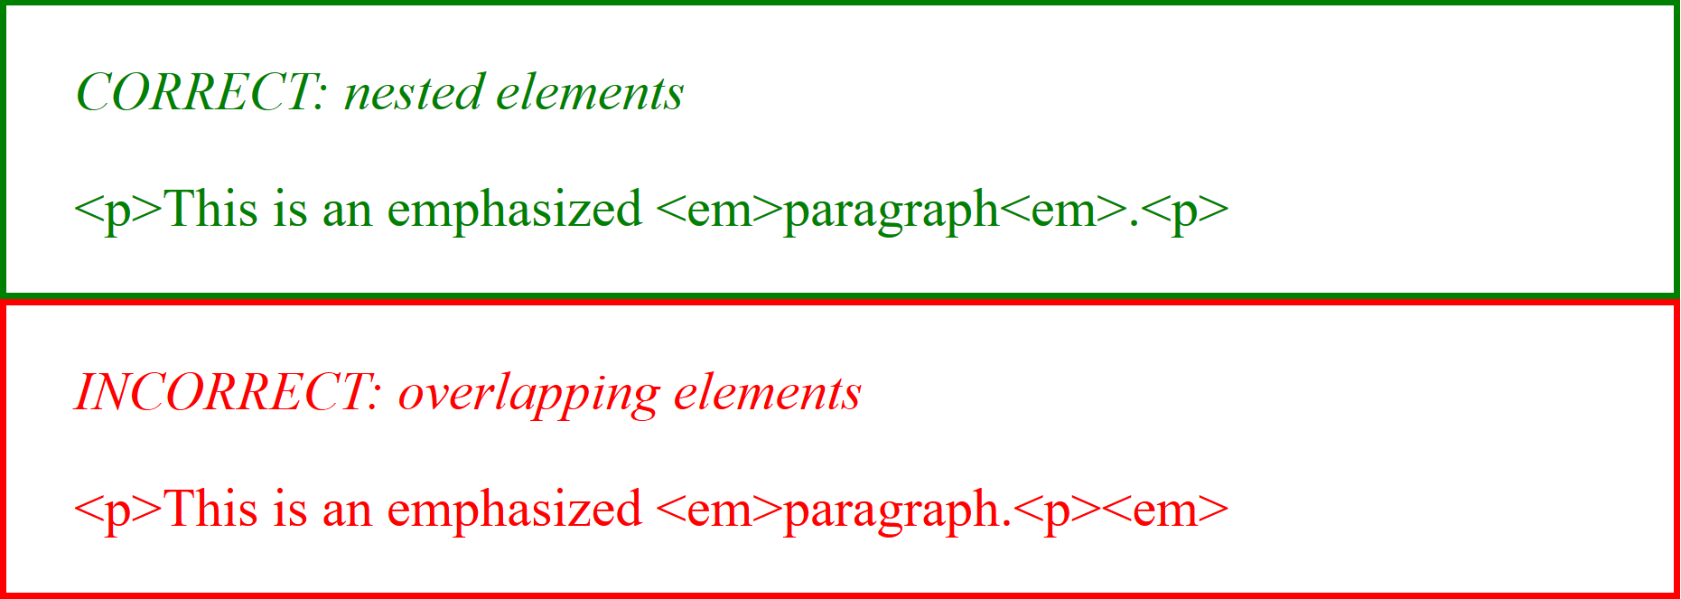
Nesting tags
show part of text in paragraph emphasized

Slide 19
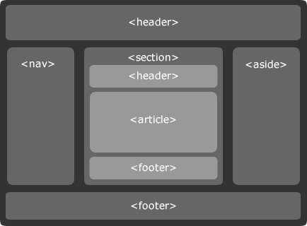
HTML5 tags
<header>
<nav>
<section>
<article>
<aside>
<footer>
source: http://www.smashingmagazine.com/2009/07/16/html5-and-the-future-of-the-web/
Notes:
indien niet als block herkend, in CSS forceren: display: block;

Slide 20
reserved chars => HTML entities
Symbol | Code | Remark
< | &lt; | less than
> | &gt; | greater than
“ | &quot; | double quotation mark
¼ | &frac14;
é | &eacute;
è | &egrave;
ê | &ecirc;
ë | &euml;
& | &amp; | ampersand
€ | &euro; | euro
$ | &sect; | paragraph
x | &times;
÷ | &divide;
α | &alpha;
ω | &omega;
Ω | &Omega;
hard space | &nbsp; | non breaking space
More HTML entities

Slide 21
comments
<!--
Write your comments here
-->
Comments are not displayed by the browser

