Slide 1
JavaScript
basics

Slide 2
usage JavaScript
HTML: structure
CSS: layout
JS: Interaction!
form validation
dynamic menus and images
dynamic style adjustments
animations
without interaction with server or database

Slide 3
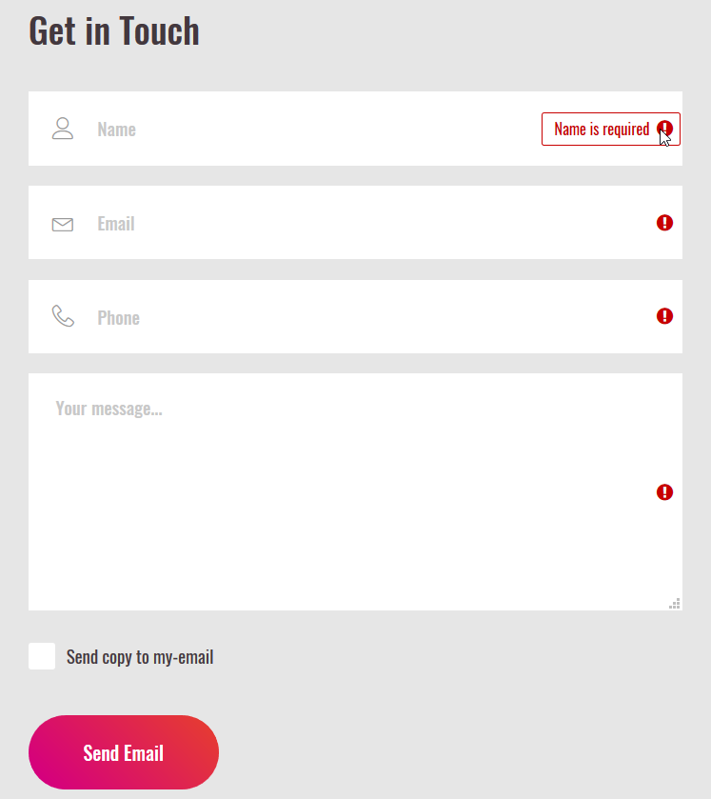
Examples of usage

Slide 4
What is JavaScript
developed in 1993 – Netscape
client-sided scripting language
script is part of the webpage
runs on user's computer
‘included’ in browsers
code readable to everyone (view source)
only usable in webpages
is interpreted, not compiled
= executed line by line
Notes:
console.debug(“tekst”);

Slide 5
What is JavaScript
Case sensitive
write in text editor
Code, Notepad++, Sublime, Textmate, ...
no compiler, no linker needed
object-based (<> object oriented)
Works with objects but not with class instantiations
dynamic binding:
Call to object, references checked during execution => errors only clear at that point

Slide 6
limitations
no communication with http-server
no databases
not possible to write to disk (except Cookies)
Very few multimedia possibilities
Max 32KB (webpage included)

Slide 7
include JavaScript
Use tag to start and stop the JavaScript code
<script>
Put here your JavaScript code
</script>
Can be placed both in
body and head tag

Slide 8
include JavaScript
Include external file containing the JavaScript code (use extension .js)
<script src=“file.js">
</script>
Use of external JS files is recommended: overview & reuse!

Slide 9
JavaScript comments
Comments in JavaScript?
1 line:
// place here your comments
whole block:
/* place here your comments */

Slide 10
building blocks
constants
variables
objects
statements
functions and methods
expressions
assignment instruction
3,1415926
radius, content, PI
document
write, prompt, parseFloat
4*PI*straal*straal*straal/3
every statement ends with ;
content = 4*PI*radius*radius*radius/3;
variable
Value attributed to variable

Slide 11
statements and variables
statements: 1 instruction = 1 statement
e.g.: document.write(‘Welcome!’);
ended with ;
variables: reference to place in memory to store data
name (=identifier) and value

Slide 12
simple input and output
document.write()
prompt()
alert()
confirm()
example

Slide 13
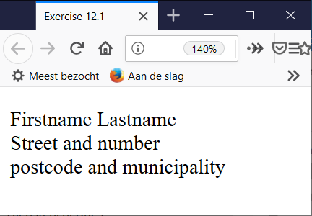
simple input and output
exercise 12.1
Create an html page that uses JavaScript to display your name and address on the screen

Slide 14
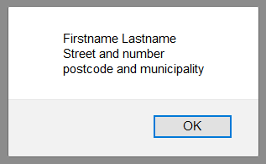
simple input and output
exercise 12.2
Create an html page that uses JavaScript to display your name and address in an alert box.

Slide 15
variables
naming & rules
letters (uppercase or lower case)
-> note: case sensitive
numbers (not as first character)
e.g.: 1test is not allowed! First char must be a letter OR underscore
Test1 of _test
no spaces or ohter punctuation marks or special characters
reserved words are forbidden (e.g.: if, false, return, …)
Use meaningful names and don’t use names longer than one line

Slide 16
variables
Declaration
var name = value
var name = new type;
var name
var sum = 0;
var message = “Welcome to this site”;
var total;
var number = new Number;
Declare at top of code block
not mandatory but good habbit

Slide 17
variables
Scope
= part of the code where variable is valid
local scope
variables declared inside a function
only defined inside that function
global scope
variables declared outside all functions
variables implicitly defined in a function (= without var)

Slide 18
variables
datatype | value | examples
number | number | 5 3.1415927 1E-8 0123
boolean |  | true false
string | Series of characters | "This is a text" 'This too' "" (empty string)
Null | The object does not exist yet
Undefined | The variable has not yet received any value
Referentie (*) | A reference (pointer, address) of an object, array or function.
NaN | Not a Number
(*) change in function = change in main program even if locally defined

Slide 19
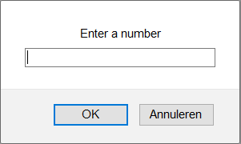
data & variables
1. numbers
2 types:
integers
floating-point numbers
Convert string into floating-point number
e.g.:
<script>
var number = prompt(Enter a number: ');
number = parseFloat(number);
document.write(‘Number entered: ' + number);
</script>

Slide 20
data & variables
2. string
e.g.: "test"
"this is a string"
'this is also a string'
Question 1: what's wrong with next string?
var sentence = "or is this a correct string?'
Question 2: string or not?
var number = '5'

Slide 21
data & variables
special characters in strings:
e.g.:
document.write("Martin Luther King said: "I have a dream".");
Question: what is the probleem?

Slide 22
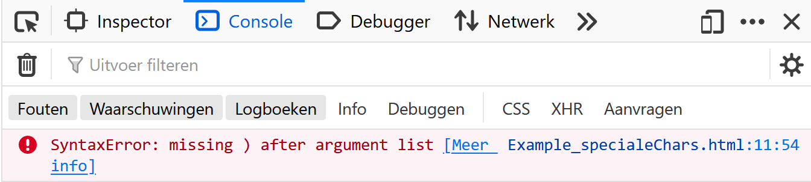
data & variables
special characters in strings:
e.g.:
document.write("Martin Luther King said: "I have a dream".");
NEVER develop webpages without consulting the console
(Tools->Error console)

Slide 23
Console !
The error console is the most important tool for front-end developers
Tip 1: Never develop anything in JavaScript without consulting your console.
Tip 2: Never develop anything in JavaScript without consulting your console.
Notes:
console.debug(“tekst”);

Slide 24

data & variables
Special characters in strings:
resolve by escape sign:
causes character after \ to be shown literally
document.write("Martin Luther King said: \"I have a dream\".");
Also useful to show, for example, the following: c:\windows\system

Slide 25
data & variables
Question:
which of the following variables have been incorrectly named:
var t2t3;
var number;
var break;
var _123;
var words&letters;

Slide 26
data & variables
Type conversion
Loosely typed language:
data type variable is not specified at the time of declaration
data type of first value stored in variable
Conversion functions numbers and strings:
String to number:
var amount = parseInt(s1);
var value = parseFloat(s1);
number to string:
var i = 256;
var s = i.toString();

Slide 27
Expressions
<script>
var number1 = 10;
var number2 = 20;
var total = number1 + number2;
alert('Total = ' + total)
</script>
= Combining constants and variables with operators and functions
=> is evaluated (calculated)

Slide 28
Operators
assignment operators
mathematical operators
string operators
logical operators
comparison operators
conditional operator
bit operators
increment and decrement operators

Slide 29
Operators
assignment operators
a = 1;
a = number1 + number2;
a = a - 5;
a+=2; (short for a=a+2)
mathematical operators
+ - / * %(modulo : remainder of division)
e.g.: is a number odd or even?
var b = a % 2;
if a = 10, what is b?
if a = 13, what is b?

Slide 30
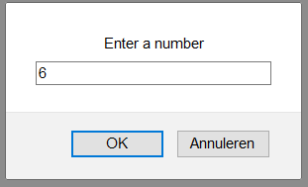
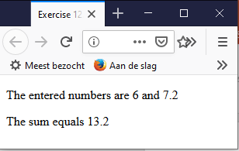
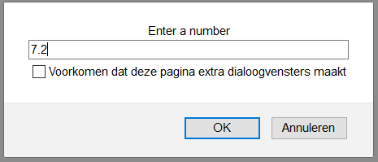
Operators
exercise 12.3
Write and test a JavaScript that:
asks the user to enter two real numbers;
calculates the sum;
prints the numbers and the sum.

Slide 31
Operators
string operators
+ : string addition
var a = "this is a ";
var b = "test";
var c = a + b;
Question: what is the result of following statements:
var c = "50" + "5";
alert(c);

Slide 32
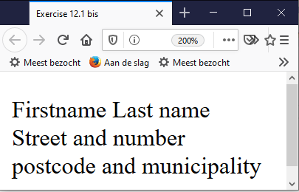
Operators
exercise 12.1 bis
repeat exercise 12.1 but now use 6 variables: firstname, lastname, street, number, postalcode and municipality
Tip: strings can be glued together with: +

Slide 33
operators
logical operators
&&
||
!
comparison operators
== !=
> >= < <=
=== !== (equal value and equal datatype)
5=="5"
5==="5"

Slide 34
operators
Bit operators
Operator | Usage | Description
Bitwise AND | a & b | Returns a one in each bit position for which the corresponding bits of both operands are ones.
Bitwise OR | a | b | Returns a one in each bit position for which the corresponding bits of either or both operands are ones.
Bitwise XOR | a ^ b | Returns a one in each bit position for which the corresponding bits of either but not both operands are ones.
Bitwise NOT | ~ a | Inverts the bits of its operand.
Left shift | a << b | Shifts in a binary representation b (< 32) bits to the left, shifting in zeros from the right.
Sign-propagating right shift | a >> b | Shifts in a binary representation b (< 32) bits to the right, discarding bits shifted off.
Zero-fill right shift | a >>> b | Shifts in a binary representation b (< 32) bits to the right, discarding bits shifted off, and shifting in zeros from the left.

Slide 35
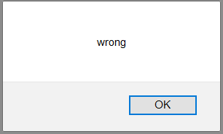
operators
conditional operator
(condition) ? value_true : value_false
-> if conditie is TRUE, value_true is executed, if not, value_false is executed.
<script>
var res = (5 == 3) ? "right" : "wrong";
alert(res);
</script>

Slide 36
Objects
All components browser and webpage e.g.: images, forms, status bar, …
read out or set
create new objects
4 types:
JavaScript Objects (built-in, e.g. Date)
Browser Objects (BOM, e.g. window, document, …)
Document Objects (DOM, e.g. forms, links, …)
Objects defined by the programmer

Slide 37
Properties and methods
Property of object
address with objectname.propertyname
e.g.: document.location
Methods = action you can perform on object
= function connected to object
e.g.: document.write()
More explanation: W3schools

Slide 38
Objects, properties and methods
document.write(‘<h1>Hello world!</h1>’);
document = determines content of browservenster
write() = a method that writes to the object document (a <h1> tag in this case)

Slide 39
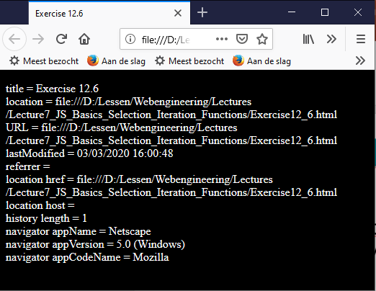
Objects, properties and methods
Write (with document.write()) the values of the following properties of a number of objects with a JavaScript application and interpret them.
document.title
document.location
document.URL
document.lastModified
document.referrer
location.href
location.host
history.length
navigator.appName
navigator.appVersion
navigator.appCodeName
What is the result of:
history.back(2)
location.href="www.thomasmore.be"

Slide 40
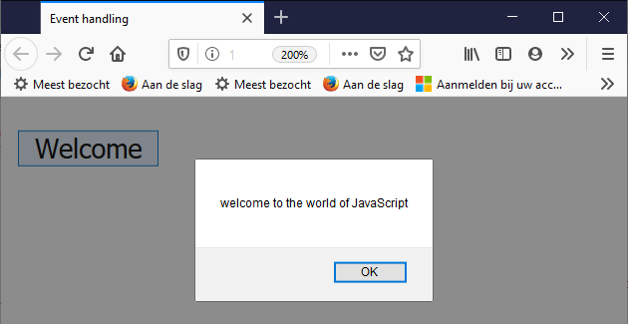
Event handlers
Respond to an event
e.g.: show a message when a user clicks a button
<input type=“button” value=“welcome” onclick=“alert(‘Welcome!’);” />

