Slide 1
JavaScript
Conditional statements

Slide 2
Program flow
normal flow of program:
From top to bottom (order of code)
change normal flow
Depending on choice of user, specific action
if … else …
switch
e.g.: only by laptop if savings are > 2000€

Slide 3
if…else…
grouped code
= compound statement
if (condition)
{
//statements if condition = true
}
else
{
//statements if condition = false
}
Note: condition = logical expression

Slide 4
if…else…
if (allowance == 2000)
{
a = "ok" ;
}
else
{
a = " not ok" ;
}
In short:
(allowance == 2000) ? a = "ok" : a = "not ok";

Slide 5
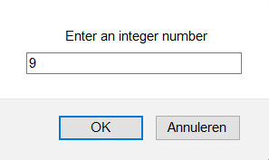
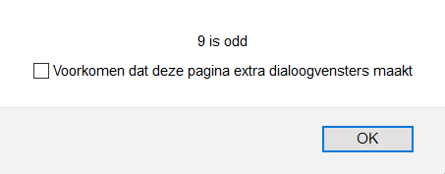
if…else…
exercise:
Create a JavaScript that asks the user for an integer (prompt) and then prints in an alert box whether that number is even or odd.

Slide 6
if…else…
Note: if only 1 statement, { } may be omitted e.g.: if(a>b) max=a; else max=b;
if … else … can also be nested

Slide 7
switch()
to test one variable against multiple possible values
e.g.: variable day can have a value 1 till 7 (mon-sun)
if a day e.g. 13 is entered => default: unknown day)
http://www.w3schools.com/js/js_switch.asp

Slide 8
switch()
switch(n) { case 1: execute code block 1 break; case 2: execute code block 2 break; default: code to be executed if n is different from case 1 and 2 }

Slide 9
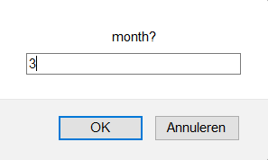
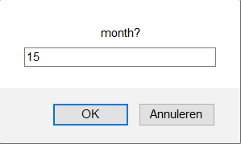
Switch()
Example:
ask a user to enter the number of a month (prompt) and print the corresponding month (alert)
If unknown month: print error message!
March

