Slide 1
JavaScript
iteration statements

Slide 2
Program flow
normal flow of program:
from top to bottom (order of the code)
change program flow
repeat 1 or more statements multiple times
for
while
for … in

Slide 3
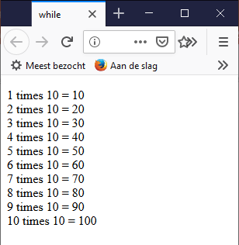
while()
Structure
initialisation-expression
while( condition )
{
statements;
step expression;
}
exercise: as long as counter <= 10
{
write: counter times 10 = result
}

Slide 4
while()
var counter = 1;
while (counter <= 10)
{
document.write(counter + ' times 10 = ' + counter*10 + '<br />');
counter++;
}
initialisation of counter
Increase counter
DO NOT FORGET!!

Slide 5
for()
opbouw
for(initialisation-expression; condition; stepexpression)
{
statements;
}
comparable to while()
difference: initialisation + automatic increase of counter => where??
Exercise: use for instead of while

Slide 6
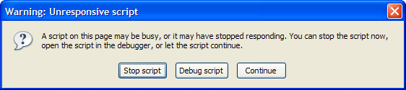
for() vs. while()
for: if it's clear in advance how many times the loop has to be run.
While: watch out for endless loops
var counter = 1;
while (counter <= 10)
{
document.write(counter + ' times 10 = ' + counter*10 + '<br />');
}

Slide 7
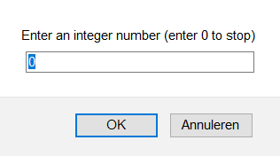
break; and continue;
break;
Jumps out of the loop
program continues with first statement after the loop
Example:
Ask the user for an integer until 0 is entered.

Slide 8
break; and continue;
continue;
jumps over one iteration of loop
continues with next iteration of loop
var counter = 1;
while (counter <= 10)
{
if (counter%2 == 0)
{
counter++;
continue;
}
document.write(counter + ' times 10 = ' + counter*10 + '<br />');
counter++;
}
skips the rest of the loop and goes to next iteration
Example with while
Example with for

Slide 9
for … in
loops through the properties of an object
Example: print all properties from the navigator, window and document objects

