Slide 1
Javascript
Functions and methods

Slide 2
Functions and methods
= group of statements that can be used as a unit
= reusable
When are functions useful?
repetition of parts of the program
define commonly used functions in general
divide problem into subproblems
Note: use in a function as many locally defined variables or transmitted parameters as possible!
http://www.w3schools.com/js/js_functions.asp

Slide 3
Functions and methods
function multiply(number1, number2)
{
return(number1*number2);
}
result = multiply(5,3);
alert(result);
Function name = multiply
2 parameters in this function
Note: always place functions in the headtag of your web page

Slide 4
Functions and methods
2 types of functions
Built-in functions
parseInt(), parseFloat(), alert(), document.write(), s.toUppercase, isNaN(), eval()…
self-written functions
e.g.: multiply(), divide(), loopcounter(), checkmail(),…

Slide 5
Eval()
var question1 = “10 + 5”;
var answer = eval(question1);
question2 = eval(10 + 5)
question 3 = eval( “10” + “5”)
question 4 = eval(10<5)
question: what is the result of this eval()?

Slide 6
Built-in object Math
Mathematical constants
Math.PI ->
Math.E ->
Math.LN10 ->
Math.LN2 ->
Math.LOG10E ->
Math.SQRT1_2 ->
Math.SQRT2 ->
Full explanation
Note: case sensitive!
3,141592654…
2,718281828…
ln(10)=2,302585093…
ln(2)=0,69314718…
1,44269…
0,707106781…
1,414213…

Slide 7
Built-in object Math: methods
abs(x) | absolute value x
acos(x) | arccosine of x, in radians
asin(x) | arcsine of x, in radians
atan(x) | arctangent of x as a numeric value between -PI/2 and PI/2 radians
atan2(y,x) | arctangent of the quotient of its arguments
ceil(x) | value of x rounded up to its nearest integer
cos(x) | cosine of x (x is in radians)
exp(x) | e^{x}
floor(x) | value of x rounded down to its nearest integer
log(x) | natural logarithm (base E) of x: ln(x)
max(x,y,z,...,n) | highest value of x,y,z,…,n
min(x,y,z,...,n) | lowest value of x,y,z,…,n
pow(x,y) | x^{y}
random() | random number between 0 and 1
round(x) | value of x rounded to its nearest integer
sin(x) | sine of x (x is in radians)
sqrt(x) | square root of x
tan(x) | tangent of x (x is in radians)

Slide 8
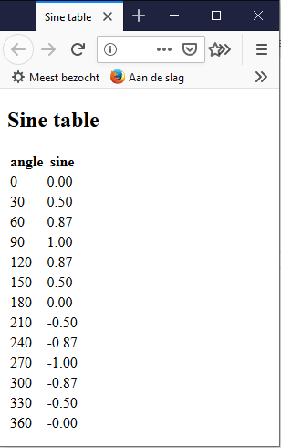
Built-in object Math
Example sine table
Example 1:
document.write(Math.floor(0.60) + "<br />");
document.write(Math.floor(0.40) + "<br />");
document.write(Math.floor(5) + "<br />");
document.write(Math.floor(5.1) + "<br />");
document.write(Math.floor(-5.1) + "<br />");
document.write(Math.floor(-5.9) + "<br />");
document.write(Math.ceil(0.60) + "<br />");
document.write(Math.ceil(0.40) + "<br />");
document.write(Math.ceil(5) + "<br />");
document.write(Math.ceil(5.1) + "<br />");
document.write(Math.ceil(-5.1) + "<br />");
document.write(Math.ceil(-5.9) + "<br />");
document.write(Math.round(0.60) + "<br />");
document.write(Math.round(0.50) + "<br />");
document.write(Math.round(0.49) + "<br />");
document.write(Math.round(-4.40) + "<br />");
document.write(Math.round(-4.60) + "<br />");
document.write(Math.random());

Slide 9
Self-written functions
Function syntax
function name(par1, par2, par3)
{
//put here the function code
}
Note! Function is only executed when you call it somewhere in your code.
E.g.:
name(1, 2, 3);

Slide 10
Self-written functions
<script>
function sum(value1, value2, value3)
{
return(value1+value2+value3);
}
result = sum(5,3,4);
alert(result);
</script>

Slide 11
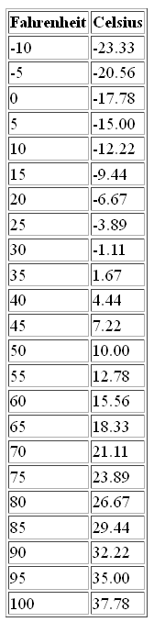
Self-written functions
examples:
conversion table
- function: Fahrenheit -> Celsius
- formula: c = 5*(f-32)/9
- use the function for the temperature conversions
Extra function: to create 1 row of the table

Slide 12
Recursivity
= self-evoking function
=> Mainly used with timers (for later)

Slide 13
exercises functions
Ask the surfer 4 calculation questions.
For each question, check that the answer was correct.
For each question the surfer gets 3 chances to find the correct answer.

