Slide 1
Final Project Report
Elijah Olsson, Jake Wantz

Slide 2
Laser Pointer Computer Vision Project
Uses OpenCV library in Processing
Detects differences in pixel contours
User-friendly interface

Slide 3
Functionality
Change Brush Size
Change Brush Shape
Change Brush Color
Reset Canvas
Save Canvas as PNG

Slide 4
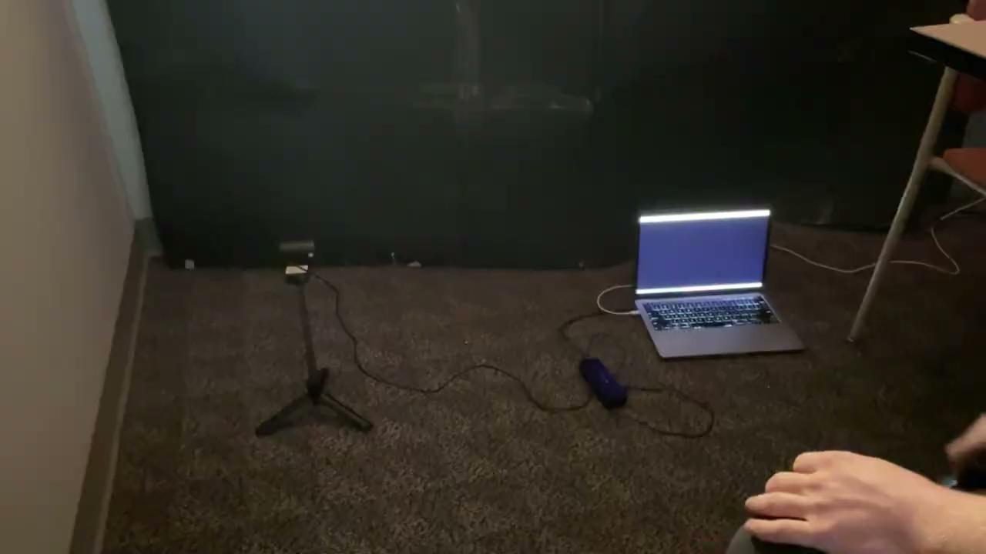
Project Setup

Slide 5

Project Demo

