Slide 1
<EPAM> Cloud&DevOps Fundamentals
Final Project

Slide 2

About me
In 2012 finished the “Galyc’ka Academia” Institute in the specialty "Information Systems" and received a "Master of Science in Information Technology" degree.
More than ten years working as a system administrator, deploying, setting up, and supporting servers (including virtual environments, VMware). Administrating Windows and Linux-based hosts.
Oleksandr Sydor
Mobile: +380 (97) 7665109
E-mail: oleksandr_sydor@epam.com

Slide 3
About the project
Task definition
The project demonstrates the CI\CD process that is relevant and commonly used at the current time for software development and implementation.
It is important because it helps organizations rapidly produce and deliver high-quality software products and services, improving their overall efficiency, reliability, and security. The process automates the entire software development lifecycle, from code creation to deployment.
Additionally, it helps organizations to identify and resolve issues quickly, reducing downtime and increasing overall system stability.
The project uses next tools and services:
GIT and Github – version control system for storage and shared usage app versions and configuration files
Google Cloud –Deployment of Prod and Dev environments
Jenkins – CI/CD processed automation
Terraform – automation of IaC environment deployment on AWS
Ansible – instances configuration management
Docker and Dockerhub – artifacts build and storage

Slide 4
Implementation
Task definition
The project shows the CI/CD process of application continuous integration and deployment based on DevOps methodology and tools.
The process core is based on Jenkins – the central events handler.
When a GitHub event occurs Jenkins runs a specific job following the triggers and dependencies.

Slide 5
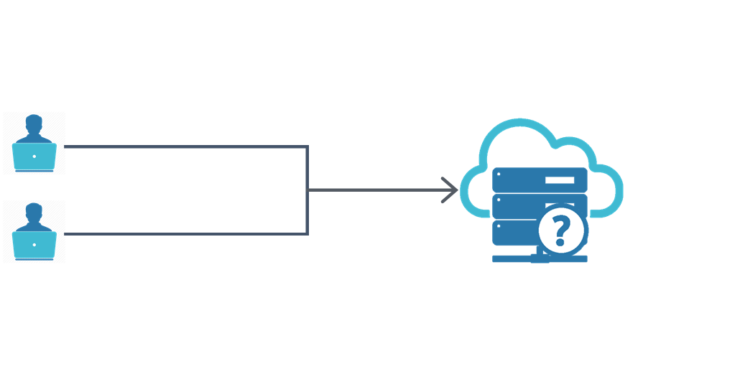
Formulation of the problem
Task definition
For the development team working on a web-based application, create functionality that provides continuous code integration and deployment to a dev environment.

Slide 6
The task topicality and goal
CI/CD Pipeline for DEV environment
Repeatable manual operations can increase the number of bugs in software and may be a cause of serious development process issues, they slow down software development.
Automation can significantly improve the code quality, speed, and efficiency of the software development process. A good solution for the problems mentioned above is the implementation of DevOps practices in the software development lifecycle.
The main goal of this project is to increase software development speed and make it more efficient and cost-optimized by applying DevOps practices and proper tools.

Slide 7
Requirements
CI/CD Pipeline for DEV environment
Store code in a repository
Work in a cloud environment
Automate build and deployment
Infrastructure as a code
Code a configuration management
Containerize workloads

Slide 8

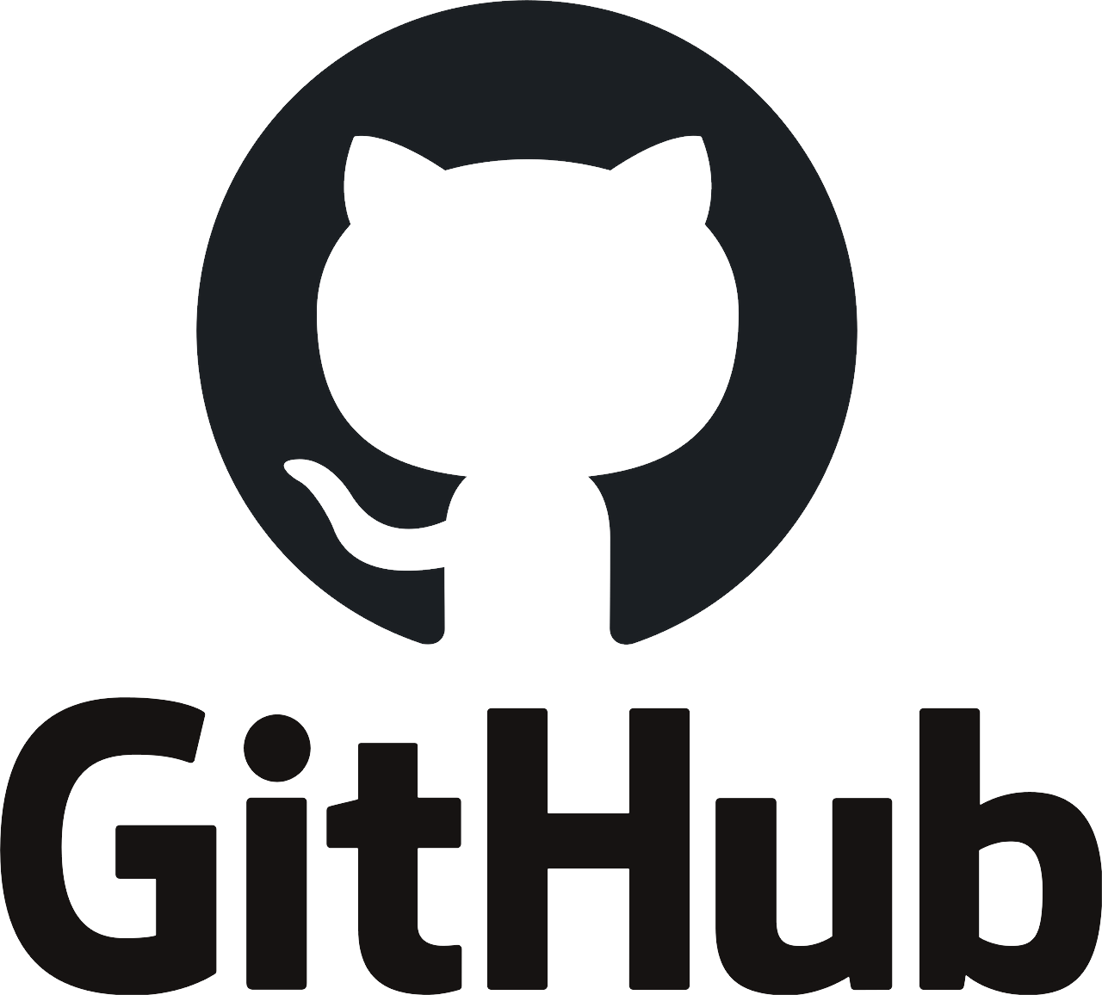

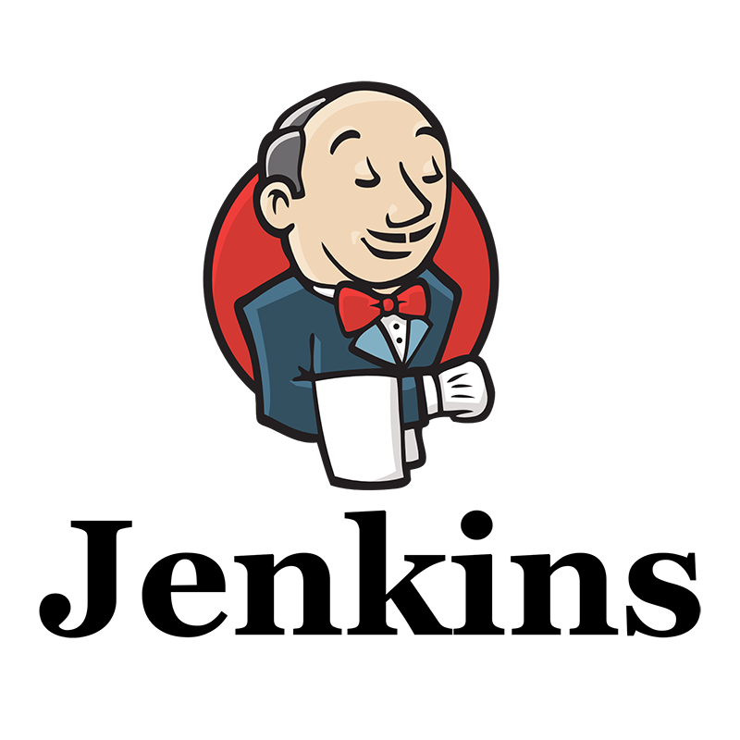

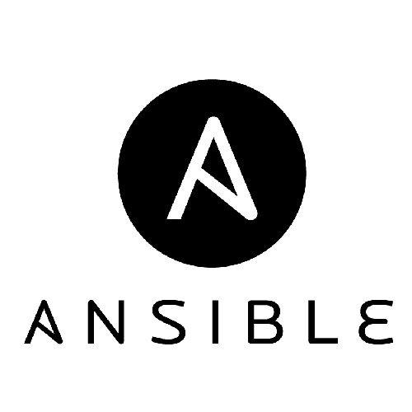
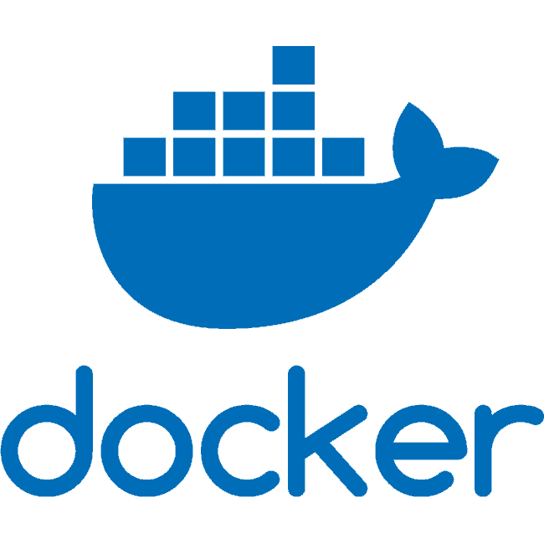
Technologies and tools selection
CI/CD Pipeline for DEV environment

Slide 9
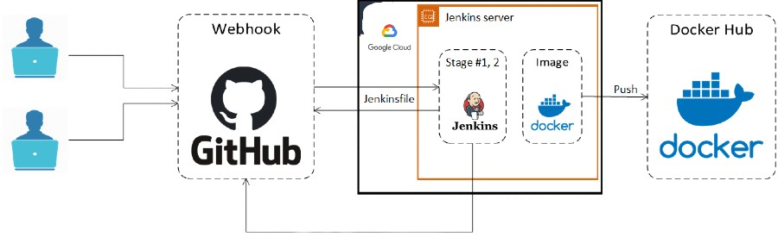
Stage #1, #2
CI/CD Pipeline for DEV environment
After pushing to the "dev" branch at the GitHub repository, a webhook triggers a Jenkins pipeline. At this stage, Jenkins clones the branch "dev", creates a Docker image, and pushes the artifact to the DockerHub repository.

Slide 10
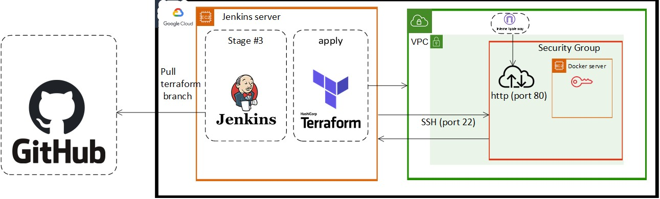
Stage #3
CI/CD Pipeline for DEV environment
At this stage, Jenkins clones the "terraform" branch, then deploys and configures an GCP infrastructure needed for running a Docker server.

Slide 11
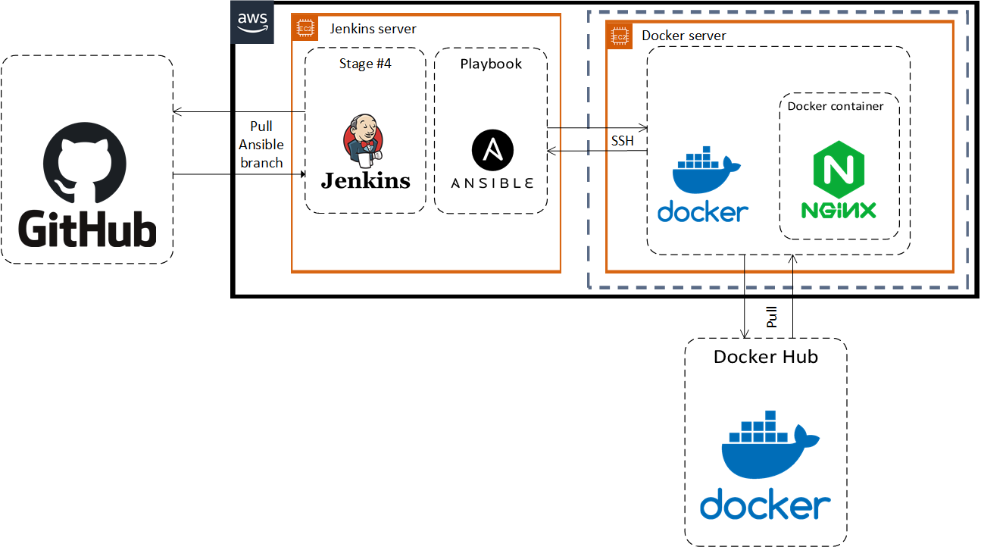
Stage #4
CI/CD Pipeline for DEV environment
In the fourth stage, Jenkins clones the "ansible" branch and runs the Ansible playbook, which installs Docker on the target server, then pull the Docker image from the DockerHub and runs a Docker container with our application.

Slide 12
Conclusions
CI/CD Pipeline for DEV environment
In this project, modern technologies and tools were used for the task solution, which gives an opportunity effectively develop an application and try it in a real environment. Security enhancement by using IAM roles instead of permanent credentials, running build agents on separate nodes, and so on can be considered as an improvement of the project. There is a sense to implement those improvements with the project scaling out.

Slide 13
CI/CD Pipeline for DEV environment
THANK
YOU!

