Slide 1
Title Slide
Company name/logo
Explain your product in 2 powerful sentences
Example: For wealthy individuals and car fans who want a high‐end sports car that is environmentally friendly, the Tesla Roadster is an electric car that delivers unprecedented performance without damaging the environment.

Slide 2
Problem Statement
Clearly articulate the problem your product or service solves. Why this is important?
Provide evidence or data to support the significance of the problem.

Slide 3
Your Solution
Explain your product or service and how it addresses the identified problem.
Highlight the unique selling points or features. Mention your competitors but highlight why you are better choice for your clients. Why client need to choose you
Don’t forget to say if you have any copyright, patent, or other proprietary rights for the product.

Slide 4
Prototype or MVP
Present visual material of your product: photo, picture, drawing, or other visuals
You can use lovable or other AI tools to create one.

Slide 5
Market Opportunity
Describe the size and growth potential of the target market.
Discuss any market trends or dynamics that support your opportunity.
Traction: test your idea with your classmate, family, friends to get some feedback and use these data.

Slide 6
Business model
Explain how your company plans to make money.
Include details on pricing, revenue streams, and customer acquisition strategy.

Slide 7
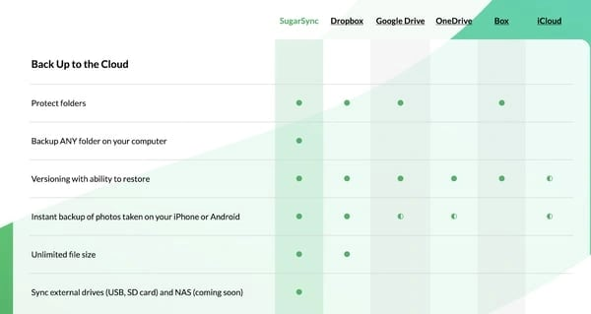
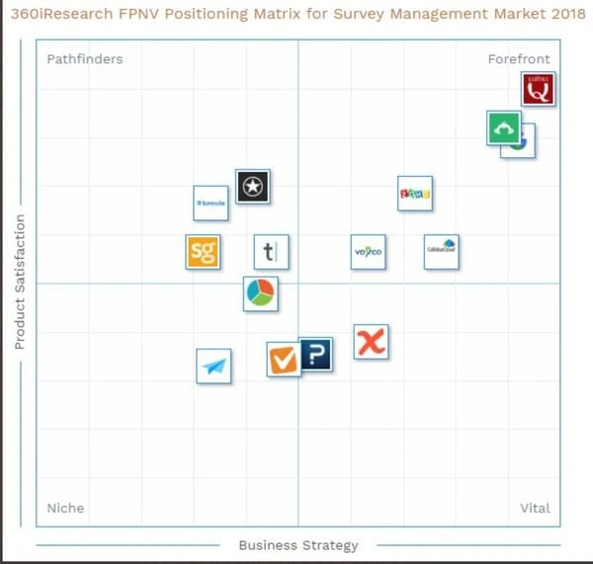
Competitive Advantage
Identify your main competitors and their strengths/weaknesses.
Highlight what sets your company apart and creates a competitive advantage.
For graphics, use any competitive analysis matrix format:
SWOT analysis
Competitive Advantage Matrix
Competitive Profile Matrix
Sales Matrix
Product Feature and Benefit Matrix
Price Matrix

Slide 8
Milestone achievement plan
What is the time frame that you plan to make this idea reality

Slide 9
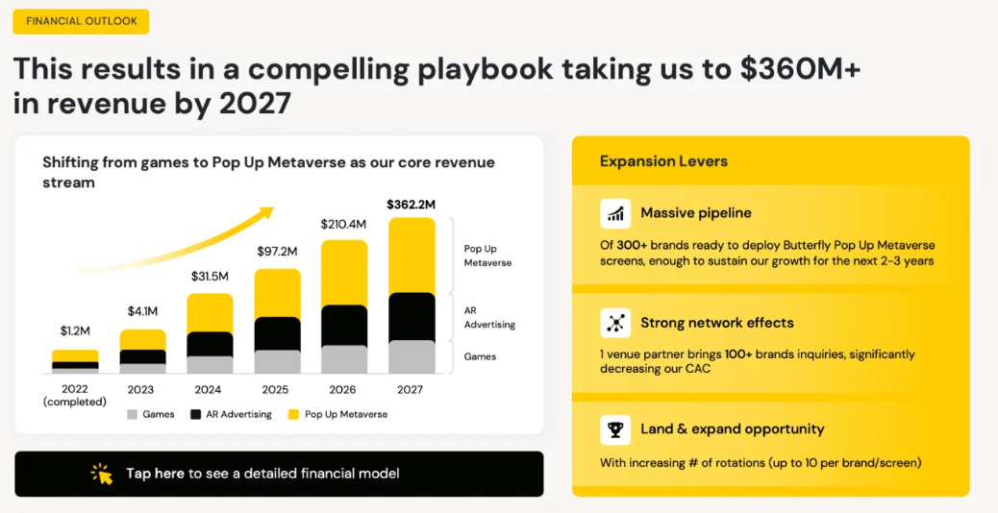
Financial Projections - optional
Present projected financial statements, including revenue, expenses, and cash flow.
Provide assumptions and methodology behind your projections.
Example:

Slide 10
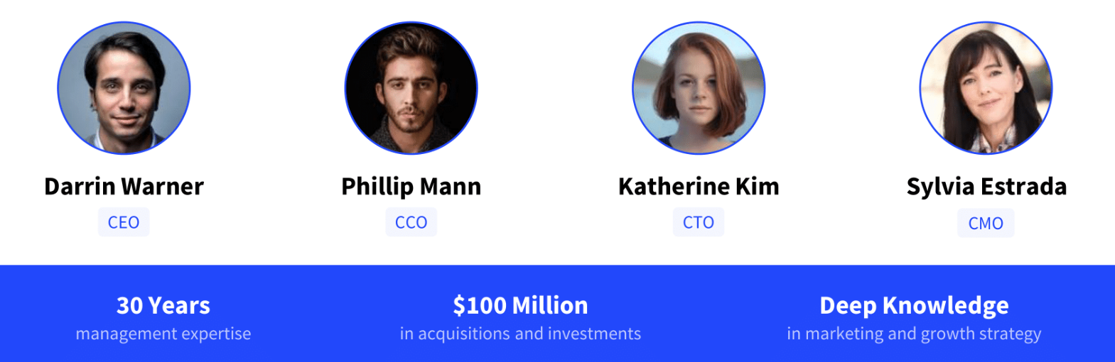
Team
Introduce key members of your team and their relevant experience.
Emphasize why your team is uniquely qualified to execute the business plan.
Example:

Slide 11
Final remarks!
Repeat You the values of your team and add WHY YOU, WHY NOW, are important to be invested in.
Add contact information (optional bonus: can be QR code for your demo)

Slide 12
Appendix
Optional slide for additional information, such as product demos, customer testimonials, or detailed financials.

