Slide 1


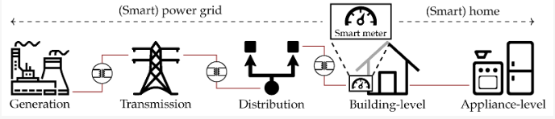
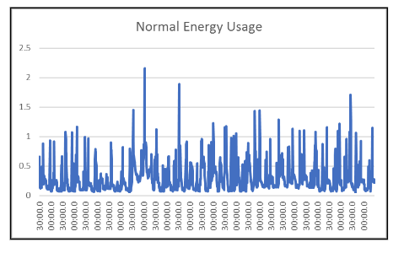
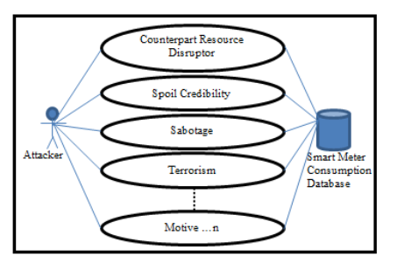
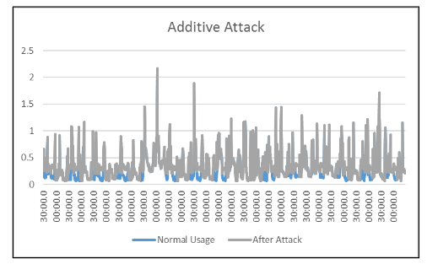
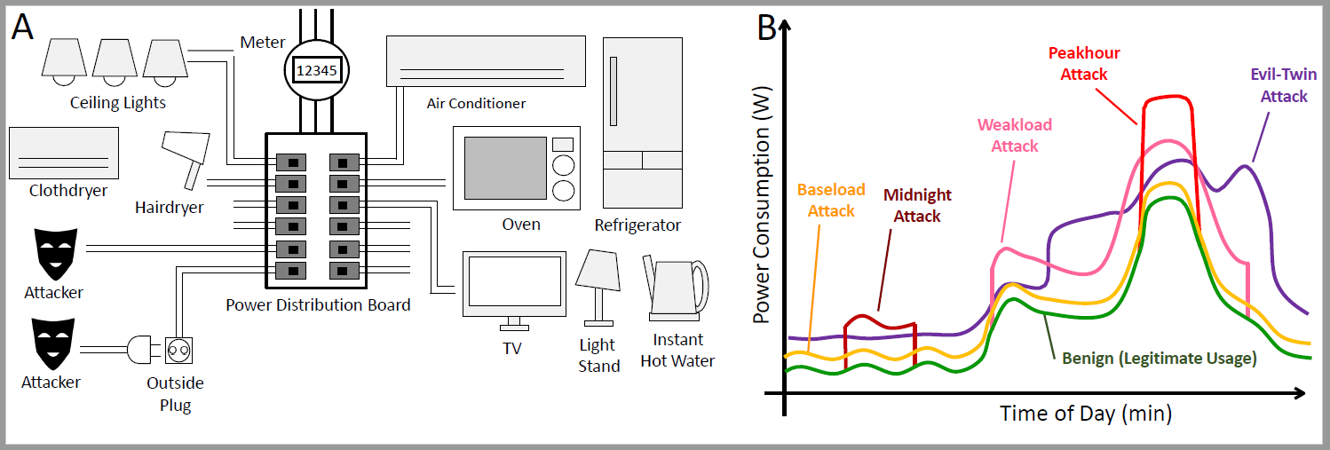
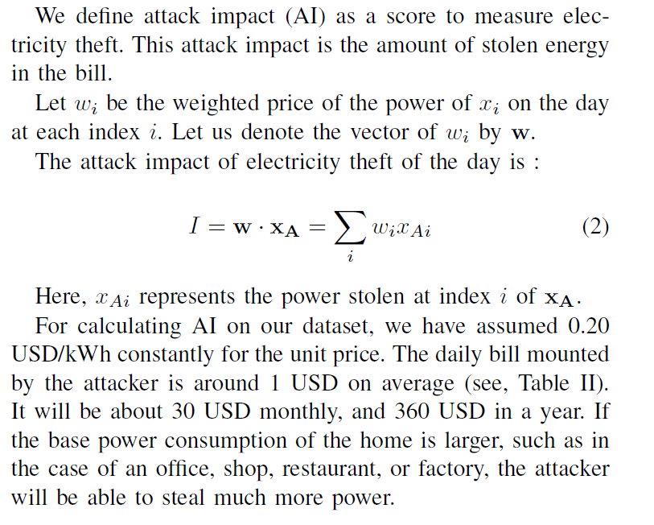
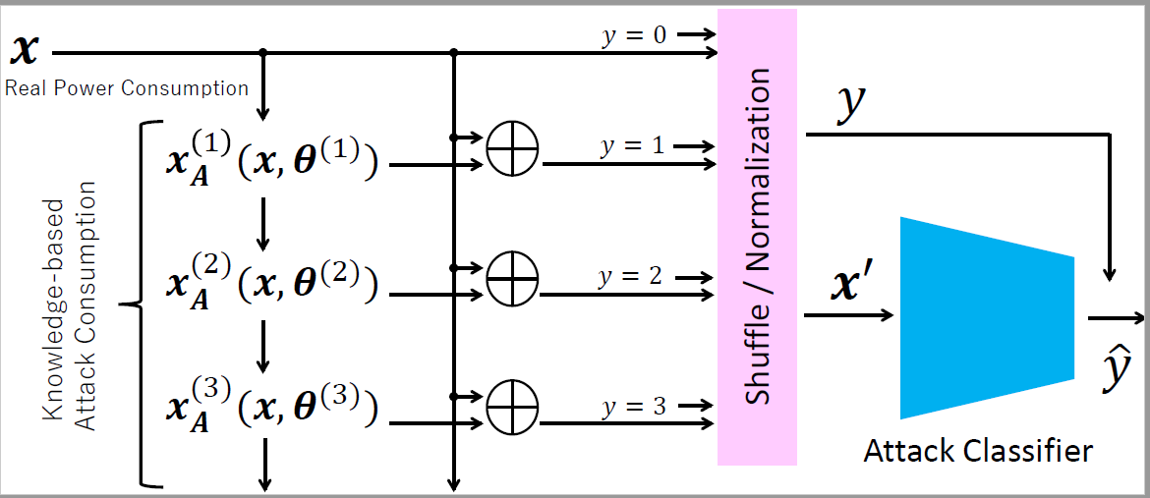
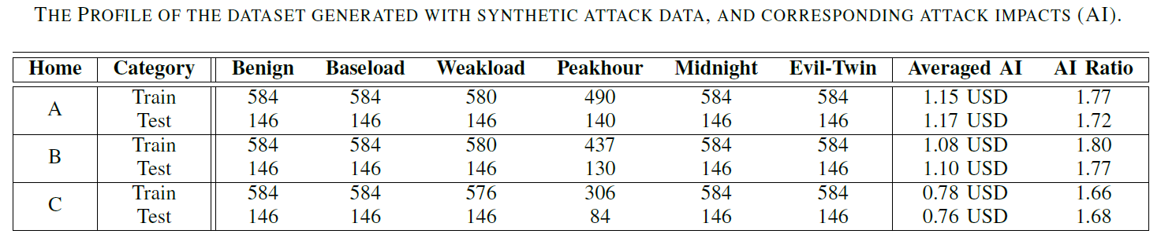
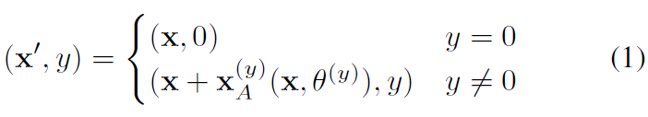
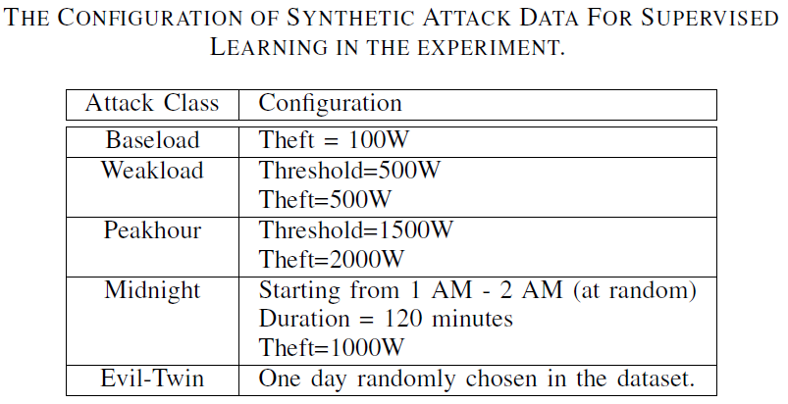
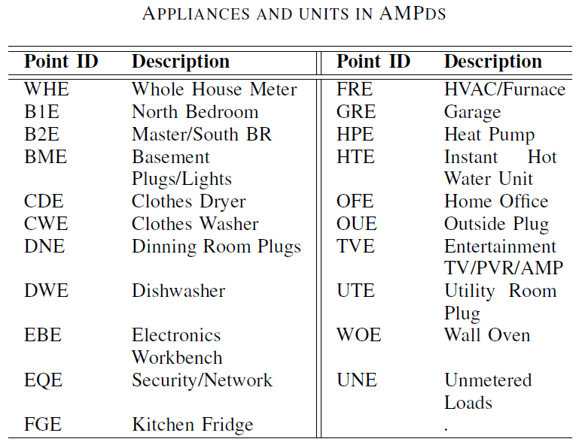
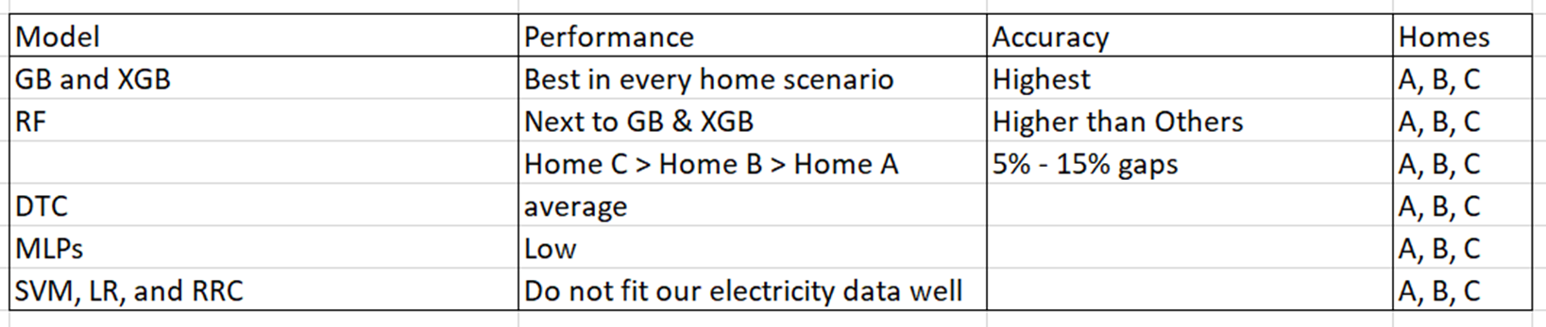
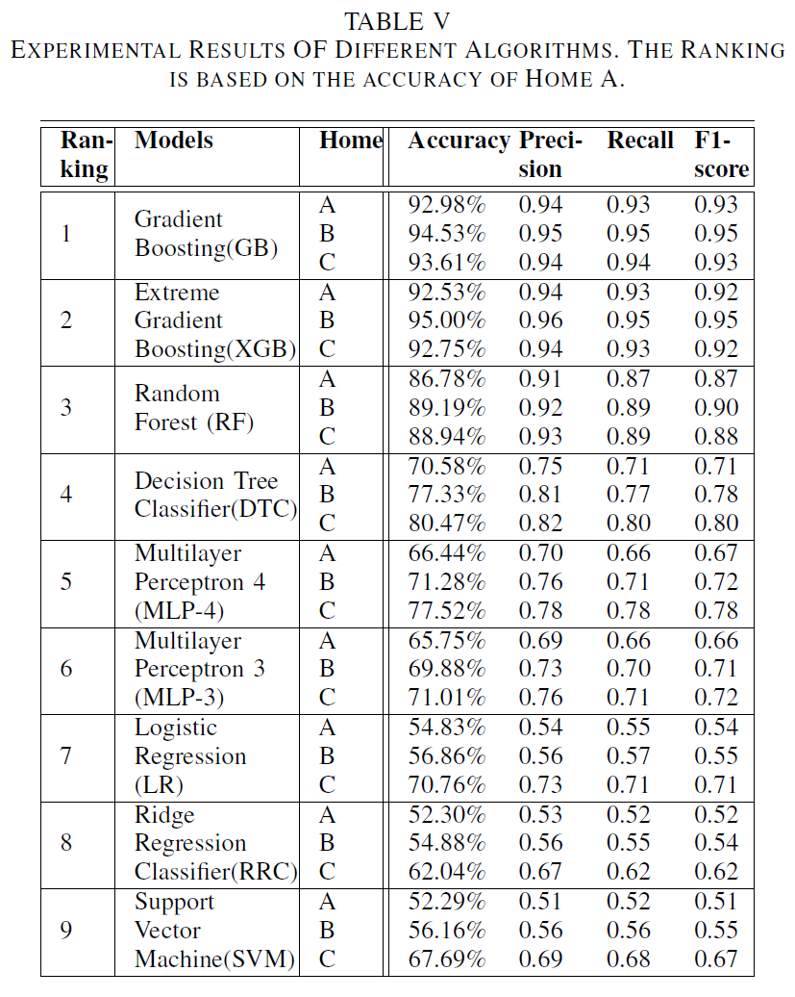
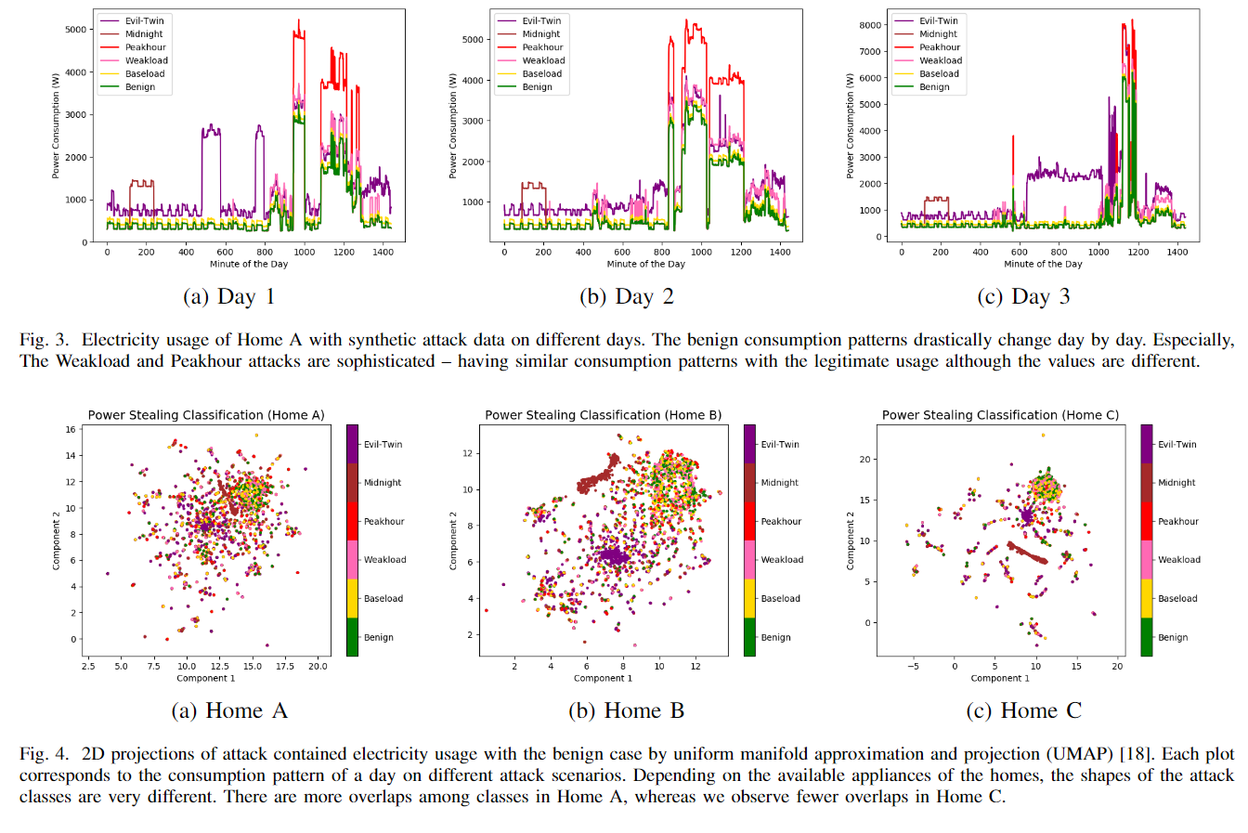
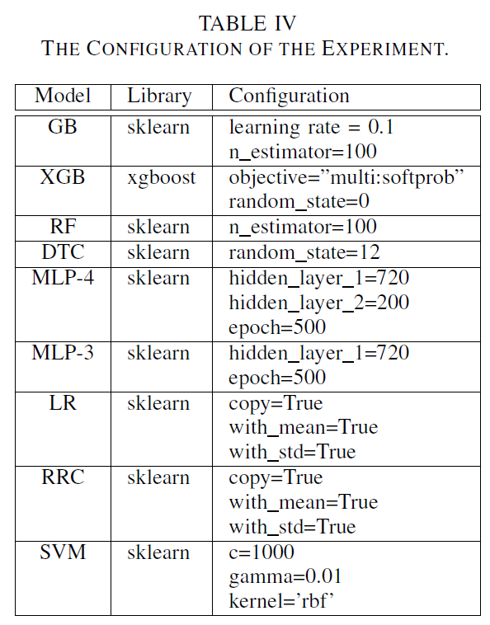
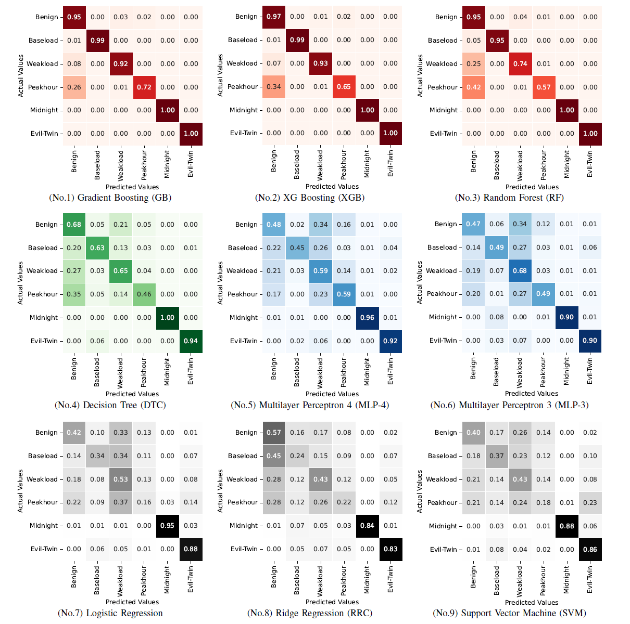
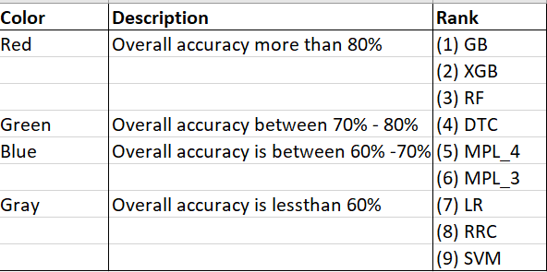
Electricity Theft Detection for Smart Homes with Knowledge-Based Synthetic Attack Data
Abraham Olufemi Abiodun. Email: abraham.olufemi.abiodun_aj9@naist.ac.jp
Abstract
Electricity thefts are conventionally manually detected by inspections, accusations, and the failure of meters. However, the recent evolution of machine learning may allow the automatic detection of electricity theft only from the patterns of meter readings. Electric consumption heavily relies on many factors, e.g., the lifestyle of the day and the weather, and thus the accuracy of detection is questioned. We propose an electricity theft detection framework for smart homes with knowledge-based synthetic attack data. This allows training of the attack classifier only from the legitimate power consumption data, i.e, without attack actions and associated labels. We identified five attack patterns as the knowledge which consisted of smart attacks and legacy attacks. We have conducted comprehensive evaluations with nine machine learning models using the Almanac of Minutely Power dataset version 2 (AMPds2) dataset fine-grained time-series data of a smart home. We found that Gradient Boosting-based algorithms achieved the best, and Random Forest performed alternatively with almost 100% accuracy for detecting and classifying legacy attacks. Some smart attacks were not detected, but those algorithms achieved good performance in detection and classification.
Background & Motivation
Electricity Theft Attack (ETA) common all over the world¹
Developing countries mostly affected²
Indian loses more than 1/5th of total electricity production to theft³
ETA detected by regular inspection of power meters⁴
Method too dependent on human and still have difficulties in finding
electricity thefts because of complexity of power systems
TAXONOMY OF ADDITIVE AND DEDUCTIVE ATTACK ON SMART METER DATA
Data manipulation
FAI¹ in SM² home network
Securing transactions (AMI)³
Energy theft detection at the appliance level
Readings of normal usage of Smart Meter
Additive attack motivation
https://www.spglobal.com/marketintelligence/en/news-insights/trending/abhemb-9pog6vtjy1i8iia¹, https://www.prnewswire.com/news-releases/96-billion-is-lost-every-year-to-electricity-theft-300453411.html¹
https://epower.com/news/world-loses-89-3-billion-annually-to-electricity-theft/#²
Readings of normal usage after additive attack
Fig 1: Scenarios of electricity theft attack in our study.
Proposed Idea and Methodology
Attack Classification
Attacker may physically access the power distribution board
Steal power to make the household pay the bills
Attacks identified and classified as: Smart attacks & Legacy attacks:
Baseload: Attack: Baseload theft of 100W for 24hrs
Weakload Attack: Weakload theft of 500W at (threshold 100W)
Peakhour Attack: Peakhour theft of 2000W at (threshold 500W)
Midnight attack: Midnight theft of 1000W randomly at 1:00am – 3:00am
Evil-Twin Attack: Evil-Twin theft of aggregated power consumption of two houses
Synthetic attack data to validate Machine Learning (ML)
Identify attacks types from legitimate electricity consumption patterns
Table II: Profiles of the data for our ETA detection
x – vector of power consumption
x_{A} – vector of stolen power
x_{A} is a function of x and attacking parameters 𝜃: e.g., x_{A} (x, 𝜃)
Collection of (x’,y) can be applied to Supervised ML model
Table III: parameters of each attack
Data Source
Table I: Names of the appliances monitoring points
Performance overview
¹AMPds2 (Almanac of Minutely Power Dataset version2
Home A contains a lot of legitimate peak consumption, whereas Homes B and C do not.
This indicates that the detection of electricity theft in Home A is potentially more difficult than in Homes B and C.
RF, GB, and XGB could successfully achieve high accuracy in Home A
RF, GB, and XGB, especially GB and XGB are promising algorithms for detecting electricity theft with smart meters
¹S. Makonin, B. Ellert, I. V. Baji´c, and F. Popowich, “Electricity, water, and natural gas consumption of a residential house in canada from 2012 to 2014,” Scientific data, vol. 3, no. 1, pp. 1–12, 2016.
RESULTS
Evaluation
Configuration of the experiment in our evaluation
Ranking of algorithms based on the accuracy of Home A.
Conclusion and Future Work
Developed a detection framework for identifying electricity theft in smart homes, using five defined synthetic attack types.
Achieved high detection accuracy with Gradient Boosting and Random Forest algorithms, notably for legacy attacks.
Identified the need for improved detection of sophisticated 'smart' attack methods.
Future research to expand attack models, analyze varied household data, and explore the correlation between attack size and detection success
Performance by attack class
Midnight and Evil-Twin attacks were well classified in all the classifiers.
GB, XGB, and RF have achieved 100% accuracy for these attacks.
Laboratory for Cyber Resilience, NAIST https://iplab.naist.jp
Last Update: 2023/11/13

