Slide 1

CMPG 315 Packet Tracer Project Group 4

Slide 2
Table of Contents
Problem Description
Network Design Description
Topology Images
Configurations
Pinging and Simulation
Optional Real World Improvements

Slide 3
Problem Description Objective: Design a robust, affordable network for a new office, supporting isolated sections for departments, secure internet access, and future growth. Requirements: Isolated network access for each section (offices, reception, technicians, meeting room, machine room, open floor) Approach: Careful planning of IP addressing, subnets, and routing Layered topology (Core, Distribution, Access) for manageability and scalability Use of VLANs for section isolation Documentation includes budget, issues, and project management Outcome: Reliable, secure, and efficient network infrastructure supporting current needs and future expansion, with thorough documentation and evaluation.

Slide 4
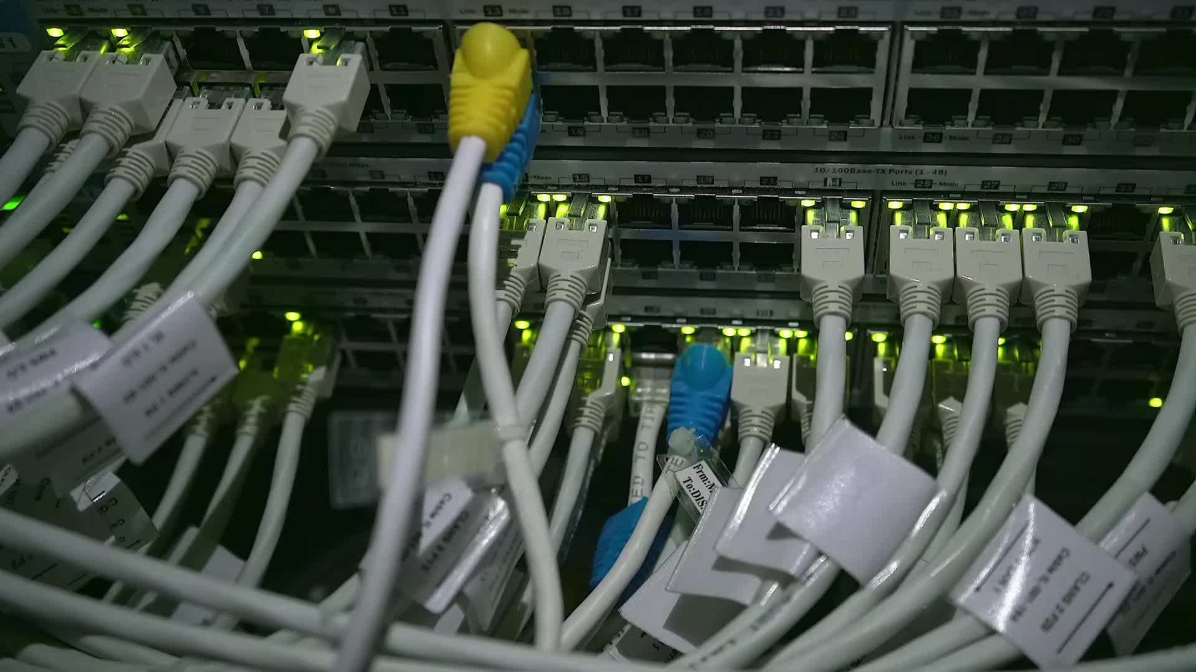
Network Design
TOPOLOGY
Two routers in the machine room (main + failover) connect to a central
Layer 3 switch.
Layer 3 switch links to Layer 2 switches in each respective section (Offices, Meeting Room, Reception, etc.). VLANs allow for isolation between the areas (e.g., Offices and Reception).

Slide 5
Network Design
.
.
CONNECTIVITY
Each section has wired access points and supports PCs, laptops, tablets, and printers.
Full Wi-Fi coverage (except machine room), supporting staff and guests.
DEVICES
Routers: High-capacity, reliable, with redundancy.
Switches: Layer 3 (core), Layer 2 (<8 ports) in sections.
Access Points: Wired, secure, support 2–4 devices per person.
Servers: Existing company servers for DHCP, DNS, storage, etc.
BENEFITS
Cost-effective, isolated, Wi-Fi-enabled, and scalable.

Slide 6
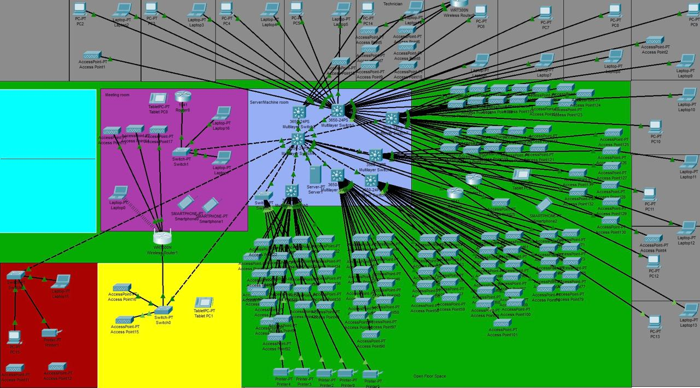
TOPOLOGY IMAGES

Slide 7
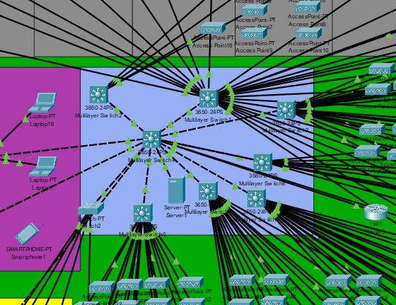
Machine Room

Slide 8
Machine Room Connection Description
There is a main switch which is connected directly to the server
This is a multilayer switch to allow for maximum possible connections
Seven other multilayer switches are present in the machine room
The purpose is to accommodate the 100 access points in the open floor space
One of the seven multilayer switches connect the end devices (PCs) in the offices.
One PT Switch whose 10 ports are switched on is used for the five printers just outside the machine room

Slide 9
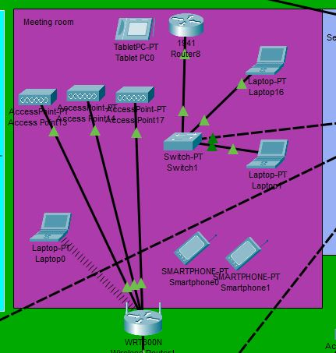
MEETING ROOM

Slide 10
MEETING ROOM DESCRIPTION
There is an availability of wireless Wi-Fi
This allows to staff to connect conveniently to the internet
The end devices common in the meeting are laptops, tablets and cellphones
This is because they are easily movable (assuming that different staff members would have different meetings in different times

Slide 11
CONFIGURATIONS
Measures needed to be taken in order to have our network components function and communicate well with each other
Some settings needed to be done on the server
The routers have two types of settings that needed to be performed on them
These is the Network Setup
And the Internet Connection Setup

Slide 12
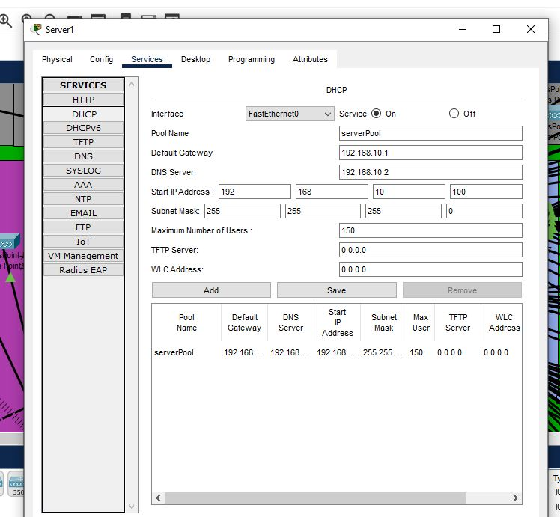
CONFIGURATIONS

Slide 13
CONFIGURATIONS
SERVER SETTINGS:
A DHCP Pool was create, in which and IP address was assigned
Along with the IP address, a default gateway and DNS server were assigned.
This allows all connected devices to have the same default gateway and subnet mask as the server
A maximum number of users was set to be 150; allowing the server to provide 150 IP addresses.

Slide 14
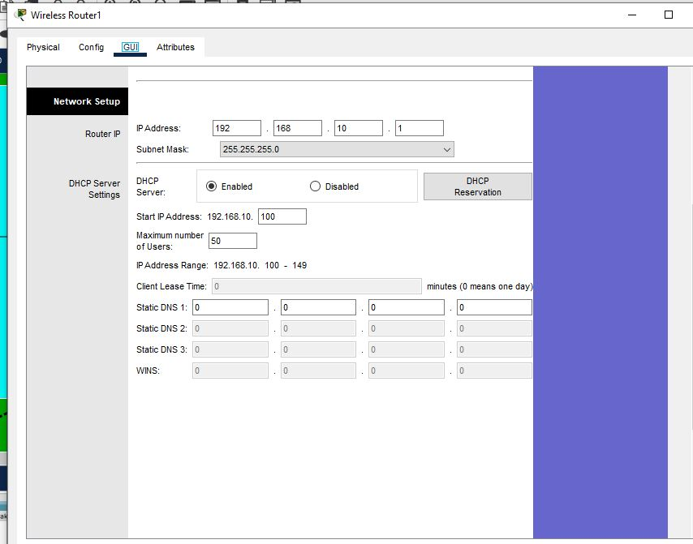
CONFIGURATIONS

Slide 15
CONFIGURATIONS
ROUTER NETWORK SETUP:
The image above shows where the router’s IP address is set and how it is configured to DHCP

Slide 16
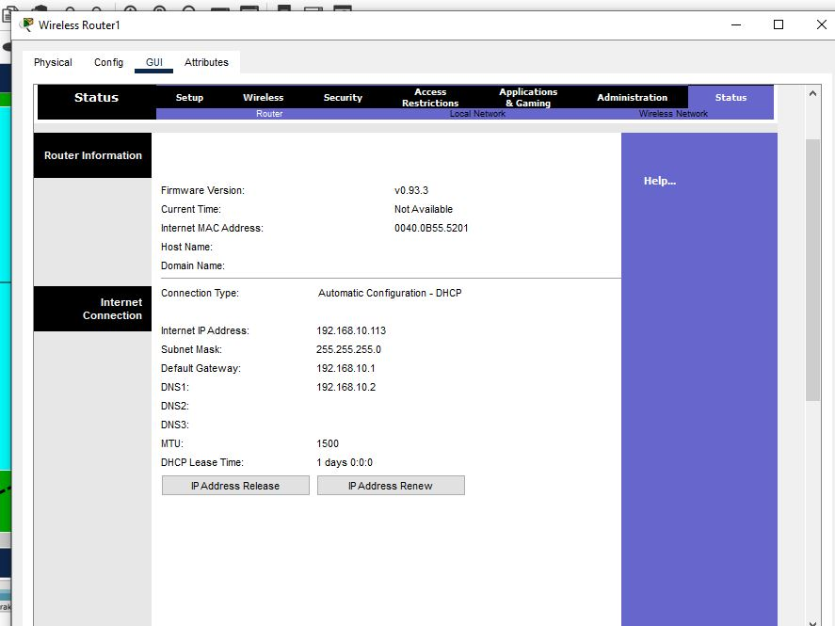
CONFIGURATIONS

Slide 17
CONFIGURATIONS
ROUTER INTERNET SETUP:
The previous image shows the status of the router after it has been configured.
Components that will only show if the router has been properly configured:
Internet IP Address
Subnet Mask
Default Gateway
DNS

Slide 18
PINGING AND SIMULATION
There are two measures that we took when testing the network we have created
We used pinging to check for the validity of the IP Addresses
And a simulation attempt to check for communication and packet transportation among components in the network
The images below show how it was done.

Slide 19
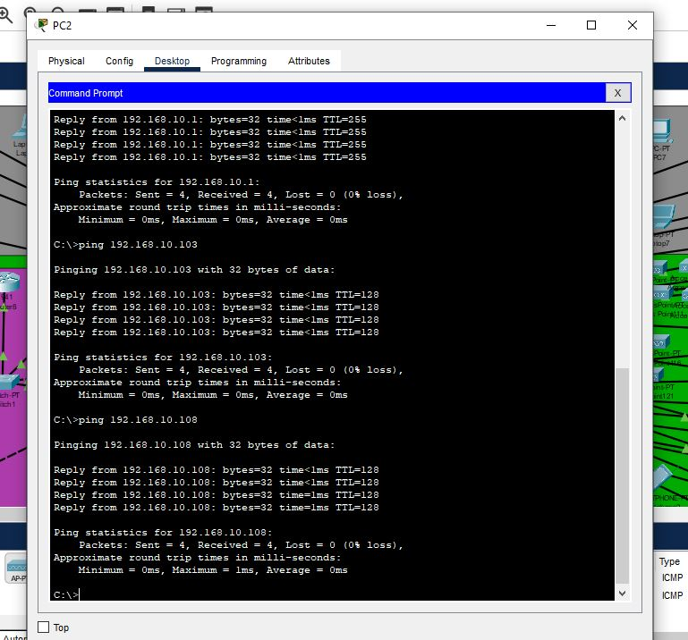
PINGING AND SIMULATION

Slide 20
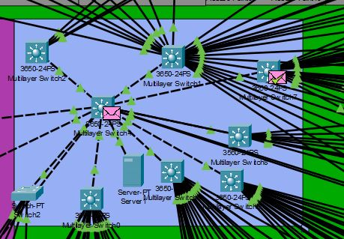
PINGINGING AND SIMULATION
The packets are illustrated as envelopes
The green tick on the envelope shows that the packet was successfully delivered

Slide 21
Optional Real World Improvements
1. Firewall Protection Set up a firewall (e. g. , Cisco ASA) between the ISP and the network to prevent threats that exceed ACLs.
2. Power Backup (UPS) Utilize UPS for routers, switches, and servers to avoid data loss during power outages.
3. Remote Access (VPN) Activate secure remote work access through VPN on the current servers.
4. Staff and Guest Wi-Fi Separation Implement UniFi/business APs to segregate Wi-Fi for enhanced performance and security.

Slide 22
Optional Real World Improvements
5. Network Surveillance Implement tools such as PRTG/Zabbix to identify problems and provide real-time alerts.
6. Access Management Restrict network access through MAC filtering or login authentication to prevent access by untrusted devices.
7. Data Preservation Utilize external drives, NAS, or cloud storage (e. g. , Google Drive) to defend against data loss.
8. Equipment Room Surveillance Incorporate IoT sensors for temperature/humidity notifications to protect equipment.

Slide 23
Thank you
Group 4
JP POULO 38225964
BL MAHLANGU 37751883
A MAQIZANA 37485229
SL TITTIES 33264740
TM HLATSHWAYO 38640406
MI NGOBENI 38016508
HH MASHABA 41014170

