Slide 1

Chris Luther Auto Company
Sales Performance Analysis

Slide 2
Aim’s Grid
Approach, Analysis and Technical Challenges
Dashboard Components
Final Report
Contents

Slide 3
Aim’s Grid
PURPOSE OF THE PROJECT
STAKEHOLDERS
To unlock Sales insights that are visible before Sales Team for decision support and Automate data to reduce time spent in manual data gathering
Sales Director
Sales Team
Marketing Team
Customer Service Team
IT
END RESULT
After the dashboards, business decisions that save cost between 15% - 20% should be made
SUCCESS CRITERIA
An Automated Dashboards providing quick and remarkable insights in order to support data driven decision making, better customer relationship, informed strategic planning and sense of risk management
After the dashboards, business decisions that save cost between 15% - 20% will be made.
Sales Team able to make better informed decisions with 10% cost savings and reduce business time by 20% from data gathering.

Slide 4
Approach, Analysis and Technical Challenges
Data Tables collected from the Management team
Formatted, compiled and cleaned
Dealt with missing values, mis-spelt text and change data types
Created calculated fields
Built Charts and created table.
Built Dashboards, with the designs done on power point, added icons, filters and dynamics

Slide 5
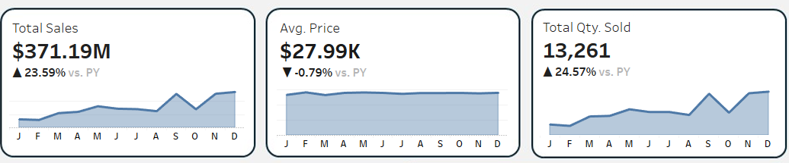
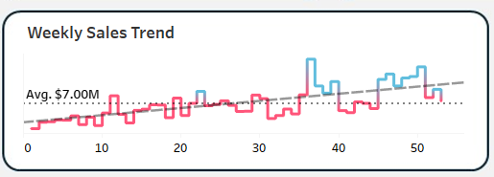
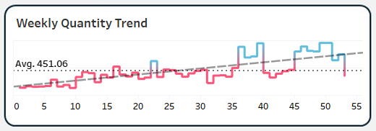
Sales Performance Dashboards Components
Sales Dashboard Components - Key Requirements
1. KPI’s and Sales Trends - Using BANS for the KPI’s and AREA & LINE CHART for the Sales Trends
2. Weekly Sales Trends - Using LINE CHART 3. Weekly Quantity Trends - Using LINE CHART

Slide 6
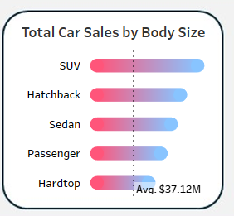
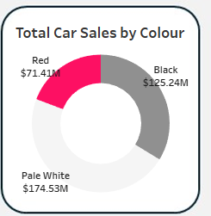
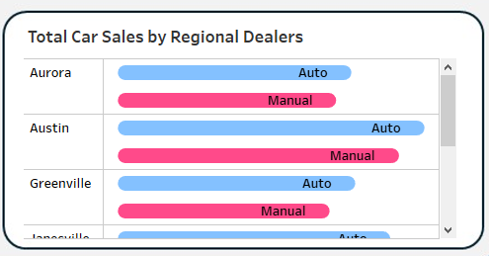
4. Total Car Sales by Body Size - Using Rounded BAR CHART 5. Total Car Sales by Colour – Using DONUT CHART
6. Total Car Sales by Regional Dealers - Using Rounded BAR CHART

Slide 7
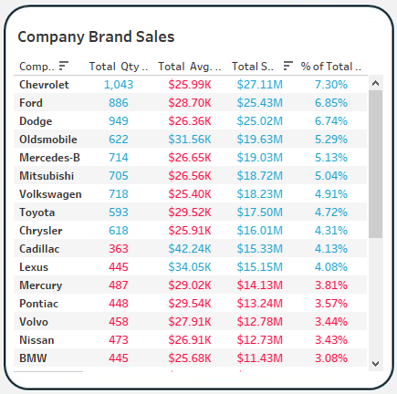
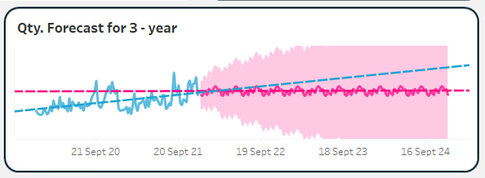
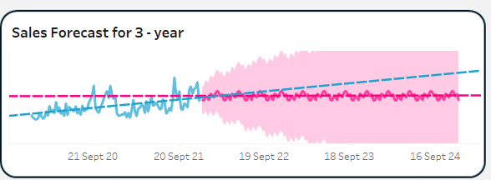
Sales & Projection Dashboard Components - Key Requirements
1. Company Brand Sales
2. Qty. Forecast for three years - Using LINE CHART 3. Sales Forecast for three years – Using LINE CHART

Slide 8
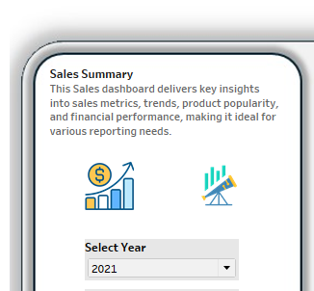
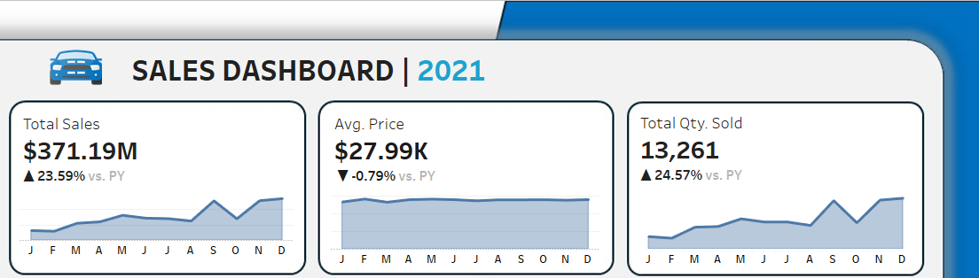
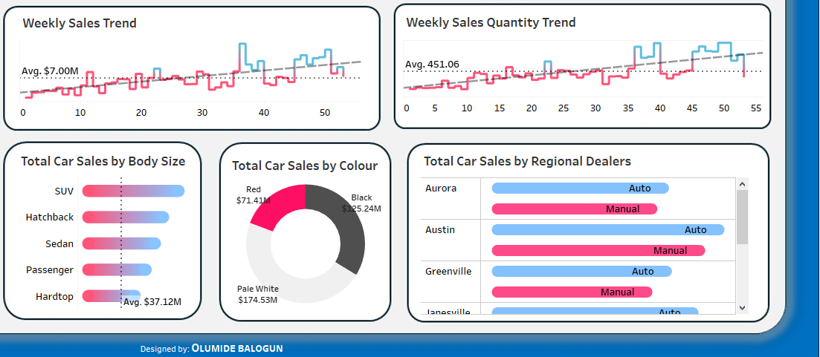
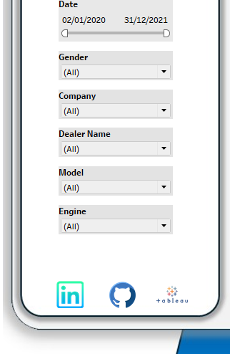

Slide 9
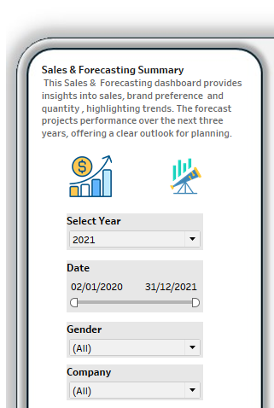
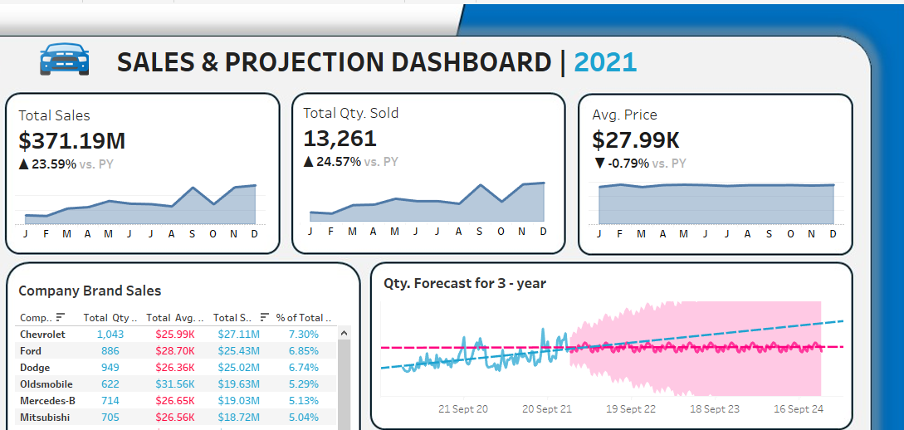
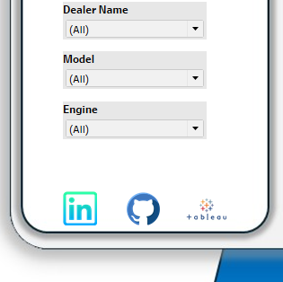
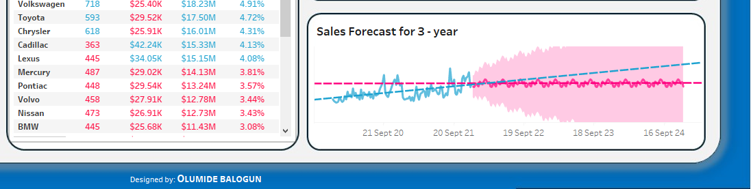

Slide 10
Final Results
Is there significant difference year – on – year for Sales, Avg. Profit and Quantity?
Hypothesis: Yes, there was clear and significant difference year – on – year.
2. Is there significant difference year – on – year in the Weekly Sales and Quantity Trends?
Hypothesis: Yes, there was clear and significant difference year – on – year.
Is the there significant difference year-on-year in the top 5 in Company Brand Sales?
Hypothesis: Yes
Which Car Colour out class the other colours year – on – year?
Pale White
Does the projection shows remarkable progress for the company?
Hypothesis: Yes
To see the functionality and dynamic nature of the dashboard: Go to https://public.tableau.com/app/profile/olumide.balogun1

