Slide 1
Smith & Robbins Superstore
Sales Performance Analysis

Slide 2
In light of the competitive landscape, Smith & Robbins Stores seeks to evaluate its performance. The company has tasked us with developing automated sales performance dashboards that deliver quick and up-to-date insights to support data-driven decision-making, enhance customer relationships, improve financial performance, and facilitate informed strategic planning. Additionally, we will provide future projections for sales, profit, and quantity over the next three years.
The sales performance dashboards will include: the Sales Dashboard, the Customer Dashboard, and the Seasonality and Forecast Dashboard.
The Goal

Slide 3
These automated (functional and dynamic) sales performance dashboards offer a comprehensive analysis of Smith & Robbins' sales performance from 2020 to 2023. The primary objective is to uncover insights into sales performance and profitability, enabling the identification of patterns, key trends, performance gaps, customer behavior, seasonality, and three-year projections. Additionally, these insights will highlight areas for improvement, ultimately enhancing sales performance, fostering better customer relationships, improving profitability, and supporting informed strategic business decisions.
Executive
Summary

Slide 4
The Task: Sales Performance Dashboards.
Approach, Analysis and Technical Challenges
Dashboard Components
Success Criteria
Final Report
Contents

Slide 5
Sales Performance Dashboards
Introduction
Smith & Robbins Stores have outlined the specifications for developing three dashboards in Tableau. These dashboards are designed to assist stakeholders, including the Sales, Marketing, and Customer Service teams, as well as executives, in analyzing sales performance, customer insights, and projections.
Sales Dashboard | Requirements
Dashboard Purpose
The purpose of the Sales Dashboard is to provide an overview of sales metrics and trends, enabling users to analyze year-over-year sales performance and gain insights into sales trends.
Key Requirements
KPI Overview
Provide a summary of total sales, profit, and quantity for both the current year and the previous year.

Slide 6
Sales Trends
Present the data for each Key Performance Indicator (KPI) on a monthly basis for both the current and previous years.
Highlight the months with the highest and lowest sales to ensure they are easily recognizable.
Product Subcategory Comparison
Analyze the sales performance across various product subcategories for both the current and previous years.
Include a comparison of sales figures alongside profit margins.
Weekly Trends for Sales and Profits
Present weekly sales and profit data for the current year.
Show the average weekly sales and profit values.
Highlight the weeks that exceed and fall below the average to emphasize variations in sales and profit performance.

Slide 7
Customer Dashboard | Requirements
Dashboard Purpose
The Customer Dashboard is designed to offer a comprehensive overview of customer data, trends, and behaviors. It will assist the marketing and sales teams, as well as management, in understanding customer segments and enhancing customer satisfaction.
Key Requirements
KPI Overview
Provide a summary of the total number of customers, total sales per customer, and total number of orders for both the current year and the previous year.
Customer Trends
Show monthly data for each Key Performance Indicator (KPI) for both the current year and the previous year.
Clearly highlight the months with the highest and lowest sales to ensure they stand out.

Slide 8
Customer Distribution by Number of Orders
Visualize the distribution of customers according to the number of orders they have placed. This will provide valuable insights into customer behavior, loyalty, and engagement.
Top 10 Customers by Profit
Display the top 10 customers who have contributed the highest profits to the company.
Include additional details such as rank, number of orders, current sales, current profit, and the date of their last order.
Seasonality and Forecast Dashboard | Requirements
Dashboard Purpose
The Seasonality and Forecast Dashboard is designed to provide insights into the seasonality and trends of sales, profit, and quantity, along with moving averages. It will project sales, profit, and quantity for a minimum of the next three years.

Slide 9
Key Requirements
Monthly Trends and Seasonality for Sales, Profit and Quantity
Illustrate trend lines for monthly sales, profit, and quantity.
Present the average monthly values.
Include a three-month moving average for sales, profit, and quantity.
Forecast for Sales, Profit and Quantity
Provide projections for sales, profit, and quantity over a minimum of the next three years.
Design & Interactivity | Requirements
Dashboard Dynamics
The dashboard should enable users to explore historical data by providing the flexibility to select any desired year.

Slide 10
Ensure easy navigation across the dashboard for users.
Make charts and graphs interactive, allowing users to filter and explore data directly through them
Data Filters
Allow users to filter data based on product details such as category and subcategory, as well as location information including region, state, and city.

Slide 11
Approach, Analysis and Technical Challenges
Collected data tables from the Management team.
Established data relationships (as a unified dataset), then formatted, compiled, and cleaned the data.
Renamed fields/tables and changed data types as needed.
Created calculated fields.
Built charts and tables.
Developed automated (functional and dynamic) dashboards. The designs were created in PowerPoint, with added icons, filters, and interactive features.
To see the functionality and dynamic nature of the dashboard: Go to https://public.tableau.com/app/profile/olumide.balogun1/vizzes

Slide 12
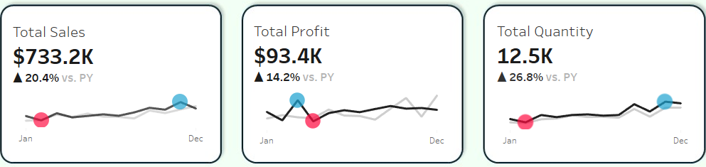
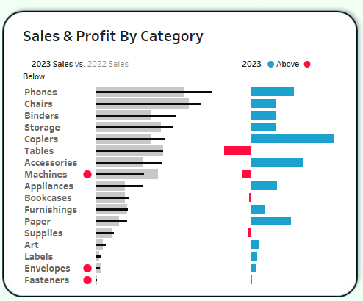
Sales Performance Dashboards Components
Sales Dashboard Components - Key Requirements
1. KPI’s and Sales Trends - Using BANs for the KPIs and Sparklines for the Sales Trends
2. Product Subcategory Comparison - Using Bar - in - Bar

Slide 13
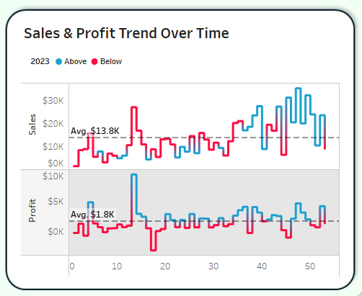
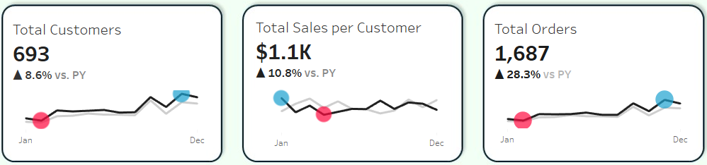
3. Weekly Trends for Sales and Profit - Using Line Chart.
Customer Dashboard Components - Key Requirements
1. KPI’s and Customer Trends - Using BANs for the KPIs and Sparklines for the Sales Trends

Slide 14
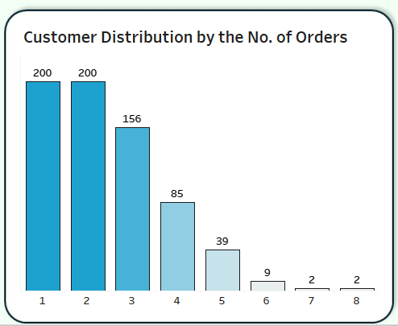
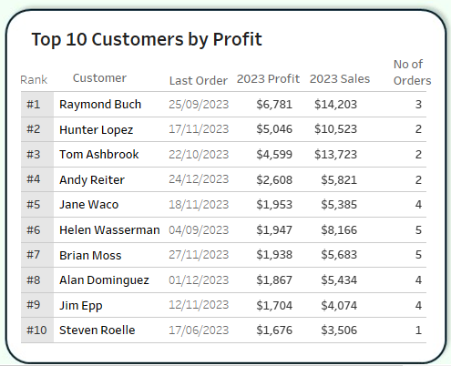
2. Customer Distribution by Number of Orders - Using Histogram.
3. Top 10 Customers by Profit - Using Table.

Slide 15
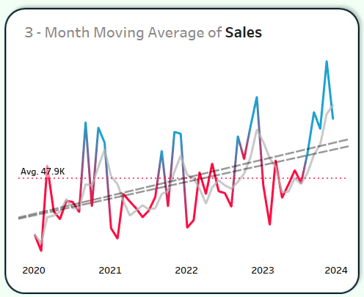
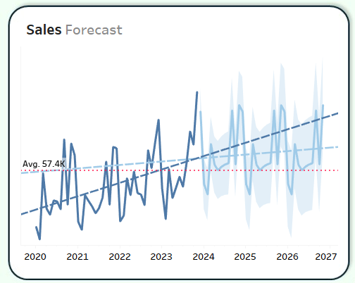
Seasonality & Forecast Dashboard Components - Key Requirements
1. Seasonality and Trends - Using Line Chart.
2. Projection - Using Line Chart.

Slide 16
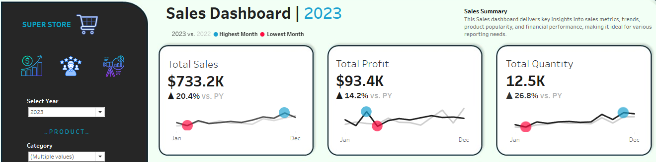
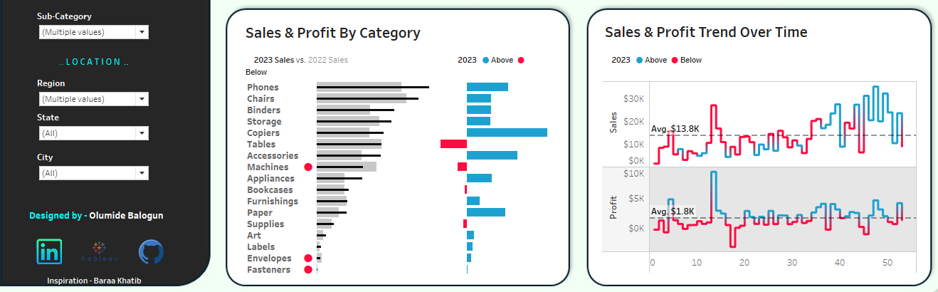

Slide 17
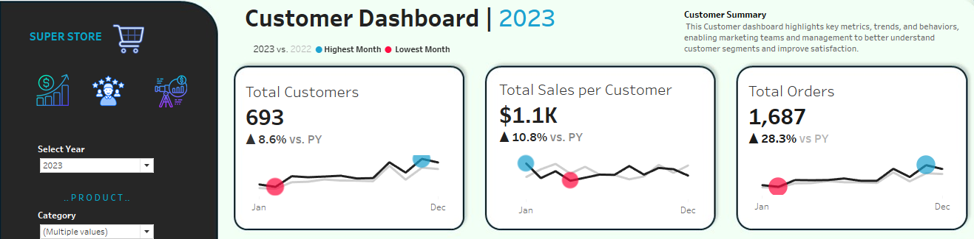
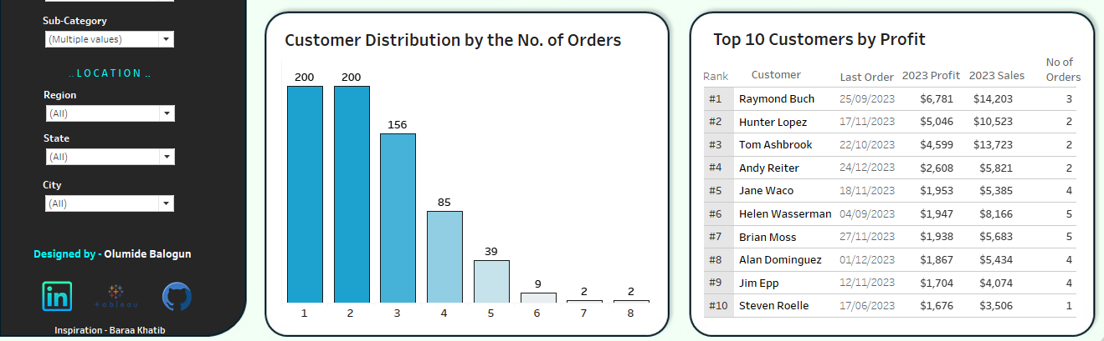

Slide 18
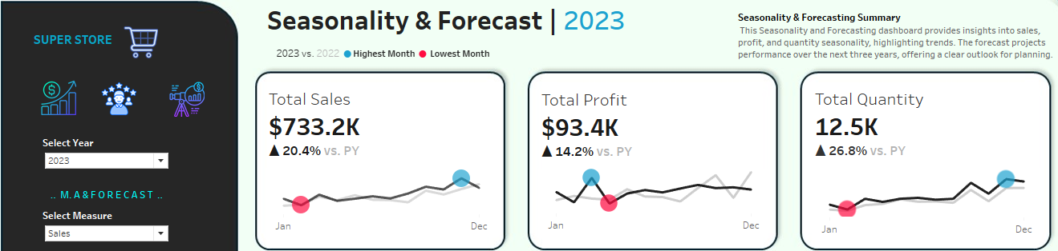
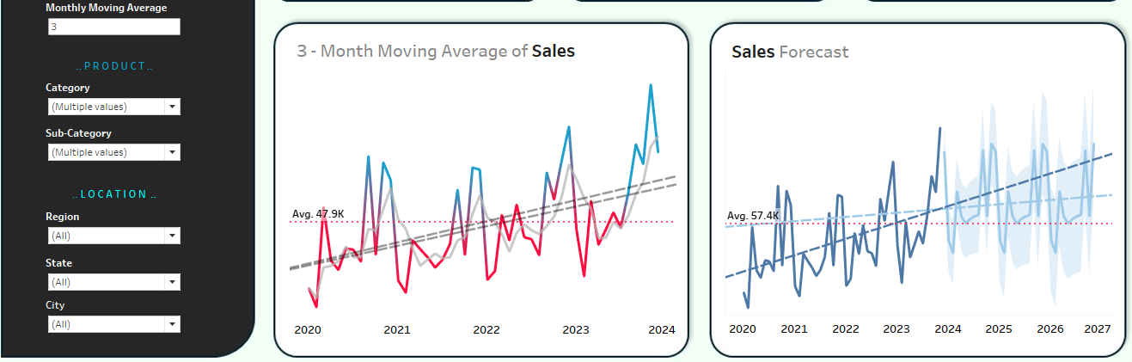

Slide 19
Success Criteria
After this Sales Performance Dashboards:
Strategic business decisions will be made to reduce costs by 15% to 20%.
The sales team will make more informed decisions, improve customer relationships, and reduce marketing expenses by 10%.
Sales analysts will automate data gathering, saving 20% of their time to focus on higher-value activities.
The executive team will make better financial decisions and develop informed strategic plans, leading to a 15% to 20% increase in profit.
To see the functionality and dynamic nature of the dashboard: Go to https://public.tableau.com/app/profile/olumide.balogun1

Slide 20
Final Results
Is there a significant year-on-year difference in Sales, Profit, and Quantity?
Hypothesis: Yes, there is a clear and significant year-on-year difference.
2. Is there a significant year-on-year difference in the Number of Customers and Orders?
Hypothesis: Yes, there is a clear and significant year-on-year difference.
3. Do the Profit and Quantity trends mirror the Sales trend?
Hypothesis: Yes, they do.
Which months show notable seasonality in Sales, Profit, and Quantity?
Answer: September, November, and December stand out.
Does the projection shows remarkable progress for the company? Does the projection indicate remarkable progress for the company?
Hypothesis: Yes, the projection shows significant progress.

Slide 21
For comprehensive Descriptive, Predictive and Prescriptive Analysis that involves:
Charts and graphs
Statistical Inferences
Correlative matrix
Regression model
Regression plot
Clusters model and customer segments
Performance Evaluation
Feature Importance plot ( for Machine Learning Models)
Time Series Decomposition plot
Time Series Forecast, ...
Go to :

