Slide 1
Problem
Solution Approach
In the last 13 months:
Over £100,000 lost to fraudulent transactions
875 (0.74%) fraudulent transactions recorded.
167 accounts affected by fraudulent transactions
Data processing
Capturing transaction patterns
Fraud detection solution
Evaluation

Slide 2
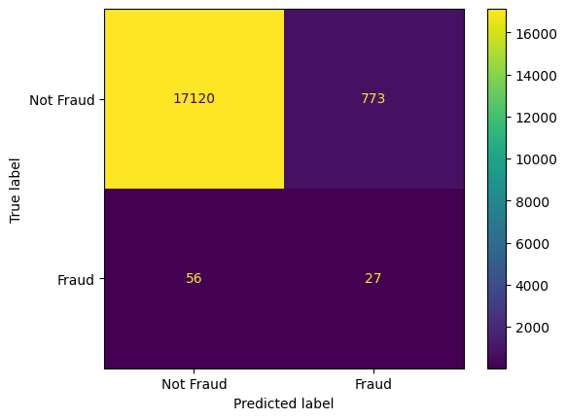
Evaluation – Using transactions from the last 2 months
Confusion matrix for transactions with fraud score greater than 79%
With a fraud score greater than 79%, 95% of the total transaction correctly classified as non-fraudulent.
4.3% of total transactions incorrectly classified as potentially fraudulent.
800 potentially fraudulent transactions reviewed over 2 months.
Of 83 fraudulent transactions recorded over last 2 months, 56 (67.5%) missed by the solution. 27 (32.5%) fraudulent transactions averted (after review).
Cost matrix for reviewed transactions
17120* £0 = £0
773 * £1 = £773
Using a £1 dummy review/resource cost, over £1700 saved.
With over 30% fraud transactions averted and money saved, this solution can be improved.
Next steps - Balancing the tradeoff between capturing more potentially fraudulent transactions and introducing transaction friction.
56 * £97 = £5432
27 * £1 = £27

