Slide 1
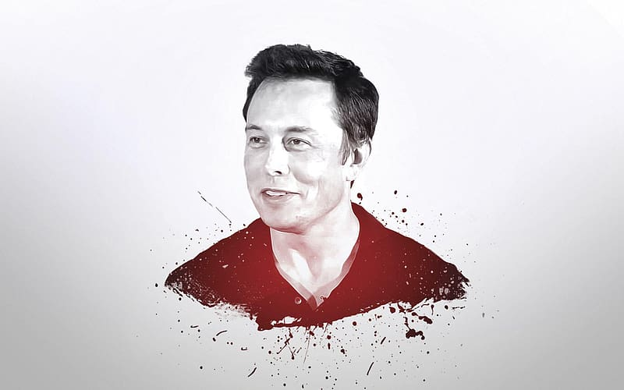

ANALYZING PUBLIC PERCEPTION AND TOPICS SURROUNDING ELON MUSK ON TWITTER
Mayokun Ajiboye
May 2024

Slide 2
Table of Contents
Introduction
Objectives
Methodology
Outcomes
Challenges
Conclusions
Recommendation

Slide 3
Intro
This project focuses on analyzing twitter data related to Elon Musk, a prominent figure in tech industry
Highlights of Elon Musk Around November 2022
Elon Musk confirms plans to charge $8 per month for Twitter verification
Elon Musk restored some banned Twitter accounts including that of Donald trump
Musk sells nearly $4 billion worth of Tesla stock
Twitter's workforce drops to less than half after Musk’s mass layoffs

Slide 4
objectives
. DEMO: collect Twitter data containing mentions of Elon Musk
. clean and preprocess the collected data
. analyze sentiment and derive topics from the tweets
. train and evaluate machine learning models to predict sentiment
. create a dashboard to visualize insights from the data

Slide 5
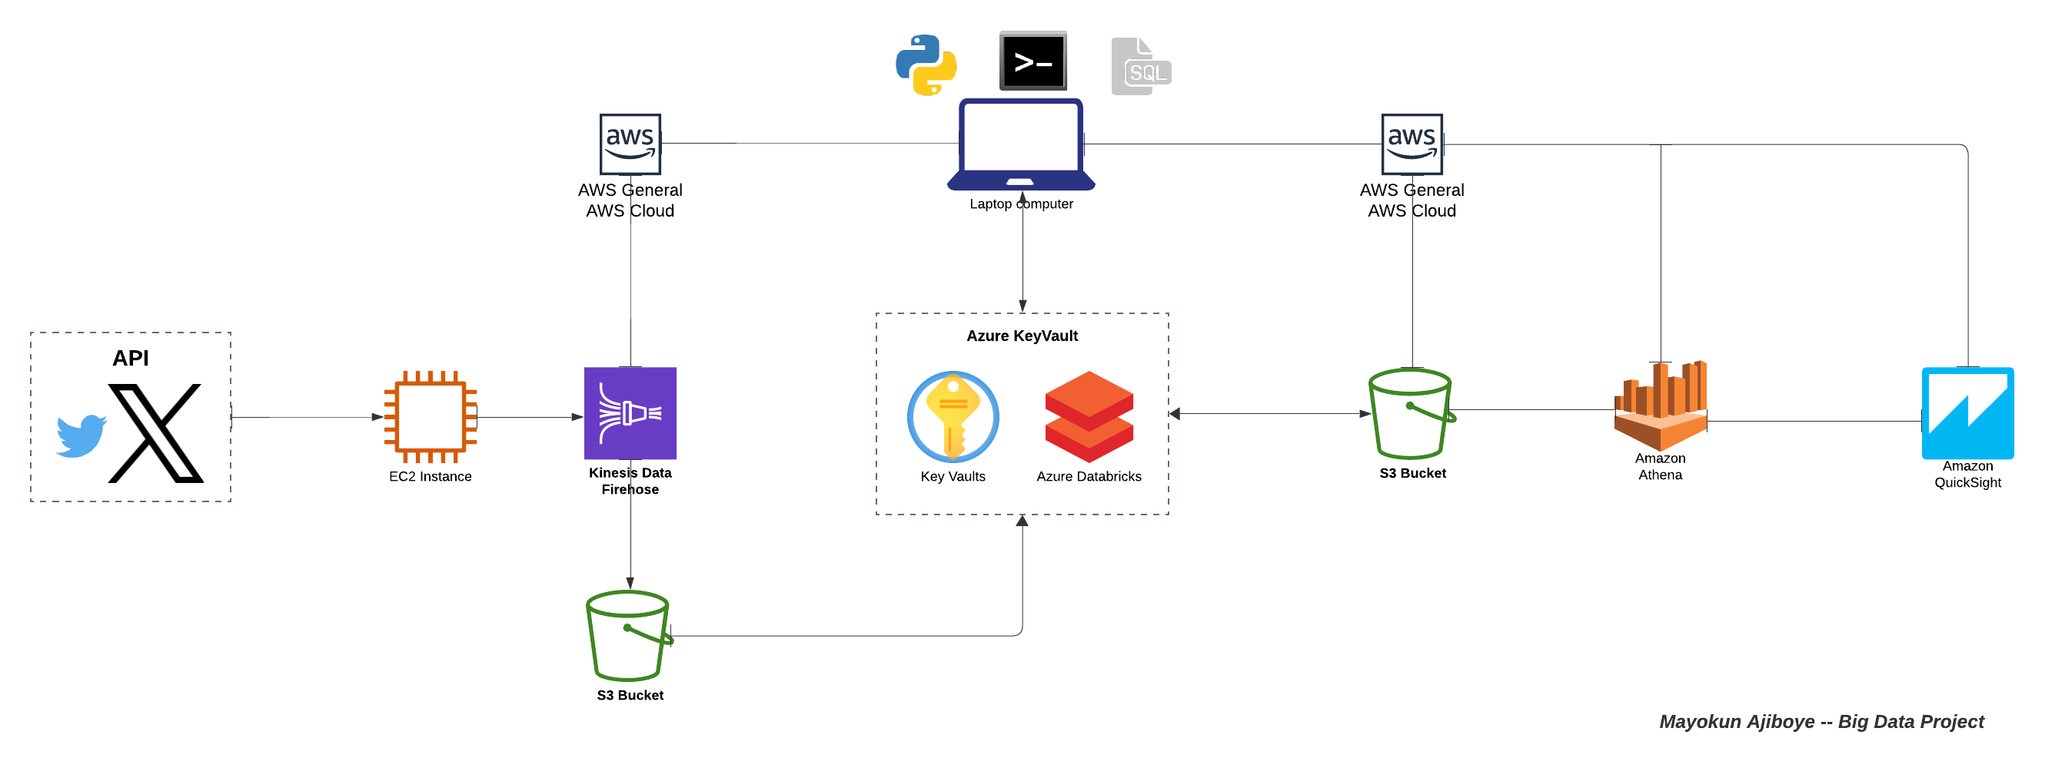
Data Flow Chart

Slide 6
methodology
- Data Collection (demo): twitter API is integrated with Data Firehose and S3 bucket via EC2 instance
- Data Cleaning: dataset is securely transferred from S3 bucket to MS Azure Databricks for wrangling
- Sentiment Analysis: pretrained model from Hugging Face library is employed – RoBERTa Classifier
- Topic Modeling: applied topic modeling algorithms to identify prevalent themes and discussions – BERTopic Model
- Feature transformation and Model Training: transformed the tweet and trained Logistic Regression and Naïve Baye’s
- Pipeline: pipelines are created for the models and the datasets are exported to a private S3 bucket for further analysis
- Visualization and Interpretation: tables are generated from the s3 bucket using AWS Athena and dashboard with QuickSight

Slide 7
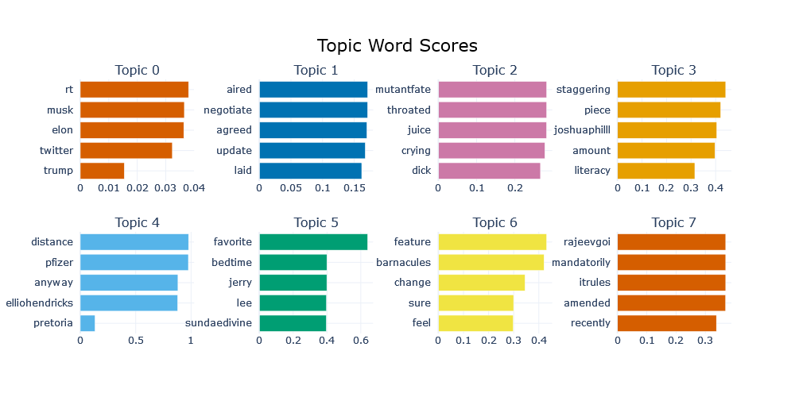
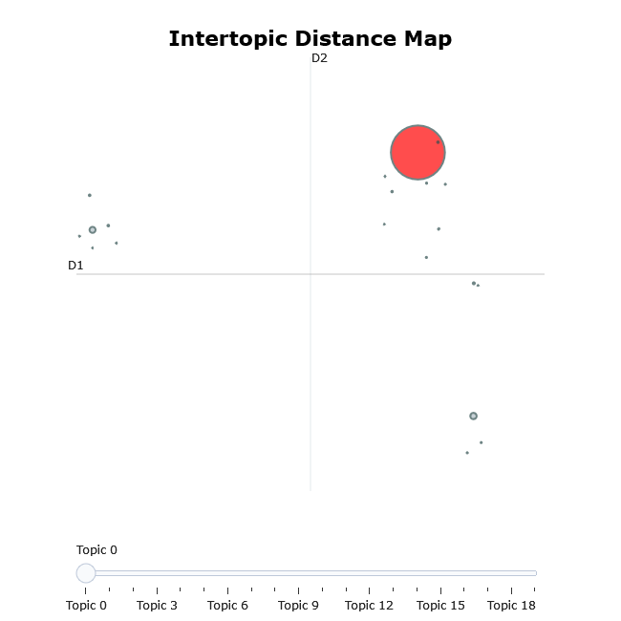
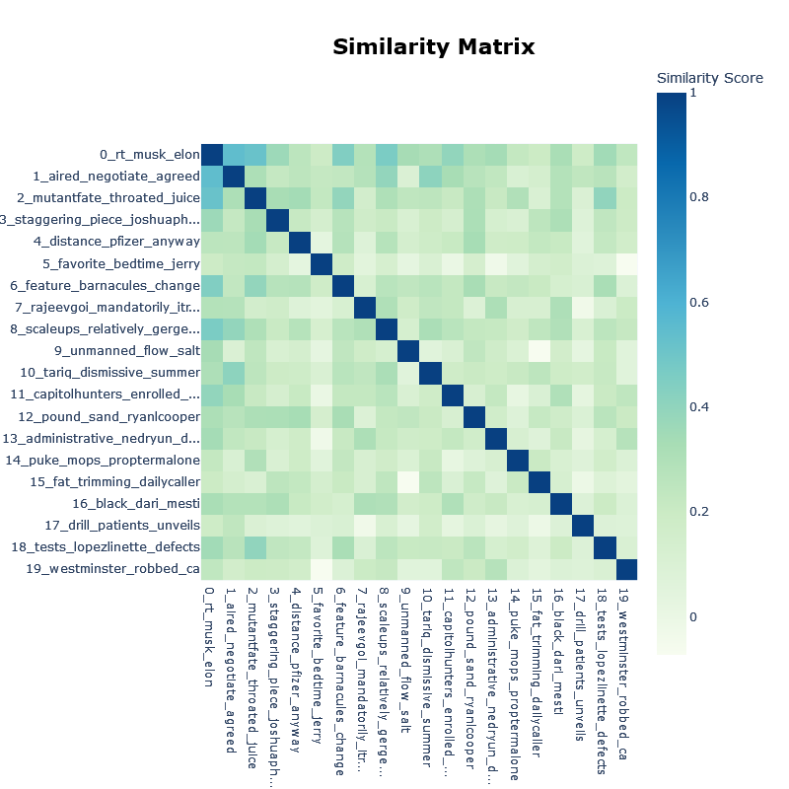
OUTCOMES topic modeling
Topic Insights
Most of the topics are concentrated on the top right corner of the inter-topic map
Dividing the topic into 3 distinct categories may be more reasonable as this could suggest a conformity with the 3 classes of sentiments
Topic 0, which carries the highest number of tweets seems to be focus more on Elon Musk, Donald Trump, and Twitter

Slide 8
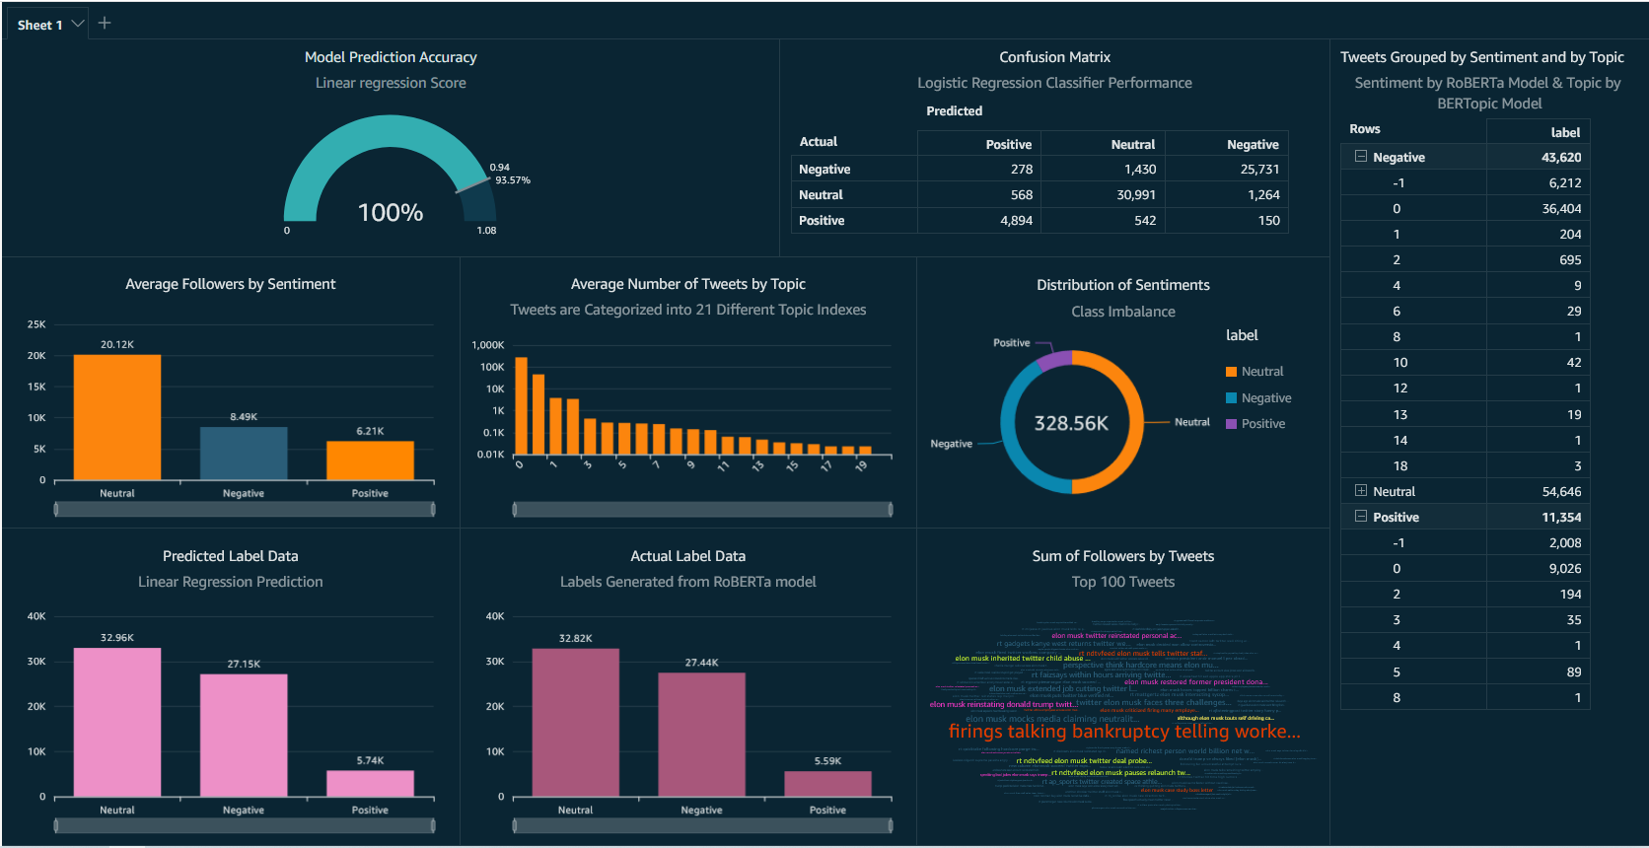
Dashboard

Slide 9
challenges
Limited computing power – Dataricks community edition
Limited data wrangling capability and chart option on QuickSight
Cost and time tradeoff in generating sentiments from pretrained model
No universal system/platform to effectively handle all data processing

Slide 10
Conclusion
Analyst attributed the considerable drop in Tesla’s stock price in 2022 to the involvement of Musk’s with Twitter (business insider, 2022)
The imbalance dataset shown on the dashboard reveals that majority of the sentiments expressed in tweets are negative, which may attest to the analyst statement above
There is high chances of predicting the right sentiment of new tweets taking into consideration the 94% accuracy of Logistic Regression classifier
Reference:
https://markets.businessinsider.com/news/stocks/elon-musk-tesla-stock-sales-twitter-wedbush-analyst-dan-ives-2022-12

Slide 11
recommendation
The time frame of data collection should be expanded to gain deeper insights and observe trends
Additional data sources should be used to avoid bias and to have more comprehensive view of public perception about Elon Musk
Demographic analysis should be conducted to understand how different groups (like age, location, …) perceive Elon Musk
The performance of models used for generating labels & prediction can be improved by trying different method and hyperparameter tuning

