Slide 1

Life Insurance Assessment RISK CLASSIFICATION
Mayokun Ajiboye
April 13, 2024

Slide 2
agenda
Introduction
Data Cleaning
Data analysis
Feature Engineering
Modeling
Evaluation
Challenges
Conclusions

Slide 3
Introduction
Why Life Insurance?
offers peace of mind and security for a premium based on principal of risk management
Life Insurance and Machine Learning
holistic approach of determining insurance policies transferred to ML through feature engineering and deep learning

Slide 4
Introduction
Data Conflict: Privacy and Bias
datasets are redacted to protect customers’ privacy; causing limitation on interpretability, bias, and data quality (dataset from: Kaggle.com)
Multi-class or Binary classification?
multiclass addresses various premium options for customer including rejection; binary class only considers a premium or no-premium term

Slide 5
Introduction
Why this topic?
this topic was chosen because it help understand classification challenges and apply basic machine learning concepts to solve problems

Slide 6
DATA CLEANING
Check for missing values and duplicates
deleted columns that has more than 20% missing values
Removed duplicates and empty rows/columns
Convert text to lowercase and removed extra spaces

Slide 7
DATA CLEANING
Split Data
to prevent data leakage
two datasets provided
training set further divided into two sets
the testing data provided has no target variable

Slide 8
DATA CLEANING
Imputation:
determine best replacement for missing values based on data distribution
for skewed, use median;
for normal distribution, use mean;
for multimodal, use KNN;
for categorical, use mode

Slide 9
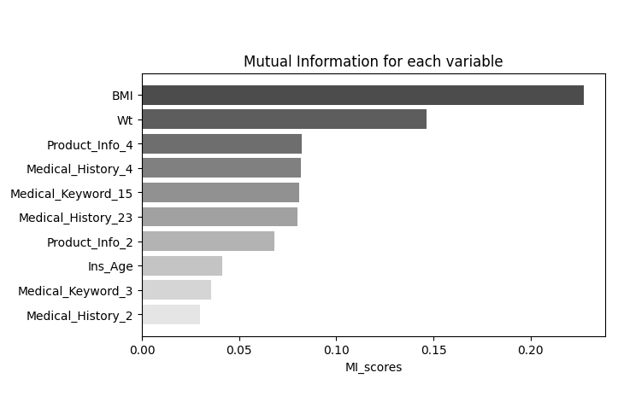
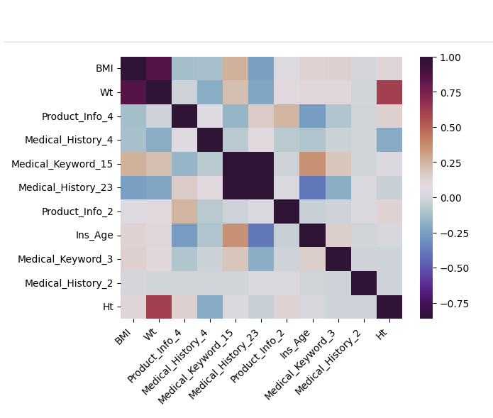
DATA ANALYSIS
the top 10 features that carry higher weights in predicting the target variable are selected for analysis using MI

Slide 10
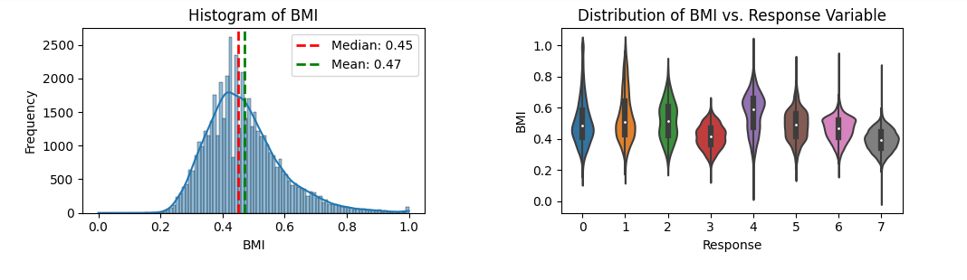
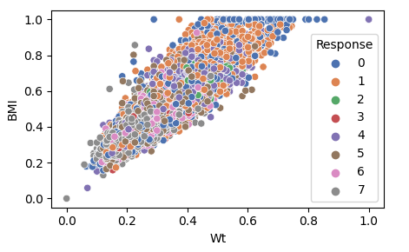
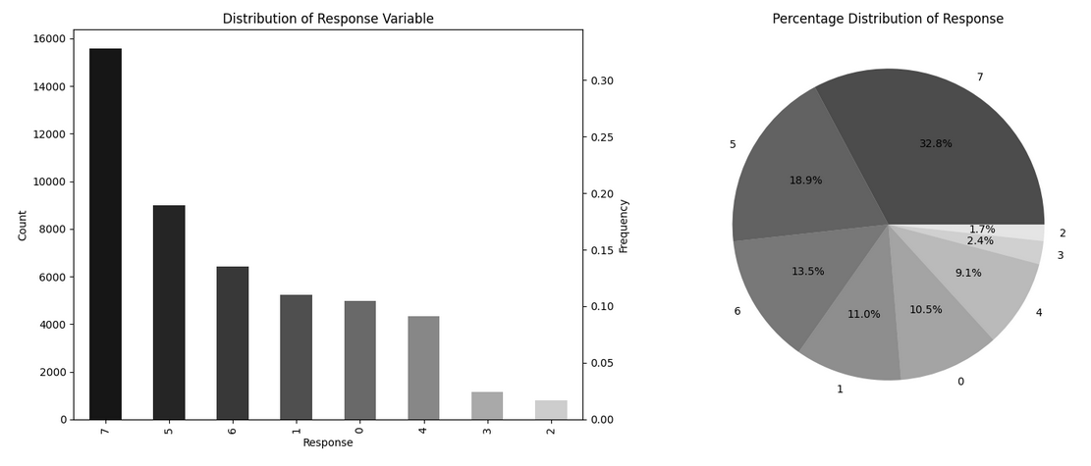

Slide 11
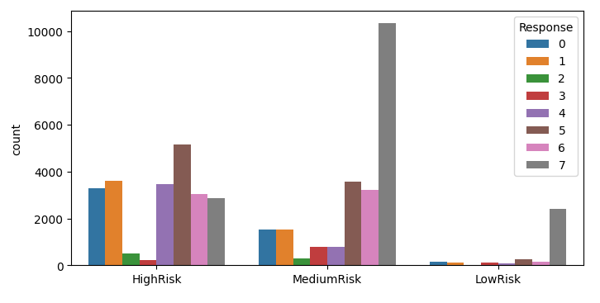
INSIGHTS
BMI | Weight | Height | Age
fewer people in the low-risk group apply for insurance.
most applicants in the medium-risk category receive a response of '7’.
very few applicants receive responses of '2' and '3’.
most applicants are in the average to high-risk range.

Slide 12
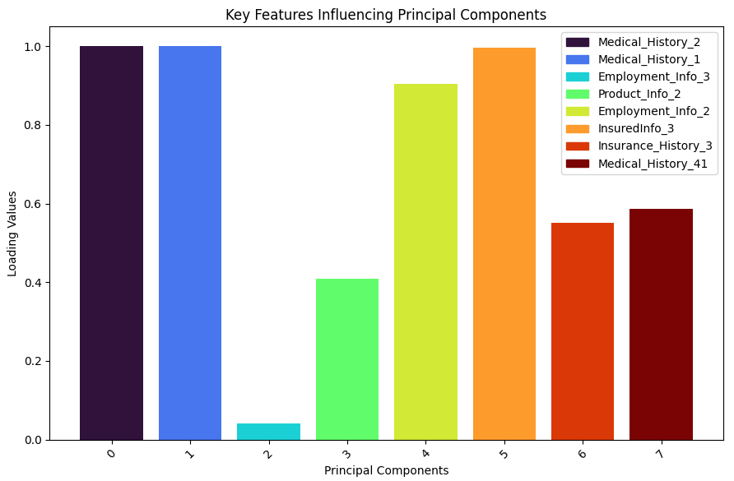
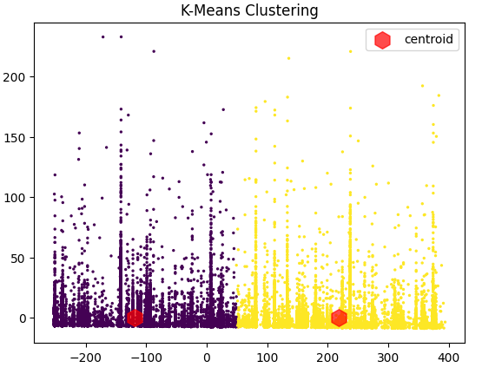
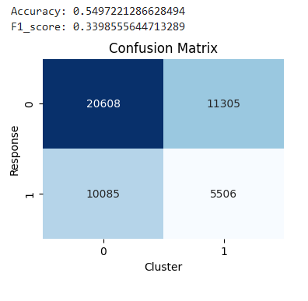
Cluster Analysis
to examine the performance of KMeans when converting a multi-class problem into a binary classification
to derive insights from the training dataset without relying on any prior label information
Steps include PCA, Kmeans, multiclass to binary, and evaluate performance

Slide 13
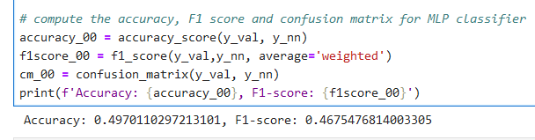
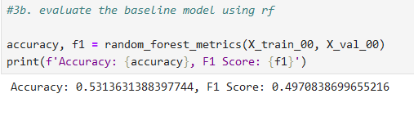


FEATURE ENGINEERING

Slide 14
FEATURE ENGINEERING
FE Attempted
Target encoding
Frequency encoding
Binning continuous variables like age, bmi, …
Feature interaction: new variable risk category, bmi_height
Label encoding

Slide 15
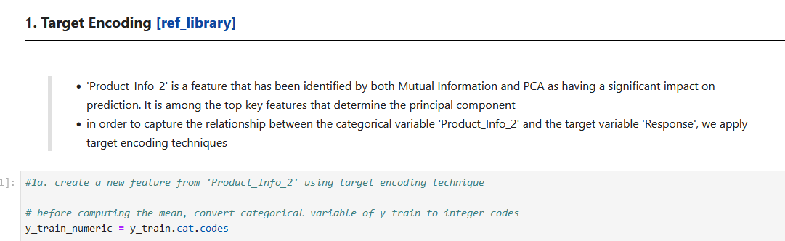
FEATURE ENGINEERING

Slide 16
modeling
Select Algorithm
Tree-based algorithm including RF, XGB, and Catboost
easy to implement
fair comparison
Tune Hyper-parameters
Tune all the tree-based ensemble algorithm
Train and Predict
Random Forest Classifier – Ensemble method | Bagging
XGB Classifier – Ensemble method | Boosting
Cat Boost Classifier – Ensemble method | Gradient Boosting

Slide 17
modeling
Stack Model
Stack Base Models: RF + XGB + CATB
Stack Meta Model: Logistic Regression

Slide 18
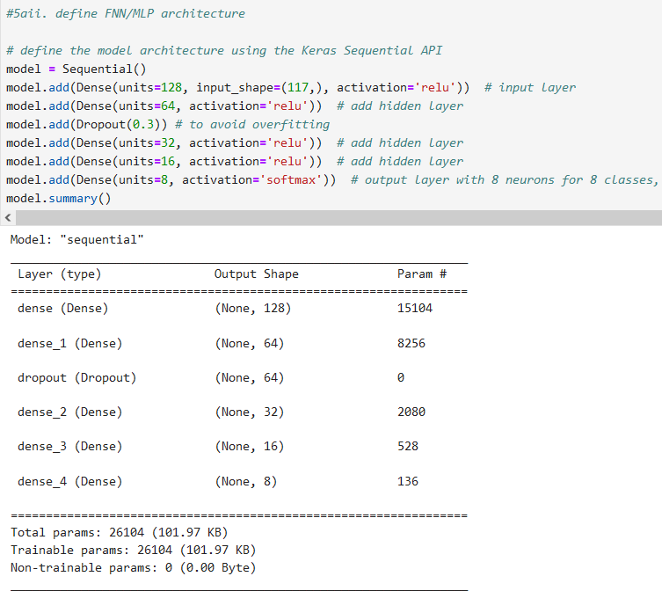
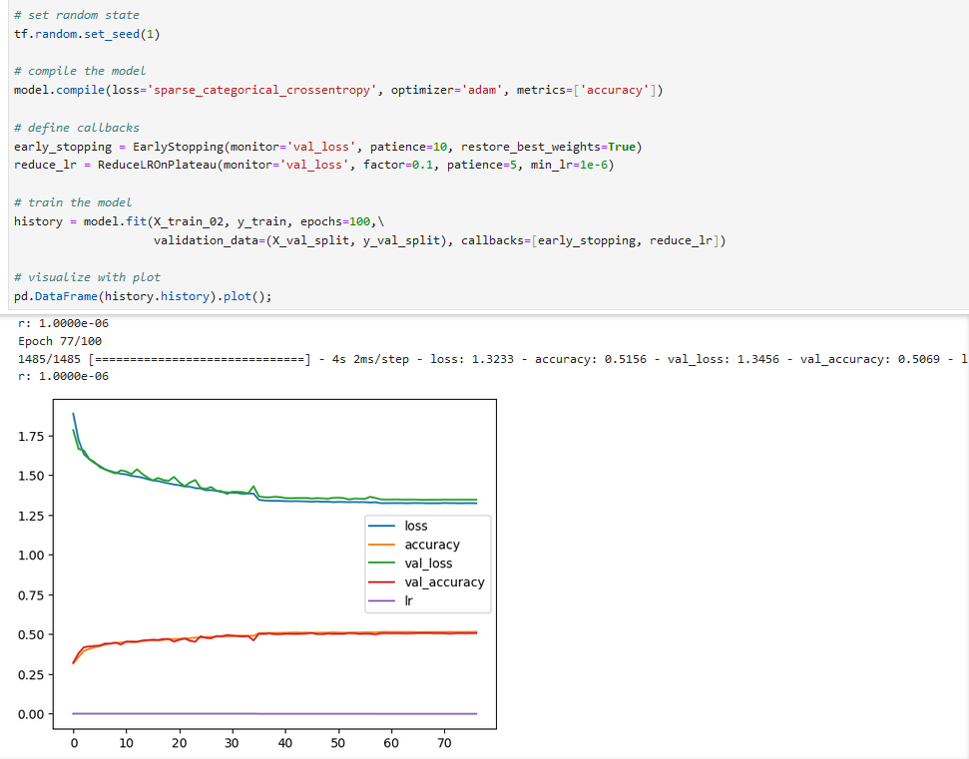
modeling
Feedforward Neural Network / Multilayer Perceptron MLP

Slide 19
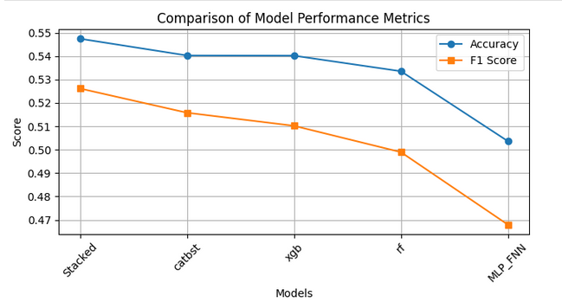
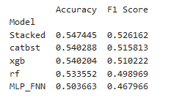
evaluation

Slide 20
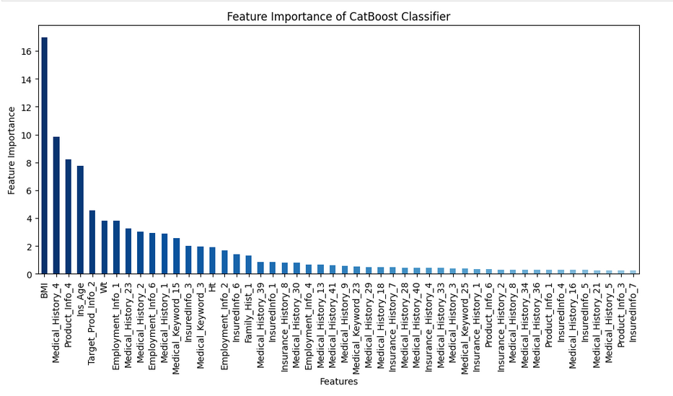
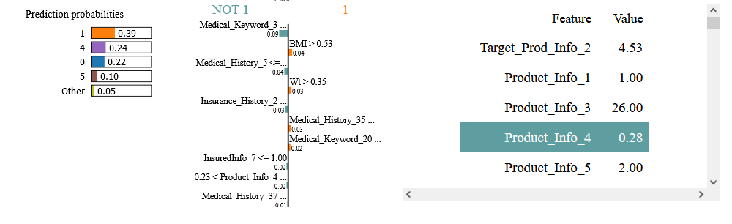

Slide 21
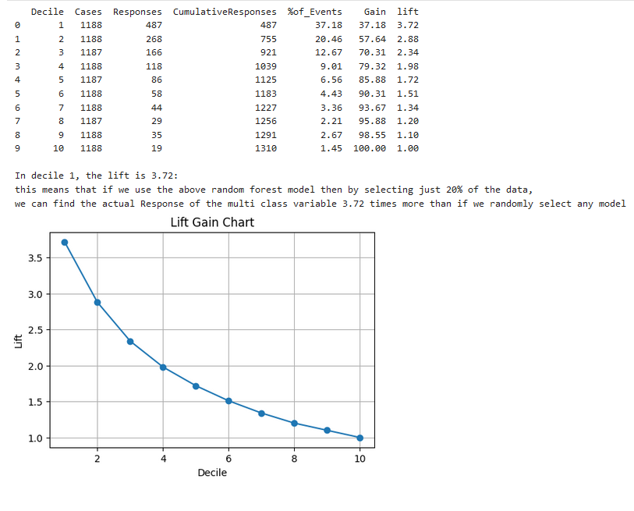

Slide 22
challenges
Limited computing power compared to cloud based or high-performance computing
resources constraints
consumes time
Large features with preprocessed information - majority are
OHE, and
normalized
Interpretability issue of normalized data
lack of subject matter expert to describe each feature
feature engineering is limited to categories that are common knowledge, e.g. age and BMI

Slide 23
conclusion
With the lift gain analysis, we find that in decile 1, the lift is 3.63. This means that utilizing our random forest model and selecting only 20% of the data, we can anticipate identifying the actual response of the multi-class variable 3.63 times more effectively than through random selection.
To enhance the model performance, it's crucial that the features remain interpretable and that information is not obscured through normalization. This approach ensures effective feature engineering and facilitates other preprocessing techniques.
Ultimately, employing a pipeline can enhance this project by ensuring scalability and suitability for deployment in a production environment.

Slide 24


