Slide 1


Android Application Development
Service
Ahsanul Karim
ahsanul.karim@sentinelbd.com
Sentinel Solutions Ltd.
http://www.sentinelbd.com

Slide 2

Application Building Blocks
Activity
UI Component Typically Corresponding to one screen.
IntentReceiver
Responds to notifications or status changes. Can wake up your process.
Faceless task that runs in the background.
Service
ContentProvider
Enable applications to share data.

Slide 3
Android Application Anatomy
Activities
Provides User Interface
Usually represents a Single Screen
Can contain one/more Views
Extends the Activity Base class
Services
No User Interface
Runs in Background
Extends the Service Base Class
Application= Set of Android Components
Intent/Broadcast Receiver
Receives and Reacts to broadcast Intents
No UI but can start an Activity
Extends the BroadcastReceiver Base Class
Content Provider
Makes application data available to other apps
Data stored in SQLite database
Extends the ContentProvider Base class

Slide 4
Service
What is Service?
Services are codes that run in the background
They can be started and stopped
Services doesn’t have UI
startService()
Audio Service
Plays Audio
stopService()
Audio Player UI

Slide 5
Service
What a Service is NOT?
There are some confusions:
A Service is not a separate process. The Service object itself does not imply it is
running in its own process; unless otherwise specified, it runs in the same
process as the application it is part of.
A Service is not a thread. It is not a means itself to do work off of the main
thread (to avoid Application Not Responding errors).
Main Features of Service
to tell the system about something it wants to be doing in the background (even when
the user is not directly interacting with the application)
to calls to Context.startService(), which ask the system to schedule work for the service,
to be run until the service or someone else explicitly stop it.

Slide 6
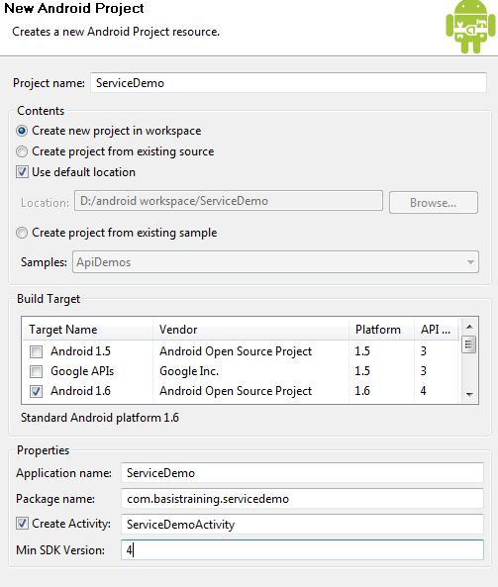
Service
Service Example
We’ll create a simple ServiceDemo application which runs in background and shows
notification in the upper Notification Bar with a period of specified time
We create a project with following:
Project Name: ServiceDemo
Build Target: 1.6
Application name: ServiceDemo
Package name:
com.basistraining.servicedemo
Create Activity:
ServiceDemoActivity
Min SDK Version: 4

Slide 7
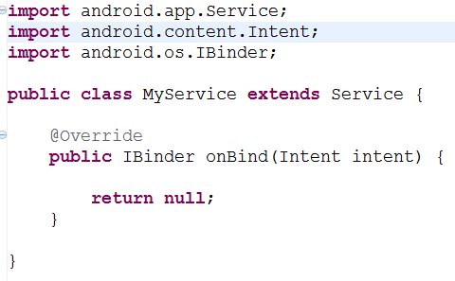
Service
Service Example (Contd.)
2. We’ll add a new class MyService that extends Service. We get the following.
3. We’ll also need to add the Service in AndroidMenifest.xml
4. Now we add other lifecycle methods of the MyService:
onCreate()
onStart()
onDestroy()

Slide 8
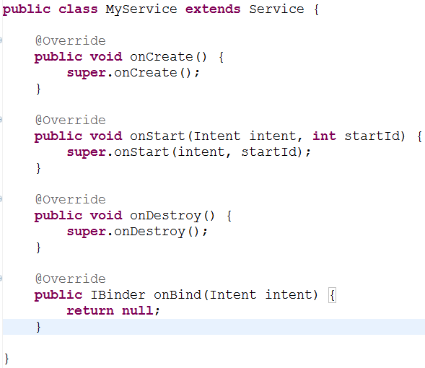
Service
Service Example (Contd.)

Slide 9
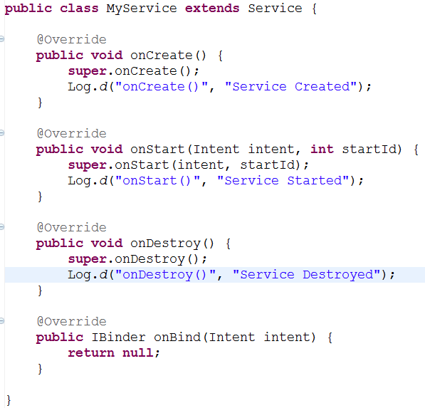
Service
Service Example (Contd.)

Slide 10
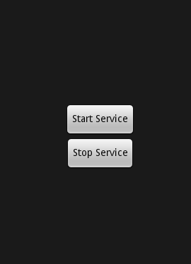
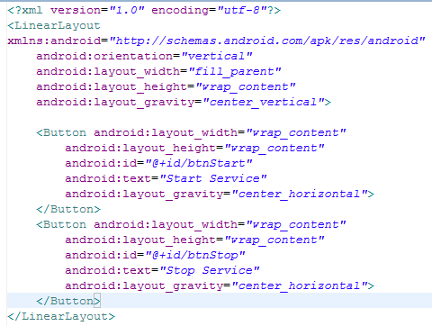
Service
Service Example (Contd.)
Now let’s make the Layout res/layout/main.xml to have 2 buttons to start and stop the
Service
There are only 2 buttons with id “@+id/btnStart” and “@+id/btnStop”

Slide 11
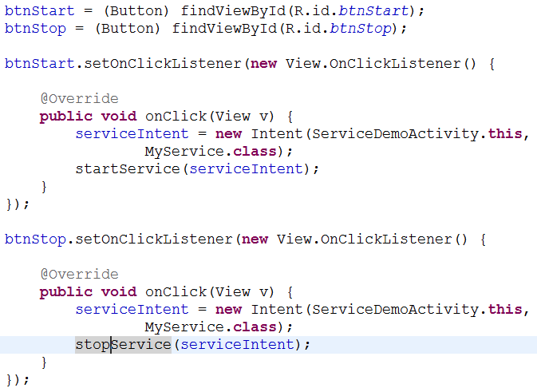
Service
Service Example (Contd.)
Now we add action to our Buttons to Start or Stop the MyService and the Application in our
onCreate() method of the Activity

Slide 12
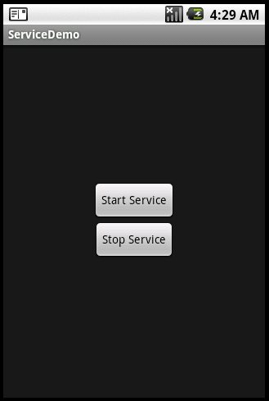
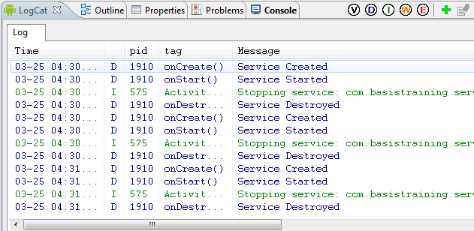
Service
Service Example (Contd.)
If we run the app and test we’ll see our buttons are starting and stopping the service in LogCat

Slide 13
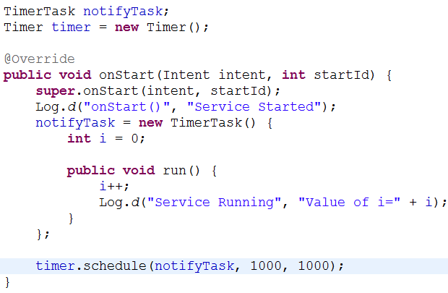
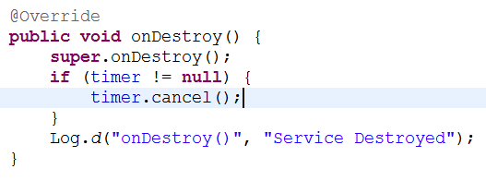
Service
Service Example (Contd.)
Now to do something on Starting of our Service, we do following:
Now to stop the timer, we do following:

Slide 14
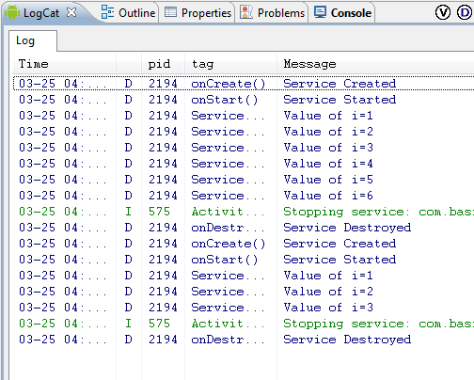
Service
Service Example (Contd.)
If we run the app and test we’ll see our buttons are starting and stopping the service in LogCat

Slide 15
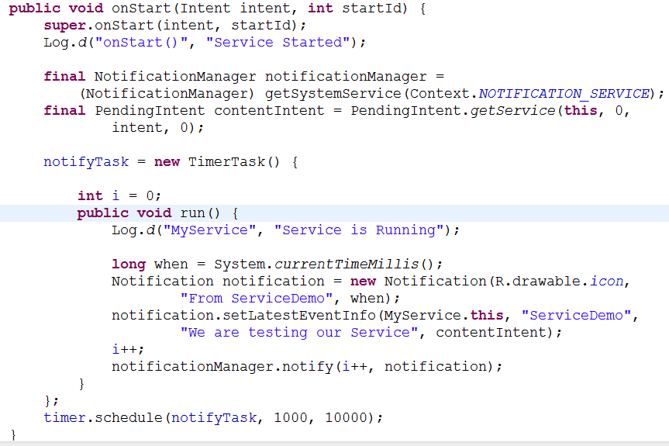
Service
Service Example (Contd.)
Now, Let we want to show a notification in the Notification Bar instead of just LogCat

Slide 16
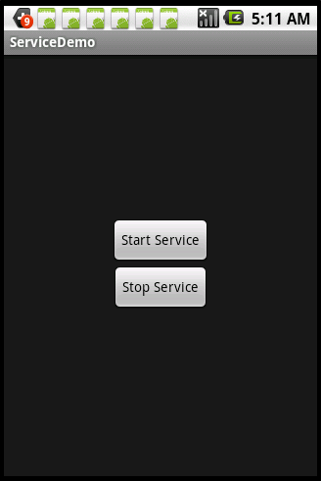
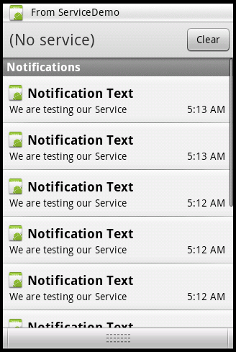
Service
Service Example (Contd.)
If we run the app and test we’ll see our buttons are starting and stopping the service in
Notification

