Slide 1
How to Securely Access Application or Database Server in a private Subnet using Bastion host without using aws management console.
Select a Region
“us-east-1, us-east-2, us-west-1, us-west-2”
Create a vpc
CSD-vpc, Cidir block = 10.0.0.0/16
2 subnet; one public & one private
CSD-pub-sbn, Cidir block = 10.0.0.0/24
CSD-prv-sbn, Cidir block = 10.0.1.0/24
Create 2 route table and configure it by routing the traffic and subnet association
CSD-pub-RT, CSD-pub-RT
Enable DNS hostname
Create an internet gateway
CSD-igw
Create a Bastion host server in the public subnet
open only port 22 @ the level of the S.G and traffic from anywhere or your IP
Create an Application or Database server in the private Subnet (make sure traffic only comes from the Bastion host server to your private subnet)
SSH into the Bastion host server and through your bastion host server ssh into you Application or Database server in your private subnet)
‘mkdir call it mycred, cd into mycred,
create a keypair file { vi mykp.pem)
Escalate the Key pair ( chmod 400 mykp.pem )
SSH into the AppDB server using mykp.pem
{ ssh -’i “mykp.pem” ec2-user@AppDBPrvIP }
Please subscribe to our youtube channel for more additional videos:
https://www.youtube.com/channel/UCD-mbdoc-1xBViFPY4PKNYA
For any additional question you may contact CSD @ 832 830 6267

Slide 2

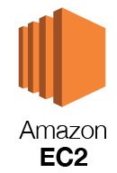
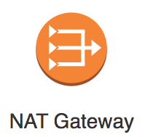
AWS Cloud
Region
VPC
Haz-1
Haz-2
Pub. Sub-2
Pub. Sub-1
Bastion
host server
Bastion
host server
Prv. Sub-1
Prv. Sub-2

