Slide 1

G2M Case Study
Virtual Internship
20-Jan-2021

Slide 2
Background –G2M(cab industry) case study
XYZ is a private equity firm in US. Due to remarkable growth in the Cab Industry in last few years and multiple key players in the market, it is planning for an investment in Cab industry.
Objective : Provide actionable insights to help XYZ firm in identifying the right company for making investment.
The analysis has been divided into four parts:
Data Understanding
Forecasting profit and number of rides for each cab type
Finding the most profitable Cab company
Recommendations for investment

Slide 3
Background –G2M(cab industry) case study
XYZ is a private firm in US. Due to remarkable growth in the Cab Industry in last few years and multiple key players in the market, it is planning for an investment in Cab industry.
Objective : Provide actionable insights to help XYZ firm in identifying the right company for making investment.
The analysis has been divided into four parts:
Data Understan
Forecasting profit and number of rides for each cab type
Finding the most profitable Cab company
Recommendations for investment

Slide 4
Objectives
The analysis has been divided into four parts:
Understanding the data
Forecasting profit and number of rides for each cab type
Finding the most profitable Cab company
Predicting the number of loyal customers
Recommendations for investment

Slide 5
Data Exploration
The master dataset has 359392 data points and 14 features
Timeframe of the data: 2016-01-31 to 2018-12-31
Data investigation:
Outliers are present in Price_Charged feature but due to
unavailability of trip duration details ,we are not treating this as outlier,
also the population and users feature possess outliers as well
Profit of rides are calculated keeping other factors constant and only
Price_Charged and Cost_of_Trip features used to calculate profit.
Users feature of city dataset is treated as number of cab users in the city.
we have assumed that this can be other cab users as well(including Yellow and
Pink cab)
Cab_Data.csv
Customer_ID.csv
Transaction_ID.csv
City.csv
Final cab data

Slide 6
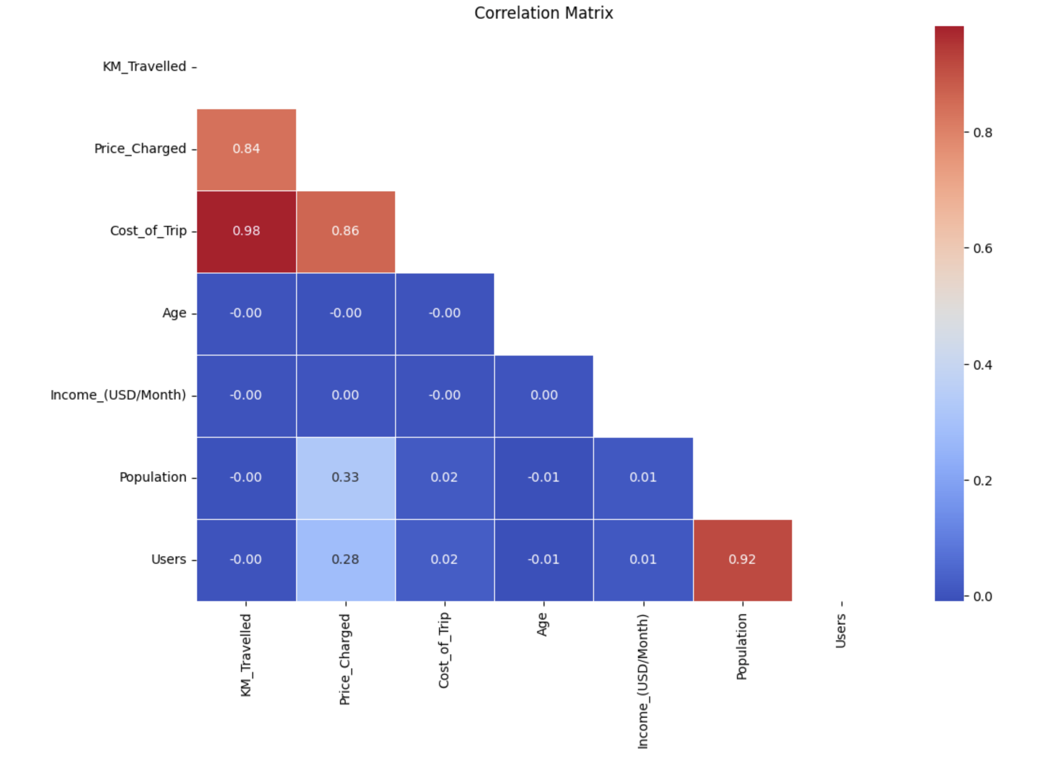
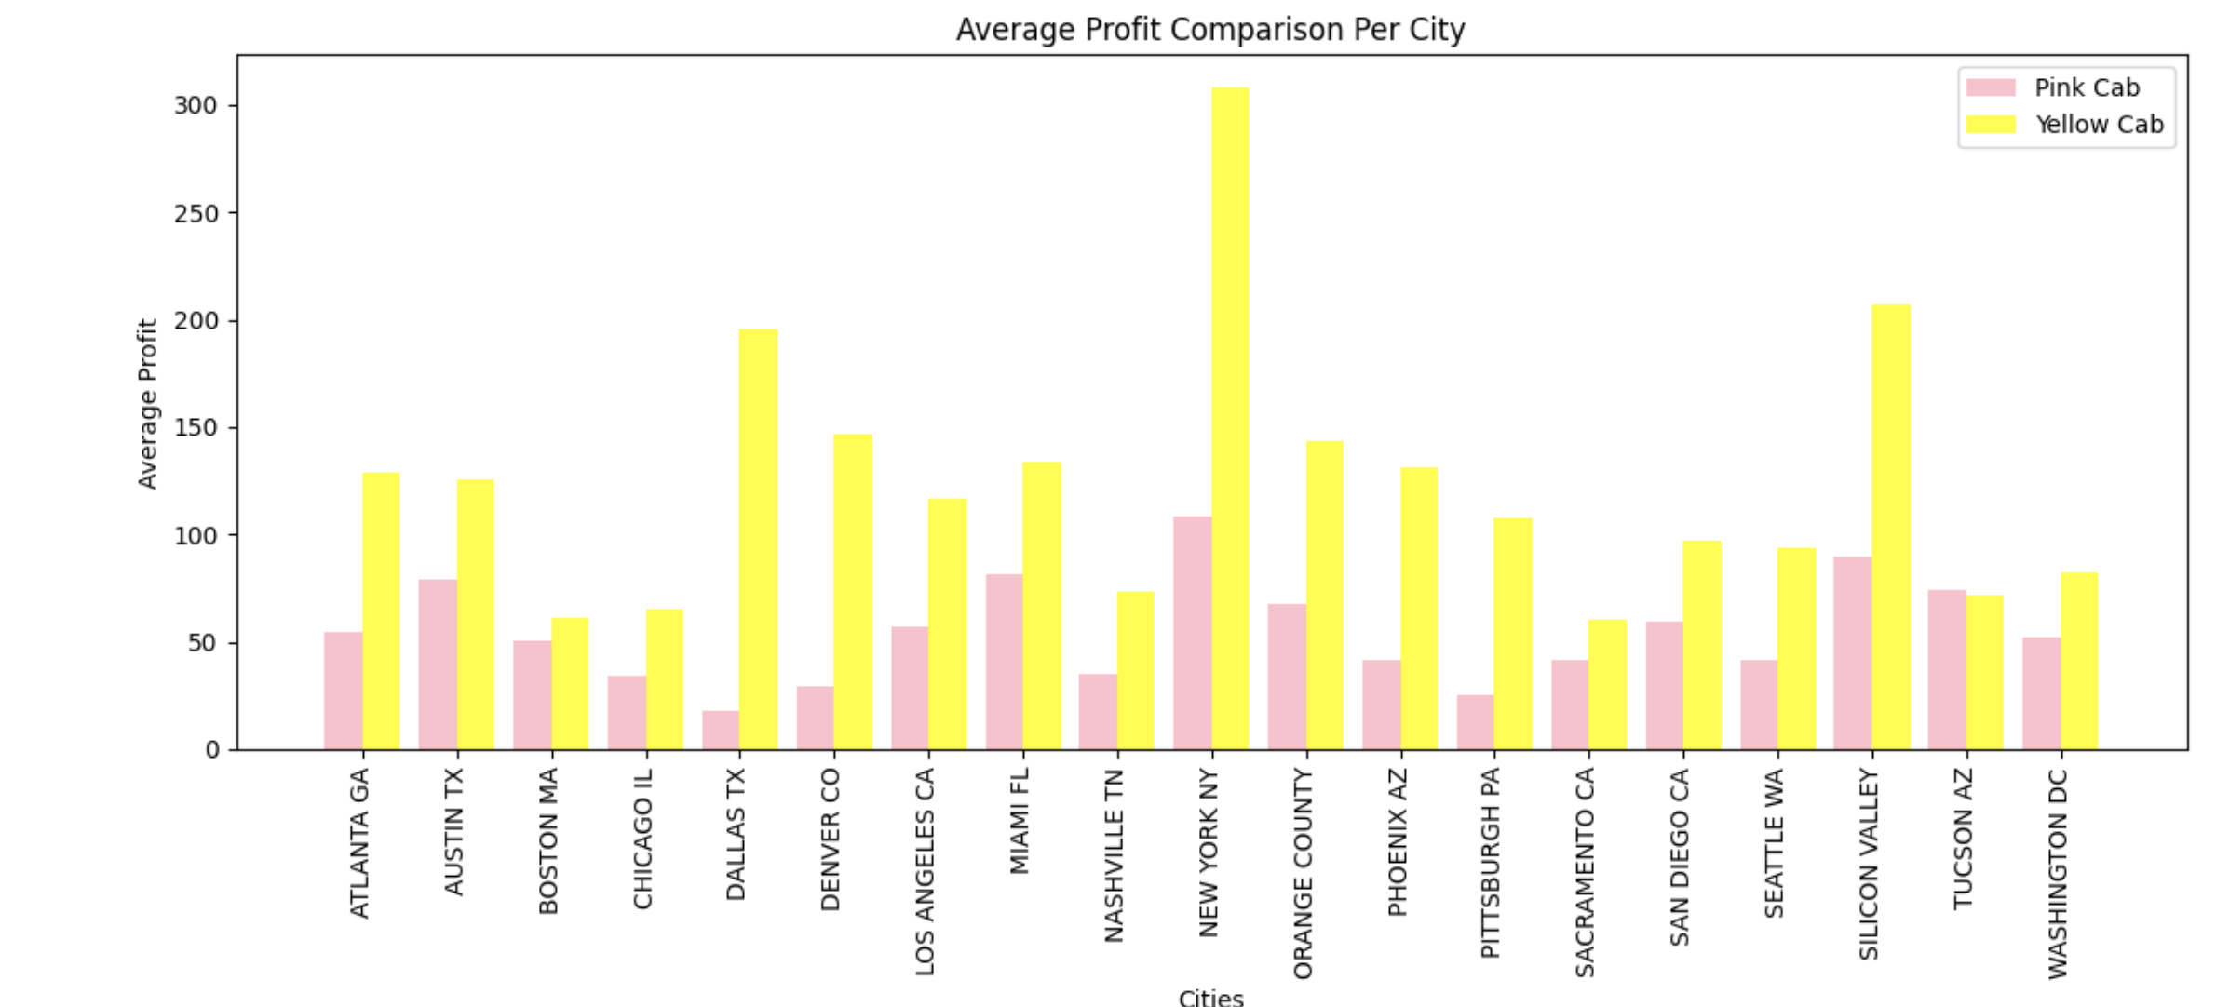
Profit Analysis
Correlation and Average Profits of cities
From the graph we can see that the average profits are very high in New Yortk, Silicon Valley and Dallas TX because this areas are hot metropolitian areas that attracts people to build business, live and go to for tourist attarctions.
Also it should be noted that the yellow cab company is doing well in this cities and everywhere else in general than the pink cab company
From the pearson correlation matrix we can see that the strongest relationships are between KM_travelled, Cost_of_Trip and Price_Chanrged as well as the population and users but the features Age and Income_(USD/Month) has no connection with others

Slide 7
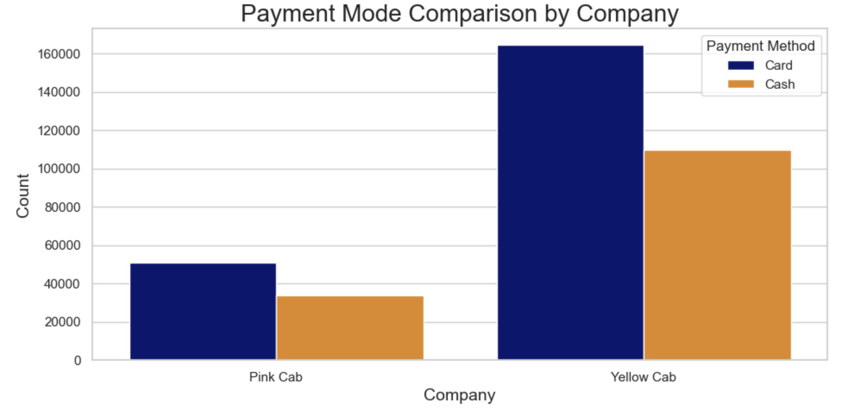
Difference in profit based on payment mode
* From the analysis it shows that there is no significant difference in the payment made from both mode of payments as they yield more or less the same average profits

Slide 8
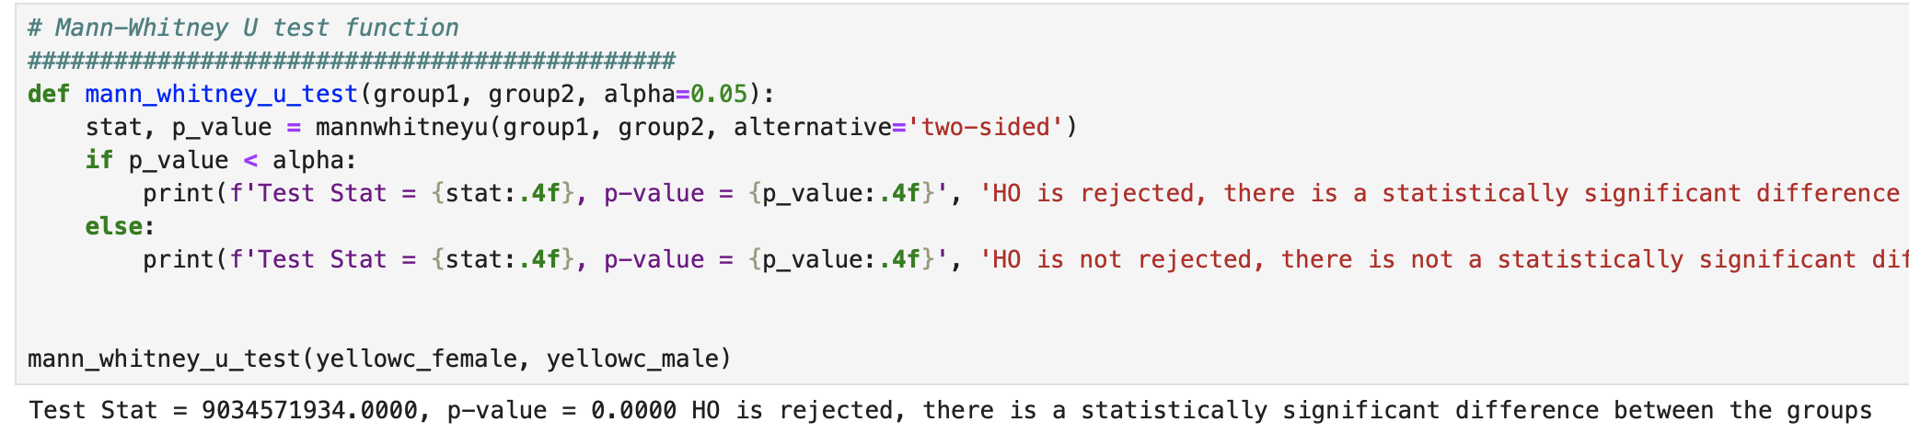
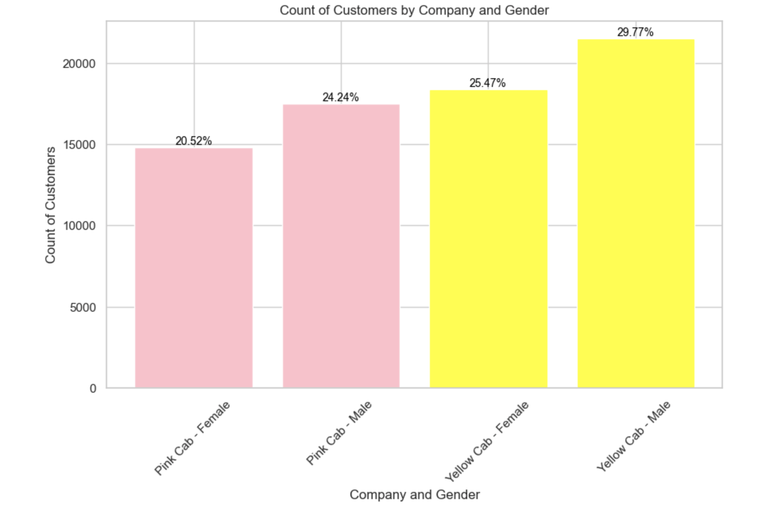
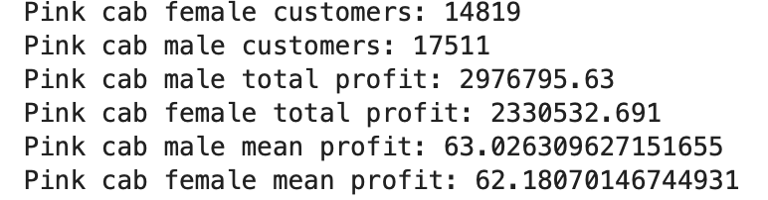
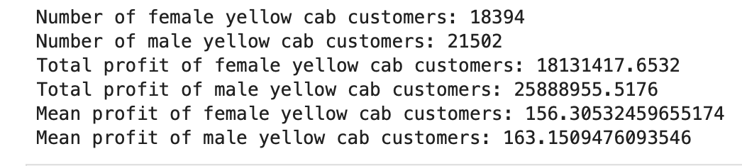
Profit and customer base Analysis Gender wise
* From the analysis it shows that there is no significant difference in the profits based on gender as they yield the same average profits regardless the gender

Slide 9
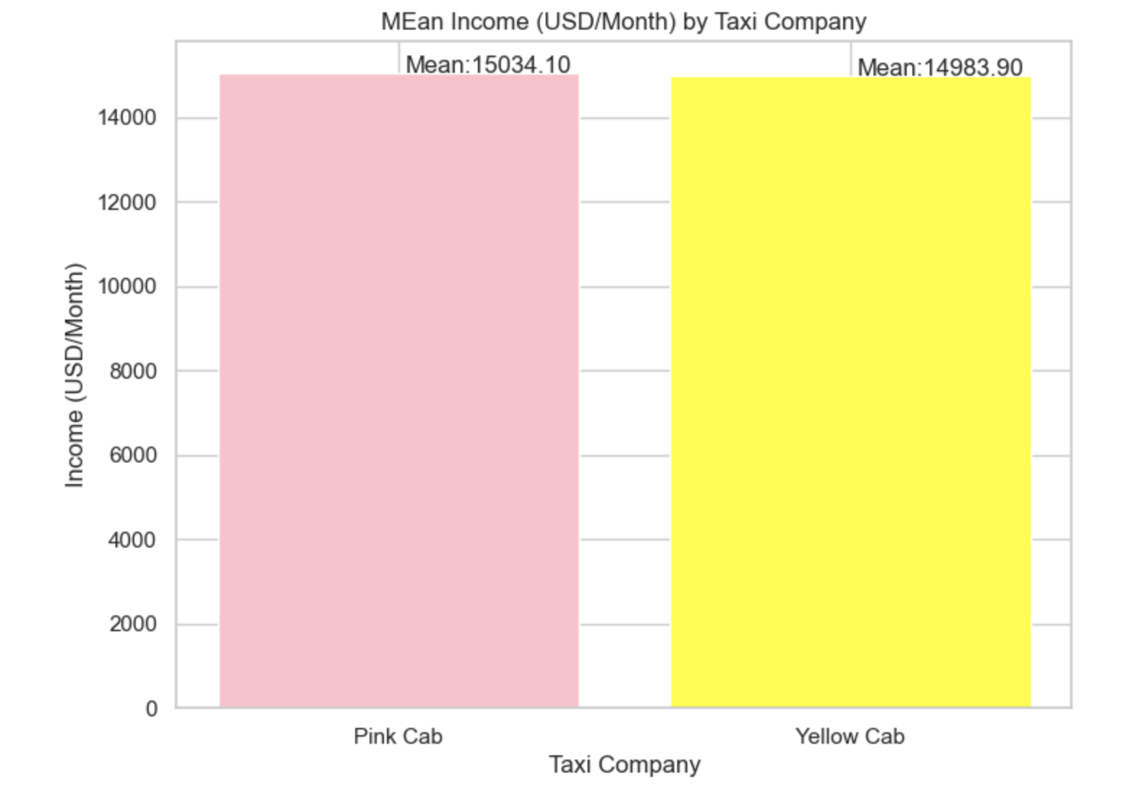
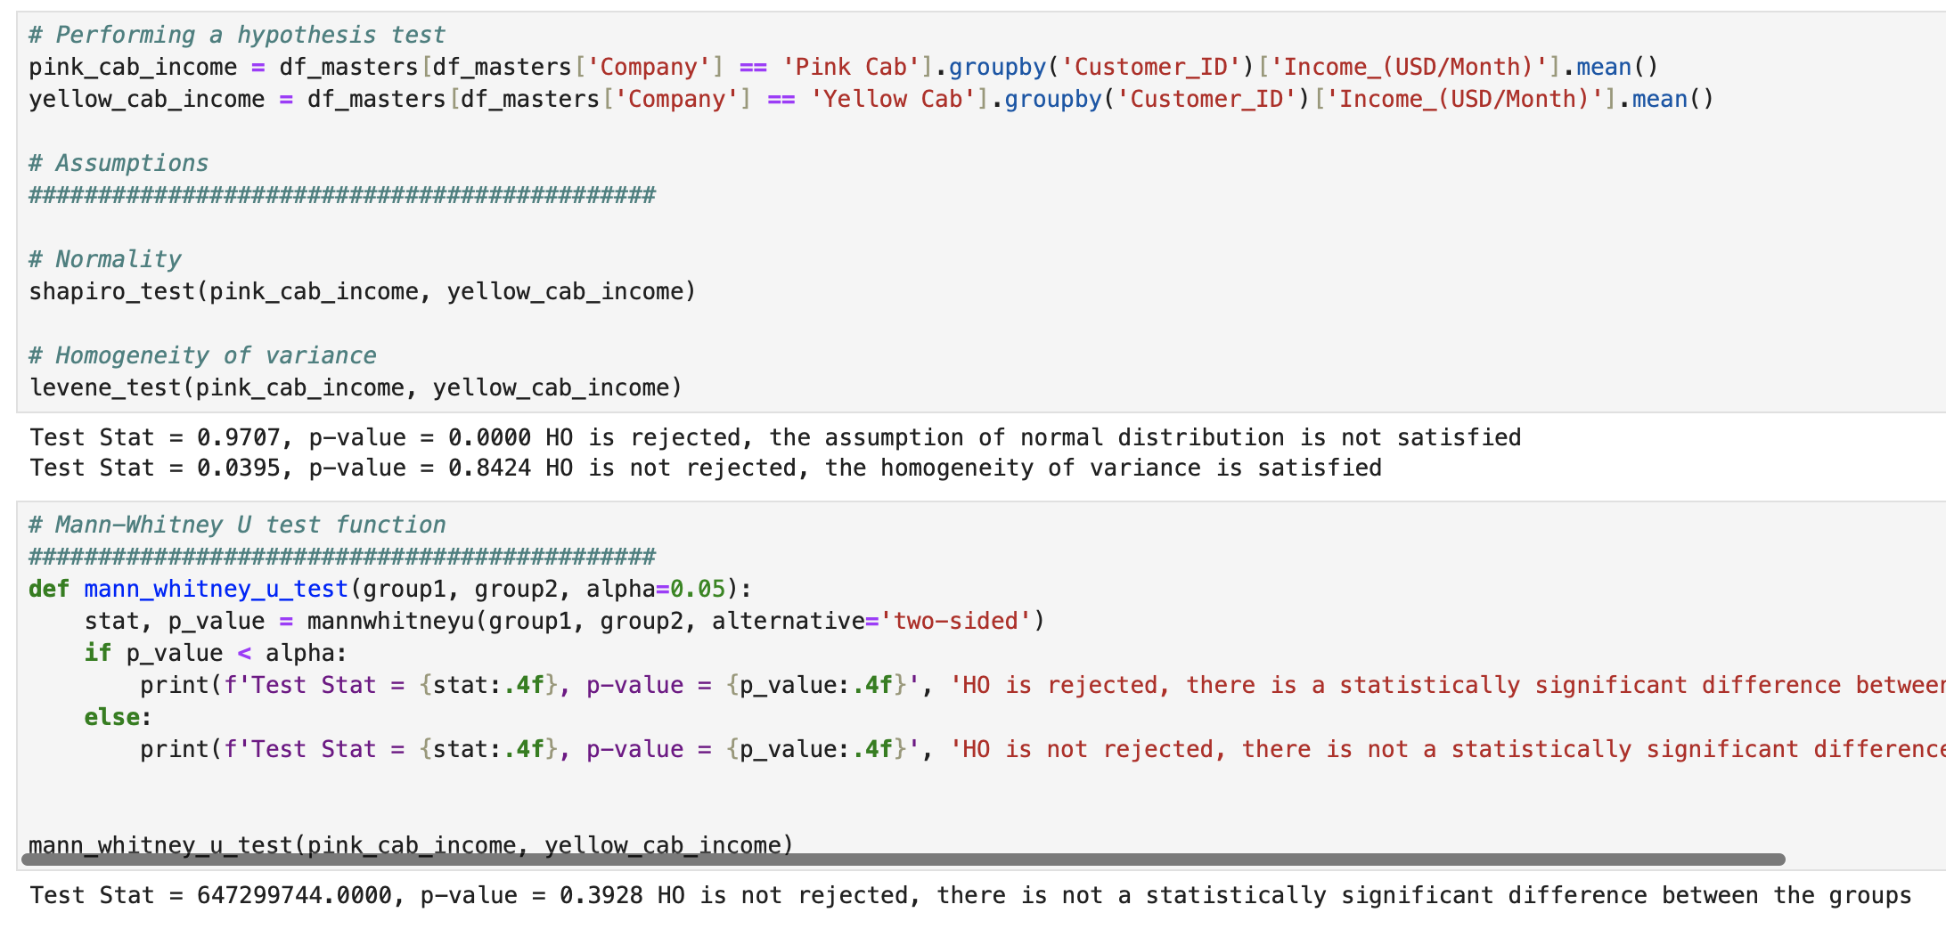
Difference in income of both cab customers
* From the analysis it shows that there is no difference betwwen the income of both company users

Slide 10
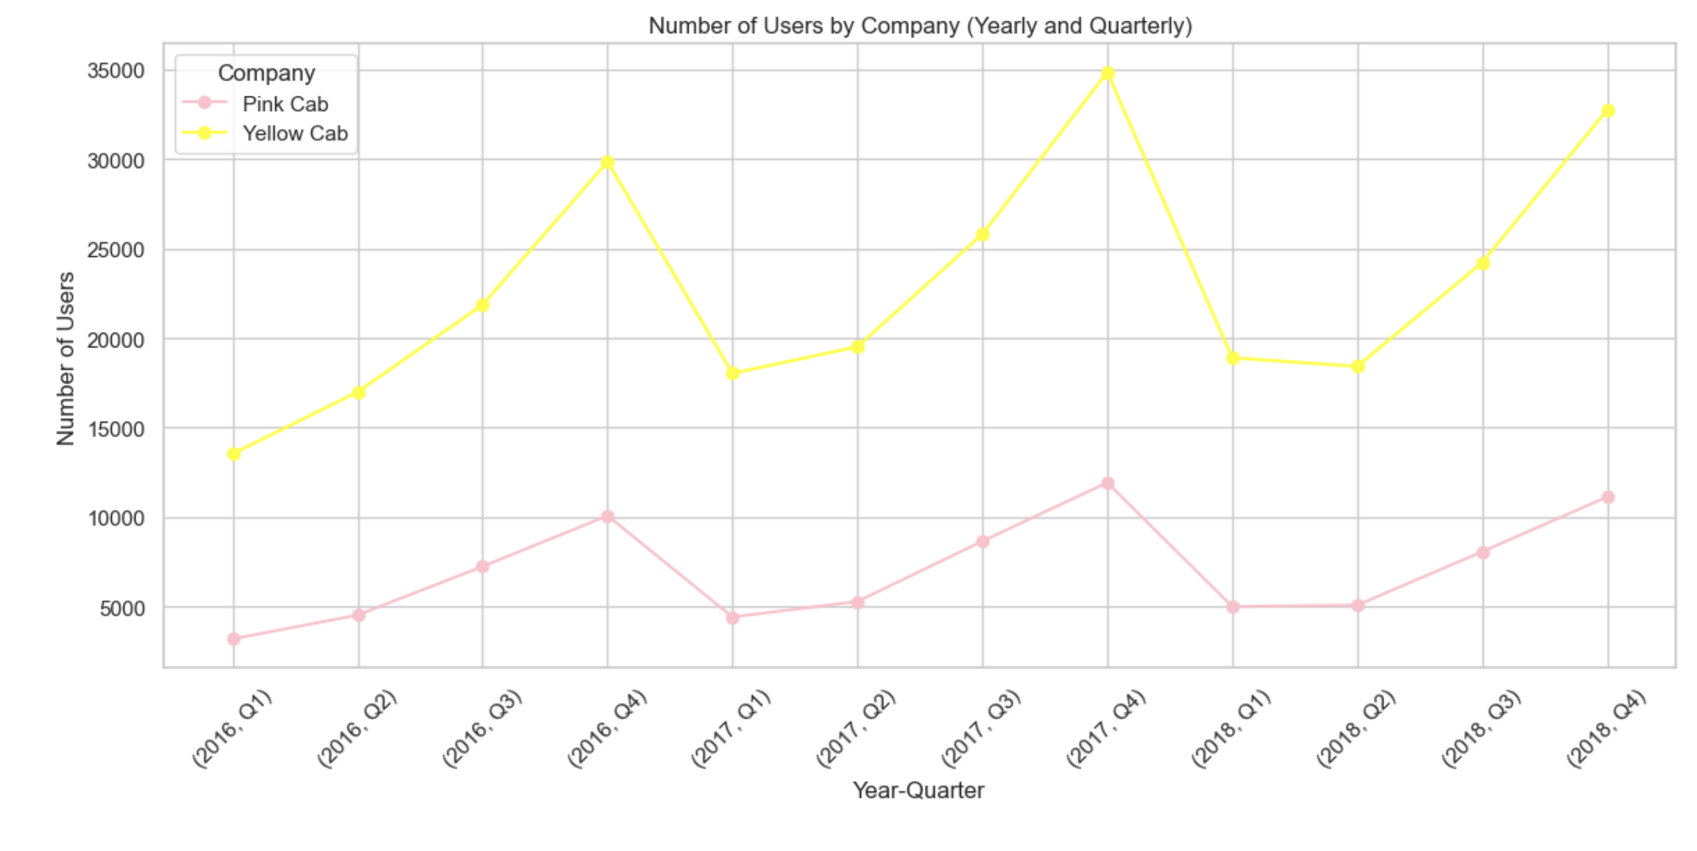
Distribution of cab users in the two year span
* From the graph we can see that there has been a zig-zag increase and decrease in number of users of the cab company, but the yellow cab tend to make more profit than the pink cab

Slide 11
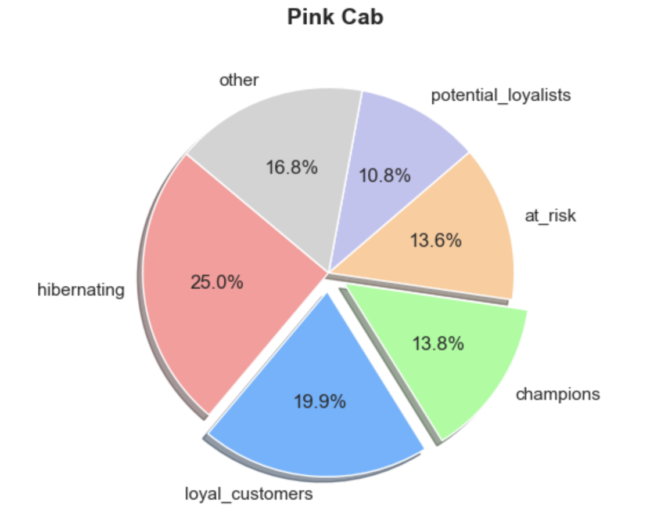
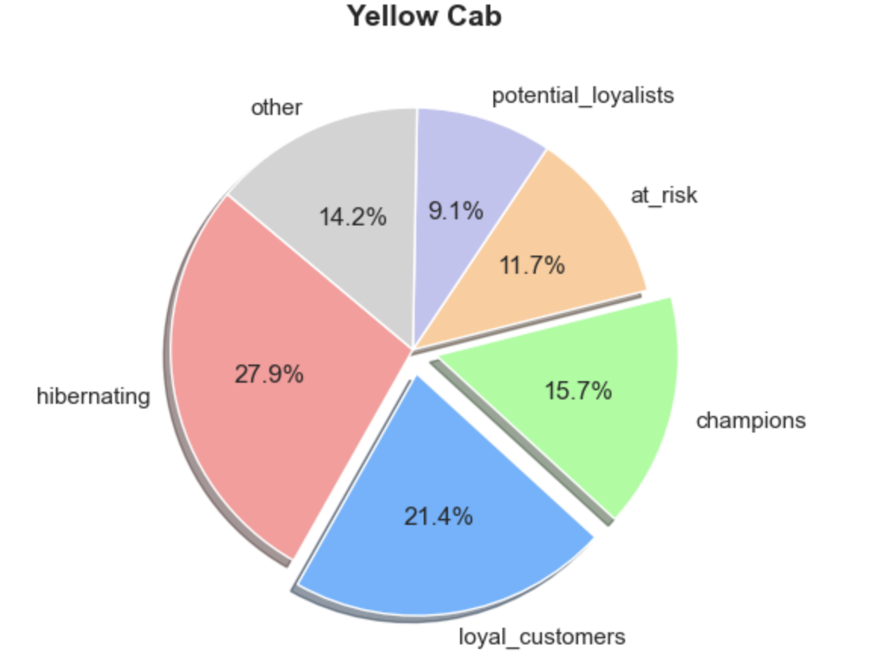
The Impact of Loyal Customers and Champions on Profit in Yellow Cab and Pink Cab Companies
From the hypothesis testing using the manny whitney u test it shoes that the yellow cab have more loyal and champion customers which generates more profits for them
Pink Cab
Yellow Cab

Slide 12
Recommendations
We have evaluated both the cab companies on following points and found Yellow cab better than Pink cab:
Customer Reach : Yellow cab has higher customer reach in 18 cities while Pink cab has higher customer reach in 1 city. We have also observed that Yellow cab is doing good in covering other cab users as compared to Pink cab.
Customer Retention: I did an analysis and discovered that the yellow cab has more loyal and champion customers than the pink cab which is generating more money for the company.
Gender Income: The income of the cab company does not vary regardless the gender that is being analysed.
Distance covered KM: Yellow cab is covering more distance than the pink cab so will tend to make more money in overall.
Profit based on Payment Method: The yellow cab tend to make more profits from the card transaction than the cash while the pink cab makes less than than that even though they make more of their money from card transaction as well.
On the basis of above point , we will recommend Yellow cab for investment.

Slide 13
Thank You

