Slide 1
TrustTill
Core claim
Making offline merchants bank-readable from the sales evidence they already have.
Informal merchants become visible when their evidence is structured.
Hackaholics 7.0
Financial Inclusion
AI evidence layer
TrustTill turns scattered proof into a reviewable trail.
TrustTill | Hackaholics 7.0 | Financial Inclusion
1
Notes:
Open with the problem in plain language. TrustTill is an evidence layer, not a loan app.

Slide 2
Messy evidence makes real merchants look invisible
A cash-heavy merchant can be active every day and still look unbankable.
Merchant reality
Bank-readable proof
Cash sales
Transfer alerts
Paper receipts
WhatsApp notes
>
Cashflow pattern
Evidence quality
Risk flags
Next best action
TrustTill translates the first list into the second.
TrustTill | Hackaholics 7.0 | Financial Inclusion
2
Notes:
Make the problem specific. Do not say merchants need generic loans. Say Wema needs cleaner evidence.

Slide 3
The AI does extraction and explanation
The verification stays transparent so a human reviewer can trust the output.
01
Extract
02
Link
03
Score
04
Explain
Amount, date, customer, channel, memo.
Match sales to receipts, deposits, and notes.
Separate verified, supported, manual, and flagged entries.
Show why each record is trusted or needs review.
AI organizes the mess. Rules keep the trust logic explainable.
TrustTill | Hackaholics 7.0 | Financial Inclusion
3
Notes:
This answers the 'how is the AI possible?' question. The AI does not decide truth alone.

Slide 4
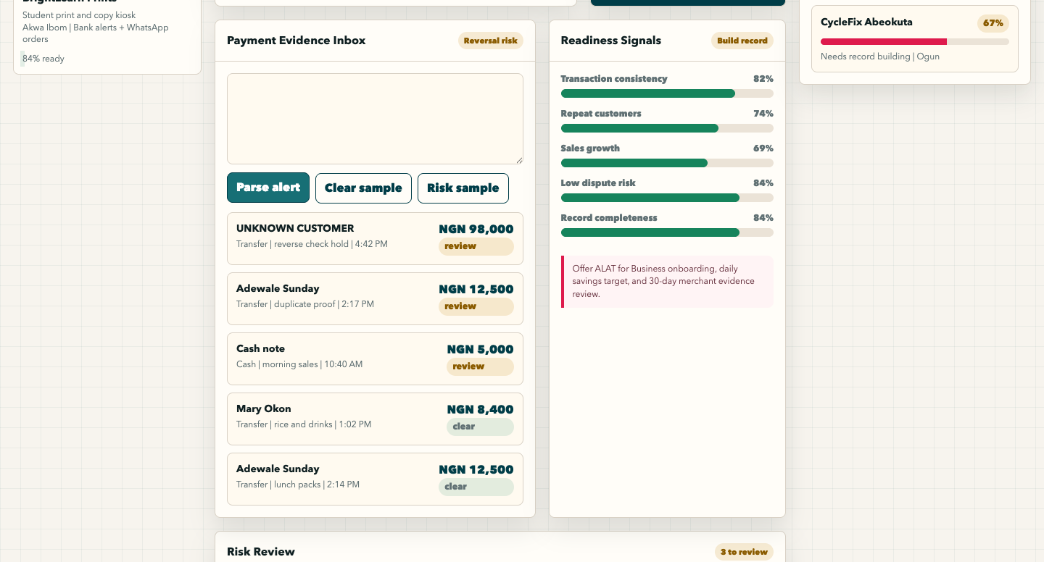
The prototype already shows the workflow
A judge can see messy evidence become a profile, score, and review queue.
Demo loop
Paste evidence
Parse record
Review flags
Open Wema Desk
Static now. API-first next.
TrustTill | Hackaholics 7.0 | Financial Inclusion
4
Notes:
Switch to the live demo if possible. This slide is the fallback proof.

Slide 5
Wema gets a practical inclusion pipeline
TrustTill connects social impact to a bankable SME acquisition path.
Acquire
Improve
Review
Identify active merchants who are ready for ALAT or SME banking.
Help merchants build cleaner records without becoming accountants.
Use risk flags before any credit or support decision.
The first win is not automated lending. It is better merchant visibility.
TrustTill | Hackaholics 7.0 | Financial Inclusion
5
Notes:
Make this sponsor-specific. Wema gets acquisition, record quality, and safer review.

Slide 6
The backend is an evidence engine
The build is realistic: ingest, normalize, reconcile, score, expose.
Sources
Ingestion
Extraction
Matching
Profile
>
>
>
>
cash, alerts,
receipts, POS
EvidenceItem
API
AI parser +
validation
SaleEvent
ledger
Wema-ready
review API
This is why backend experience matters: the hard part is reliable data flow, not a flashy chatbot.
TrustTill | Hackaholics 7.0 | Financial Inclusion
6
Notes:
Use this slide to establish implementation credibility.

Slide 7
The ask is a 30-day pilot
Start small, learn fast, and prove whether merchant evidence quality improves.
Pilot group
Support needed
Success metric
20 to 50 campus or market merchants.
Mentorship, API guidance, and compliance feedback.
More verified records and clearer Wema review decisions.
Make existing merchant evidence count.
TrustTill | Hackaholics 7.0 | Financial Inclusion
7
Notes:
End on a concrete pilot request. Keep it actionable and credible.

