Slide 1
INTRODUCTION TO SQL SpitalLabs Data Analytics Class
KOLA ADEMOLA

Slide 2
Your best quote that reflects your approach… “It’s one small step for man, one giant leap for mankind.”
AGENDA
What is SQL?
Key Concepts
Databases and Tables
Data Types
Order of Operation
SQL Statements
Data Definition Language (DDL)
Data Manipulation Language (DML)
Data Query Language (DQL)
Data Control Language (DCL)
DATA MANIPULATION
JOINS
INNER
LEFT/RIGHT
OUTER
CROSS
SELF
LENGTH, UPPER, LOWER
REPLACE, TRIM, LTRIM, RTRIM, CONCATENATION
SUBSTRING
WHERE, BETWEEN, GROUP BY, ORDER BY, LIMIT,
AGGREGATE FUNCTIONS
HAVING & CASE
LIST AGGREGATION
CEIL & FLOOR, ROUND, POWER
DATE & TIME FUNCTIONS
SUB-QUERY, CTE & TEMP TABLES
VIEWS, INDEX
RANDOM, SETSEED
PATTERN MATCHING BASICS
ADVANCE PATTERN MATCHING (REGULAR EXPRESSIONS)
Window functions(ROW_NUMBER, RANK, DENSE_RANK, LAG, LEAD, NTILE, RUNNING TOTAL)

Slide 3
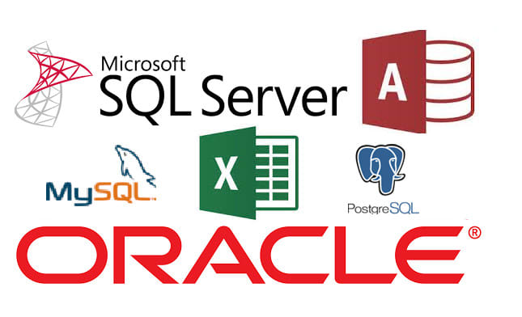
Your best quote that reflects your approach… “It’s one small step for man, one giant leap for mankind.”
What is SQL?
SQL, which stands for Structured Query Language, is a powerful language used for managing and manipulating relational databases. It is the standard language for interacting with relational database management systems (RDBMS).
RDBMS is a software system that allows users to create, manage, and manipulate relational databases such as; PostgreSQL, MySQL, MS SQL Server etc.. It provides a structured and organized approach to storing and retrieving data, ensuring data integrity and consistency.

Slide 4
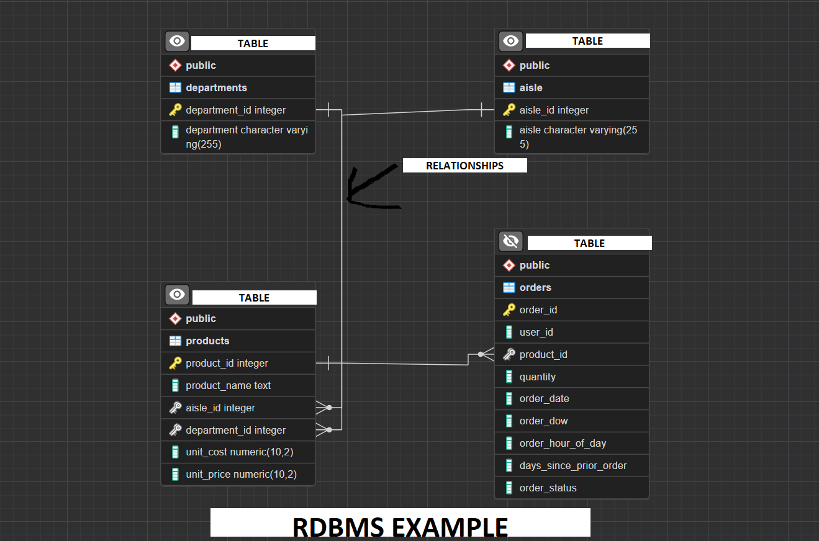
Your best quote that reflects your approach… “It’s one small step for man, one giant leap for mankind.”
What is SQL?
By using SQL, we can easily define the structure of our databases, create tables, define relationships between tables, and enforce data integrity through constraints. SQL also provides a flexible and efficient way to retrieve, update, and delete data from the database, enabling users to perform complex operations and generate meaningful insights.
Overall, SQL and RDBMS work hand in hand to provide a reliable and efficient solution for managing and manipulating relational databases, making it an essential tool for data management in various industries and applications.

Slide 5
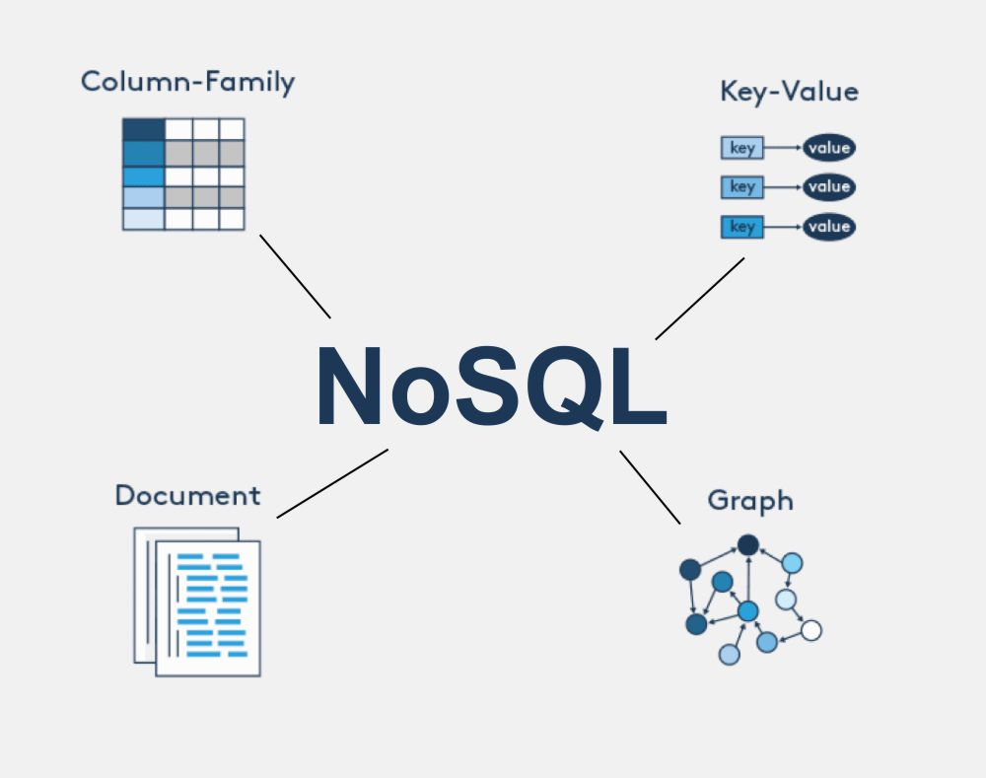

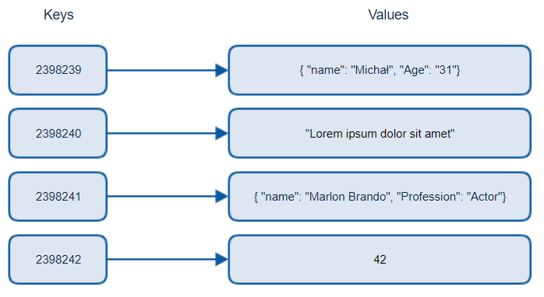
Your best quote that reflects your approach… “It’s one small step for man, one giant leap for mankind.”
What is SQL?
NoSQL DBMS: NoSQL databases are non-tabular databases and there store data differently than relational tables, there just refer to any No Relational Database Management System hence the name NoSQL.
Unstructured Data
Suitable for Documents, Graphs, Key value, column family etc
examples of NoSQL databases
MongoDB
Apache CouchDB
Oracle NoSQL Database.
Riak

Slide 6
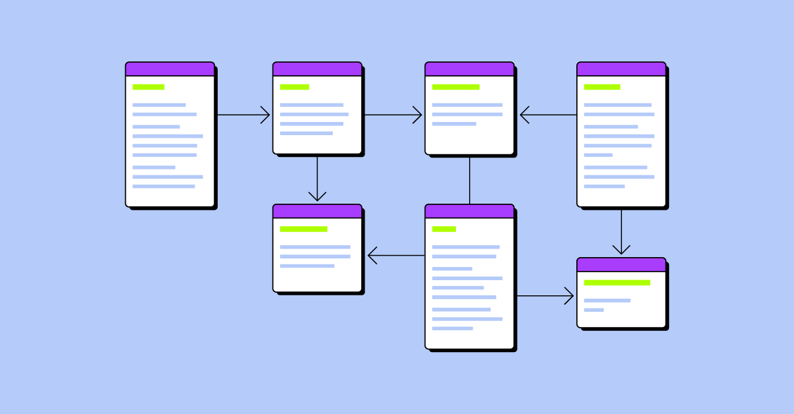
Your best quote that reflects your approach… “It’s one small step for man, one giant leap for mankind.”
KEY CONCEPTS – DATABASE & TABLES
A database is a structured collection of related data. It acts as a central repository for storing and managing information. Think of it as a virtual container that holds multiple tables, views, indexes, and other objects.
Within a database, we have tables. Tables are used to organize and store data in a structured manner. They consist of rows, also known as records, and columns, also known as fields or attributes. Rows represent individual instances of data, while columns define the attributes or properties of the data.

Slide 7

Your best quote that reflects your approach… “It’s one small step for man, one giant leap for mankind.”
KEY CONCEPTS – DATABASE & TABLES
DATA: This is basically different types of information that are formatted in a particular manner, such as;
Names and addresses of people
Phone numbers and email addresses
Financial data, such as transactions and account balances
Weather data, such as temperature and precipitation
Stock prices and market indices
Social media posts and user activity
Health data, such as medical records and test results
Sales data, such as customer orders and product information
Web traffic data, such as page views and clicks
Sports statistics, such as scores and player performance.

Slide 8
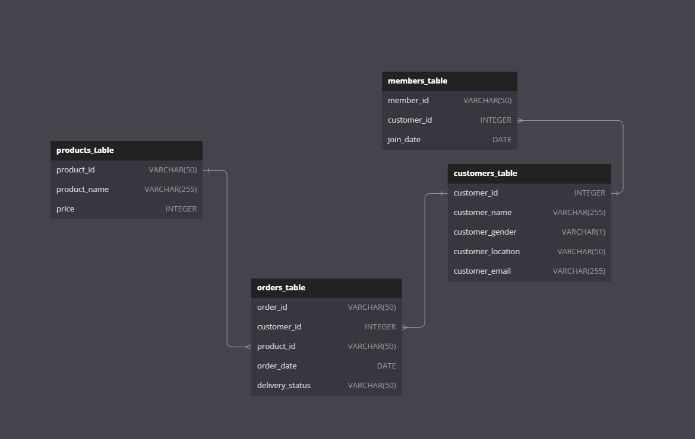
Your best quote that reflects your approach… “It’s one small step for man, one giant leap for mankind.”
KEY CONCEPTS – DATABASE & TABLES
ERD:ER Diagram stands for Entity Relationship Diagram.
ERD is a diagram that displays the relationship of entity sets stored in a database.
ER diagrams help to explain the logical structure of databases.
ER diagrams are created based on three basic concepts:
Entities
Attributes
relationships.

Slide 9
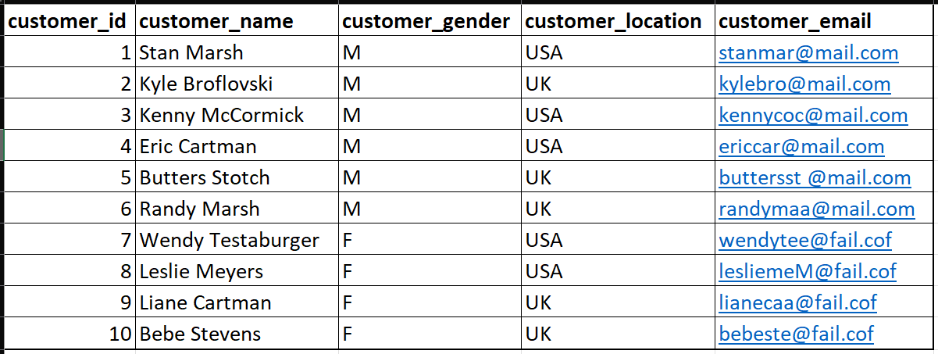
Your best quote that reflects your approach… “It’s one small step for man, one giant leap for mankind.”
KEY CONCEPTS – DATABASE & TABLES
Let's consider an example to better understand tables. Imagine a table called "Customers." Each row in this table represents a customer, and each column represents a specific attribute of that customer, such as their name, gender, location etc..
Databases provide a structured way to organize and manage data, while tables allow us to represent and store data in a tabular format. Understanding these concepts is crucial as we explore SQL operations and queries further.

Slide 10
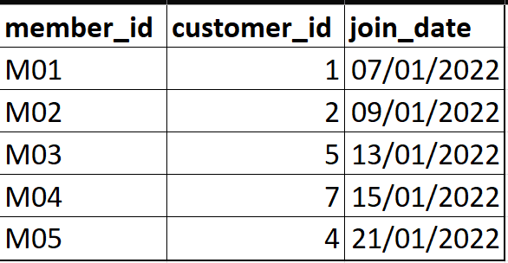
Your best quote that reflects your approach… “It’s one small step for man, one giant leap for mankind.”
KEY CONCEPTS – DATA TYPES
In SQL, data types play a vital role in defining the nature and characteristics of data stored in a database. Let's explore the concept of data types and their significance.
Data types in SQL define the type and format of the data that can be stored in a column of a table, if a column is of a “Numeric” data type then only numerical values can be stored in that particular column, or if a column is of the “String” data type the only text values or characters can be stored in that column as well. Let's consider the table called “members“, In this table, we have columns with different data types. For example, the “customer_id" column is of integer data type, while the “member_id" column is of the string data type and the “join_date” is of the date data type.
Each column has a specific data type, ensuring that the data is stored and retrieved correctly. Choosing the appropriate data type is essential to ensure efficient storage, accurate calculations, and data consistency. It also helps enforce data validation and integrity constraints.

Slide 11
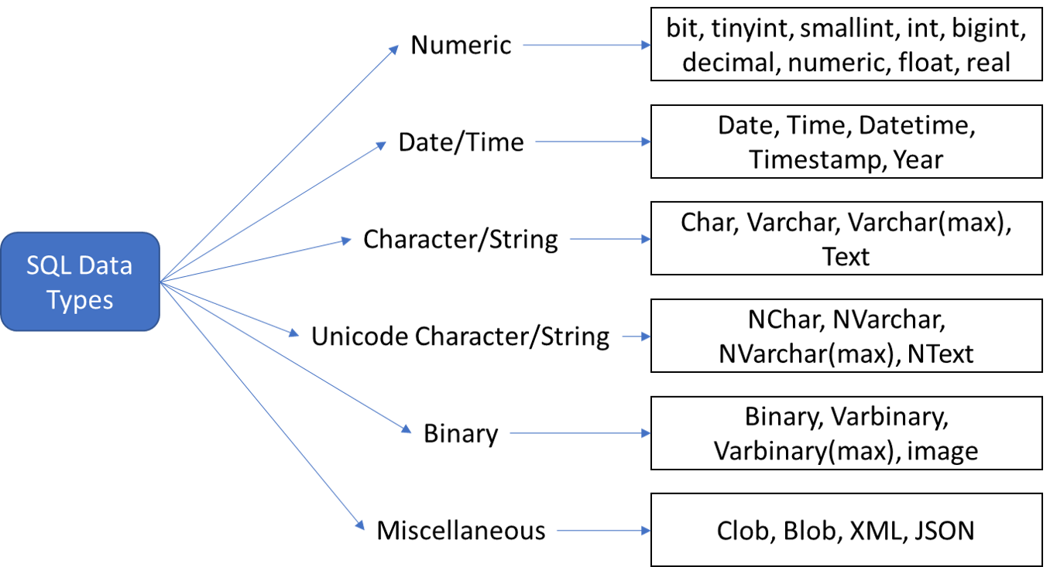
Your best quote that reflects your approach… “It’s one small step for man, one giant leap for mankind.”
KEY CONCEPTS – DATA TYPES
SQL offers a wide range of data types to accommodate different types of information;
Numeric: Used for all kinds of numbers, including whole numbers and decimal numbers. Examples include:
INT: Used for storing integers.
FLOAT/REAL: Used for storing floating-point numbers.
DECIMAL/NUMERIC: Used for storing fixed-point numbers with a specified precision and scale.
Date/Time: Used for representing dates and times. Examples include:
DATE: Used for storing dates in the format 'YYYY-MM-DD'.
TIME: Used for storing time values in the format 'HH:MM:SS'.
TIMESTAMP/DATETIME: Used for storing both date and time values.
Character/String: Used for storing textual data. Examples include:
CHAR: Used for fixed-length strings.
VARCHAR: Used for variable-length strings.
TEXT: Used for storing large amounts of text data.
Boolean: Used for storing true/false values. Examples include:
BOOLEAN: Used for storing true/false or 1/0 values.
Binary: Used for storing binary data, such as images or files. Examples include:
BLOB: Used for storing large binary objects(for images)
VARBINARY: Used for variable-length binary data(for files).
Miscellaneous: There are additional data types that are specific to certain databases or have specialized purposes. Examples include:
ENUM: Used for defining a list of possible values(for specified set of values; “male” & “female”)
JSON: Used for storing JSON (JavaScript Object Notation) data.
UUID: Used for storing universally unique identifiers(similar to primary keys but advanced).

Slide 12
Your best quote that reflects your approach… “It’s one small step for man, one giant leap for mankind.”
KEY CONCEPTS – SQL Statements
Data Definition Language (DDL)
Data Definition Language (DDL) is a subset of SQL statements used to define and manage the structure of database objects. Let's explore the key DDL statements and their significance.
DDL statements are responsible for creating, altering, and dropping database objects such as tables, views, indexes, and constraints. They allow us to define the structure and organization of our database.
Let's dive into some essential DDL statements:
CREATE: The CREATE statement is used to create a new database object.
Code example:
CREATE TABLE Employees (
ID INT,
Name VARCHAR(50),
Salary DECIMAL(10,2)
);

Slide 13
Your best quote that reflects your approach… “It’s one small step for man, one giant leap for mankind.”
KEY CONCEPTS – SQL Statements
Data Definition Language (DDL)
ALTER: The ALTER statement is used to modify the structure of an existing database object.
Code example:
ALTER TABLE Employees
ADD COLUMN Age INT
ADD COLUMN DOB DATE;
DROP: The DROP statement is used to remove a database object.
Code example:
DROP TABLE Employees;
It's important to note that DDL statements are auto-committed, meaning the changes take effect immediately and cannot be rolled back.
DDL statements play a crucial role in defining the structure and organization of our database. They allow us to create, modify, and remove database objects, ensuring the database reflects our desired structure.
Understanding DDL statements is essential as we move forward in our SQL journey and work with creating and managing database objects.

Slide 14
Your best quote that reflects your approach… “It’s one small step for man, one giant leap for mankind.”
KEY CONCEPTS – SQL Statements
Data Manipulation Language (DML)
Data Manipulation Language (DML) consists of SQL statements used to retrieve, insert, update, and delete data within database objects. Let's explore the key DML statements and their significance.
DML statements are responsible for interacting with the data stored in database objects. They allow us to query the data, insert new records, update existing records, and delete unwanted records.
Let’s dive into some essential DML statements:
SELECT: The SELECT statement is used to retrieve data from one or more tables based on specified criteria.
Code example:
SELECT *
FROM Employees
WHERE Salary > 50000;
INSERT: The INSERT statement is used to add new records into a table.
Code example:
INSERT INTO Employees (Name, Age, Salary)
VALUES ('John Doe', 30, 60000);

Slide 15
Your best quote that reflects your approach… “It’s one small step for man, one giant leap for mankind.”
KEY CONCEPTS – SQL Statements
Data Manipulation Language (DML)
UPDATE: The UPDATE statement is used to modify existing data in a table.
Code example:
UPDATE Employees
SET Salary = Salary * 1.1
WHERE Department = 'Sales’;
DELETE: The DELETE statement is used to remove unwanted records from a table.
Code example:
DELETE FROM Employees
WHERE Age > 60;
DML statements allow us to manipulate and interact with the data stored in our database objects, enabling us to retrieve, insert, update, and delete data as needed.
DML statements are essential for data manipulation within the database. They provide the means to retrieve specific data, insert new records, update existing records, and delete unwanted records, giving us control over the data stored in our database.
Understanding DML statements is crucial as we navigate through SQL and perform various data manipulation tasks.

Slide 16
Your best quote that reflects your approach… “It’s one small step for man, one giant leap for mankind.”
KEY CONCEPTS – SQL Statements
Data Query Language (DQL)
Data Query Language (DQL) consists of SQL statements used specifically for querying and retrieving data from the database. Let's explore the key DQL statements and their significance.
DQL statements focus on retrieving and manipulating data to extract useful information from the database. They allow us to retrieve specific records, filter data based on conditions, sort results, and perform aggregate functions.
Let’s dive into some essential DQL statements:
SELECT: The SELECT statement is the core DQL statement used to retrieve data from one or more tables based on specified criteria.
Code example:
SELECT *
FROM Customers
WHERE Age > 30;
WHERE: The WHERE clause is used to specify conditions that the retrieved data must meet.
Code example:
SELECT *
FROM Orders
WHERE TotalAmount > 1000;

Slide 17
Your best quote that reflects your approach… “It’s one small step for man, one giant leap for mankind.”
KEY CONCEPTS – SQL Statements
Data Query Language (DQL)
ORDER BY: The ORDER BY clause is used to sort the retrieved data in ascending or descending order based on specified columns.
Code example:
SELECT *
FROM Products
ORDER BY Price DESC;
GROUP BY: The GROUP BY clause is used to group the retrieved data based on one or more columns. It is often used with aggregate functions like SUM, AVG, COUNT, MIN, MAX etc.
Code example:
SELECT Category, SUM(Revenue)
FROM Sales
GROUP BY Category;
DQL statements allow us to retrieve specific data from the database, apply filters, perform sorting, and aggregate functions to derive meaningful insights, there’re crucial for querying and retrieving data from the database. They enable us to extract specific information, apply filters, sort data, and perform calculations using aggregate functions.
Understanding DQL statements empowers us to retrieve the exact data we need and gain valuable insights from our database.

Slide 18
Your best quote that reflects your approach… “It’s one small step for man, one giant leap for mankind.”
KEY CONCEPTS – SQL Statements
Data Control Language (DCL)
Data Control Language (DCL) consists of SQL statements used to control access, permissions, and security within a database. Let's explore the key DCL statements and their significance.
DCL statements are responsible for managing user access, granting permissions, and ensuring data security within the database. They allow us to control who can perform specific operations and maintain the integrity of our data.
Let’s dive into some essential DCL statements:
GRANT: The GRANT statement is used to grant specific privileges or permissions to users or roles.
Code example:
GRANT SELECT,
INSERT
ON Employees
TO User1;

Slide 19
Your best quote that reflects your approach… “It’s one small step for man, one giant leap for mankind.”
KEY CONCEPTS – SQL Statements
Data Control Language (DCL)
REVOKE: The REVOKE statement is used to revoke previously granted privileges or permissions from users or roles.
Code example:
REVOKE UPDATE,
DELETE
ON Customers
FROM User2;
DCL statements provide control over who can access and manipulate the data, ensuring the security and integrity of our database.
DCL statements play a vital role in controlling access, managing permissions, and ensuring data security within the database. They allow us to grant or revoke specific privileges, providing fine-grained control over user actions.
Understanding DCL statements is crucial to maintaining data integrity, managing user access, and ensuring the security of our database.

Slide 20
Your best quote that reflects your approach… “It’s one small step for man, one giant leap for mankind.”
KEY CONCEPTS – Order of Operations
Order of Operation is just the sequence any SQL query follows during execution.
FROM/ JOIN: This operation specifies the tables from which data is being retrieved.
WHERE: This operation filters the data based on a specified condition.
GROUP BY: This operation groups the data based on a specified column.
HAVING: This operation filters the grouped data based on a specified condition.
SELECT: This operation selects the columns that will be displayed in the query result.
DISTINCT: This operation removes duplicate rows from the query result.
ORDER BY: This operation sorts the query result based on a specified column or columns.
LIMIT: This operation limits the number of rows returned by the query.

Slide 21
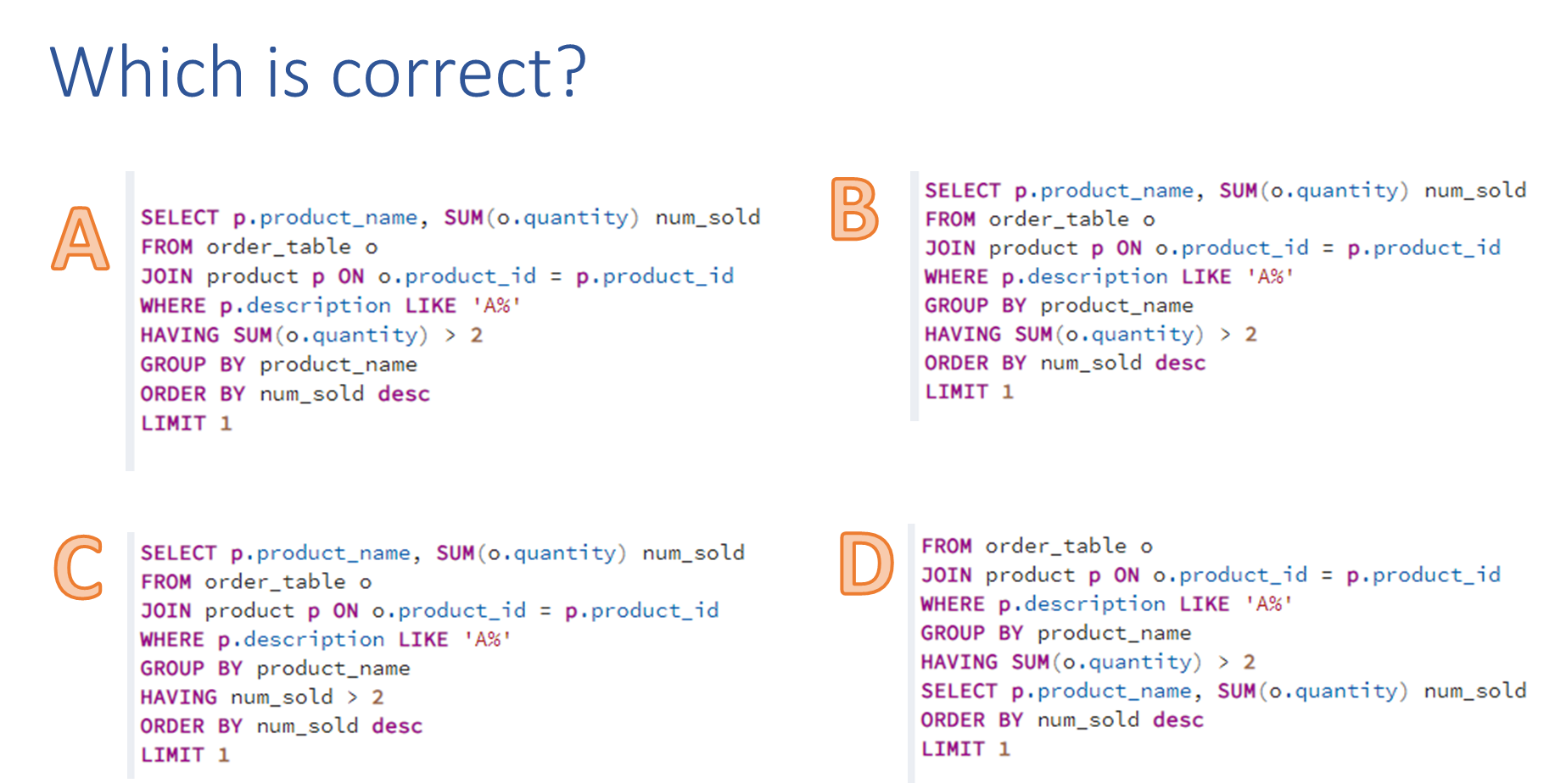
Your best quote that reflects your approach… “It’s one small step for man, one giant leap for mankind.”
KEY CONCEPTS – Order of Operations
QUIZ

Slide 22
Your best quote that reflects your approach… “It’s one small step for man, one giant leap for mankind.”
DATA MANIPULATION – INNER JOINS
JOINS:
Joins are used to combine rows from multiple tables based on a related column between them. Here are different types of joins:
INNER JOIN: Returns only the matching rows between the tables.
Question: Show the names of the customers and their order details
SELECT orders_table.*,
customers_table.customer_name
FROM orders_table
INNER JOIN customers_table ON orders_table.customer_id = customers_table.customer_id;

Slide 23
Your best quote that reflects your approach… “It’s one small step for man, one giant leap for mankind.”
DATA MANIPULATION – LEFT & RIGHT JOINS
LEFT JOIN returns all rows from the left table and the matching rows from the right table WHILE
RIGHT JOINS returns all rows from the right table and the matching rows from the left table.
Question: Show all our customer names & the dates when they became a member for those who are members.
LEFT JOIN
SELECT customers_table.customer_name,
members_table.join_date
FROM customers_table
LEFT JOIN members_table ON customers_table.customer_id = members_table.customer_id;
RIGHT JOIN
SELECT customers_table.customer_name,
members_table.join_date
FROM customers_table
LEFT JOIN members_table ON customers_table.customer_id = members_table.customer_id;

Slide 24
Your best quote that reflects your approach… “It’s one small step for man, one giant leap for mankind.”
DATA MANIPULATION – FULL JOINS / FULL OUTER JOINS
FULL JOIN or FULL OUTER JOIN Returns all rows from both tables, matching rows, and non-matching rows.
Question: Display the full details of all customers plus the dates for any customer that is a member
SELECT customers_table.*,
members_table.join_date
FROM members_table
FULL OUTER JOIN customers_table ON customers_table.customer_id = members_table.customer_id;

Slide 25
Your best quote that reflects your approach… “It’s one small step for man, one giant leap for mankind.”
DATA MANIPULATION – CROSS JOINS
CROSS JOIN returns the Cartesian product of the two tables, resulting in all possible combinations of rows.
Question: Combine every customer name with every product
SELECT c.customer_name, p.product_name
FROM customers_table c
CROSS JOIN products_table p;

Slide 26
Your best quote that reflects your approach… “It’s one small step for man, one giant leap for mankind.”
DATA MANIPULATION – LENGTH, UPPER, LOWER
These are string manipulation functions, they’re used to modify strings or texts.
LENGTH: Returns the length of a string.
UPPER: Converts a string to uppercase.
LOWER: Converts a string to lowercase.
Question: Show the customer names and the length of their name & their names in upper and lower case as well.
SELECT customer_name, LENGTH(customer_name) name_length,
UPPER(customer_name) upper_name,
LOWER(customer_name) lower_name
FROM customers_table;

Slide 27
Your best quote that reflects your approach… “It’s one small step for man, one giant leap for mankind.”
DATA MANIPULATION – REPLACE
REPLACE: Replaces occurrences of a substring within a string.
Question: Replace the “mail” in customer emails with any other email service and then show both the old and newly modified email..
SELECT customer_email,
REPLACE(customer_email, ‘mail', ‘gmail') modified_email
FROM customers_table;

Slide 28
Your best quote that reflects your approach… “It’s one small step for man, one giant leap for mankind.”
DATA MANIPULATION – TRIM FUNCTIONS
TRIM FUNCTIONS: There’re used to remove unwanted or extra leading and trailing spaces(white space) from a string / text.
TRIM: Removes leading and trailing spaces from a string.
LTRIM: Removes leading spaces from a string.
RTRIM: Removes trailing spaces from a string.
Question: Remove both leading & trailing spaces, remove only leading spaces & remove only trailing spaces from this string:::: ‘’ TRIM ‘’
SELECT TRIM(' TRIM ') trimmed_string,
LTRIM(' TRIM ') ltrimmed_string,
RTRIM(' TRIM ') rtrimmed_string;

Slide 29
Your best quote that reflects your approach… “It’s one small step for man, one giant leap for mankind.”
DATA MANIPULATION – CONCATENATION
CONCATENATION: Combines two or more strings into one.
Question: Join the names of our customers and their location together as one.
SELECT CONCAT(customer_name, ' - ', customer_location) customer_name_location
FROM customers_table;
OR
SELECT customer_name || ' - ‘ || customer_location AS customer_name_location
FROM customers_table;

Slide 30
Your best quote that reflects your approach… “It’s one small step for man, one giant leap for mankind.”
DATA MANIPULATION – SUBSTRING
SUBSTRING: The substring function extracts a portion of letters / characters from a string based on a starting position and length.
Question: Create customer initials using the first 3 letters of their names, then display it along side their full names.
SELECT customer_name,
SUBSTRING(customer_name, 1, 3) initials
FROM customers_table;

Slide 31
Your best quote that reflects your approach… “It’s one small step for man, one giant leap for mankind.”
DATA MANIPULATION – WHERE & BETWEEN
WHERE: This function is used to filter our data based on the specified condition.
Question: Show all our customers from the “UK” Question: Show our products with price over “150,000”
BETWEEN: This function is used to group items in a column into distinct values, they’re best used with aggregate functions.
Question: Show all orders that fall between “2022-01-07” – “2022-01-20”.
SELECT customer_name,
customer_location
FROM customers_table
WHERE customer_location = 'UK'
SELECT product_name,
price
FROM products_table
WHERE price > 150000
SELECT order_id,
order_date
FROM orders_table
WHERE order_date BETWEEN '2022-01-07' AND '2022-01-20';

Slide 32
Your best quote that reflects your approach… “It’s one small step for man, one giant leap for mankind.”
DATA MANIPULATION – GROUP BY, ORDER BY & LIMIT
GROUP BY: This function is used to group items in a column into distinct values, they’re best used with aggregate functions.
Question: Show the different kind of gender groups our customers fall into.
ORDER BY: This is used to order the content or data in a column in ascending(ASC) or descending(DESC) order and it works with both texts and numbers.
Question: Display our products from most expensive to the least expensive.
LIMIT: This is used to limit our result to the specified number / condition.
Question: Show our last 3 orders and the names of the customer that placed the orders.
SELECT customer_gender
FROM customers_table
GROUP BY customer_gender
SELECT product_name,
price
FROM products_table
ORDER BY price ASC;
SELECT customer_name,
o.*
FROM orders_table o
JOIN customers_table c ON o.customer_id = c.customer_id
ORDER BY order_date DESC
LIMIT 3;

Slide 33
Your best quote that reflects your approach… “It’s one small step for man, one giant leap for mankind.”
DATA MANIPULATION – AGGREGATE FUNCTIONS
COUNT
AGGREGATE FUNCTIONS:
Aggregate functions perform calculations on a set of values and return a single value
COUNT returns the number / count of rows in the column or filter conditions.
Question: Show the number of customers we have in each location.
SELECT customer_location,
COUNT(*) total_customers
FROM customers_table
GROUP BY customer_location;

Slide 34
Your best quote that reflects your approach… “It’s one small step for man, one giant leap for mankind.”
DATA MANIPULATION – AGGREGATE FUNCTIONS
SUM
SUM returns the summation or total of values in the column or filter conditions.
Question: How much has each customer spent in our store.
SELECT c.customer_name,
SUM(p.price) total_price
FROM customers_table c
JOIN orders_table o ON c.customer_id = o.customer_id
JOIN products_table p ON o.product_id = p.product_id
GROUP BY customer_name;

Slide 35
Your best quote that reflects your approach… “It’s one small step for man, one giant leap for mankind.”
DATA MANIPULATION – AGGREGATE FUNCTIONS
AVG
AVG returns the average of the numbers in a column or filter conditions.
Questions: How much has Male & Female spend on average.
SELECT c.customer_gender,
AVG(p.price) total_price
FROM customers_table c
JOIN orders_table o ON c.customer_id = o.customer_id
JOIN products_table p ON o.product_id = p.product_id
GROUP BY customer_gender;

Slide 36
Your best quote that reflects your approach… “It’s one small step for man, one giant leap for mankind.”
DATA MANIPULATION – AGGREGATE FUNCTIONS
MIN
MIN returns the minimum number in the column or filter conditions.
Question: Which product has the lowest price.
SELECT product_name,
MIN(price) min_price
FROM products_table;

Slide 37
Your best quote that reflects your approach… “It’s one small step for man, one giant leap for mankind.”
DATA MANIPULATION – AGGREGATE FUNCTIONS
MAX
MAX returns the maximum number in the column or filter conditions.
Question: Which product has the highest price.
SELECT product_name,
MAX(price) max_price
FROM products_table;

Slide 38
Your best quote that reflects your approach… “It’s one small step for man, one giant leap for mankind.”
DATA MANIPULATION – HAVING
HAVING: The HAVING clause is used in queries to filter the result set based on conditions applied to aggregated values (e.g., using aggregate functions like SUM, COUNT, etc.) instead of the WHERE clause.
Question: Show the our customers that have spent over “500,000” at our store.
SELECT o.customer_id,
SUM(p.price) total_amount
FROM orders_table o
JOIN products_table p ON o.product_id = p.product_id
GROUP BY o.customer_id
HAVING SUM(p.price) > 500000;

Slide 39
Your best quote that reflects your approach… “It’s one small step for man, one giant leap for mankind.”
DATA MANIPULATION – CASE
CASE: The CASE expression allows us to perform conditional logic within our query. It evaluates this conditions and returns a result based on the condition that matches.
Question: classify our products into 3 groups;
Below “100,000” are “Low Priced Products”
Between “100,000 – 180,000” are “Average Priced Products”
Above “180,000” are “Expensive Products”
SELECT product_name,
price,
CASE
WHEN price < 100000 THEN 'Low Priced Products'
WHEN price >= 100000 AND price < 180000 THEN 'Average Priced Products'
ELSE 'Expensive Products’
END AS price_category
FROM products_table;

Slide 40
Your best quote that reflects your approach… “It’s one small step for man, one giant leap for mankind.”
DATA MANIPULATION – LIST AGGREGATION
LIST AGGREGATION: List aggregation combines multiple values into a single string, this can be used to get the list of values under a certain group or criteria
Question: Display the names of customers that fall under each location our store is located.
SELECT customer_location,
STRING_AGG(customer_name, ', ') customers
FROM customers_table
GROUP BY customer_location;

Slide 41
Your best quote that reflects your approach… “It’s one small step for man, one giant leap for mankind.”
DATA MANIPULATION – CEIL & FLOOR, ROUND & POWER
CEIL: Returns the smallest integer greater than or equal to a specified number.
FLOOR: Returns the largest integer less than or equal to a specified number.
ROUND: Rounds a number to a specified number of decimal places.
POWER: Raises a number to a specified power.
Question: Use this functions on the following numbers respectively; 9.2, 9.8, 9.25232, 2
SELECT CEIL(9.2),
FLOOR(9.8),
ROUND(9.25232, 2),
POWER(2, 4),
2^4 AS another_power;

Slide 42
Your best quote that reflects your approach… “It’s one small step for man, one giant leap for mankind.”
DATA MANIPULATION – DATE & TIME FUNCTIONS
There are various date and time functions available in SQL and they’re;
CURRENT_DATE: This is used to access, display / return the current date.
CURRENT_TIME: This is used to access, display / return the current timestamp.
CURRENT_TIMESTAMP: This is used to access, display / return the current timestamp(date & time).
Question: Show the current date, time & timestamp.
SELECT CURRENT_DATE,
CURRENT_TIME,
CURRENT_TIMESTAMP;

Slide 43
Your best quote that reflects your approach… “It’s one small step for man, one giant leap for mankind.”
DATA MANIPULATION – DATE & TIME FUNCTIONS
DATE_PART: This is used to slice / extract a specific part or component (e.g., year, month, day) of the selected date
DATE_TRUNC: This is used to truncate a date or timestamp to a specified precision (e.g., year, month, day).
EXTRACT: This is used to slice / extracts a specific component (e.g., year, month, day) from a date or timestamp
Question: Display the names of our members, their join date, the month, year and day they joined and the truncated year, month & day they joined.
SELECT c.customer_name,
m.join_date,
DATE_PART('year', m.join_date) part_join_year,
DATE_PART('month', m.join_date) part_join_month,
DATE_PART('day', m.join_date) part_join_day,
DATE_TRUNC('year', m.join_date) truncated_join_year,
DATE_TRUNC('month', m.join_date) truncated_join_month,
DATE_TRUNC('day', m.join_date) truncated_join_day,
EXTRACT(YEAR FROM m.join_date) extracted_join_year,
EXTRACT(MONTH FROM m.join_date) extracted_join_month,
EXTRACT(DAY FROM m.join_date) extracted_join_day
FROM members_table m
JOIN customers_table c ON m.customer_id = c.customer_id;

Slide 44
Your best quote that reflects your approach… “It’s one small step for man, one giant leap for mankind.”
DATA MANIPULATION – DATE & TIME FUNCTIONS
AGE: This is used to calculates the difference between two dates or timestamps.
AGE(end_date, start_date)
Question: Display how long it’s been since our members joined us.
SELECT member_name,
AGE(CURRENT_DATE, join_date) membership_duration
FROM members_table;

Slide 45
Your best quote that reflects your approach… “It’s one small step for man, one giant leap for mankind.”
DATA MANIPULATION – DATE & TIME FUNCTIONS
TO_CHAR: This is used to convert a date or timestamp to a formatted string.
TO_CHAR(date, ‘date_format’)
Question: Show the week number, weekday & month name of when our members joined.
SELECT c.customer_name,
m.join_date,
TO_CHAR(m.join_date, ‘WEEK’) week_number,
TO_CHAR(m.join_date, ‘MONTH’) month_name,
TO_CHAR(m.join_date, ‘DAY’) weekday_name
FROM members_table m
JOIN customers_table c ON m.customer_id = c.customer_id;

Slide 46
Your best quote that reflects your approach… “It’s one small step for man, one giant leap for mankind.”
DATA MANIPULATION – DATE & TIME FUNCTIONS
INTERVAL: This performs operations with intervals (durations of time).
Question: Add 1 day to the dates our customer joined our membership program.
SELECT c.customer_name,
m.join_date,
m.join_date + INTERVAL '1 day' AS corrected_join_date
FROM members_table m
JOIN customers_table c ON m.customer_id = c.customer_id;

Slide 47
Your best quote that reflects your approach… “It’s one small step for man, one giant leap for mankind.”
DATA MANIPULATION – SUB-QUERY, CTE & TEMP TABLES
SUB-QUERY: A sub-query is a query nested within another query. It can be used to retrieve data for filtering, joining, or for performing calculations. It can be used in various parts of a SQL statement, such as the SELECT, FROM, WHERE, or HAVING clauses
Question: Find all orders that were above the average product price in our store.
SELECT o.order_id,
p.product_name,
p.price
FROM orders_table o
JOIN products_table p ON o.product_id = p.product_id
WHERE p.price >= (
SELECT AVG(price)
FROM products_table
);

Slide 48
Your best quote that reflects your approach… “It’s one small step for man, one giant leap for mankind.”
DATA MANIPULATION – SUB-QUERY, CTE & TEMP TABLES
CTE (Common Table Expression): CTEs are just named temporary result set that can be referenced within a query. It improves code readability and reusability.
Question: How many orders do we get on average for each day of the week
WITH cte AS(
SELECT order_date,
COUNT(*) total_orders
FROM orders_table
GROUP BY order_date
)
SELECT TO_CHAR(order_date, 'Day') day_of_week,
ROUND(AVG(total_orders), 1) average_orders
FROM cte
GROUP BY day_of_week;

Slide 49
Your best quote that reflects your approach… “It’s one small step for man, one giant leap for mankind.”
DATA MANIPULATION – SUB-QUERY, CTE & TEMP TABLES
TEMP TABLES: These are temporary tables that are created and used within a session or transaction. They are useful for storing intermediate results or complex calculations.
Question: Create a temp table to hold of USA customers details
CREATE TEMPORARY TABLE us_customers AS(
SELECT *
FROM customers_table
WHERE customer_location = 'USA'
)
SELECT *
FROM us_customers

Slide 50
Your best quote that reflects your approach… “It’s one small step for man, one giant leap for mankind.”
DATA MANIPULATION – VIEWS, INDEX
VIEWS: A view is a virtual table derived from one or more tables or views. It provides a way to simplify complex queries or restrict access to data by presenting a customized or filtered view of the underlying tables.
Question: Create a view with the names of customers in our membership program.
CREATE VIEW member_details AS(
SELECT c.customer_name, m.join_date
FROM customers_table c
JOIN members_table m ON c.customer_id =m.customer_id);
SELECT *
FROM member_details;

Slide 51
Your best quote that reflects your approach… “It’s one small step for man, one giant leap for mankind.”
DATA MANIPULATION – VIEWS, INDEX
INDEX: An index is a data structure that improves the speed of data retrieval operations on database tables. It allows for faster searching and sorting of data.
Question: Create an Index with the customer name column & take note of query speed
CREATE INDEX customer_name_index
ON customers_table(customer_name);
SELECT customer_name, customer_location
FROM customers_table
WHERE customer_name = 'Eric Cartman';

Slide 52
Your best quote that reflects your approach… “It’s one small step for man, one giant leap for mankind.”
DATA MANIPULATION – PATTERN MATCHING BASICS
PATTERN MATCHING BASICS: Pattern matching is performed using the LIKE or ILIKE operator with wildcard characters;
% used for matching any number of characters
_ used for matching specified number of characters.
Question: Show customer that;
Have “E” & “e” in their names
Have “N” as the 3rd letter of their name.
Their names end with “ki”.
Their names begin with “B”
“HP” products.
SELECT customer_name
FROM customers_table
WHERE customer_name LIKE '%E%';
SELECT customer_name
FROM customers_table
WHERE customer_name ILIKE ‘__N%';
SELECT customer_name
FROM customers_table
WHERE customer_name LIKE '%ki';
SELECT customer_name
FROM customers_table
WHERE customer_name LIKE 'B%';
SELECT product_name
FROM products_table
WHERE product_name ILIKE 'HP%';

Slide 53
Your best quote that reflects your approach… “It’s one small step for man, one giant leap for mankind.”
DATA MANIPULATION – ADVANCED PATTERN MATCHING (REGULAR EXPRESSIONS)
ADVANCED PATTERN MATCHING (REGULAR EXPRESSIONS): Advanced pattern matching can be achieved using regular expressions with the REGEXP operators. A regular expression is a sequence of characters that forms a search pattern. It is a powerful tool used for pattern matching and manipulating strings. Regular expressions consist of a combination of characters and special metacharacters that define a pattern to be matched against a string. Here are some common metacharacters or operators used in regular expressions:
. Matches any single character.
* Matches zero or more occurrences of the preceding element.
+ Matches one or more occurrences of the preceding element.
? Matches zero or one occurrence of the preceding element.
[ ] Defines a character class, matching any character within the brackets.
^ Matches the start of a string.
$ Matches the end of a string.
| Acts as an OR operator, allowing multiple patterns to be matched.
\ Escapes a special character or indicates a special sequence.
Question: Find the customer with the wrong email address.
SELECT *
FROM customers_table
WHERE customer_email ~ '^[a-zA-Z0-9._-]+@[a-zA-Z0-9.-]+\.[a-zA-Z]{3}$'
SELECT *
FROM customers_table
WHERE customer_email ~ '^[\w._-]+@[\w\d]+\.[\w]{3}$';

Slide 54
Your best quote that reflects your approach… “It’s one small step for man, one giant leap for mankind.”
DATA MANIPULATION – WINDOW FUNCTIONS
(ROW_NUMBER, RANK, DENSE_RANK)
WINDOW FUNCTIONS: Window functions perform calculations across a set of rows and return a result for each row.
ROW_NUMBER: This window function assigns a unique sequential number to each row within the specified window frame. The numbering starts from 1 and increments by 1 for each subsequent row. If there are ties in the ordering, each tied row will receive a distinct row number
RANK: This window function assigns a rank to each row within the specified window frame based on the ordering. Rows with the same values in the ordering columns receive the same rank, and the next rank is skipped for tied rows.
DENSE_RANK: This window function assigns a dense rank to each row within the specified window frame based on the ordering. Rows with the same values in the ordering columns receive the same dense rank, and there are no gaps between ranks. Unlike RANK(), the dense ranks do not skip values for tied rows.
Question: Find and our customer orders according to when the orders were placed.
SELECT order_id,
customer_id,
order_date,
ROW_NUMBER() OVER (PARTITION BY customer_id ORDER BY order_date) AS row_rank,
RANK() OVER (PARTITION BY customer_id ORDER BY order_date) AS normal_rank,
DENSE_RANK() OVER (PARTITION BY customer_id ORDER BY order_date) AS dense_rank
FROM orders_table;

Slide 55
Your best quote that reflects your approach… “It’s one small step for man, one giant leap for mankind.”
DATA MANIPULATION – WINDOW FUNCTIONS
(LAG, LEAD)
LAG: The LAG() function allows you to access the value of a previous row within the specified window frame, but returns an empty cell when there is nothing.
LEAD: The LEAD() function allows you to access the value of a subsequent row within the specified window frame, but returns an empty cell when there is nothing.
Question: Show the current order date along side their last order date and next order date.
SELECT customer_id,
order_id,
order_date,
LAG(order_date) OVER (PARTITION BY customer_id ORDER BY order_date) AS previous_order_date,
LEAD(order_date) OVER (PARTITION BY customer_id ORDER BY order_date) AS next_order_date
FROM orders_table;

Slide 56
Your best quote that reflects your approach… “It’s one small step for man, one giant leap for mankind.”
DATA MANIPULATION – WINDOW FUNCTIONS
(NTILE)
NTILE: This divides a result set into specified number of groups and assigns a group number to each row.
Question: Break our sales into 4 quarters.
SELECT order_id,
order_date,
NTILE(4) OVER (ORDER BY order_date) sales_quarter
FROM orders_table;

Slide 57
Your best quote that reflects your approach… “It’s one small step for man, one giant leap for mankind.”
DATA MANIPULATION – WINDOW FUNCTIONS
(RUNNING TOTAL)
RUNNING TOTAL: Calculates a cumulative total of a value across a set of rows using SUM() function and windows function.
Question: What is the cumulative/running total for our customers and the products they bought.
SELECT o.customer_id,
p.product_name,
p.price,
SUM(p.price) OVER (PARTITION BY o.customer_id ORDER BY o.order_date) running_total
FROM orders_table o
JOIN products_table p ON o.product_id = p.product_id;

Slide 58
THANK YOU!

