Slide 1
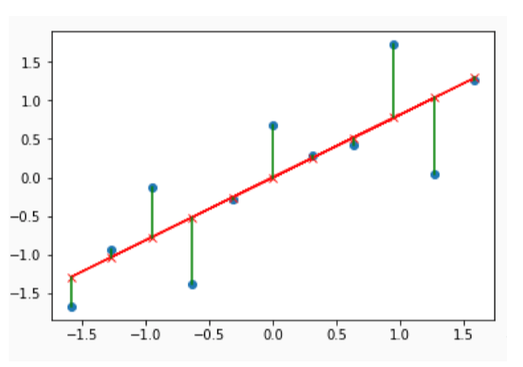
Errors / Residuals

