Slide 1
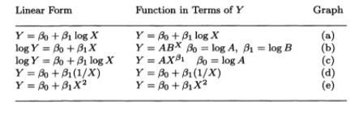
Some Transformations to try (Jobson, 1991)

Slide 2
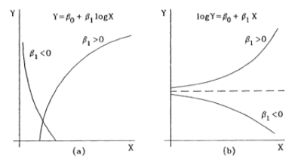
Transformations (a) and (b)

Slide 3
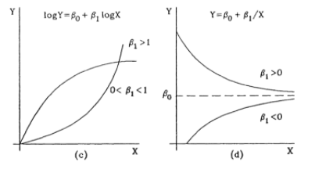
Transformations (c) and (d)

Slide 4
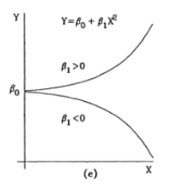
Transformation (e)

