Slide 1

DATA ANALYTICS PROJECT
SKYCONNECT
GROUP OF AIRLINES
Cleared for Takeoff: A Data-Driven Analysis
of Flight Performance, Revenue & Operations (2022–2024)
Prepared by: Data Analytics Trainees (Tech Studio Academy) — APRIL 2026 | Lagos, Nigeria

Slide 2




TOOLS USED & ROLES
MySQL
Power BI
Data Cleaning
Visualisation
Deduplication, joins,
transformations
KPI cards, charts,
slicers & dashboards
Word
PowerPoint
Documentation
Presentation
Report authoring
& analysis
Stakeholder summary
& slides
SkyConnect • Performance Dashboard 2022–2024

Slide 3
PROJECT OVERVIEW
1,000
1200
590M
Total Flights
Passengers
Total Revenue
136M
67%
2022–2024
Total Profit
On-Time Rate
Analysis Period
SkyConnect • Performance Dashboard 2022–2024

Slide 4
BUSINESS CONTEXT & KEY QUESTIONS
CONTEXT
KEY QUESTIONS
SkyConnect Group of Airlines operates a multi-route network across key African hubs . (Lagos, Nairobi, Cairo, Dakar, etc.)
While the airline generates strong revenue, the performance varies significantly across routes and time periods
We also identified that a high incidence of delays and cancellations is affecting operational reliability
Customer segments (Loyalty Status & Seat Class) are not evenly contributing to revenue
Management lacks a unified, data-driven view of performance across operations
1
What is driving operational inefficiencies and delay patterns across routes and airlines?
2
Which routes, customers, and seat classes generate the most value – and are they being optimized?
3
How can SkyConnect Group of Airlines improve performance while sustaining revenue growth and customer satisfaction?
SkyConnect • Performance Dashboard 2022–2024

Slide 5
2022–2024 PERFORMANCE OVERVIEW
$68M
2022 Revenue
Baseline year
$272M
2023 Revenue
+300% growth
$250M
2024 Revenue
−8% decline
23%
Profit Margin
Below 25-30% avg
SkyConnect • Performance Dashboard 2022–2024

Slide 6
TOP REVENUE ROUTES & AIRLINES
SkyConnect • Performance Dashboard 2022–2024

Slide 7
FLIGHT PERFORMANCE & DELAYS
241
124 min
33%
76.8%
Delayed Flights
Avg Delay
Delay Rate
Severe Delays
SkyConnect • Performance Dashboard 2022–2024

Slide 8
PASSENGER BEHAVIOUR INSIGHTS
1,200
44 yrs
56%
28%
15%
Total Bookings
Average Age
Middle-Aged
Older Adults
Young Adults
SkyConnect • Performance Dashboard 2022–2024

Slide 9
LOYALTY PROGRAMME EFFECTIVENESS
KEY FINDING
Regular passengers generate 3× more revenue than all other loyalty status combined
Gold and Silver status shows low revenue contribution
Platinum status underperforms despite premium positioning
Loyalty program lacks clear upgrade path making it difficult for customers to move from regular to loyal customers
SkyConnect • Performance Dashboard 2022–2024

Slide 10
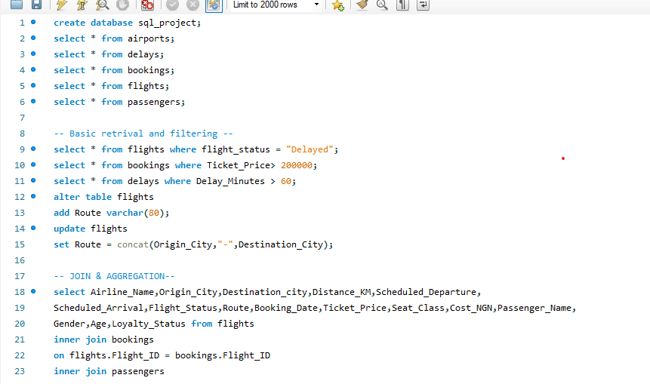
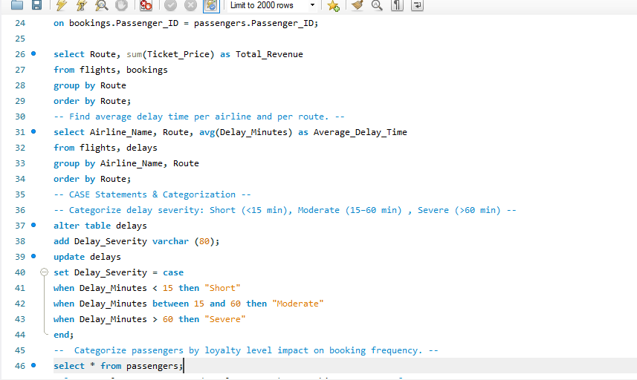
DATABASE SETUP (Screenshots of MySQL Workbench)
SkyConnect • Performance Dashboard 2022–2024

Slide 11
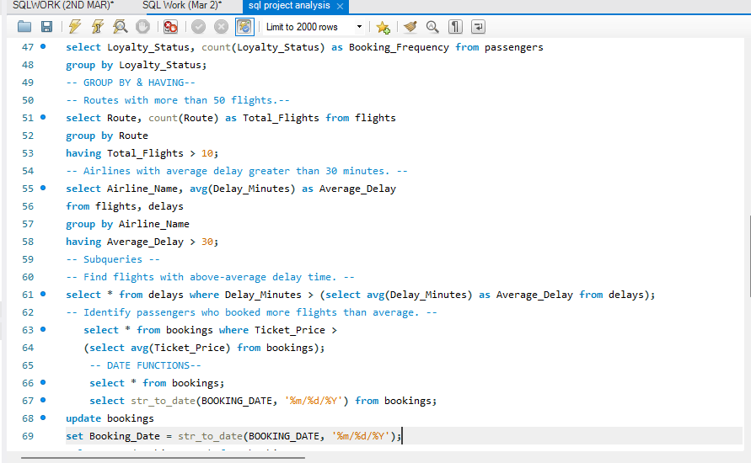
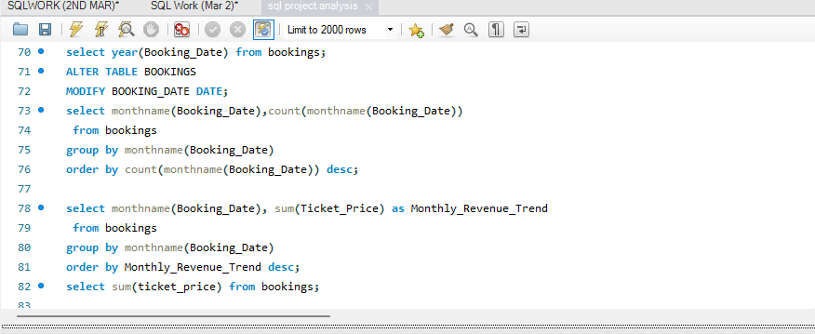
DATABASE SETUP (Screenshots of MySQL Workbench)
SkyConnect • Performance Dashboard 2022–2024

Slide 12
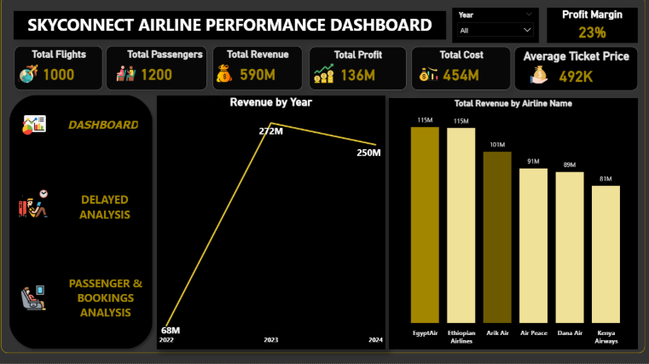
EXECUTIVE OVERVIEW DASHBOARD
SkyConnect • Performance Dashboard 2022–2024

Slide 13
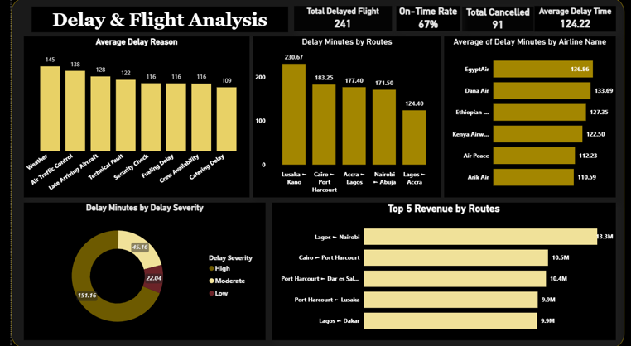
DELAY ANALYSIS DASHBOARD
SkyConnect • Performance Dashboard 2022–2024

Slide 14
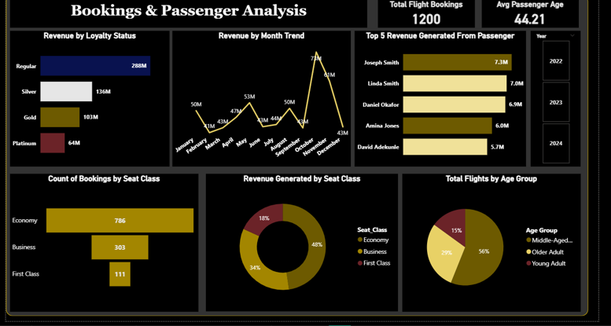
CUSTOMER BEHAVIOUR ANALYSIS DASHBOARD
SkyConnect • Performance Dashboard 2022–2024

Slide 15
SIX CRITICAL INSIGHTS
01
Revenue peaked in 2023, but growth is unstable
Revenue increased significantly into 2023, followed by a noticeable slowdown in 2024
02
Weather & Air Traffic Control are the primary delay drivers
These two factors account for the highest delay minutes
03
Delay Severity (High) dominate total delay distribution by 70%+
Most delays are not minor, they are operationally disruptive
04
High-traffic routes drive both revenue AND congestion
Routes like Cairo → Port Harcourt generate top revenue but also experience strain i.e. most profitable ≠ most efficient
05
Loyalty program is underperforming
Regular passengers contribute more volume than premium tiers
06
Young adults are underrepresented by 15% only
A key demographic is not being fully captured, resulting in a missed opportunity for long-term customer growth
SkyConnect • Performance Dashboard 2022–2024

Slide 16




STRATEGIC RECOMMENDATIONS
(Immediate Actions)
URGENT
Invest in Predictive Weather & Air Traffic Control Delay Management Systems
Use machine learning models to forecast storms or congestion hours ahead and reschedule flights or prepare backup crews early
HIGH
Strengthen Loyalty Upgrade Structure
Introduce clear rules ( e.g. 5 flights in 3 months = “Silver”) with benefits like priority boarding, lounge access or 10-15% to encourage repeat bookings
MEDIUM
Improve Flight Scheduling on Busy Routes
Spread out departures to reduce congestion and turnaround delays
LOW
Refine Pricing and Seat Allocation
Adjust seat mix and pricing based on demand ( e.g. add more economy seats on busy routes and discount unsold business class before departure)
SkyConnect • Performance Dashboard 2022–2024

Slide 17
STRATEGIC RECOMMENDATIONS
(Sustained Improvements)
URGENT
Invest in Fleet Modernization
Gradually replace older aircraft with more fuel-efficient and reliable models to reduce technical delays and long-term cost
HIGH
Develop Strategic Airport Partnerships
Collaborate with major airports to secure priority scheduling, reduced turnaround time and better ground handling support
MEDIUM
Build a Strong Customer Experience System
Implement a mobile platform that provides real-time flight updates , automated compensation for delays, and personalized offers based on travel history
LOW
Expand Data Infrastructure & Analytics Capacity
Establish a centralized data and analytics team to improve forecasting, pricing and long-term planning
SkyConnect • Performance Dashboard 2022–2024

Slide 18
SkyConnect • Performance Dashboard 2022–2024

Slide 19
CLEARED FOR TAKEOFF
SkyConnect's Data-Driven Future
"Data doesn't just describe what happened —
it tells us what must happen next."
Empowering leadership • Strengthening reliability • Sustainable African aviation growth
Data Analytics Trainees (Tech Studio Academy) — April 2026 | Lagos, Nigeria

