Slide 1
Employee Attrition Analysis
at TechCrush Corporation
IBM HR Analytics · 1,470 Employees
Presented by:
TechCrush Data Analytics Bootcamp
Cohort 6 · Group 24 · Capstone Project · 2026
Prepared for: Aisha Musa & Chinedu Okoli

Slide 2
What is this analysis about?
The Question We Asked:
1,470
Why are employees leaving TechCrush?
Total Employees
Which groups are most at risk?
237
What can the company actually do about it?
Employees Who Left
Our Dataset:
We used the IBM HR Analytics dataset which has 1,470 employee records with info on salary, job role, travel habits, satisfaction scores, and more.
16.1%
Attrition Rate

Slide 3
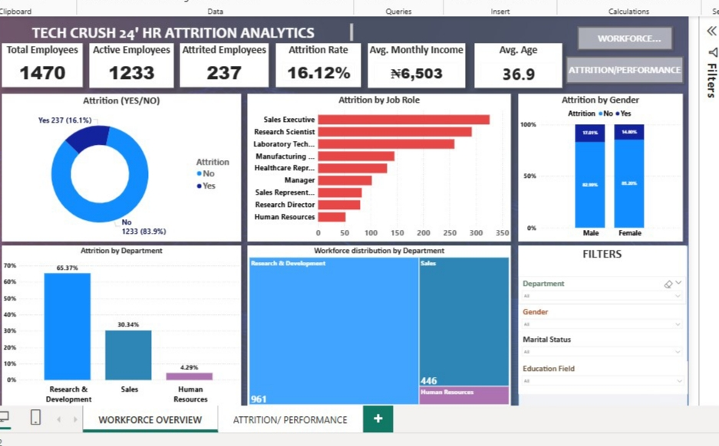
Dashboard Overview
Power BI Dashboard — Tech Crush Group 24 • IBM HR Attrition Analytics • 2026

Slide 4
Who is leaving the most?
Attrition rate by job role (sorted highest to lowest)
Sales Representative
39.8%
Laboratory Technician
23.9%
Human Resources
23.1%
Sales Executive
17.5%
Research Scientist
16.1%
Manufacturing Director
6.9%
Healthcare Rep
6.9%
Research Director
2.5%
Almost 40% of Sales Representatives leave every year, that's about 2 in every 5 people.

Slide 5
Why are they leaving? From the Analysis:
Too Much Overtime
Frequent Business Travel
Lower Pay
30.5% vs 10.4%
24.9% vs 8.0%
#4,787 vs #6,833/mo
Employees working overtime leave at nearly 3 times the rate of those not working overtime.That's a huge difference.
People who travel a lot for work leave over 3× more than those who don't travel at all.
Employees who left earned $2,046 less per month than those who stayed. That's over #24000 a year.

Slide 6
What makes people STAY?
Stock Options.
Satisfaction Scores
No stock options
Employees who left consistently scored lower on job and environment satisfaction.
24.4% attrition
Job Satisfaction
Level 1 grant
Active: 2.78
9.4% attrition
Left: 2.47
Level 2 grant
Env. Satisfaction
7.6% attrition
Active: 2.77
Left: 2.46
Level 3 grant
17.6% attrition
Relationship Sat.
Active: 2.73
Left: 2.6
This shows that, even a small stock grant can reduce the attrition rate than no stock at all.

Slide 7
What should TechCrush do? Recommendation
Reduce Overtime
Check which teams are overloaded and hire more people. Also give staff time off when they work extra.
Pay Frontline Staff More
Sales Reps and Lab Technicians earn much less than average. Compare their salaries to the market.
Invest in Training
Employees with no training leave at almost 28%. Regular training shows staff they are valued.
Give Stock Options to Everyone
Even giving a small Level 1 grant to entry-level staff cuts attrition in half. Very cost-effective.
Reduce Business Travel
Use online meetings more. Set a limit on how many trips employees can make per quarter.
Clear Career Paths
Employees leaving after 6–8 years feel stuck. Make promotion requirements clear and visible.

Slide 8
What We Learned
Before this project, we thought attrition was random. But the numbers showed very clear patterns , overtime, pay, and travel all link directly to people leaving.
1) Data tells a story
02
Something as simple as a stock option grant can cut attrition in half. You don't always need a big budget or change to make a meaningful difference.
3) Small changes = big impact
Sales Reps leave for different reasons than Lab Technicians. Good HR strategy means understanding each role, not just making company policies.
2) One size doesn't fit all

Slide 9
Conclusion:
TechCrush's 16.1% attrition did not just happen, it has clear causes and clear solutions. With the right changes, this can be fixed.
Thank You!

