Slide 1
CARCASS CUTS AND IDENTIFICATION ANS 517

Slide 2
INTRODUCTION
Carcass is prepared into cuts to make it:
-convenient to buy in smaller amounts
-convenient to buy in suitable portions and sizes
-easier to prepare and quicker to cook
-easier to store safely
Primal cuts are large primary piece of meat separated from the animal and fabricated cuts are smaller portions taken from primal cuts
Fabricated cuts of meat are influenced by the structure and composition of the carcass e.g. the position of bones and muscles

Slide 3
FABRICATION PROCESS...
SIDE (HALVES)
⇩
QUARTERS
⇩
PRIMALS
(wholesale cuts)
⇩
SUB-PRIMALS
⇩
RETAIL (FABRICATED) CUTS

Slide 4
Two major keys to successful identification of carcass cuts:
1. Determine the species (beef, pork, or lamb) • Colour of lean • Type of fat • Size of cut
2. Determine the wholesale origin of the retail cut
-Seven basic groups of retail cuts:
blade cuts
arm cuts
rib cuts
loin cuts
sirloin cuts
breast, brisket, and short plate cuts
leg, round, and ham cuts
Notes:
Color of lean. Beef is usually a bright, cherry-red color. Color varies from light, bright red to a dark red. Pork lean varies from greyish-pink to greyishred, while lamb cuts vary from a light, reddish-pink to a brick red. - Type of fat. Beef fat is usually firm and white, cream-white, or possibly slightly yellow in color. Pork fat tends to be white and greasy, while lamb fat is often brittle and chalk-white in appearance. - Size of cut. Beef cuts are large in size, while the same cuts from pork and lamb are usually half the size of beef. Lamb tends to produce the smallest cuts.
BLADE REGION Blade cuts include the blade bone (scapula). The back bone and a portion of the rib bone may be present. The shape of the blade bone varies, depending on where the steak was cut from the shoulder or chuck. It may take the shape of the number seven (7) or it may be straight and flat.
ARM REGION Arm cuts contain the arm bone (humerus). Cross sections of rib bones may be present. There are many muscles in arm cuts, which run in different directions.
The shoulder or chuck produces both blade cuts and arm cuts.
RIB REGION Rib cuts from the rib region contain the back bone (comprised of the chine and feather bones in this instance) and the rib bone

Slide 5
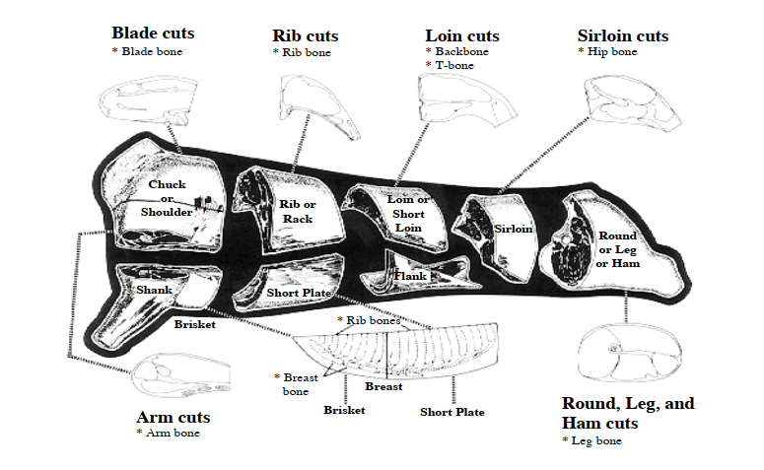
Courtesy of Texas A & M University
Notes:
LOIN (SHORT LOIN) REGION Loin (short loin) cuts contain the back bone. The back bone in these cuts can be further broken down into the spine, chine, and finger bones. In addition, one top loin steak carries the 13th rib. The three major muscles of concern include the loin eye or top loin, the tenderloin, and the flank (abdominal muscles)
SIRLOIN REGION Sirloin cuts originate from the area of the loin that is closest to the round. The two bones found in these cuts are the backbone and the hip bone. Important major muscles include the top sirloin, tenderloin, and the bottom sirloin. BRISKET, BREAST, AND SHORT PLATE REGION Brisket, breast, and short plate cuts contain breast bone and rib bones. Important cuts from this area include the beef brisket, short ribs, pork spareribs and bacon sides (from the belly), and lamb riblets.
ROUND, LEG, AND HAM REGION Round, leg, and ham cuts are from the hind leg. Center cuts from the leg contain the leg bone (femur). The four major muscle groups include the tip (knuckle), top (inside) round or leg, bottom (outside) round or leg, and the eye of round or leg.

Slide 6
• Bone structure
-easiest way to identify a cut
-cuts are named by the bones contained in the cuts
-indicates where the cuts originated from on the carcass
• Muscle structure
-can also help identify a cut
Notes:
Bone structure can sometimes be the easiest way to identify a cut. Many cuts are named by the bones contained in the cuts, and they indicate where the cuts originated from on the carcass. The shape of bones is similar in all three species, with the size of each bone varying with both age and species. • Muscle structure can also help identify a cut. For this reason, it can be very useful to understand muscle structure and how the shape of muscles differs in various cuts. Studying retail cut charts is often helpful to becoming familiar with muscle structure.

Slide 7
RETAIL CUT NOMENCLATURE
U.R.M.I.S. (Uniform Retail Meat Identity Standards)
Developed by the US Industrial Cooperative Meat Identification Standards Committee in 1972

Slide 8
Nomenclature consists of three parts:
Species of the cut: Beef, Pork or lamb
Primal cut: one of the seven cuts per species
Loin, Rib, Leg, Arm, Hip, or Belly/Side
Retail cut:
-Name (Common, Geographic, Trade, or Cooking Method)
-Steak/Chop
-Roast
-Boneless or Bone-in

Slide 9
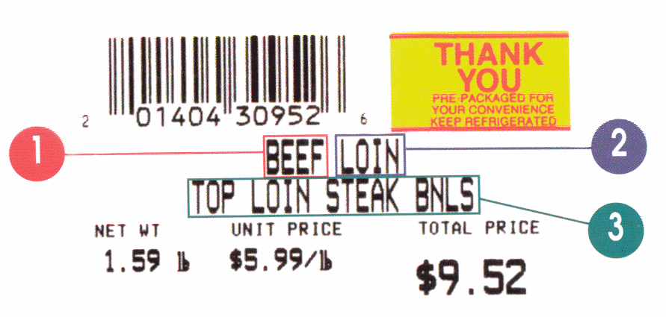
U.R.M.I.S. LABEL
1. SPECIES
2. PRIMAL
3. RETAIL CUT

Slide 10
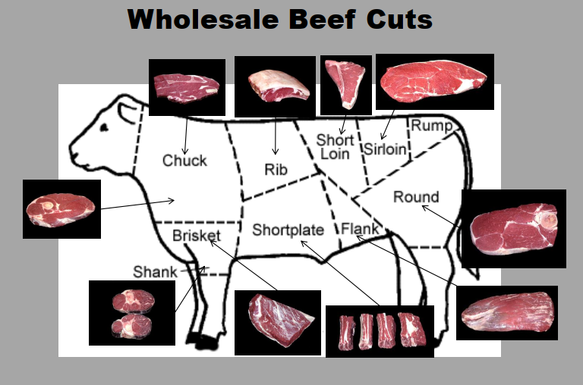
Wholesale Cuts and Overview of Retail Cuts
Courtesy of Texas A & M University

Slide 11
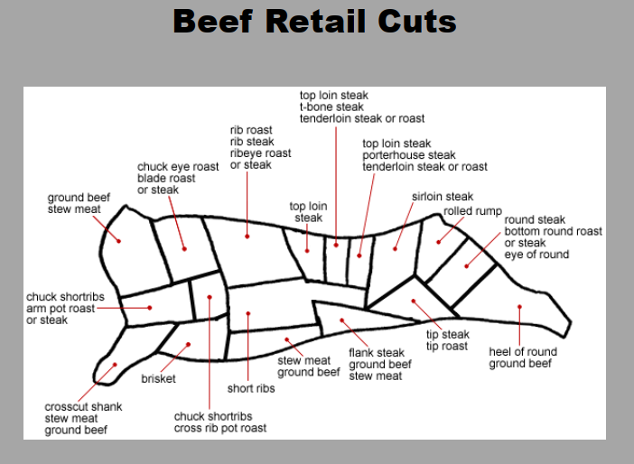
Courtesy of Texas A & M University

Slide 12
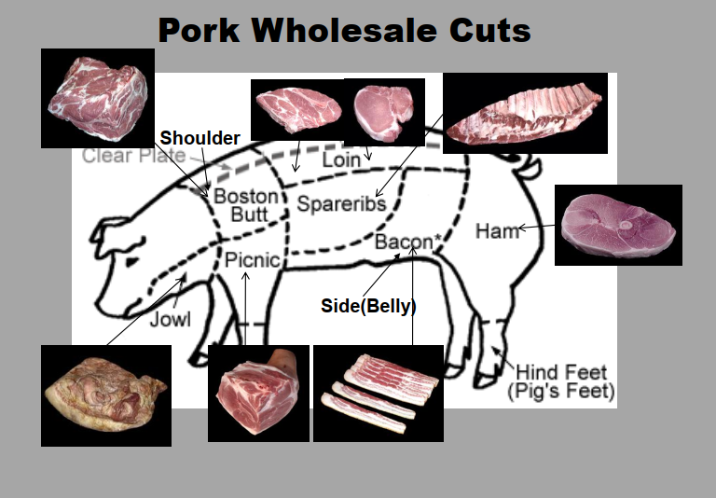
Courtesy of Texas A & M University

Slide 13
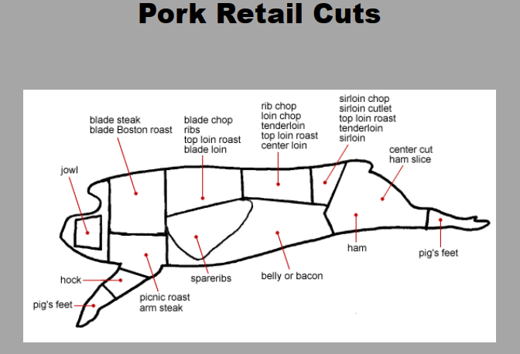
Courtesy of Texas A & M University

Slide 14
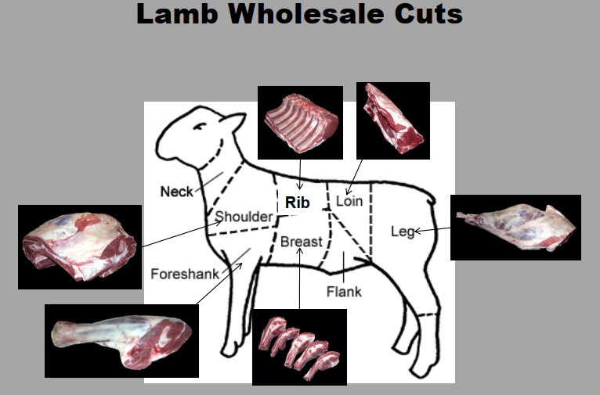
Courtesy of Texas A & M University

Slide 15
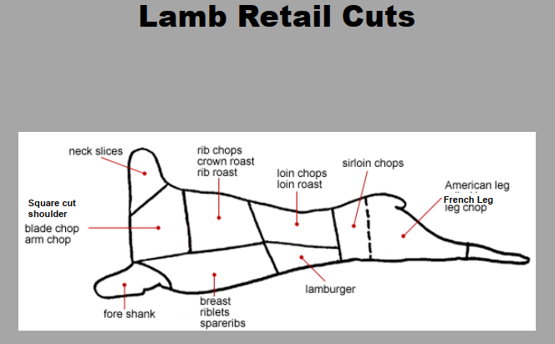
Courtesy of Texas A & M University

Slide 16
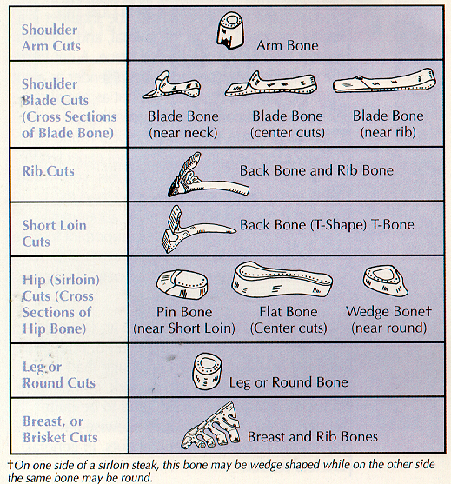
Tip:
Each of the seven categories
have an associated bone
Courtesy of Texas A & M University

Slide 17
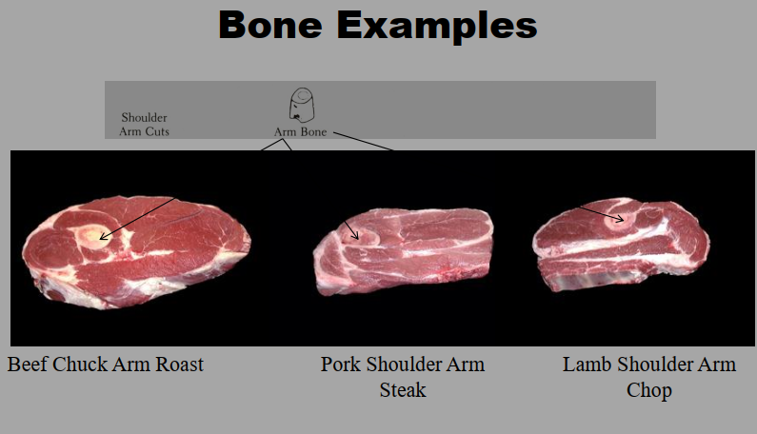
Courtesy of Texas A & M University

Slide 18
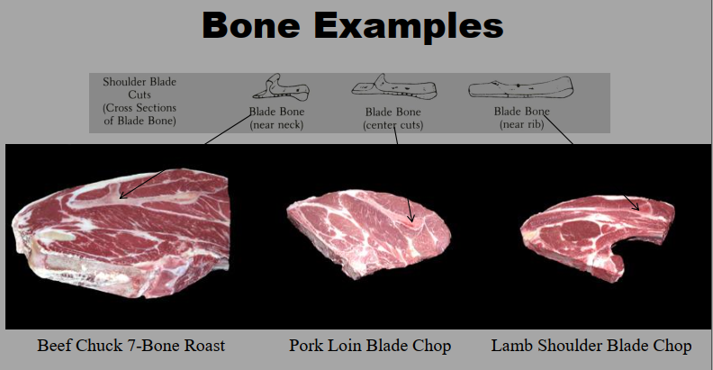
Courtesy of Texas A & M University

Slide 19
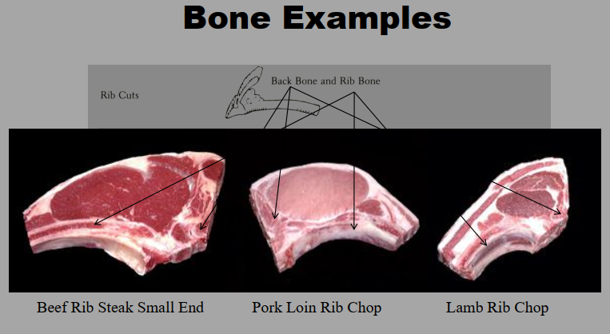
Courtesy of Texas A & M University

Slide 20
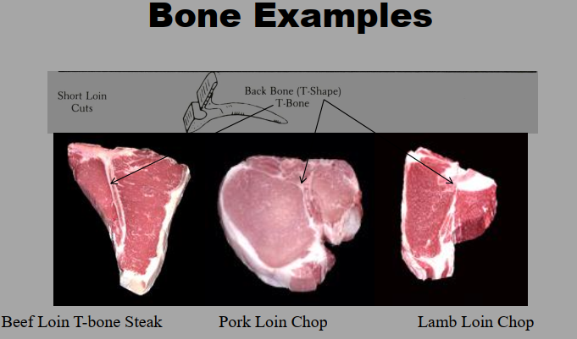
Courtesy of Texas A & M University

Slide 21
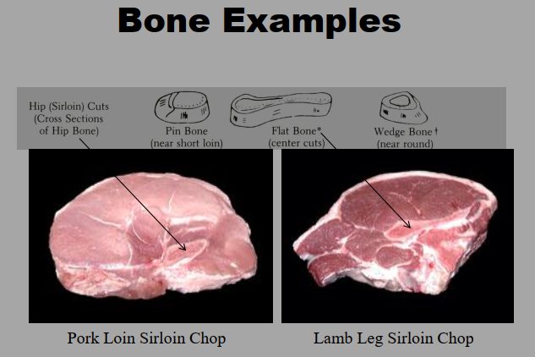
Courtesy of Texas A & M University

Slide 22
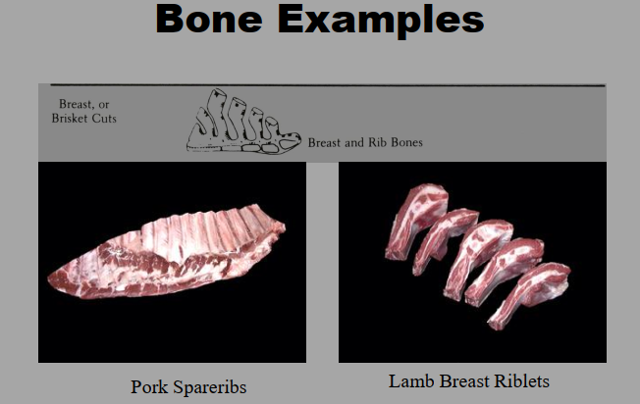
Courtesy of Texas A & M University

Slide 23
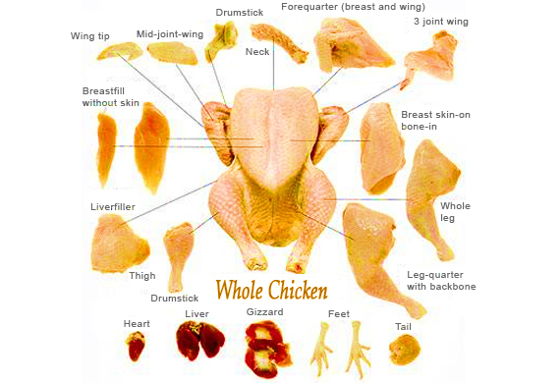
Also important!
Cuts of Poultry
www.huerto-trading.com

Slide 24
Further Readings/Additional Resources
- Texas AgriLife Extension Service and the AggieMeat website (aggiemeat.tamu.edu) - University of Nebraska Meat Identification Page - Tennessee 4-H Meat Judging Activity Guidelines - Texas A & M Meat Science Department http://meat.tamu.edu/extension.html

