Slide 1

Design and Implementation of a
Network Intrusion Detection System
Monitoring and Preventing Unauthorized Access
Oluwakemi Bankole April 2026 Cybersecurity Project
Notes:
Good day, my name is Oluwakemi Bankole. I will be presenting my final year project on the design and implementation of a Network Intrusion Detection System for monitoring and preventing unauthorized access.

Slide 2
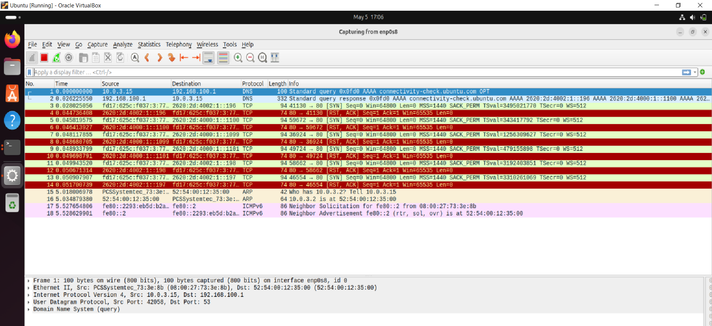
02
Introduction
Project Context
Organizations rely on networks for daily operations, but the same networks are exposed to threats such as scanning, brute-force attempts and unauthorized access attempts.
Why NIDS Matters
A Network Intrusion Detection System monitors network traffic, identifies suspicious patterns and supports security teams with investigation evidence. - It sees traffic across the network instead of only one machine. - It raises alert quickly when rules match suspicious patterns - Creates evidence for investigation and reporting - Supports faster containment decisions by an administrator
Observed TCP traffic in Wireshark during lab testing
Core idea: monitor → detect → analyze → respond
Notes:
With the rise in cyber threats, organizations need tools that can monitor network activities and identify suspicious behavior before damage occurs. This project focuses on using a lab environment to demonstrate traffic capture and analysis.

Slide 3
03
Problem Statement
Networks are vulnerable when suspicious traffic is not monitored.
Project Scope -Virtualbox-based lab only - Detection-first deployment using Suricata - Normal traffic plus simulated attacks - Alerts review using logs and screenshots
01
02
03
Unauthorized Access
Late Detection
Weak Evidence
Attackers may attempt to discover services and gain entry into poorly monitored systems.
Without monitoring, reconnaissance and scanning behavior can go unnoticed.
Poor packet visibility makes it difficult to investigate and prove what happened.
Project Aim
Build a controlled lab, simulate suspicious traffic, capture packets, analyze TCP behavior, and present clear evidence.
Notes:
The problem is that many networks lack proper monitoring. If attackers perform scans or attempts at unauthorized access, the activity may not be detected early. My project addresses this by designing a monitoring lab and analyzing the network traffic produced during testing.

Slide 4
04
Aim and Objectives
Aim
To design and implement a Network Intrusion Detection System lab for monitoring and identifying suspicious network activity.
01
02
03
Build the lab
Generate traffic
Analyze evidence
Use VirtualBox with Ubuntu, Kali Linux and Metasploitable to create a controlled test network.
Use Nmap and normal network activity to produce observable packet patterns.
Use Wireshark and Suricata concepts to detect reconnaissance-style behavior.
Project Outcome
Detect suspicious behaviour and generate useful alerts
Notes:
The aim of this project is to implement a practical NIDS lab. The objectives are to build the environment, simulate traffic, capture packets, analyze suspicious behavior, and document the findings professionally.

Slide 5
05
System Architecture
The lab is designed around three roles: attacker, target and monitoring sensor.
Kali Linux
Metasploitable
Ubuntu
Attacker
Nmap scan
Victim / Target
Vulnerable services
NIDS Sensor
Wireshark + Suricata
Monitoring Path
The monitoring machine captures traffic flowing through the active interface and analyzes packet behavior for detection evidence.
Notes:
The architecture consists of Kali as the attacker, Metasploitable as the target, and Ubuntu as the monitoring machine. The purpose of the design is to observe traffic and analyze suspicious activity in a safe virtual lab.

Slide 6
06
Tools Used and Their Roles
VirtualBox
Virtual lab platform for isolating the project environment
Kali Linux
Attacker machine used for Nmap scanning and traffic generation
Metasploitable
Intentionally vulnerable target machine
Ubuntu
Monitoring workstation used for Wireshark and Suricata testing
Wireshark
Packet capture and protocol analysis
Nmap
Reconnaissance and port scanning simulation
Suricata
NIDS engine for traffic inspection and alerting concepts
Notes:
These tools were selected because they represent a realistic junior SOC workflow: create a controlled lab, generate suspicious activity, capture the traffic and interpret the packets.

Slide 7
07
Implementation Workflow
01
02
03
Configure lab
Capture traffic
Analyze findings
Set up Ubuntu, Kali and Metasploitable in VirtualBox and identify active network interfaces.
Use Wireshark on the active interface to observe DNS, TCP, ARP and other protocol activity.
Inspect TCP flags and repeated connection attempts to identify scanning behavior.
Commands used:
ip a
ifconfig
nmap -Pn -sT <target-ip>
tcp.flags.syn == 1
Evidence-focused approach
Every major step was documented with screenshots so the defence shows a clear implementation path, not just theory.
Notes:
I implemented the project using a simple workflow: configure the lab, capture traffic, simulate activity, and analyze the findings. Each step was documented with screenshots for evidence.

Slide 8
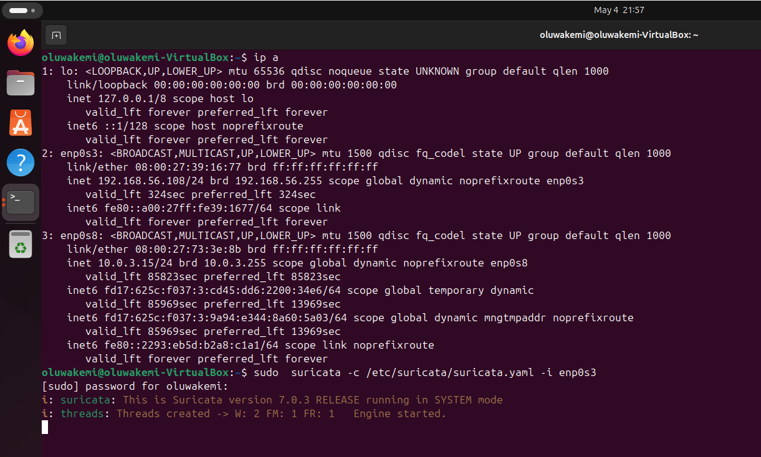
08
Step 1 — Lab and Interface Setup
SCREENSHOT EVIDENCE
What this proves
The monitoring machine was configured and network interfaces were identified before packet capture and detection testing.
Key finding
Traffic visibility depended on the active interface. During testing, enp0s8 showed live TCP traffic while enp0s3 showed mainly broadcast traffic.
Defence
I identified the active interface before analyzing traffic to ensure the monitoring system captured relevant packets.
Ubuntu interface discovery and Suricata startup evidence
Notes:
This slide shows the lab configuration stage. I used ip a to identify network interfaces and tested Suricata. This helped me understand which interface was carrying observable traffic.

Slide 9
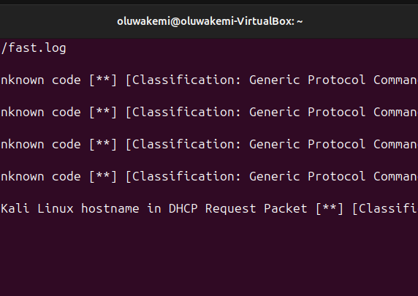
09
Step 2 — Suricata Deployment
sudo apt install suricata -y
suricata --build-info
sudo suricata -c /etc/suricata/suricata.yaml -i <interface>
sudo tail -f /var/log/suricata/fast.log
Analysis
Suricata was deployed as the NIDS engine. Initial logs confirmed the engine was producing alerts and recording traffic events.
Suricata fast.log showing IDS log output during testing
SOC relevance
Security teams use IDS logs to triage suspicious network events and begin investigation.
Notes:
Suricata was installed and tested as the IDS tool. I monitored the fast.log output to confirm that the system was recording network events.

Slide 10
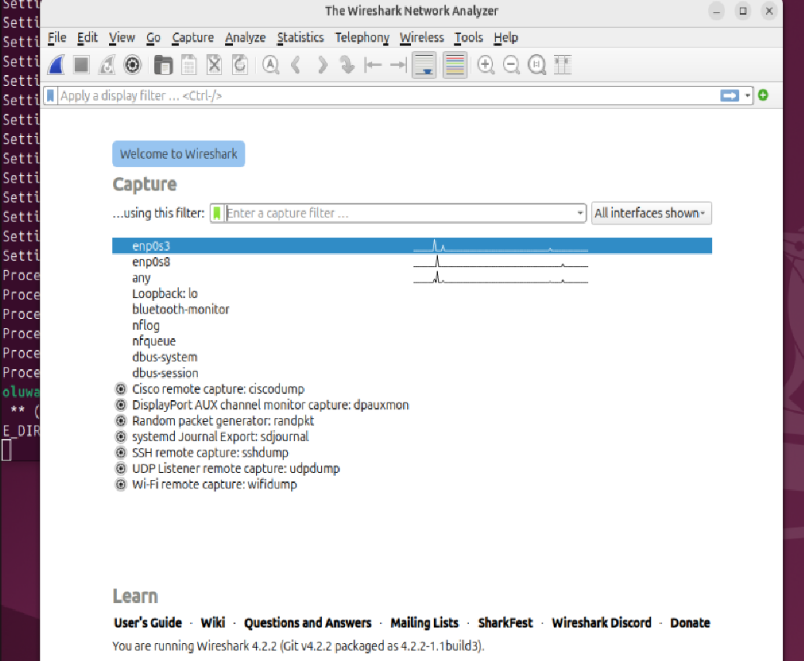
10
Step 3 — Interface Troubleshooting
Issue encountered
Live attack visibility was inconsistent on the host-only interface. This is common in virtualized labs when traffic routing prefers another interface.
Resolution
I monitored the interface that showed actual TCP activity during testing. This ensured the evidence reflected real packets flowing through the lab system.
SOC Reporting
I adapted the monitoring configuration based on packet visibility, which is an important troubleshooting step in network security analysis.
Wireshark interface selection screen
Notes:
A challenge I faced was that not all interfaces showed the same traffic. I therefore used Wireshark to confirm the active interface and adapted the capture process accordingly.

Slide 11
11
Step 4 — Attack Simulation with Nmap
Purpose
Nmap was used to simulate reconnaissance activity. Attackers commonly scan systems to discover reachable services and possible weaknesses.
SOC interpretation
Kali Linux running Nmap vulnerability scan against target IP
A scan is often an early-stage attack behavior. Detecting reconnaissance helps security teams respond before exploitation occurs.
nmap --script vuln 192.168.56.101
nmap -Pn -sT 192.168.56.101
Evidence to discuss
The command window proves the attack simulation step. The traffic analysis slides prove what was observed on the network.
Notes:
I used Nmap from Kali Linux to simulate reconnaissance. This is the same type of activity an attacker may perform to discover services before attempting exploitation.

Slide 12
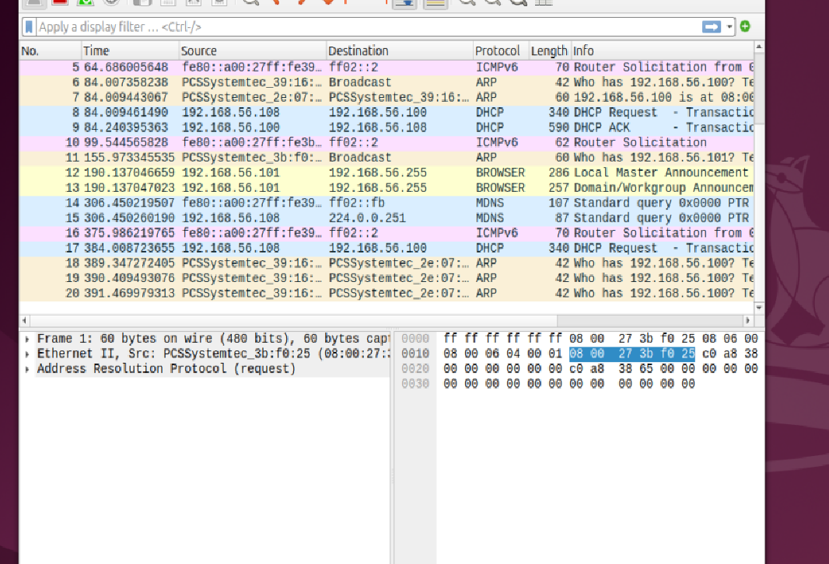
12
Step 5 — Live Traffic Capture
Observed protocols
ARP, DHCP, ICMPv6 and TCP activity were observed during capture. This confirmed packet visibility in the lab environment.
Why it matters
Packet capture provides raw evidence. It allows the analyst to inspect source, destination, protocol, flags and behavior.
Slide takeaway
The monitoring machine successfully captured live traffic for analysis.
Wireshark capture showing lab traffic on the monitoring interface
Notes:
Wireshark was used to capture live packets. This gives me raw network evidence that can be analyzed even when IDS alerts are limited by the virtual lab environment.

Slide 13
13
Step 6 — Detection Evidence: TCP Pattern
Key observation
The capture shows repeated TCP [SYN] packets followed by [RST, ACK] responses.
Meaning
SYN packets are connection attempts. Repeated attempts across ports are consistent with scanning behavior.
SOC Reporting
This traffic pattern indicates reconnaissance activity, where an attacker attempts to identify available services.
Captured TCP SYN and RST/ACK behavior on active interface enp0s8
Notes:
This is one of the most important slides. The repeated SYN and RST/ACK pattern is evidence of scanning behavior. SYN represents a connection request, and repeated attempts indicate service discovery or reconnaissance.

Slide 14
14
Traffic Analysis: How the Pattern Indicates Scanning
TCP flag interpretation
01
02
03
SYN
RST/ACK
Repetition
A host sends a SYN packet to begin a TCP connection attempt.
A reset response usually indicates the connection is refused or the port is closed.
Many connection attempts in a short period suggest reconnaissance or port scanning.
Professional interpretation
Evidence summary
A SOC analyst does not only rely on tool alerts. The analyst also interprets packet behavior and explains why traffic is suspicious.
The captured packets show connection attempts and reset responses, which support the conclusion that scanning-like behavior occurred.
Notes:
This slide explains the technical meaning of the packet pattern. Repeated SYN packets and reset responses are characteristic of port scanning or connection probing.

Slide 15
15
Role of the NIDS in Monitoring and Prevention
A NIDS supports the security workflow by moving from visibility to response.
Monitor
Detect
Investigate
Respond
Capture packets from the active interface
Identify suspicious flags, scans and unusual patterns
Use logs and packet details to explain what happened
Block attacker IPs, harden services and improve monitoring
Example prevention action:
sudo ufw deny from <attacker-ip>
Project interpretation
The project demonstrates detection and analysis. Prevention can be implemented using firewall rules after identifying suspicious traffic.
Notes:
A NIDS helps move from monitoring to detection, investigation and response. In a real environment, after identifying suspicious traffic, firewall rules or IPS controls can be used to reduce risk.

Slide 16
16
Challenges Encountered and How They Were Resolved
Challenge
Resolution
Traffic not visible on expected interface
Compared interfaces and selected the one showing live TCP packets
Suricata alerts were inconsistent
Used Wireshark packet evidence for direct analysis
VirtualBox routing behavior
Documented NAT/active-interface behavior as part of troubleshooting
Need for defence evidence
Captured screenshots at every major implementation stage
What this demonstrates
The implementation did not only show tool usage. It also showed troubleshooting, network understanding and analyst thinking.
Notes:
One of the main challenges was virtual network visibility. Instead of stopping, I troubleshot the interfaces and used packet-level evidence to support the project objectives.

Slide 17
17
Results and Findings
Result 1: Lab was implemented
Ubuntu, Kali Linux and Metasploitable were used to create a controlled cybersecurity lab environment.
Result 2: Traffic was captured
Wireshark captured live traffic including TCP, DNS, ARP and other network protocols.
Result 3: Suspicious behavior was identified
Repeated SYN and RST/ACK patterns were interpreted as reconnaissance/port scanning behavior.
Final evidence used to support analysis
Final project story: Attack simulation → packet capture → analysis → evidence-based conclusion
Notes:
The project achieved the main results: the lab was created, traffic was captured and suspicious network behavior was identified through packet analysis.

Slide 18
18
Skills Demonstrated
Network monitoring
Packet analysis
Linux basics
Nmap scanning
Suricata IDS concepts
Troubleshooting
Incident investigation
Technical documentation
Summary
This project demonstrates the kind of hands-on evidence expected from an entry-level SOC analyst: lab work, screenshots, traffic analysis and clear reporting.
Notes:
This project demonstrates practical skills relevant to junior SOC analyst roles, including monitoring, packet analysis, Linux, Nmap and documentation.

Slide 19

19
Recommendations and Future Improvements
01
02
03
Integrate SIEM
Add IPS controls
Expand attack tests
Forward Suricata logs into Splunk or ELK for dashboarding and alert correlation.
Move from detection to active prevention using firewall automation or Suricata IPS mode.
Include brute-force, web enumeration, malicious payload detection and custom rules.
Common challenges
Choosing the wrong interface and seeing no traffic
Incorrect HOME_NET or YAML syntax errors
Rules not loaded or alerts not appearing as expected
Lessons learned
Validate every step before moving forward
Simple attack scenarios are enough for strong evidence
Good screenshots make the final report much stronger
Recommendations
Use a clean folder for screenshot evidence
Keep commands and IP addresses consistent
Explain alerts in analyst language, not just raw logs
Notes:
Future improvements include integrating with a SIEM like Splunk, enabling active prevention controls, expanding attack scenarios and publishing the project as a portfolio case study.

Slide 20
20
Conclusion
The project successfully demonstrated how suspicious network behavior can be captured, analyzed and explained using a NIDS-style lab.
What was achieved
Why it matters
A controlled virtual cybersecurity lab was built, attack simulation was performed, network traffic was captured, and TCP scanning behavior was identified.
The project shows how monitoring and packet analysis support early detection and prevention of unauthorized access attempts.
Thank You
Notes:
In conclusion, this project shows how suspicious traffic can be captured and analyzed in a lab environment. It also demonstrates practical skills useful for cybersecurity monitoring and SOC analysis. Thank you.

