Slide 1
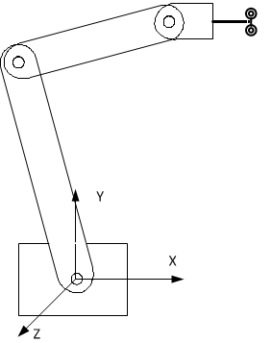
Assignment

Slide 2
1) A three-link planar manipulator has a simple fixed end-effector with a spray paint nozzle mounted on the end. The nozzle does not move relative to the last link but can be switched on and off as required.
It is required to trace a path from a point A (400,0,0) to a point B (200,20,0) to spray a line over a period of 1 second. While spraying the end-effector must be moving at constant speed.
It is required that the last link of the manipulator must stay horizontal when spraying is occuring. The links are 300mm, 200mm and 100mm(including spray gun) long.
Plot the values of the joint angles versus time. Note: use radians instead of degrees.
Repeat the process starting from point C (300,375,0) and moving to a point D (-400,375,0).
Discuss your solutions for the above.

Slide 3
Scheme for MM459 Assignment
(Note. This assignment is worth 20% of the overall mark for this module.)
Part 1 Due 5pm Friday week 7
Assignment of coordinate frames and formulation of task 6 marks
Forward kinematic transform ⁰T₃ 10 marks
Inverse kinematic transform θ₁, θ₂, θ₃ 10 marks
i) Graphs of joint angles (radians) versus time (seconds) point A to point B 6 marks
ii) Graphs of joint angles (radians) versus time (seconds) point C to point D 6 marks
Discussion of difference between solution in part i) and that required for part ii) 12 marks

