Slide 1



Microsoft SharePoint Online Features and Benefits

Slide 2
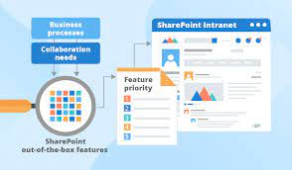
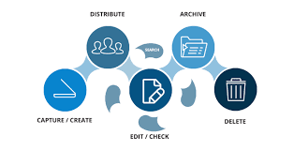

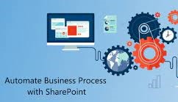
What is Microsoft SharePoint & its Benefits?
Microsoft SharePoint is a centralized and secure platform used for collaboration, data management, improved efficiency and information exchange across an organization.
Transform Business Process
Share & Work together
Content Management
Retrieval
A modern platform for shared access, interaction, and collaboration
Streamline document sharing and document life cycle management
A simple, fast, and safer way to find information irrespective of whether you are searching for files, people or resources
Build robust solutions, deliver business value, and achieve digital transformation

Slide 3
SharePoint Online Vs On-Premise
The major difference between both is the infrastructure architecture.
SharePoint Online
SharePoint On-Prem
Hosted by Microsoft in the cloud and requires no installation by the admins
On premise farm architecture required. Maintenance & patch updates dependent on admin
Seamless integration with O365, power apps, power BI etc.
Integrate with other Microsoft solutions via a data gateway
Improved collaboration tools for the org (Search, coauthoring, metadata, external share, OneDrive)
Limited collaboration tools
Improved governance to support document retention policies set by organizations
Governance had to be configured manually

Slide 4

Business Value
One stop shop & available Everywhere
All business applications available on O365 & accessible once there’s internet. Saves time to access useful resources
Document Management & Transparency
Used to organize, share & segregate documents, improved metadata to reduce the time it takes to search for documents & keep a trail of every activity carried out
Business Process
Helps in automating processes, creating standardization across the org & templates for use. This increases efficiency & productivity by reducing time spent on tasks
Power to the Users
O365 is a business tool & not an IT tool it empowers users to take control of how they work on the go via personalization's, OneDrive, dashboards etc.

Slide 5
Document Naming Convention
[year][month][day]-Document_name_other_title
Example
20220320-SharePoint_Online_Walktrough

Slide 6
DGCE Use Cases
YOUR TITLE 02
YOUR TITLE 04
Collaborations on projects/Research
Dashboards
1
2
3
4
YOUR TITLE 01
YOUR TITLE 03
Monitoring and Evaluation
Automation and flows

Slide 7


