Slide 1
FlexTrade User Experience Analysis (2020–2023)
Oluwaseyi Shobayo

Slide 2
Task Overview
.
Objective: Analyze user engagement, conversion trends, and feedback to derive actionable insights.
Deliverables:
Create pivot tables for analysis.
Include a dashboard summarizing findings.
Present findings visually and concisely

Slide 3
Key Metrics Overview
Highlights:
Total Unique Customers: 1,000
Average Bounce Rate: 49%
Add-to-Cart Rate: 51%
Average Conversion Rate: 50%
Average Session Duration: 15 minutes
Focus Areas: Engagement, conversion, and feedback.

Slide 4
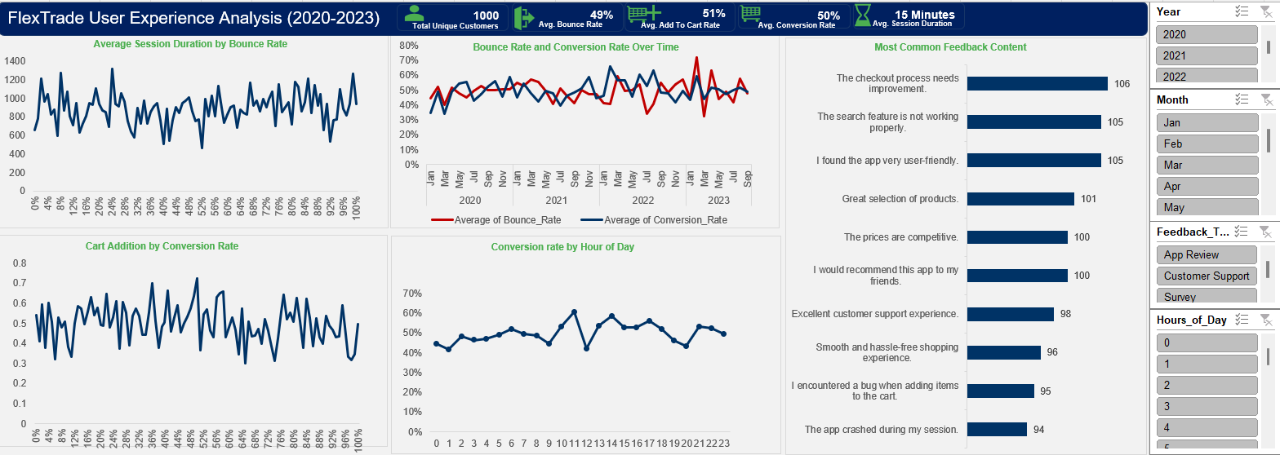
FlexTrade Dashboard

Slide 5
Session Duration vs. Bounce Rate
Insight:
Short sessions don’t always correlate with high bounce rates; some users quickly find what they need and complete purchases.
Longer sessions don’t guarantee conversions; users may be struggling with navigation.
Recommendations:
Improve Product Search & Navigation
Implement autocomplete, filtering options, and personalized recommendations to help users find products faster.
Monitor Exit Pages
Identify where users drop off after short sessions (e.g., search results, checkout) and optimize these areas.
Action:
Introduce Engaging Content & Enhanced Navigation
Use interactive product displays and personalized recommendations to extend session durations and reduce bounce rates.

Slide 6
Bounce Rate and Conversion Rate Trends
Insight:
Some users leave quickly (high bounce rate) but may return later to convert.
High targeted traffic (e.g., paid ads) can lead to higher bounce rates but better conversion.
An inverse relationship exists: As bounce rates drop, conversions improve.
Recommendations:
Segment Returning vs. New Users
If returning users convert better, focus on remarketing campaigns.
Optimize Landing Pages
Match landing pages with ad content.
Add clear CTAs (Call-to-Actions) for immediate conversions.
Test different layouts, CTAs, and messaging to reduce bounce rates.
Action:
Optimize Landing Pages & Address Bounce Points
Improve search filters, reduce load times, and minimize unnecessary checkout steps to decrease bounce rates and improve conversions.

Slide 7
Cart Addition and Conversion Rate
Insight:
High cart additions don’t always result in high conversion rates.
Reasons:
Unexpected costs (e.g., high shipping fees).
Complicated checkout process.
Users browsing but not ready to buy.
The "Cart Addition by Conversion Rate" chart shows variability in conversion despite added items.
Recommendations:
Simplify Checkout Process
Streamline steps to reduce friction and enhance user experience.
Address Cart Abandonment
Send cart reminders and discounts (e.g., “Complete your order for 10% off!”).
Action:
Minimize Distractions & Offer Incentives
Simplify checkout, remove obstacles, and offer incentives (e.g., limited-time offers, free shipping thresholds) to improve the cart-to-checkout ratio.

Slide 8
Feedback Analysis
Insight:
Negative Feedback: Checkout process issues & search problems.
Positive Feedback: User-friendly experience, great selection, competitive pricing.
Key Themes:
Negative: Users are frustrated with the checkout process and non-functional search.
Positive: Users appreciate the app’s ease of use, pricing, and product selection.
Recommendations:
Fix Search Issues
Introduce search filters, voice search, and auto-suggestions.
Streamline Checkout Process
Simplify steps to improve conversion.
Leverage Positive Feedback
Feature customer testimonials on key pages to boost trust.
Action:
Prioritize addressing technical issues (checkout and search), while promoting the app’s user-friendly design and competitive pricing in marketing efforts.

Slide 9
Additional Insight: Conversion Trends by Hour
Peak Conversion Hours:
10 AM, 11 AM, 1 PM, 2 PM, 5 PM
Insight:
These hours reflect when users are most likely to complete purchases.
Likely tied to lunch breaks (1-2 PM) & post-work relaxation (5 PM).
The "Conversion Rate by Hour of Day" graph highlights these peak periods.
Recommendations:
Time-Limited Offers & Flash Sales
Run targeted promotions during peak hours (e.g., “Lunchtime Deal—20% off from 12-2 PM!”).
Targeted Campaigns
Use peak hours for promotional emails or flash sales to maximize ROI.
Action:
Leverage these peak hours for promotional activities to drive conversions.

Slide 10
Additional Insight: The Peak Year for Conversions
Insight:
2022 had the highest conversion rate at 53%, surpassing other years.
The average cart addition rate in 2022 was 52%, indicating strong purchase intent.
Possible Reasons:
Improved marketing strategies (targeted ads, promotions).
Streamlined checkout process (faster payments, fewer steps).
High demand for specific products.
Effective loyalty programs or discounts.
Action:
Analyze what worked in 2022 and replicate successful strategies in future years.

Slide 11
Recommendation
Improve Search & Navigation
Implement autocomplete, filters, and personalized recommendations.
Optimize Checkout Process
Streamline checkout and address cart abandonment with reminders and discounts.
Leverage Positive Feedback
Feature customer testimonials and user-friendly design in marketing.
Run Targeted Campaigns During Peak Hours
Use time-limited offers and flash sales to capitalize on peak conversion hours.
Fix Technical Issues
Address checkout and search feature problems to improve user experience

Slide 12
Conclusion
Focusing on fixing technical issues (checkout and search) and optimizing user experience will lead to better conversion rates.
By targeting peak hours and leveraging positive feedback, the business can boost user engagement and overall sales.
Continuous monitoring of these trends will allow for data-driven improvements and maximize ROI.

Slide 13
Thank you

