Slide 1

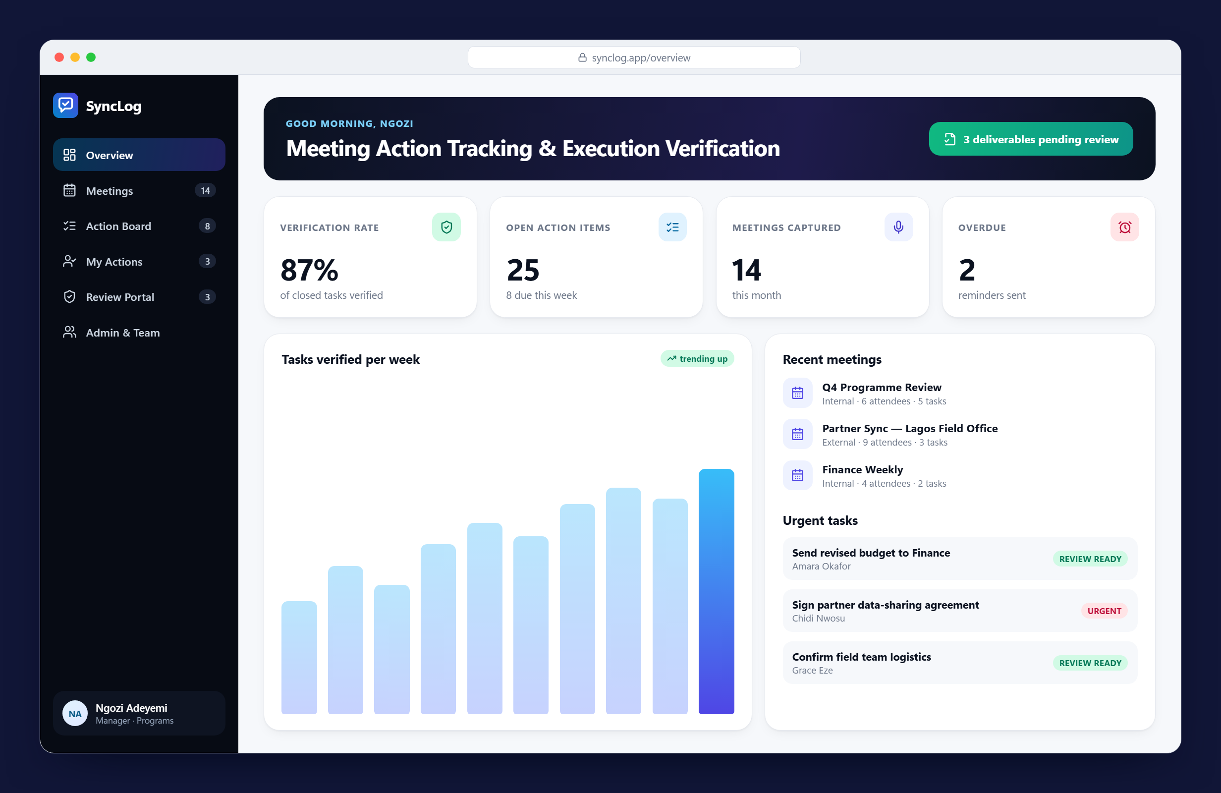


SyncLog
MEETING ACCOUNTABILITY PLATFORM
From meeting to done. AI meeting capture, owned action items and verified delivery across every team in your organisation.
Live demo synclog.vercel.app
Source code github.com/oluwatayo-david/meeting_tracker
October 2026 · oluwatayo damilola
Notes:
Introduce SyncLog: one place where every meeting decision becomes an owned task and is only closed once a manager verifies the evidence.

Slide 2






Meetings end, and the follow-through gets lost
What happens today without a shared system
Lost action points
No clear ownership
Hours of manual chasing
Decisions sit in notebooks and email threads and are never followed up.
Nobody records who is responsible for what, so tasks fall through the cracks.
Managers spend hours each week sending reminders and checking progress.
No proof of work
Siloed project teams
Slow meeting minutes
"Done" is a claim, not evidence, and there is no formal sign-off.
Each project tracks work its own way, with no shared view across teams.
Minutes take 24–48 hours to circulate, so attendees act late.

Slide 3
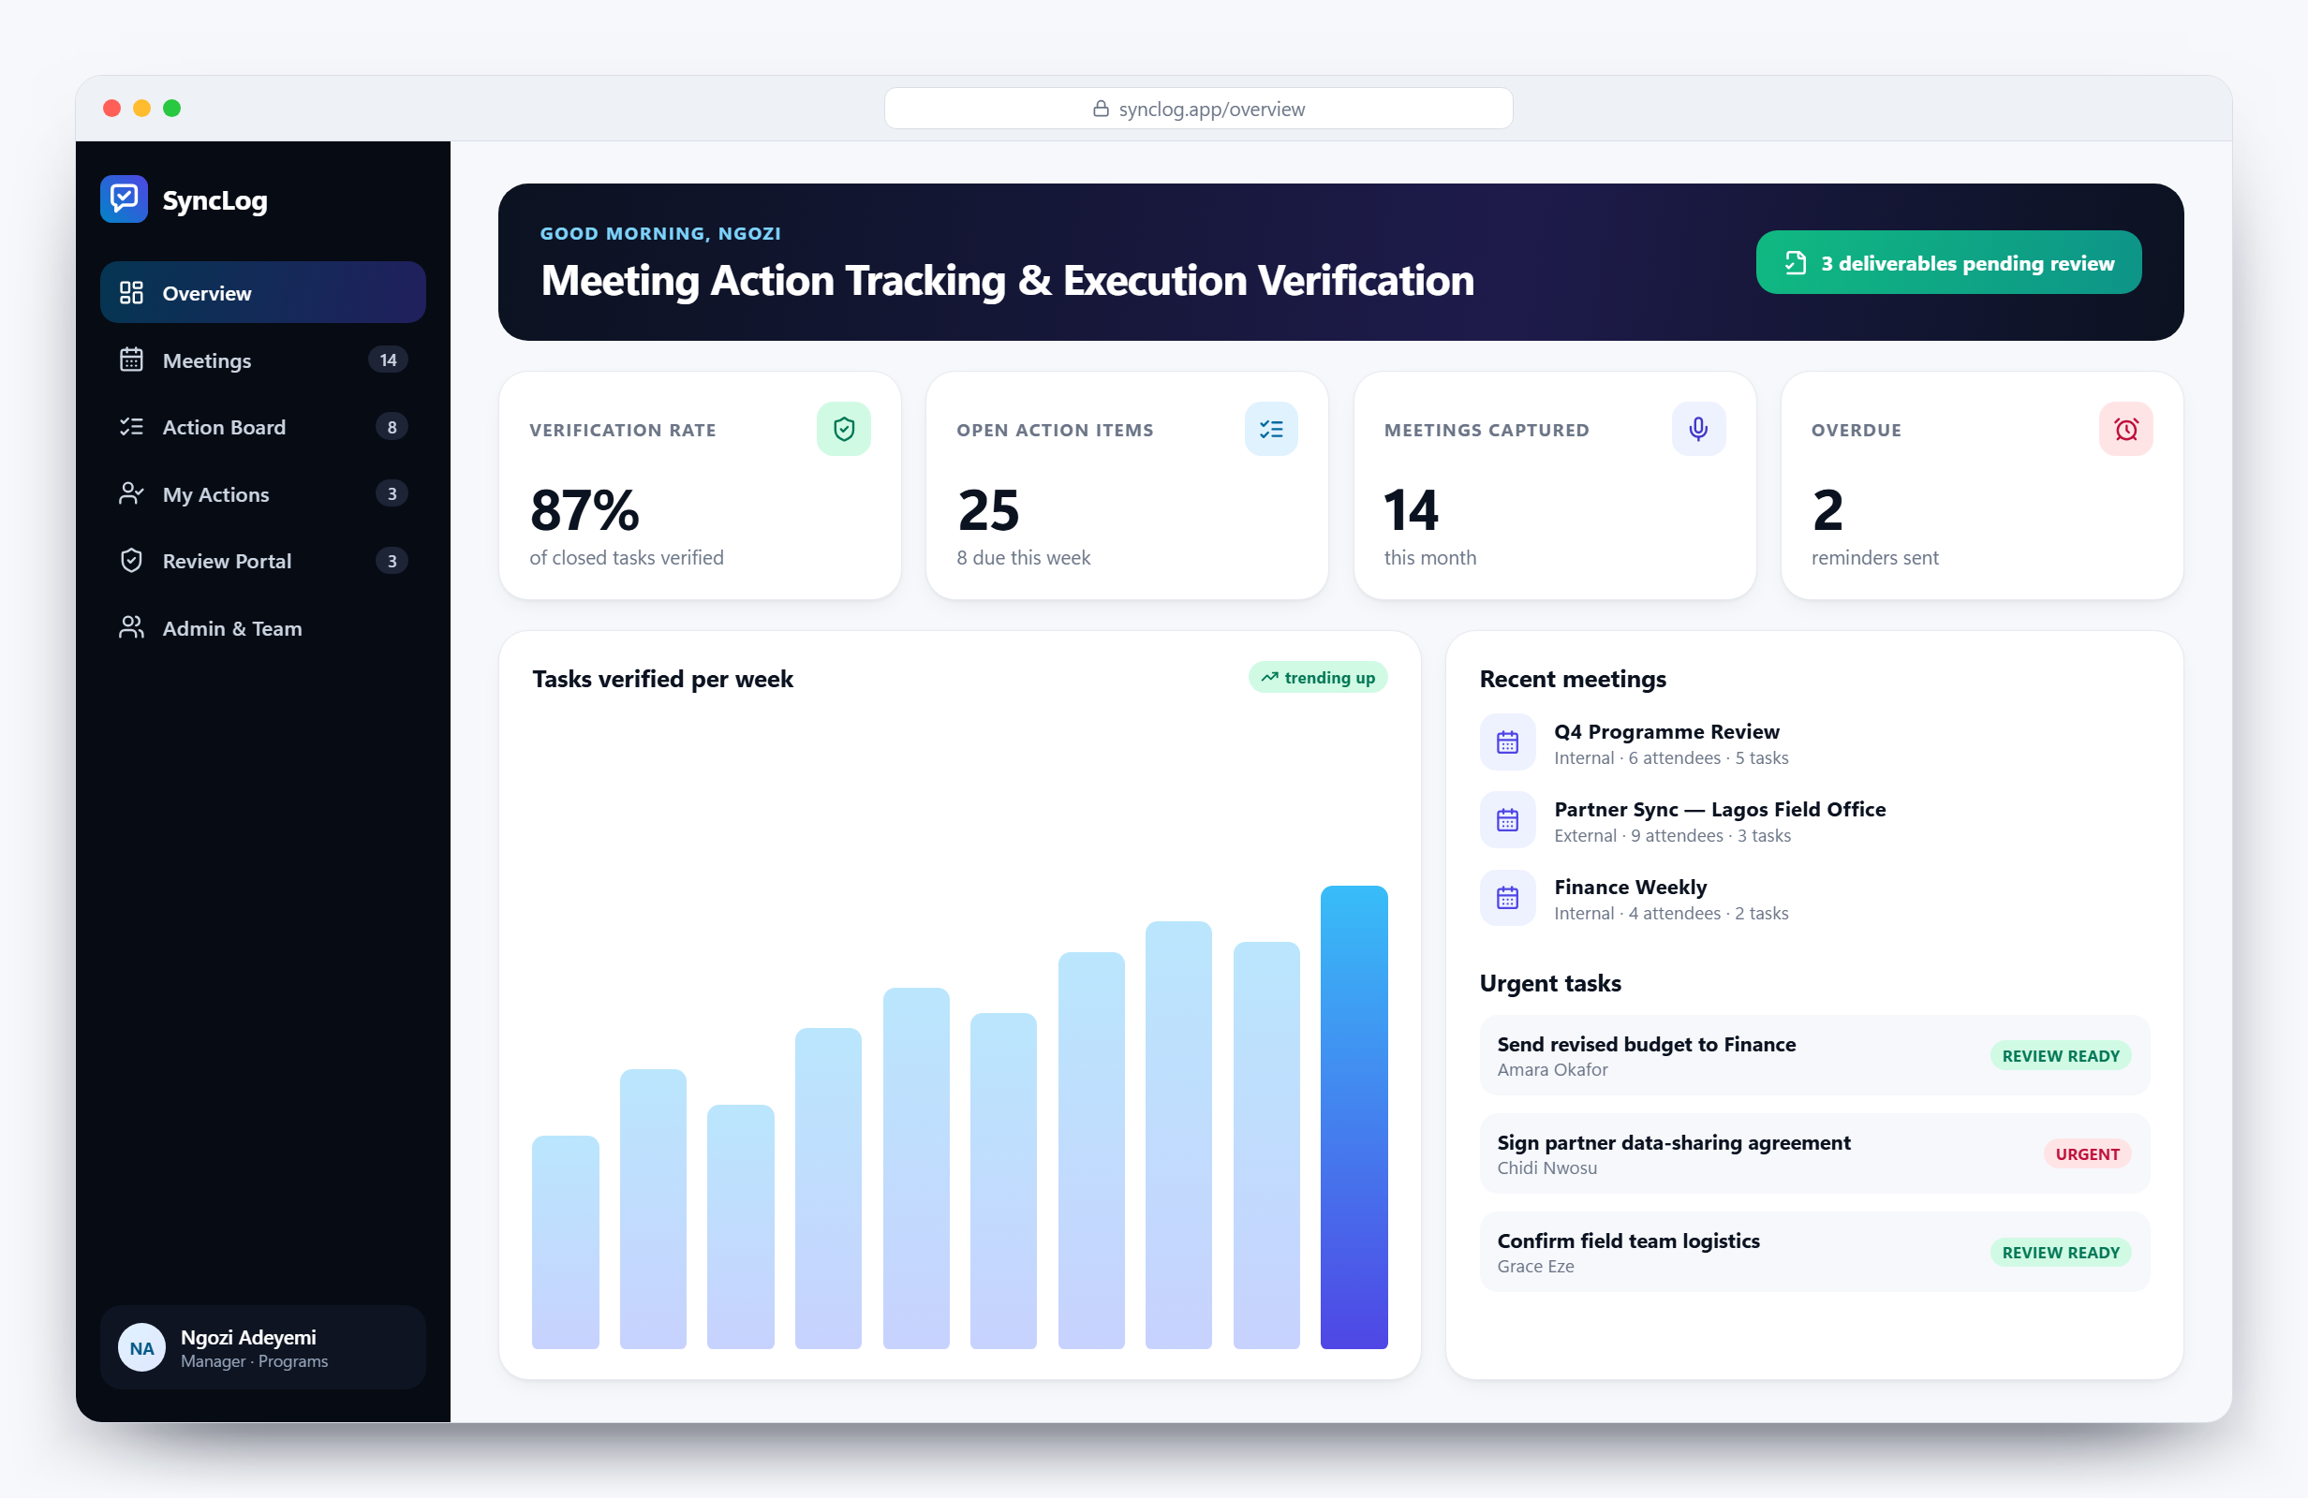



Meet SyncLog
One workspace that takes every meeting from conversation to verified delivery
Capture
AI turns the live meeting into a summary, decisions and owned action items.
Execute
Every owner sees their tasks, due dates and AI help in one board.
Verify
Work is closed only when a manager approves the submitted evidence.

Slide 4

How it works
Six steps from the meeting room to verified delivery
01
02
03
04
05
06
Schedule
Record
Extract
Execute
Submit
Verify
Manager creates the meeting; invitations go out by email.
The meeting is recorded and transcribed live by Gemini.
AI drafts the summary, decisions, risks and action items.
Owners work their board, with Copilot guidance on each task.
Owners upload files, links and a note as proof of work.
Manager approves or sends back; the dashboard updates.
The whole loop runs inside SyncLog: no follow-up spreadsheets, no lost action points, no ambiguity about who owns what.

Slide 5
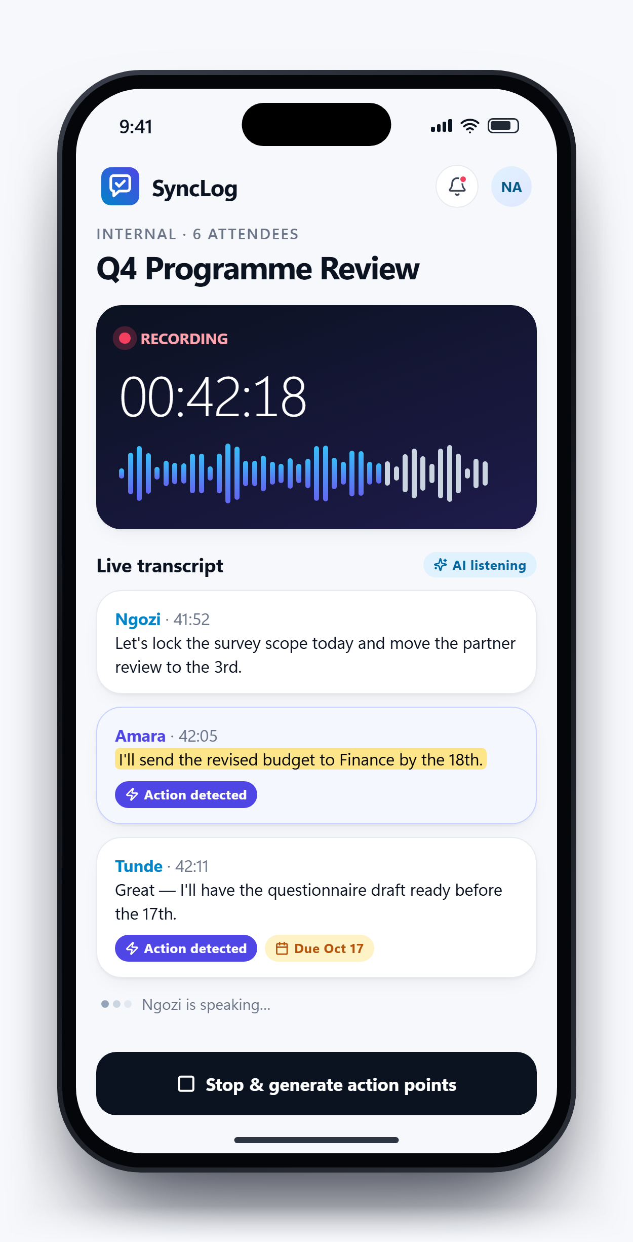
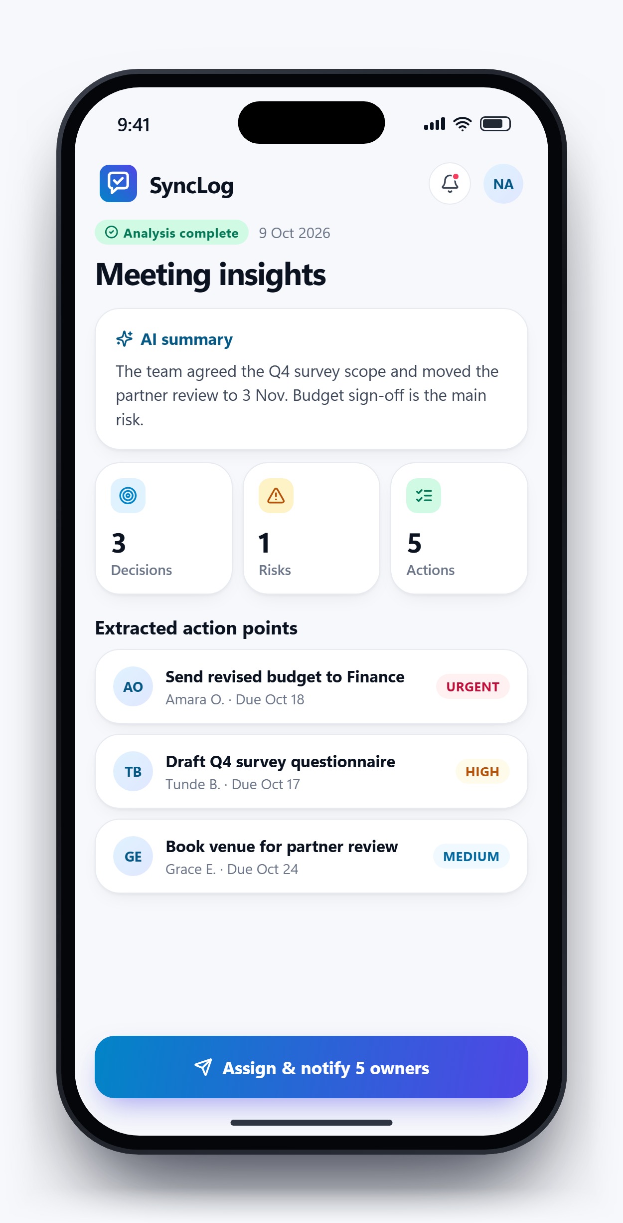


Every decision is captured as it is spoken
STEP 1 · CAPTURE
Record in the room
Start recording from any phone or laptop when the meeting begins.
AI listens for actions
Gemini transcribes live and flags commitments, owners and dates.
Assign in one tap
Review the summary, decisions and risks, then notify every owner.
Notes:
Left: the live recording screen with action items detected in the transcript. Right: the AI summary and extracted action points, ready to assign.

Slide 6
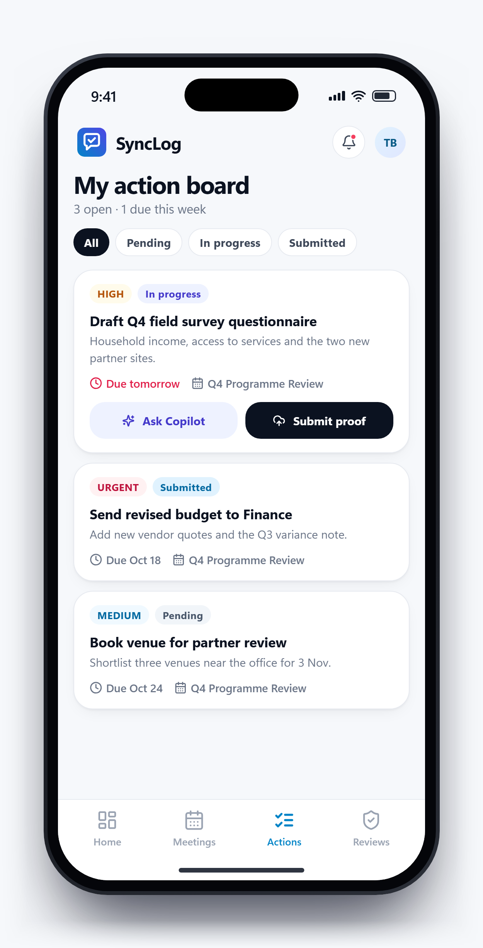
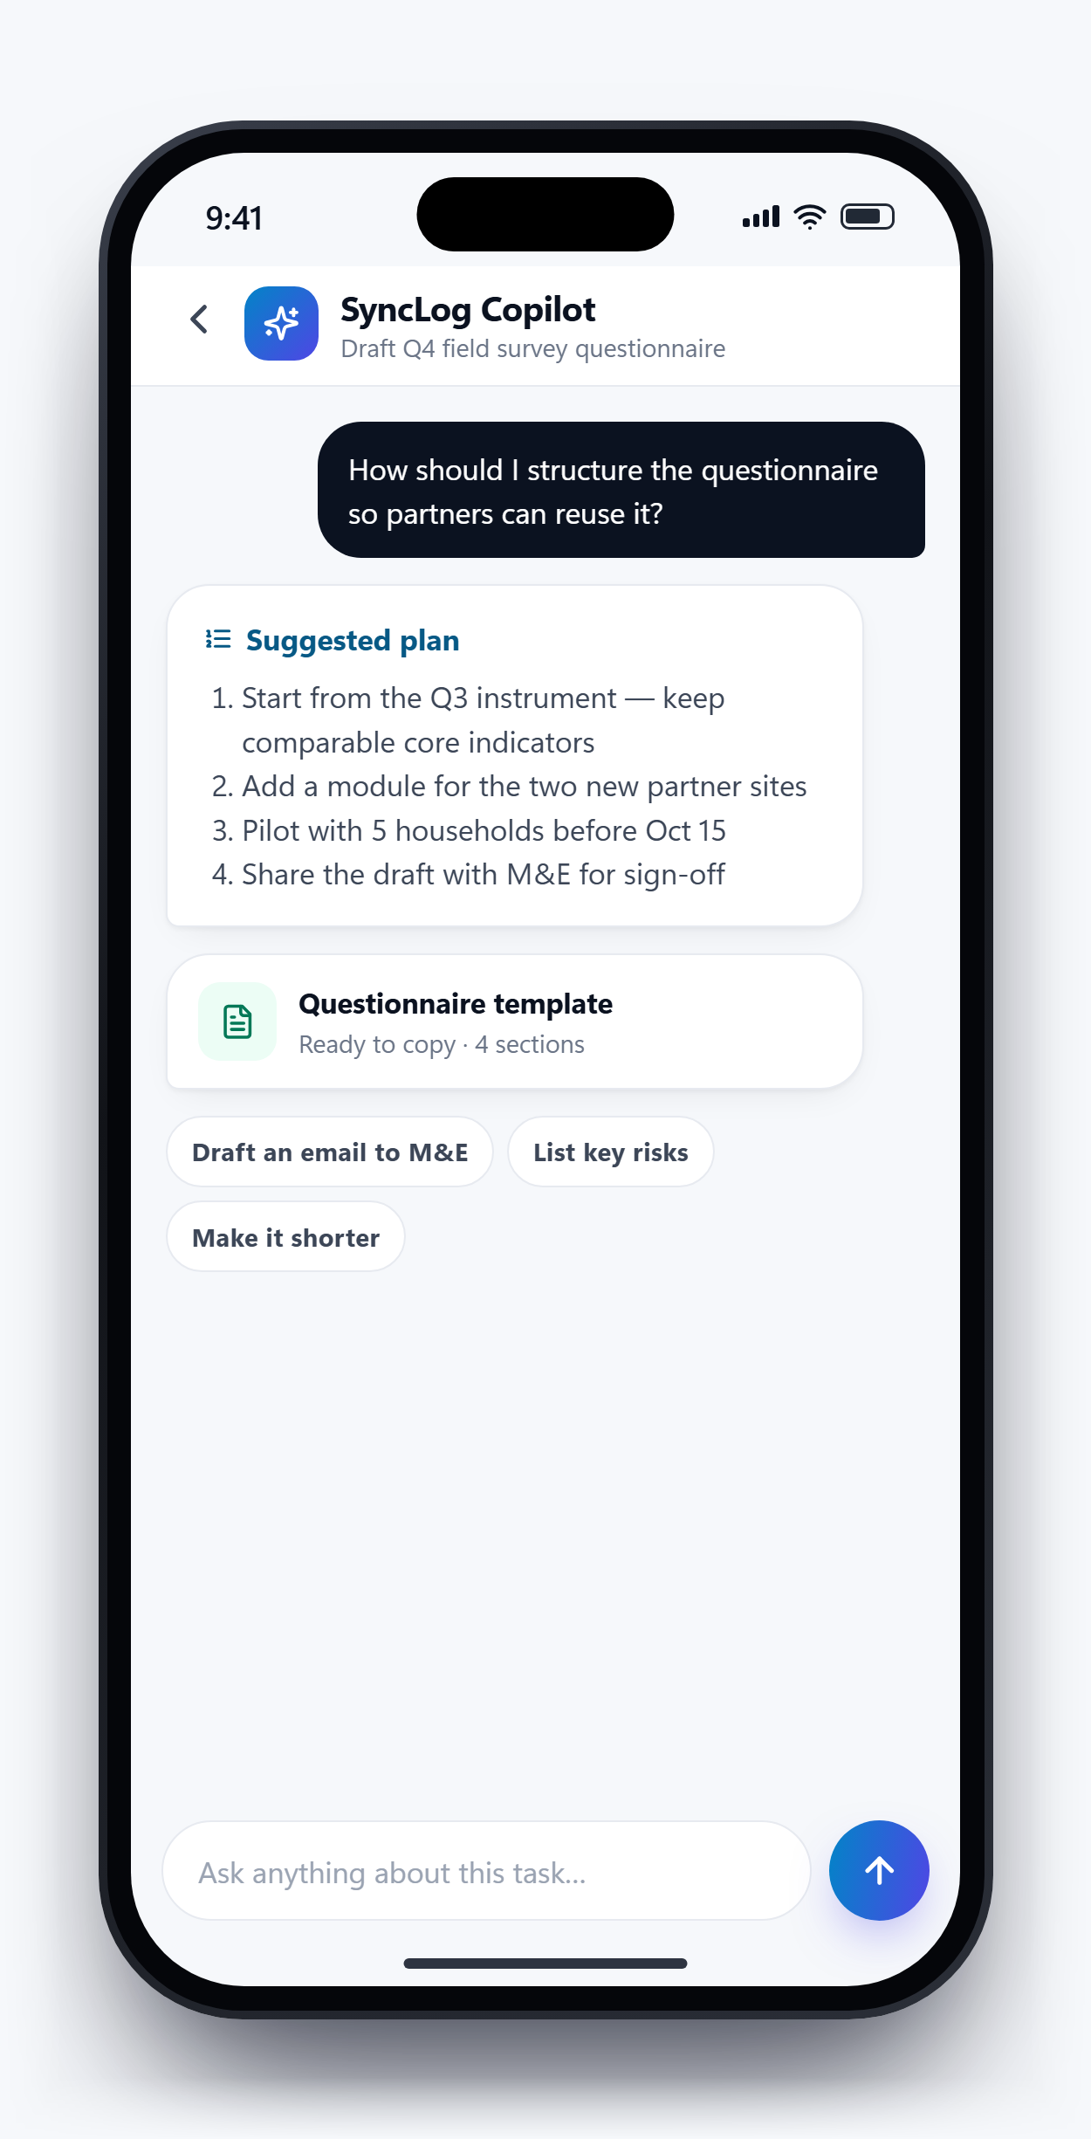



Everyone knows what they own, and by when
STEP 2 · EXECUTE
A personal action board
Priority, status, due date and source meeting on every task.
Copilot on every task
Step-by-step plans, templates, risks and draft emails on demand.
Submit proof from the task
Attach files or links when the work is done, with a note.
Notes:
Staff see only their own tasks. Copilot gives task-specific guidance so execution starts faster.

Slide 7
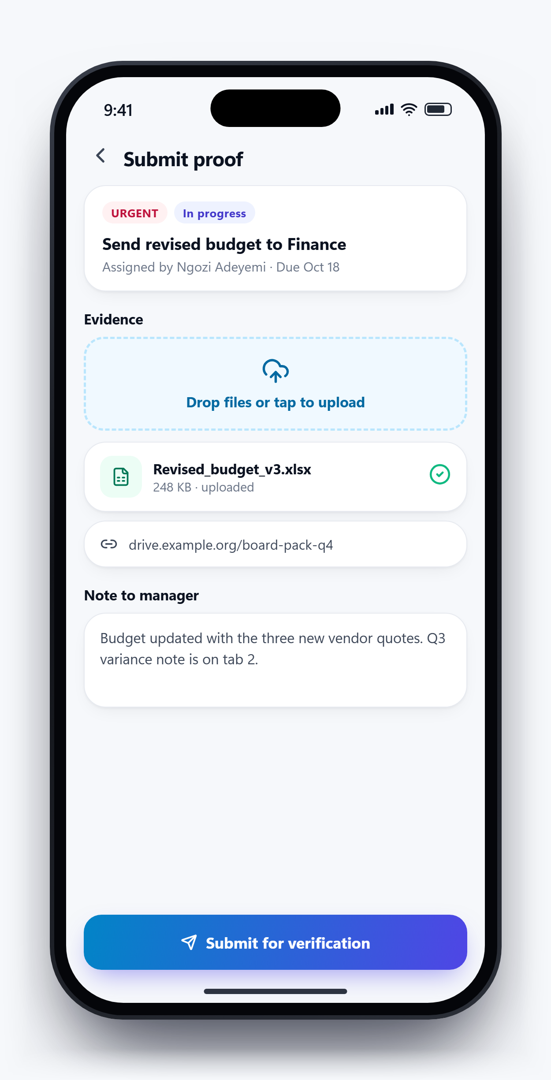
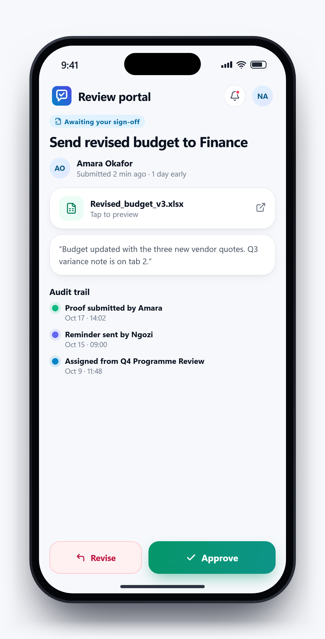



Nothing is done until it is verified
STEP 3 · VERIFY
Evidence, not claims
Owners submit files, links and notes against the exact task.
Approve or send back
Managers approve or return the task for revision with feedback.
A full audit trail
Every assignment, reminder, submission and decision is timestamped.
Pending
In progress
Submitted
Approved
Rejected
Notes:
The five task statuses are shown along the bottom. A rejected task goes back to the owner with the manager's feedback.

Slide 8
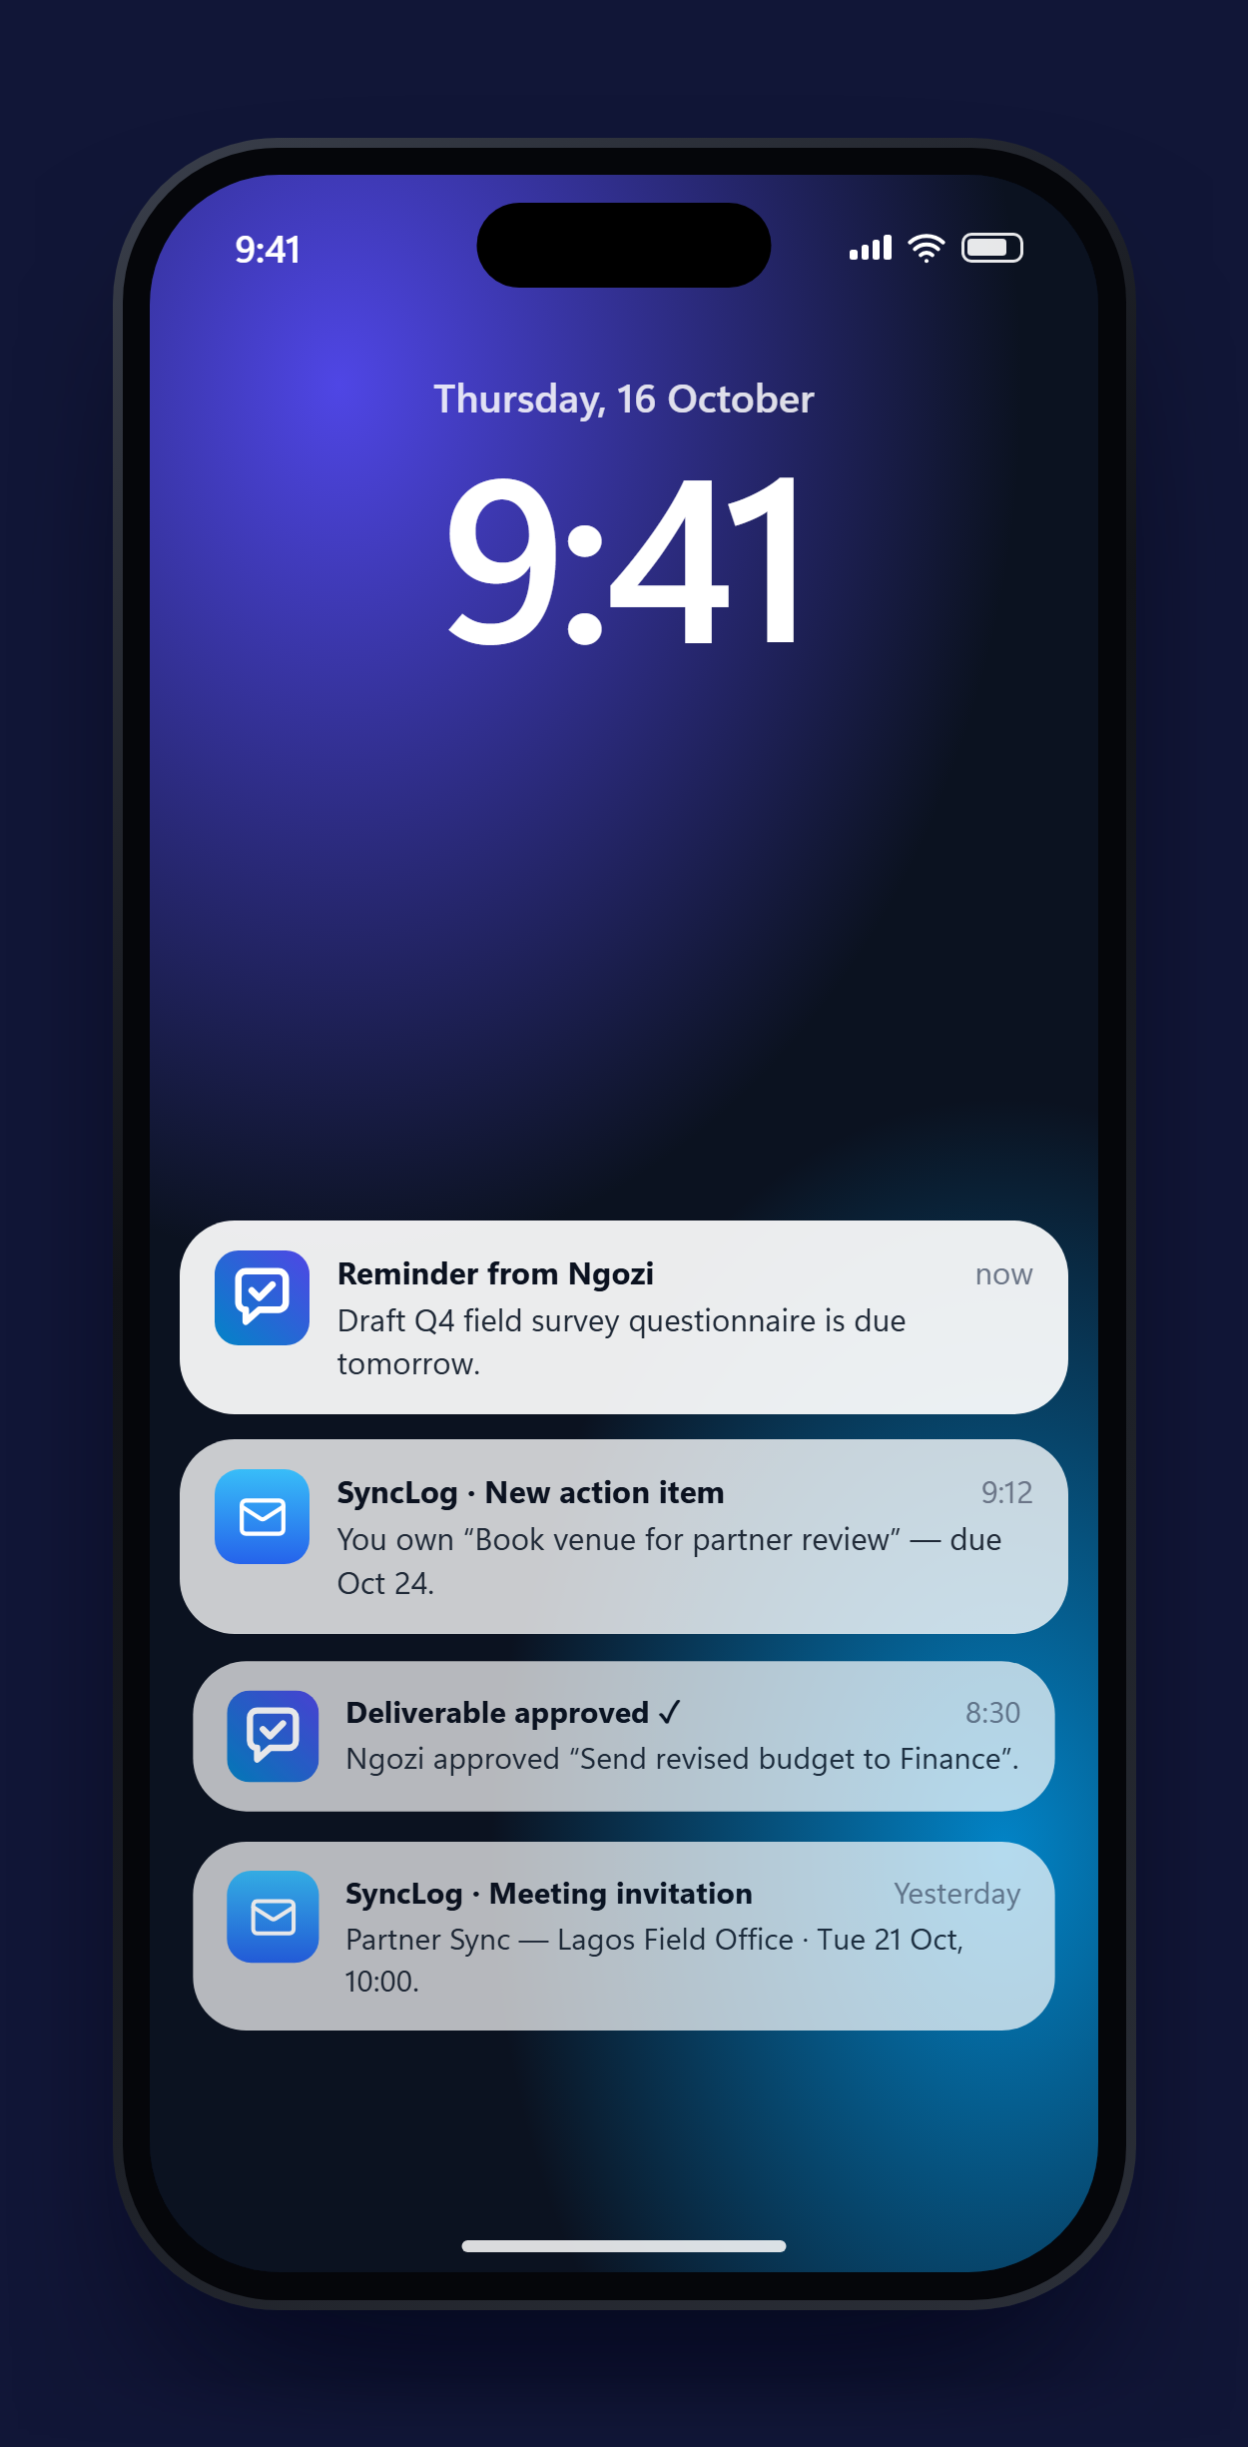




The right email reaches the right person, automatically
ALWAYS IN THE LOOP
Meeting invitation
New task assigned
Sent to every attendee when a meeting is created, with date, time and organiser.
Each owner gets the task, priority, due date and a link to submit proof.
One-click reminders
Staff welcome
Managers nudge an owner in one click; overdue tasks are flagged in red.
New team members receive their account details and sign-in steps.
Delivered through the organisation’s own SMTP mail server.

Slide 9




Everyone sees exactly what they need
Role-based access, enforced in the database with row-level security
Principal (Admin)
Project Manager
Staff Member
Onboard and manage all users
See every meeting and project
Approve or reject across teams
Organisation-wide dashboard
Schedule and run meetings
Assign action items to staff
Send reminders to owners
Review and verify proof of work
See their own action items
Use Copilot on any task
Update status as work moves
Submit proof of completion
Staff see only their own work, managers see the meetings they run, and principals see everything.

Slide 10





One workspace for every team and project
Each team keeps its own view; leadership sees all of them together
Programmes
Finance
Operations
Research
People & HR
Partner meetings, field reviews and delivery milestones.
Budget sign-offs, approvals and reporting deadlines.
Logistics, procurement and day-to-day coordination.
Data reviews, analysis and publication actions.
Recruitment, training milestones and onboarding.
1
3
5
100%
shared workspace
access levels
task statuses tracked
tasks with a named owner

Slide 11





Built on proven, low-cost technology
Modern managed services that start free and scale with use
Next.js 15
Supabase
Google Gemini
Web app
Database & sign-in
AI engine
Fast React web app that works on phones and laptops.
PostgreSQL with row-level security on every table.
Transcription, action extraction and Copilot guidance.
SMTP email
Vercel
Security
Notifications
Hosting
Access control
Invites, assignments and reminders via Nodemailer.
Zero-maintenance deployment with automatic HTTPS.
Signed sessions, rate limiting and per-role data access.

Slide 12






What your organisation gains
Less chasing, clearer ownership and evidence ready for donors
Time saved
Clarity
Every decision
No more manual follow-up emails and status check-ins.
Each person knows what is expected, by when and how urgent.
has an owner, a deadline and verified evidence that it was done.
Transparency
Faster delivery
Leaders see every project without attending every meeting.
Copilot guidance gets work started sooner.
Delivery records double as evidence for donor reporting and grant accountability.
Donor reporting
Accountability
Verified records are ready to share with funders.
An audit trail supports reviews and resolves disputes.

Slide 13
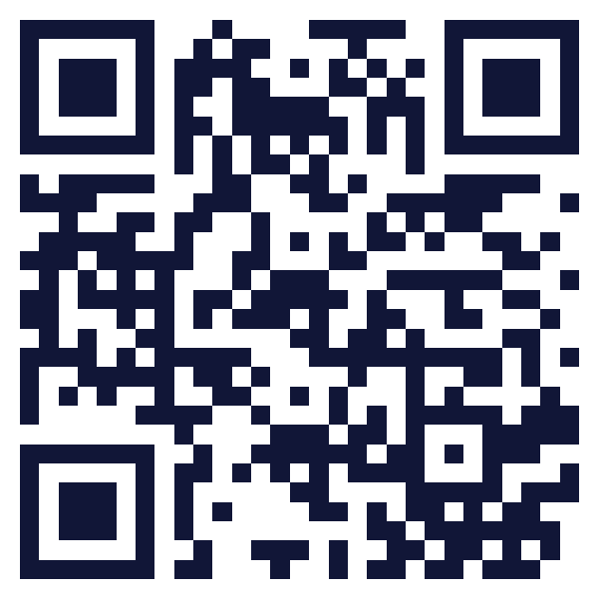




See SyncLog working, live
LIVE DEMO
Open the live app
synclog.vercel.app
Suggested demo path
Create a meeting and invite attendees
Record a few minutes and let AI extract the actions
Scan to try it on your phone
Open the action board and ask Copilot for help
Submit proof, then approve it as the manager
Source code github.com/oluwatayo-david/meeting_tracker
Notes:
Click "Open the live app" (in slideshow mode) to switch to the browser. Suggested path: create a meeting, record a short clip, show the extracted actions, open Copilot, then submit and approve proof. The audience can scan the QR code to follow along. Source code: https://github.com/oluwatayo-david/meeting_tracker

Slide 14



From meeting to done, across every project
THANK YOU
Questions
Next steps
Get in touch
Open discussion and a live walkthrough of SyncLog.
Pilot with one team, onboard the rest, then go live.
oluwatayo damilola
Try it synclog.vercel.app
Source code github.com/oluwatayo-david/meeting_tracker

