Slide 1
Gaussian Processes for Machine Learning
Neil Lawrence
University of Sheffield
29th January 2016
OxWaSP Symposium

Slide 2
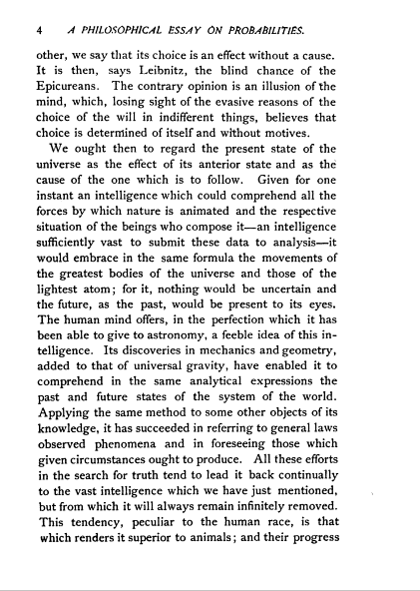
Notes:
On this slide and next two I’ll review Laplace’s perspective which was that we should use probability to deal with our state of ignorance. Probability as a means of abstraction across the scales.

Slide 3
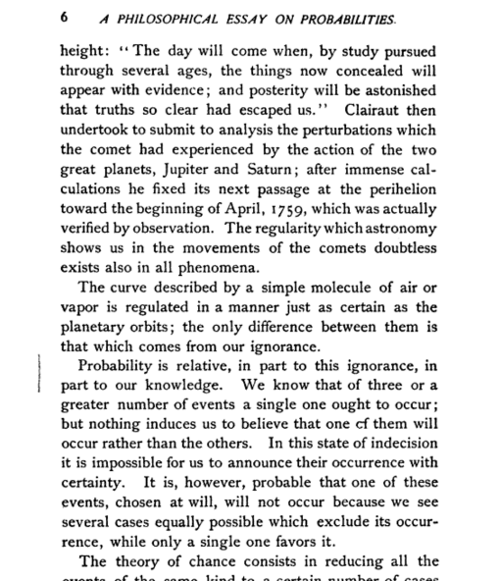

Slide 4
Physical
World
Empirical Models
Mechanistic Models
info
Compute: Fast
Compute: Slow
info?
Data Driven
Knowledge Driven
info
Statistics and
Machine Learning
Physics
Notes:
In this slide I’ll introduce the overall perspective on mathematical models: there are broadly two types, mechanistic and phenomenological. I’ll relate modelling to challenges in the physical world and emphasize the need for there to be information transfer between the real world and our models, but with a particular focus on a transfer between phenomenological models and mechanistic models, which I believe is a more challenging and interesting domain.

Slide 5
The Data are Not Enough
Four pillars:
Deterministic/Stochastic
Mechanistic/Emipirical
Goal: model complex phenomena over time
Problem:
Mechanistic models are often inaccurate
Data is often not rich enough for an empirical approach
Question 1: How do we combine inaccurate physical model with machine learning?

Slide 6
Central Dogma
DNA
Transcription
mRNA
Translation
Protein
Notes:
In this slide I’m going to use the layered model of network systems to describe the challenges of understanding complex systems in the physical world such as biological systems and neuroscience. I’ll give an analogy: imagine trying to understand the internet when you only have measurements of the cables and access to YouTube.

Slide 7
Decision: Transcription Factors
Measured using Microarray since 1998
mRNA
Translation
Difficult to measure
TF Protein
Transcription
Measured using Microarray since 1998
Other mRNAs
Notes:
In this slide I’m going to use the layered model of network systems to describe the challenges of understanding complex systems in the physical world such as biological systems and neuroscience. I’ll give an analogy: imagine trying to understand the internet when you only have measurements of the cables and access to YouTube.

Slide 8
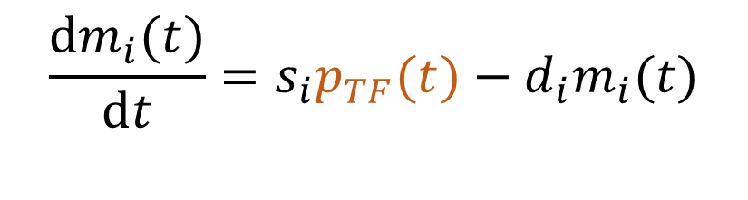
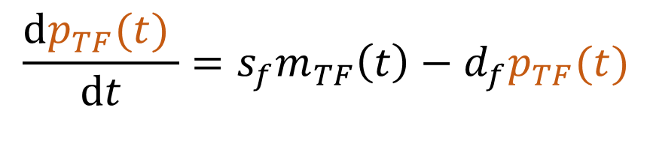



Mechanistic Model
mRNA $m_{TF}\left(t\right)$
$$\frac{ⅆp_{TF}(t) }{ⅆt}=s_{f}m_{TF}\left(t\right)−d_{f}p_{TF}(t)$$
Translation
TF Protein $p_{TF}(t)$
$$\frac{ⅆm_{i}(t)}{ⅆt}=s_{i}p_{TF}(t)−d_{i}m_{i}(t)$$
Transcription
Other mRNAs $m_{i}(t)$

Slide 9
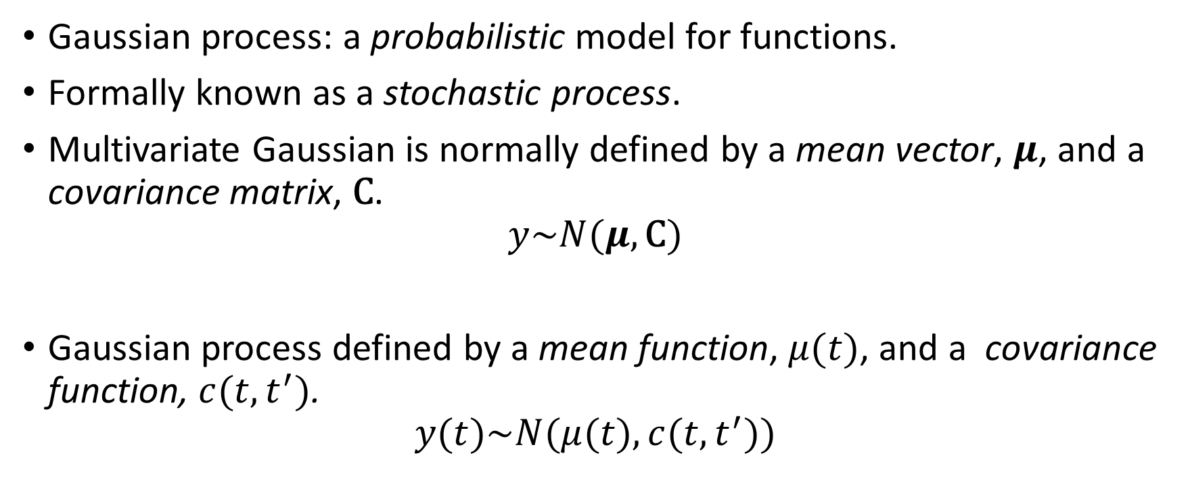

Need to Model $p_{TF}(t)$
Gaussian process: a probabilistic model for functions.
Formally known as a stochastic process.
Multivariate Gaussian is normally defined by a mean vector, $μ$, and a covariance matrix, $\text{C}$.
$$y\sim N(μ,\text{C})$$
Gaussian process defined by a mean function, $μ(t)$, and a covariance function, $c(t,t^{′})$.
$$y(t)\sim N(μ(t),c(t,t^{′}))$$

Slide 10


Zero Mean Gaussian Sample
index
5
10
15
20
25
2
1
0.9
1.5
5
0.8
0.7
$$\text{y}$$
1
10
0.6
index
0.5
0.5
15
0.4
0.3
0
20
0.2
0.1
25
0
5
10
15
20
25
index
covariance $\text{C}$
samples from Gaussian

Slide 11




Zero Mean Gaussian Process Sample
$$t^{′}$$
5
10
15
20
25
2
1
0.9
1.5
5
0.8
0.7
$$y(t)$$
10
1
0.6
$$t$$
0.5
0.5
15
0.4
0.3
0
20
0.2
0.1
25
0
5
10
15
20
25
t
covariance function $c(t,t^{′})$
samples from Gaussian process

Slide 12
Gaussian Processes
Notes:
The processes we often use are smoother, here infinitely differentiable. They provide general models of functions.

Slide 13
Gaussian Processes

Slide 14
Gaussian Processes

Slide 15


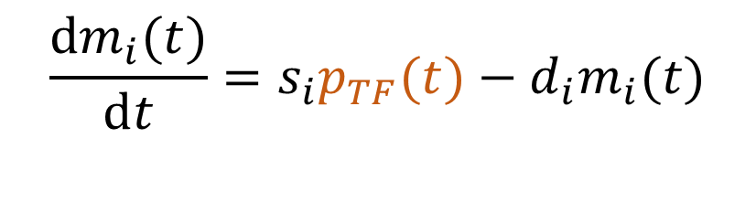
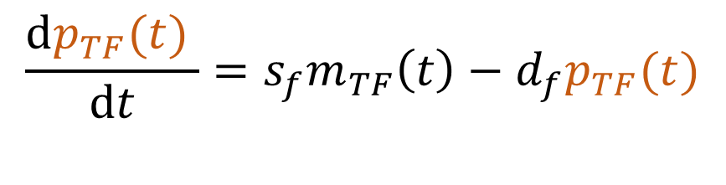

Results
$$m_{TF}\left(t\right)$$
$$\frac{ⅆp_{TF}(t) }{ⅆt}=s_{f}m_{TF}\left(t\right)−d_{f}p_{TF}(t)$$
$$p_{TF}(t)$$
$$\frac{ⅆm_{i}(t)}{ⅆt}=s_{i}p_{TF}(t)−d_{i}m_{i}(t)$$
$$m_{i}(t)$$
TPAMI, 2 PNAS papers, 2 Comp Bio

Slide 16
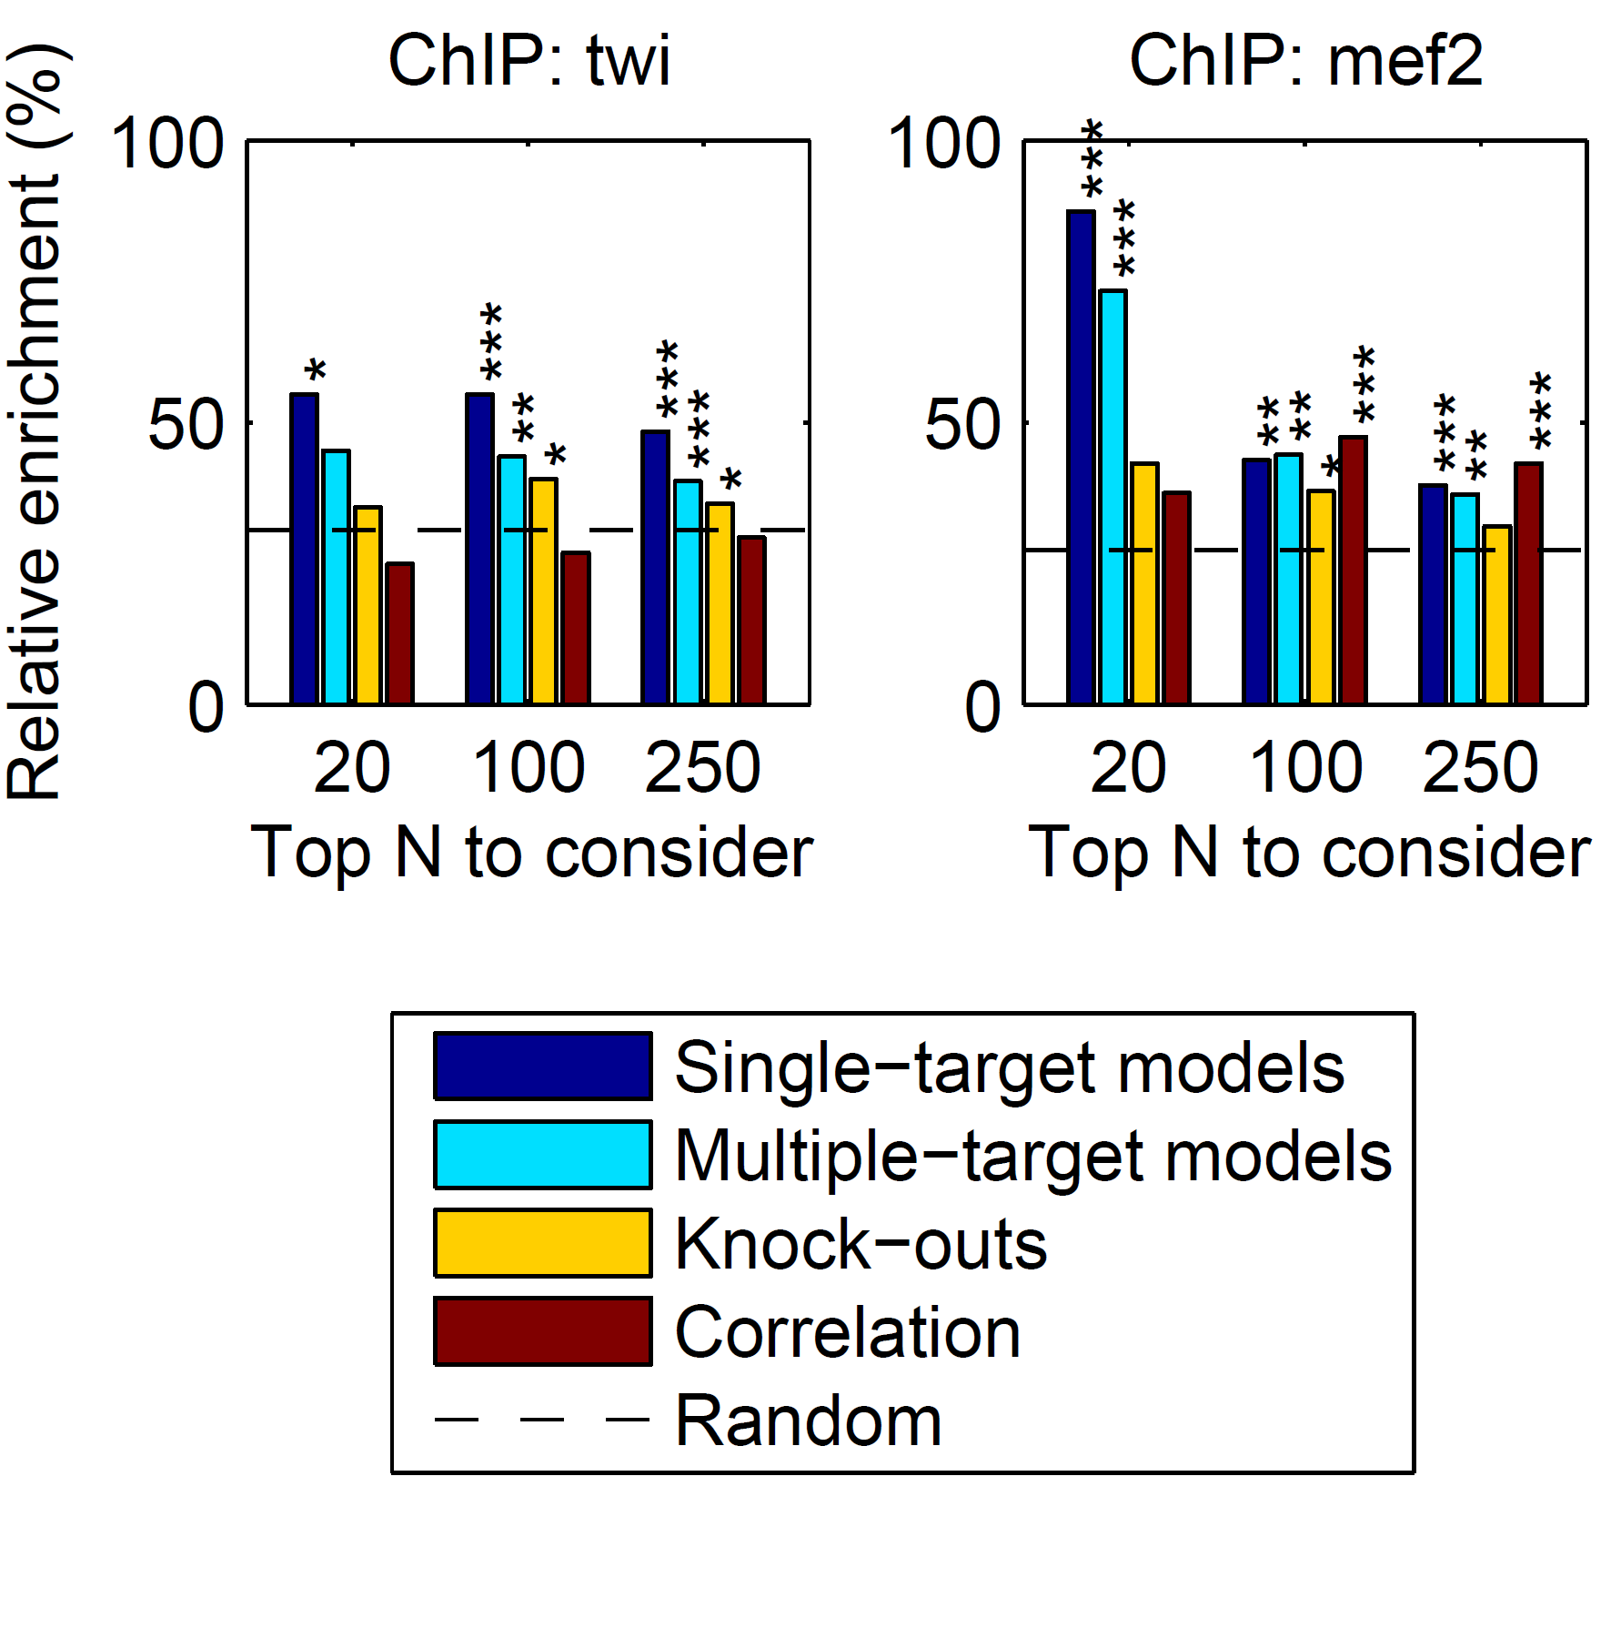

Slide 17
MATLAB Demo
demo_2016_01_29_OxWaSP.m

Slide 18
Further Challenge
This model inter-relates different functions with mechanistic understanding.
What if you need to inter-relate across different modalities of data at different scales.
E.g. biopsy images + genetic test + mammogram for breast cancer diagnostics.

Slide 19
The Data are Not Enough
Four pillars:
Deterministic/Stochastic
Mechanistic/Empirical
Goal: model complex phenomena over time
Problem:
Mechanistic models are often inaccurate
Data is often not rich enough for an empirical approach
Question 2: How do we formulate the right representations to integrate different data modalities?

Slide 20


Classical Latent Variables
$$\text{x}$$
$$\text{y}$$

Slide 21

Classical Treatment
Assume a priori that
$$\text{x}\sim N(0,\text{I}\text{)}$$
Relate linearly to $\text{y}$
$$\text{y} \text{=} \text{Wx} \text{+}ϵ$$
Framework covers many classical models PCA, Factor Analysis, ICA

Slide 22
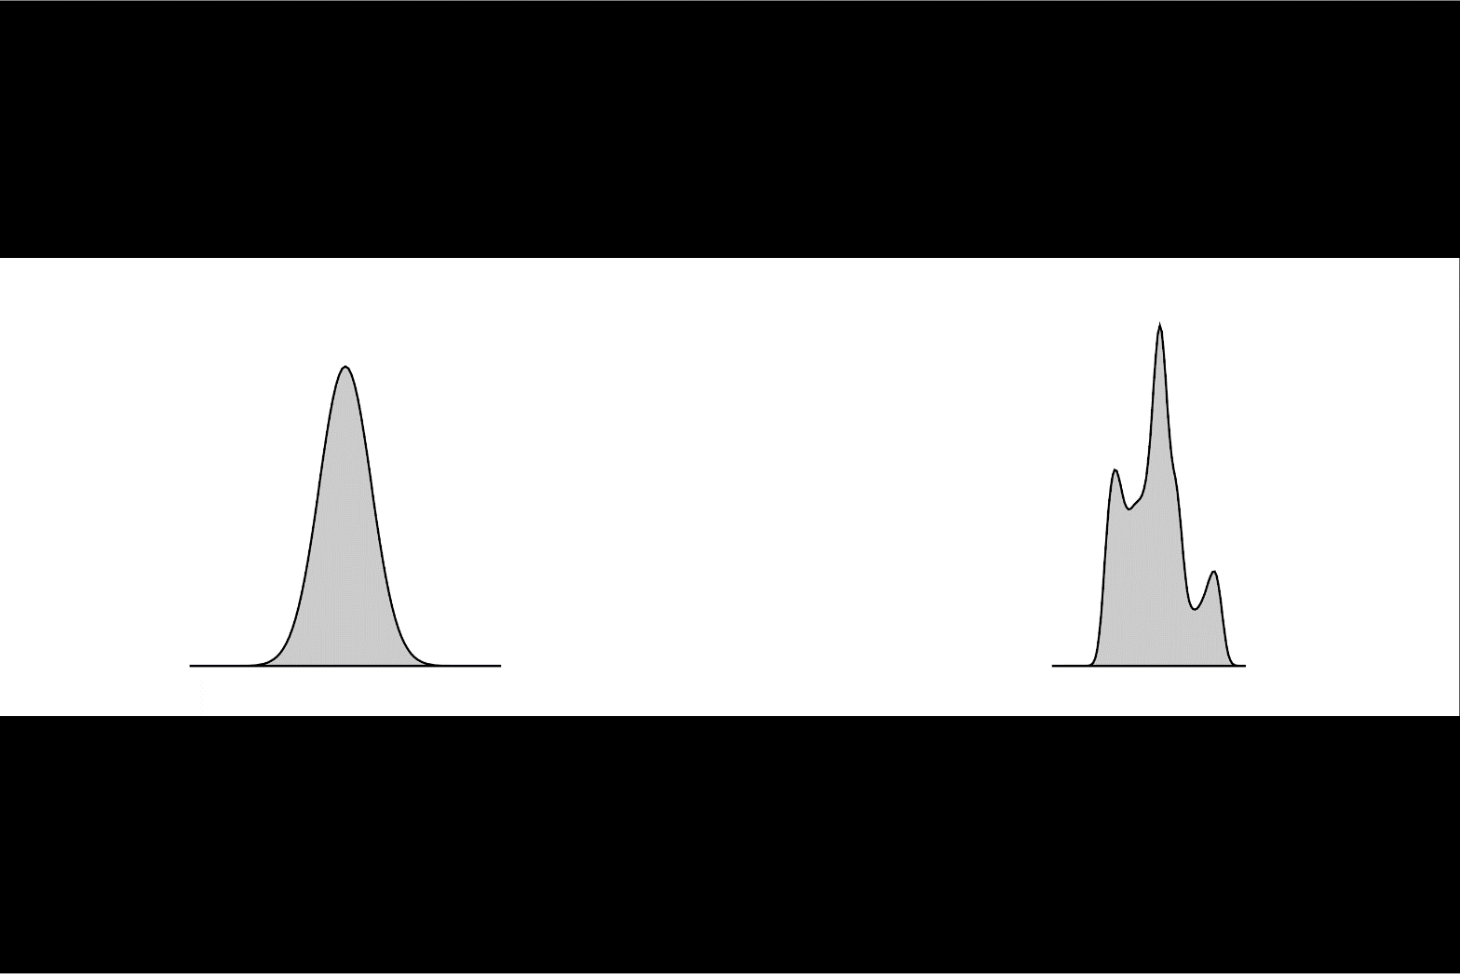


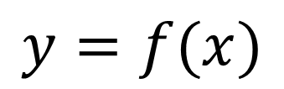
Render Gaussian Non Gaussian
$$y=f(x)$$
$$x$$
$$y$$
Notes:
In practice, many things are non gaussian, here I’ll introduce the idea of process composition: deep Gaussian processes, which we intend to use to deal with the Non Gaussian and abstract nature of the data. I’ll relate it to the OSI model and suggest that abstraction in this way, with propagation of uncertainty is a promising approach to phenomological modelling at multiple levels.

Slide 23
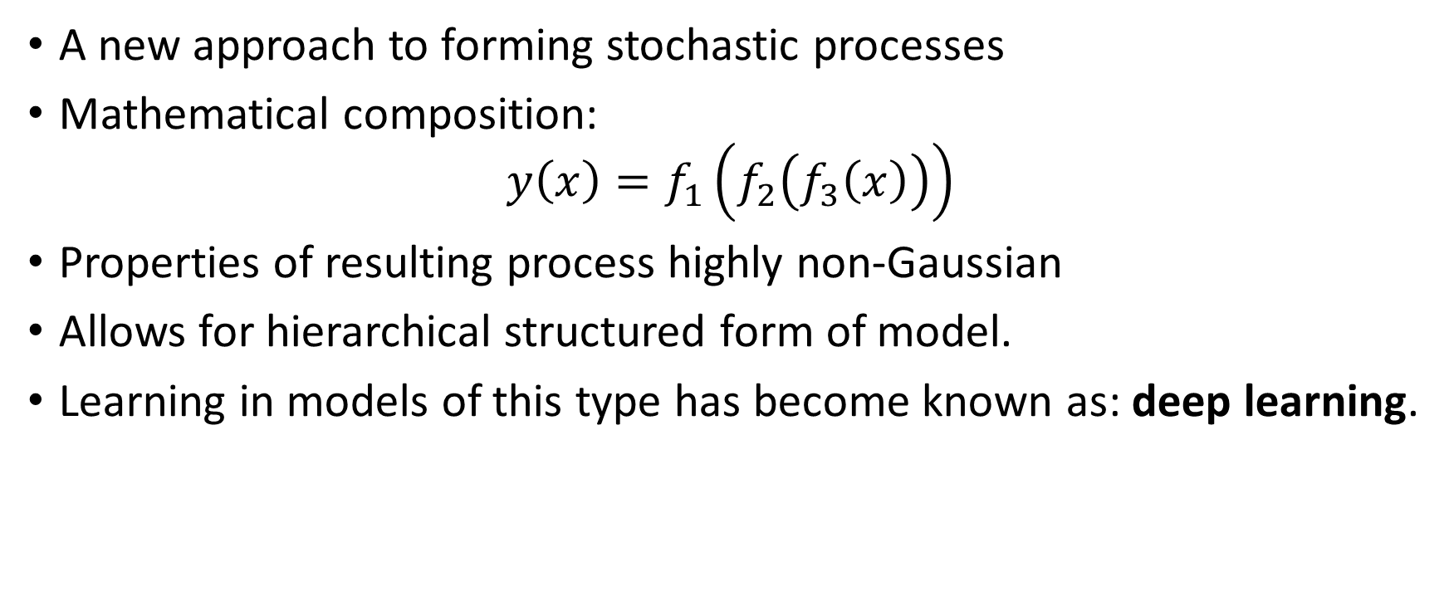
Stochastic Process Composition
A new approach to forming stochastic processes
Mathematical composition:
$$y\left(x\right)=f_{1}\left(f_{2}\left(f_{3}\left(x\right)\right)\right)$$
Properties of resulting process highly non-Gaussian
Allows for hierarchical structured form of model.
Learning in models of this type has become known as: deep learning.
Notes:
Non Gaussianity and structure achieved through the process of stochastic process composition. Leads to more flexible familiies of processes which can express more interesting beliefs about the system. Can be made to closely reflect the abstraction structure we referred to before.

Slide 24
Use Abstraction for Complex Systems
High Level Ideas
Stratification of Concepts
Low Level Mechanisms
Notes:
In this slide I’m going to use the layered model of network systems to describe the challenges of understanding complex systems in the physical world such as biological systems and neuroscience. I’ll give an analogy: imagine trying to understand the internet when you only have measurements of the cables and access to YouTube.

Slide 25
Biology and Health
Health
? ? ?
Molecular Biology
Notes:
Relate it to the situation in health where many of the intermediate layers are known. Einstein’s work was like a two layer system. How do we deal with multiple layers of abstraction.

Slide 26
Neuroscience
Behaviour
? ? ?
Neuron Firing
Notes:
Similar for the brain and behaviour. We are an an interesting juncture where the tools we use to develop our understanding of abstraction will be necessary for also unpicking function in the brain.

Slide 27
Example: Motion Capture Modelling
Notes:
I’ll give a quick demonstration of the deep Gaussian process (or show a video) probably on the motion capture. This one involves walkers and runners.

Slide 28
MATLAB Demo
demo_2016_01_29_OxWaSP.m

Slide 29

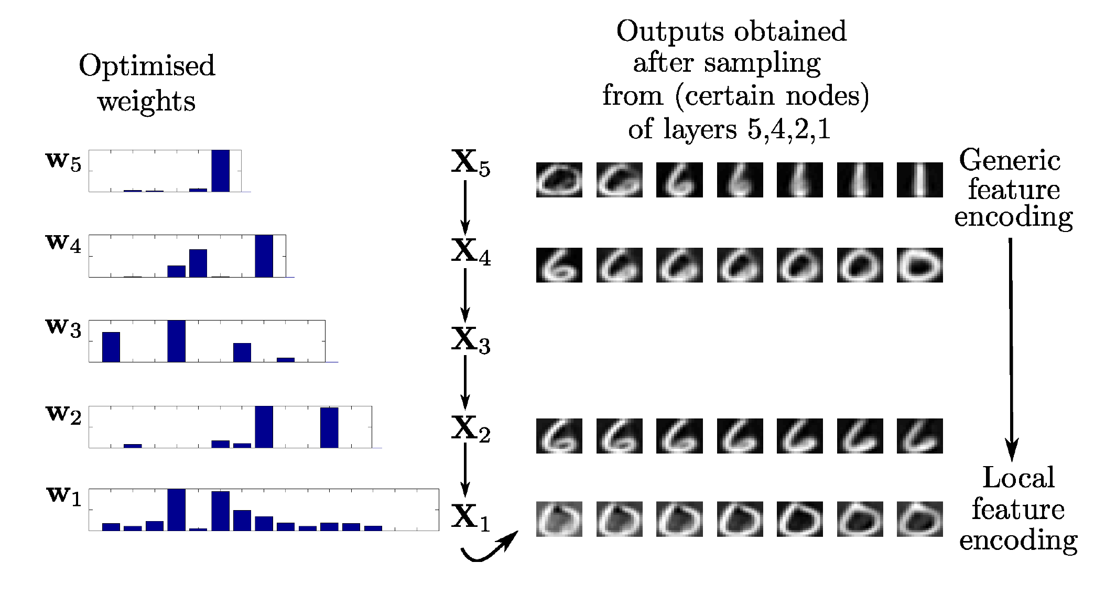
Modelling Digits
Notes:
This one involves a structure that is learnt to model digits.

Slide 30
MATLAB Demo
demo_2016_01_29_OxWaSP.m

Slide 31

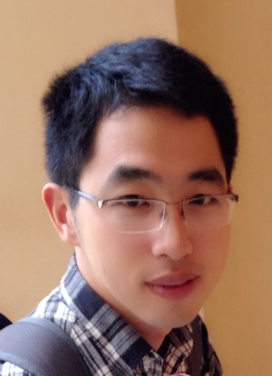

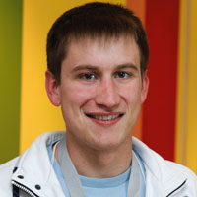
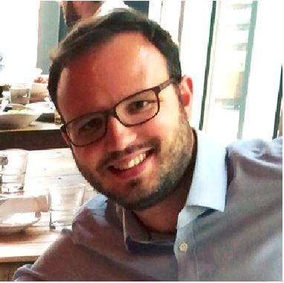
Health
Complex system
Scarce data
Different modalities
Poor understanding of mechanism
Large scale
genotype
environment
epigenotype
State of health
clinical tests
gene expression
Organ states
treatment
clinical notes
Cell states
survival analysis
PLoS Comp Bio, Nature Methods
biopsy
X-ray
Notes:
I’ll mention the larger challenge of health data where we need to integrate different data modalities and the mechanism by which they are generated is unknown. The challenge is to learn the structure that we imposed on the previous data set.

Slide 32
To Find Out More
Gaussian Process Summer School
12th-15th September 2016 in Sheffield
This year in parallel with/themed as a UQ orientated school (co-organisation with Rich Wilkinson)
Occurring alongside ENBIS Meeting
http://gpss.cc/

Slide 33
Future
Methodology
Deep GPs (also current)
Latent Force Models (current but dormant)
Latent Action Models and Stochastic Optimal Control (new)
Probabilistic Geometries (starting)
Exemplar Applications
Health and Biology (existing)
Developing world (existing)
Robotics at different scales (starting)
Perception: vision (dormant) haptic (new)

Slide 34
Summary
Complex systems:
‘big data’ is too ‘small’.
The data are not enough.
Need data efficient methods
http://www.theguardian.com/media-network/2016/jan/28/google-ai-go-grandmaster-real-winner-deepmind
Solutions:
Hybrid mechanistic-empirical models
Structured models for automated data assimilation

Slide 35
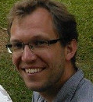

The Digital Oligarchy
Response to concentration of power with data
CitizenMe
London based start up
User-centric data modelling
New challenges in ML
Integration of ML, systems, cryptography.
Notes:
Also of interest: resolving the data liquidity problem (this could go into an appendix if the talk is too long). This means providing methods that respect user privacy. We cannot do this if our methods constantly require all data to be assimilated. Learning needs to be distributed across the population and in control of the users.

Slide 36
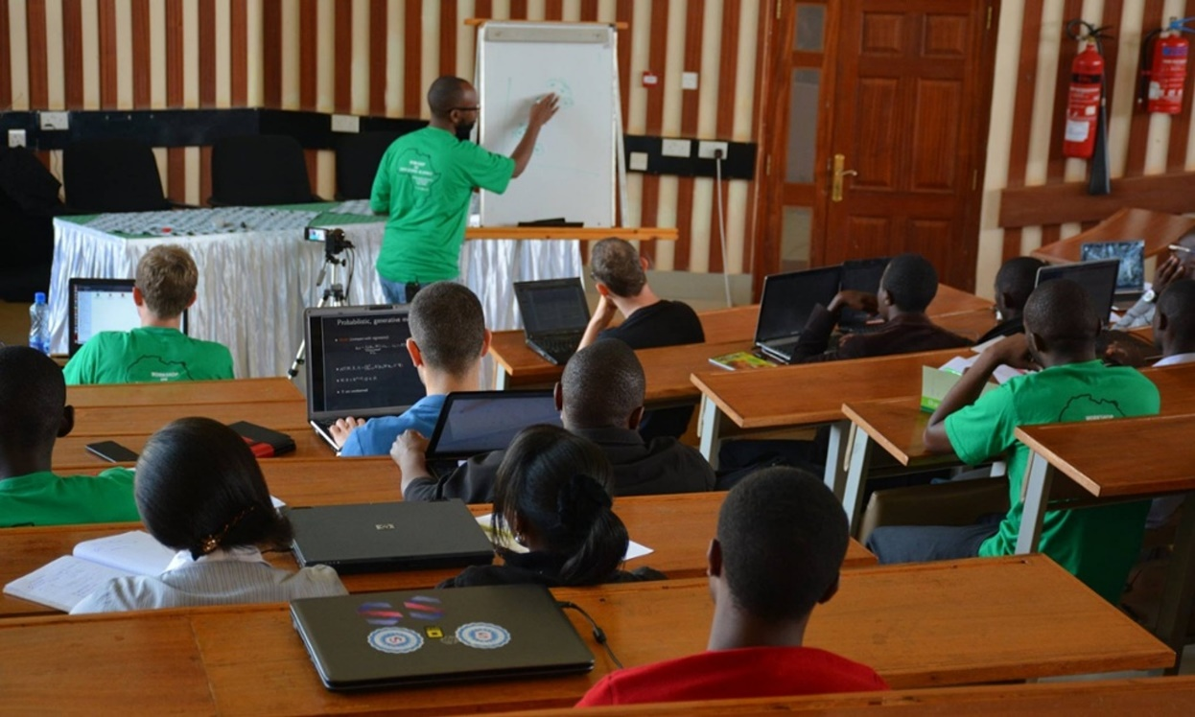
Open Data Science and Africa
Challenge
“Whole pipeline challenge”
Make software available
Teach summer schools
Support local meetings
Publicity in the Guardian
Opportunities to deploy pipeline solution
Notes:
Talk about why Africa is an interesting domain for deploying machine learning models, particularly given the context of the lack of infrastructure there and the possiblities for deploying solutions that are actually more efficient than those we have in Europe. The need to work with systems designers and cryptographers.
Uncertainty and modelling often critical in resource limited environments when a proper statistical design can not be undertaken due to cost.

Slide 37
Disease Incidence for Malaria
Notes:
Here I’ll use the example of disease monitoring in Uganda to describe the utility of these models in practice. I’ll relate what we need to do in resource deprived environments with a classical epidemiological approach (which would involve a randomized survey). The importance of modelling becomes apparent when the data itself is not randomized.

Slide 38
Uganda
Spatial models of disease
Notes:
Here I’ll use the example of disease monitoring in Uganda to describe the utility of these models in practice. I’ll relate what we need to do in resource deprived environments with a classical epidemiological approach (which would involve a randomized survey). The importance of modelling becomes apparent when the data itself is not randomized.

Slide 39
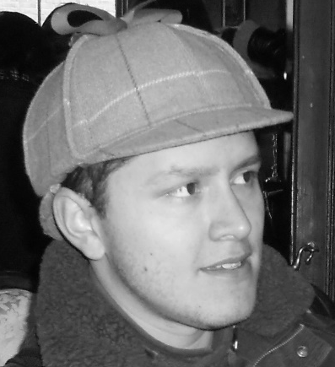
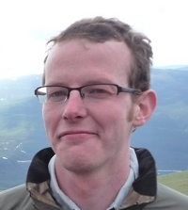

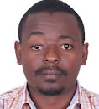
Deployed with UN Global Pulse Lab
http://pulselabkampala.ug/hmis/
Notes:
Possibly show a quick demo of the site Ricardo worked on with UN global pulse.

