Slide 1
PETs TRANSFORMER
From raw data
to a defensible release
A privacy release gate that protects the dataset, proves the recipient can still use it, and refuses unsafe releases.
END-TO-END PROJECT OVERVIEW
1
2
3
Tell it who gets the data.
DATA
RECIPIENT
VERDICT
It protects it. It measures usefulness. It shows its work.
TEAM
Oluwatobi Sholanke · Abdullahi Abdulwasiu · Emmanuel Ebere · Ali Ahmad · Ngum Claudia
PETs TRANSFORMER / PRIVACY RELEASE GATE
01
Notes:
Animation cue: reveal the three circles from left to right, then land on the line “defensible release”.

Slide 2
01 / WHY THIS EXISTS
Removing names is not the same as protecting people
The difficult part is not hiding one identifier. It is keeping the recipient’s questions answerable without leaving people easy to single out.
THE FAILURE MODE
THE BALANCE TO SOLVE
98.9%
1
2
3
of patients are unique when birth date, sex and postcode are combined.
Utility
Privacy
Evidence
Researchers still need answers: length of stay, revisits, trends.
Attackers should not be able to link a row back to a person.
A release must explain what changed and why it passed.
Synthetic hospital data / challenge scenario
PETs TRANSFORMER / PRIVACY RELEASE GATE
02
Notes:
Animation cue: start with the 98.9% figure, then build the three-way balance: utility, privacy, evidence.

Slide 3
02 / THE PRODUCT
A release gate that is recipient-aware
The same dataset can be safe for one recipient and unsafe for another. The scenario is part of the protection decision.
1
DATASET
2
SCENARIO
3
ENGINE
4
VERDICT
tables, text,
columns
recipient, trust,
questions
detect → select →
tune → transform
release, review
or block
Protection is not a one-click anonymiser.
It is a measured decision about one release to one recipient.
PETs TRANSFORMER / PRIVACY RELEASE GATE
03
Notes:
Animation cue: move a glowing “scenario” token into the engine; only then reveal the verdict.

Slide 4
03 / THE ENGINE
Six stages turn a vague sharing request into evidence
Every stage has a concrete responsibility. The gate is deliberately conservative: it can repair, hold for review, or refuse.
Detect
Transform
01
Label columns and personal data from names, values and evidence.
04
Pseudonymise, generalise, redact and shuffle.
Select
Verify
02
Keep only what the recipient’s required questions need.
05
Run look-alike attacks and compare original vs protected answers.
Tune
Report
03
Search safe settings against real usefulness scores.
06
Write the dashboard, manifest, summary and downloads.
The output is not just a file. It is a release decision with a traceable reason.
PETs TRANSFORMER / PRIVACY RELEASE GATE
04
Notes:
Animation cue: reveal the six cards as a conveyor belt. Pause on Verify: this is where unsafe output is stopped.

Slide 5
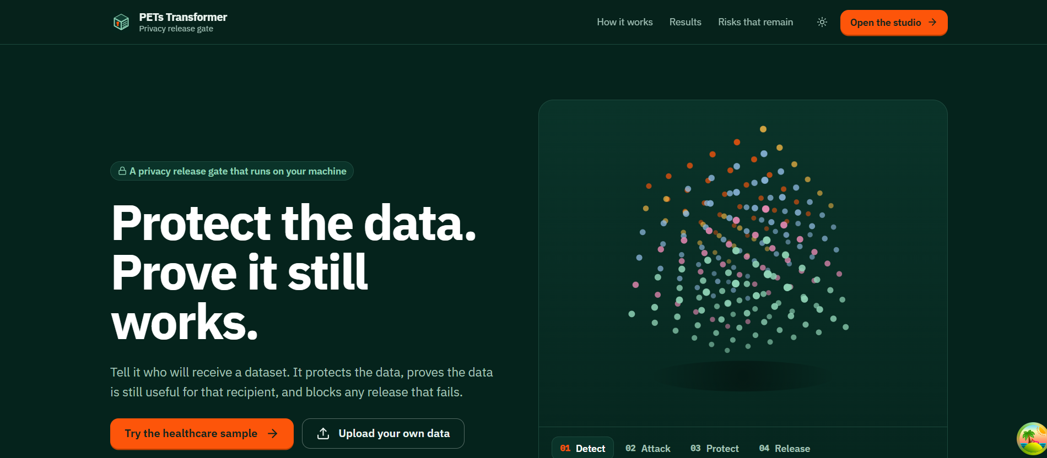
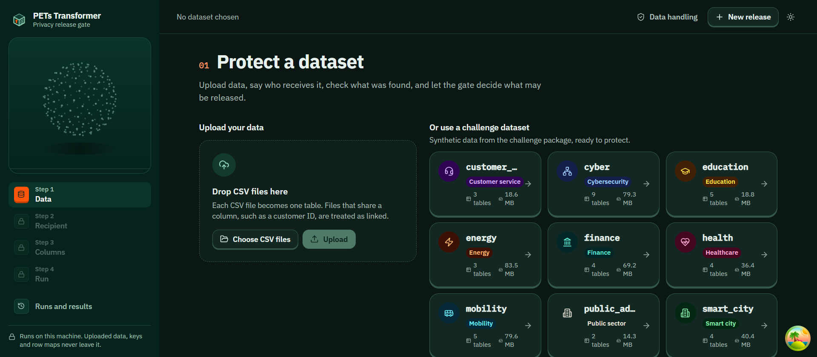
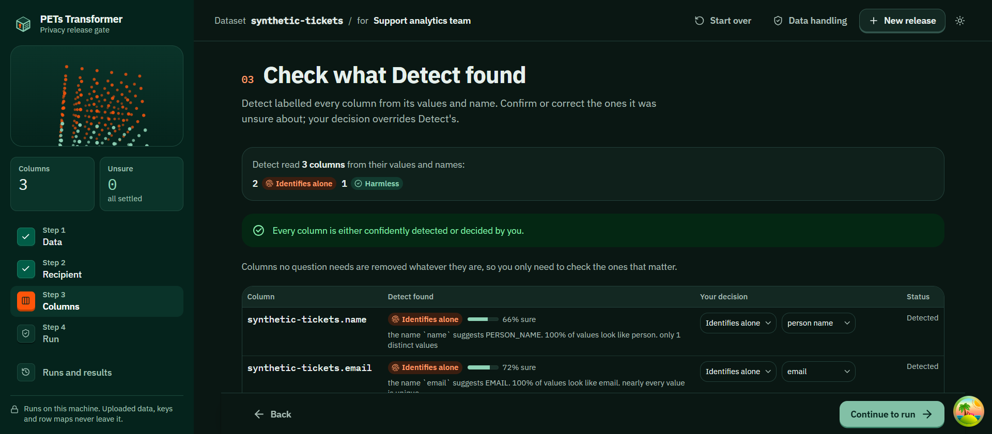
04 / THE WEB STUDIO
A four-step workflow keeps the person in control
The app turns the engine into a reviewable flow: choose data, describe the recipient, confirm uncertain labels, then run the gate.
1 Start with the problem
2 Choose data
3 Review Detect
1
DATA
2
RECIPIENT
3
COLUMNS
4
RUN
PETs TRANSFORMER / PRIVACY RELEASE GATE
05
Notes:
Animation cue: use a gentle left-to-right slide between the four steps. The screenshots are real project screens.

Slide 6
05 / DETECT
Detection is evidence-backed, not a black box
The detector combines column names, value patterns and cross-column checks. When confidence is low, a person can override it before the gate runs.
EXAMPLE LABELS
birth_date
identifies alone
postcode
clue
diagnosis
private fact
patient_hash
technical ID
visit_notes
free text
Human review is not a failure state. It is the explicit hand-off for uncertainty.
PETs TRANSFORMER / PRIVACY RELEASE GATE
06
Notes:
Animation cue: highlight one uncertain row and move it into a human-review callout. Stress that decisions are visible.

Slide 7
06 / SELECT + TUNE
Usefulness is measured against the recipient’s real questions
The engine starts from an allow-list, removes columns, and re-runs the questions. It searches for the safest settings that still answer them.
RECIPIENT QUESTIONS
SEARCH LOOP
RESULT
?
How long was the stay?
1
remove a column
0.99
2
score the question
usefulness score
?
How often did patients revisit?
3
coarsen the setting
Which diagnoses co-occur?
If a coarsening breaks a question, a safe column can come back and the search runs again.
?
4
keep the best safe plan
PETs TRANSFORMER / PRIVACY RELEASE GATE
07
Notes:
Animation cue: circulate the four search-loop steps, then pop the 0.99 result only after the loop is complete.

Slide 8
07 / TRANSFORM
Protection uses the smallest change that closes the risk
Different fields need different techniques. The engine also uses a recipient-specific key and shuffles rows so structure does not leak through order.
FIELD-LEVEL CHANGES
TECHNIQUES
Original
birth_date
1987-04-19
Keyed pseudonyms
links revisits without exposing the original ID
Protected
birth_date
1980s
Generalisation
reduces precision in dates, ages and locations
Original
patient_id
P-10482
patient_id
pt_7c9…
Code shortening
preserves a useful category without raw labels
Protected
Original
visit_notes
“Anna called…”
Layered redaction
removes personal data from free text
Protected
visit_notes
[name] called…
Row shuffling
prevents arrival order from becoming a clue
PETs TRANSFORMER / PRIVACY RELEASE GATE
08
Notes:
Animation cue: show each original field flipping into its protected value; then reveal the technique list.

Slide 9
08 / VERIFY
The gate attacks its own output before it releases it
A release is only successful when privacy and usefulness pass together. If rows still stand out, the engine repairs the release or blocks it.
1
2
3
4
5
TRANSFORM
ATTACK
REPAIR
RECHECK
VERDICT
protected output
look-alike check
blank one clue
privacy + utility
release / hold / block
Attempt 1 → blocked
Repair → age band removed
Attempt 2 → RELEASED
PETs TRANSFORMER / PRIVACY RELEASE GATE
09
Notes:
Animation cue: show the first verdict as blocked, then rewind one step, remove one clue, and land on the released state.

Slide 10
09 / PUBLIC RELEASES
Public recipients get answers, never rows
When the recipient is “anyone”, the engine switches modes: it publishes differentially private answers with an explicit budget and bounded contribution.
ROW-LEVEL RELEASE
HEALTH-S2 SELF-ASSESSMENT
Research team
protected rows
ε 1
privacy budget
Vendor under contract
protected rows
254
noisy answers
Public dashboard
no rows
PETs TRANSFORMER / PRIVACY RELEASE GATE
10
Notes:
Animation cue: first show the three recipient types; then morph the public row into a cloud of noisy answers.

Slide 11
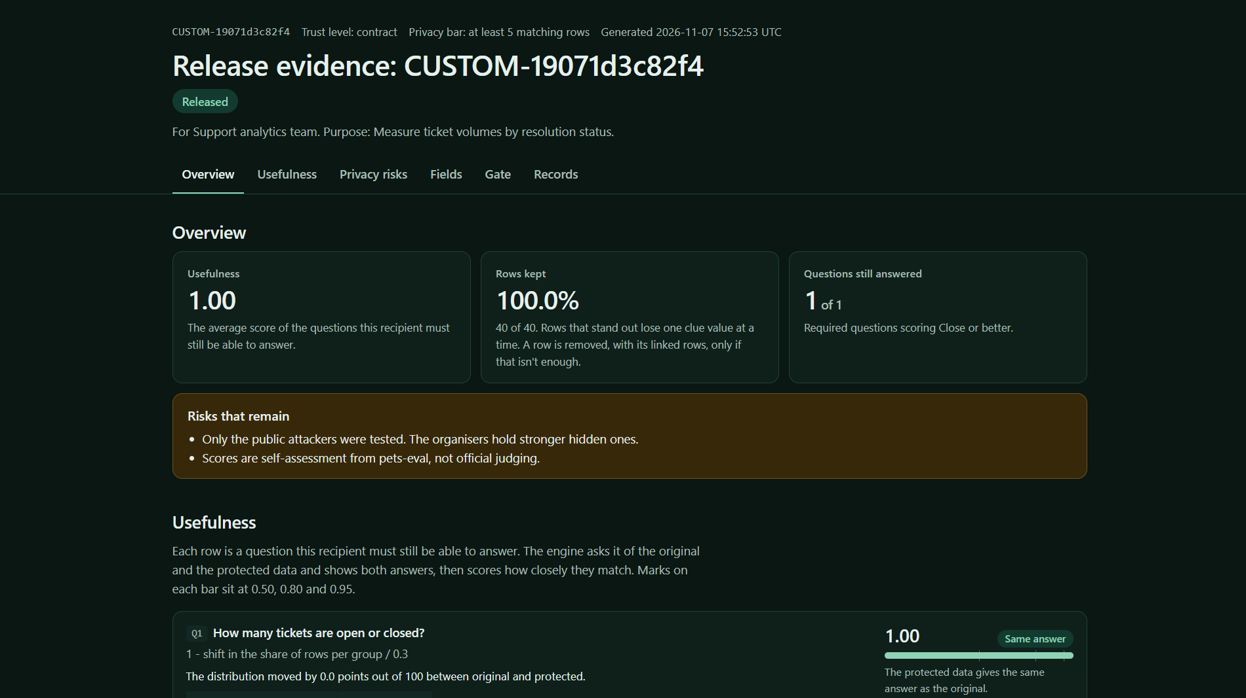
10 / EVIDENCE
The result comes with a browser, a manifest and a plain-language story
The dashboard makes the decision inspectable: scores, field treatment, question comparisons, risks and the protected records are all traceable.
WHAT THE REPORT EXPLAINS
Privacy score
Did the attacks find people?
Usefulness score
Did the questions still work?
Field-by-field record
What changed, and why?
Risk register
What remains unresolved?
Downloads
Protected data and evidence only
Evidence is part of the product, not an afterthought.
PETs TRANSFORMER / PRIVACY RELEASE GATE
11
Notes:
Animation cue: zoom into the dashboard screenshot, then reveal the five evidence questions one by one.

Slide 12
11 / RESULTS
The gate preserves utility without hiding the trade-offs
Self-assessment uses the challenge’s public attackers and pets-eval toolkit. The headline is strong performance plus honest residual risk.
USEFULNESS BY SCENARIO
RISKS WE STILL REPORT
Repeat visits can form a unique pattern.
Diagnosis knowledge can single out 25% of visits.
Cyber logs retain minute-level timestamps.
Public budgets can accumulate across releases.
Strong numbers are more credible when the weak spots are visible.
PETs TRANSFORMER / PRIVACY RELEASE GATE
12
Notes:
Animation cue: bars rise in scenario order. Then fade in the risk list as a deliberate contrast to the score.

Slide 13
12 / ARCHITECTURE
A local-first stack keeps sensitive data on the machine
The web app is a thin interface around a Python engine. Docker Compose keeps the API, engine dependencies and nginx frontend together.
1
BROWSER
2
WEB
3
API
4
ENGINE
React + TypeScript
Chakra UI
nginx serves UI
and proxies /api
FastAPI routers
+ run service
Python
pandas + PETs
Sensitive inputs, keys, row maps and run evidence stay in the local workspace volume.
That is why the current deployment model is Docker Compose first; cloud deployment needs durable storage and a worker model.
PETs TRANSFORMER / PRIVACY RELEASE GATE
13
Notes:
Animation cue: trace the request from browser to engine, then illuminate the local workspace volume as the privacy boundary.

Slide 14
THE TAKEAWAY
A release is ready
when the evidence says so
ONE SENTENCE
Tell it who gets the data.
It protects it, proves it is still useful, and blocks any release that fails.
PETs Transformer turns data sharing from an informal export into a recipient-specific, measured decision.
Protect
field-level techniques, keyed pseudonyms, text redaction
Prove
question scores, attacker checks, dashboards and manifests
PETs Transformer
Privacy release gate / 2026
Refuse
repair, hold or block when the release cannot meet the bar
TEAM
Oluwatobi Sholanke · Abdullahi Abdulwasiu · Emmanuel Ebere · Ali Ahmad · Ngum Claudia
PETs TRANSFORMER / PRIVACY RELEASE GATE
14
Notes:
Animation cue: reveal Protect, Prove and Refuse in sequence. End on the one-sentence product promise.

