Slide 1
Project One @ Revature
@Author: Jia ying Li
Date: 2022/02/18

Slide 2
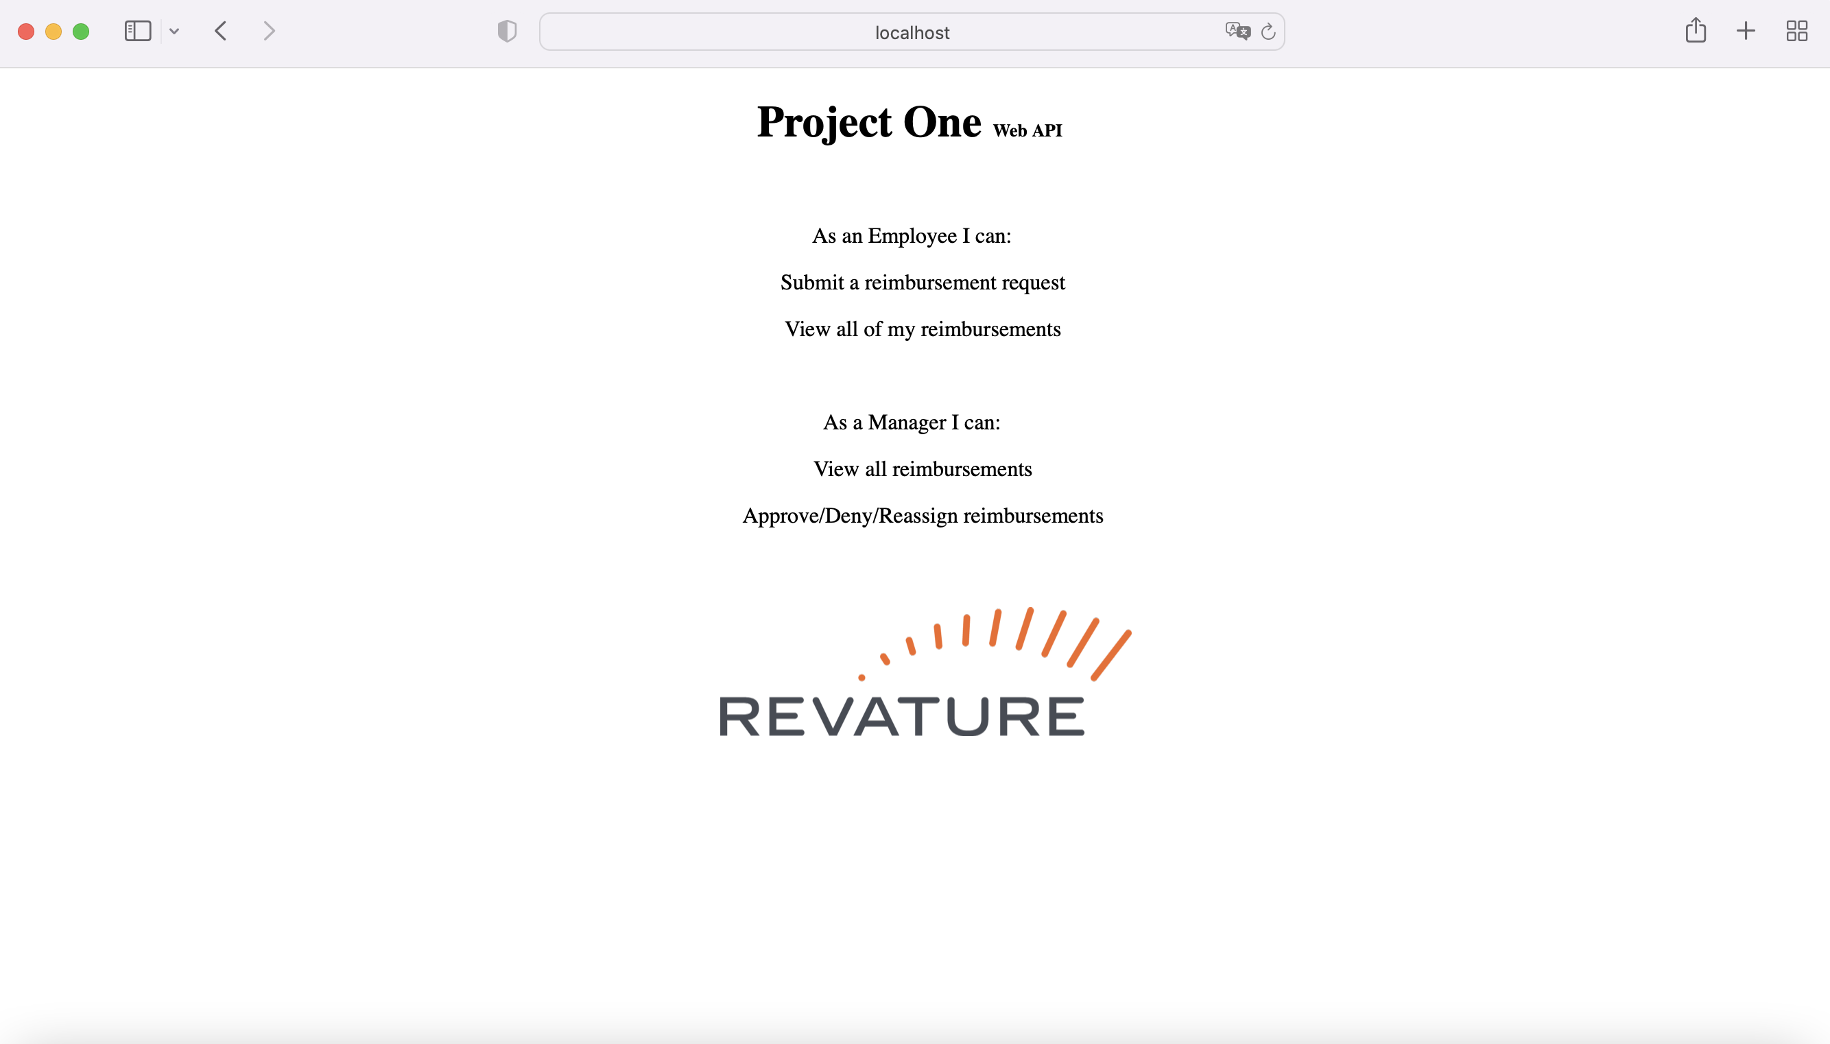
@localhost:8888

Slide 3
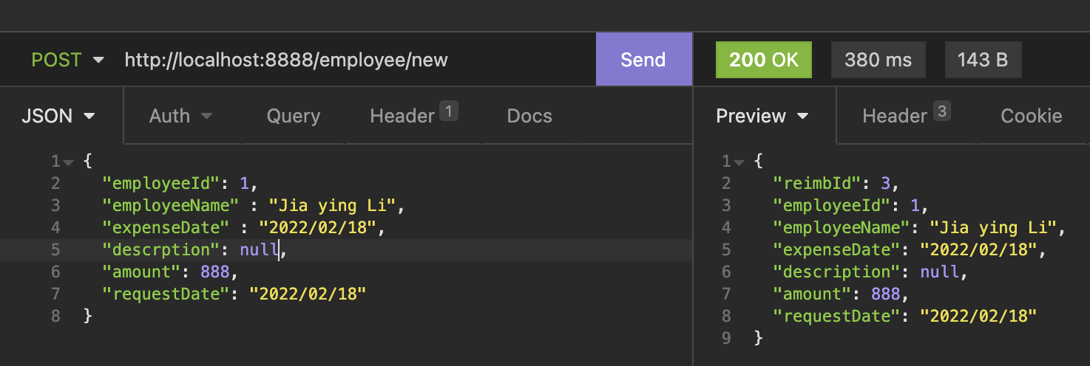
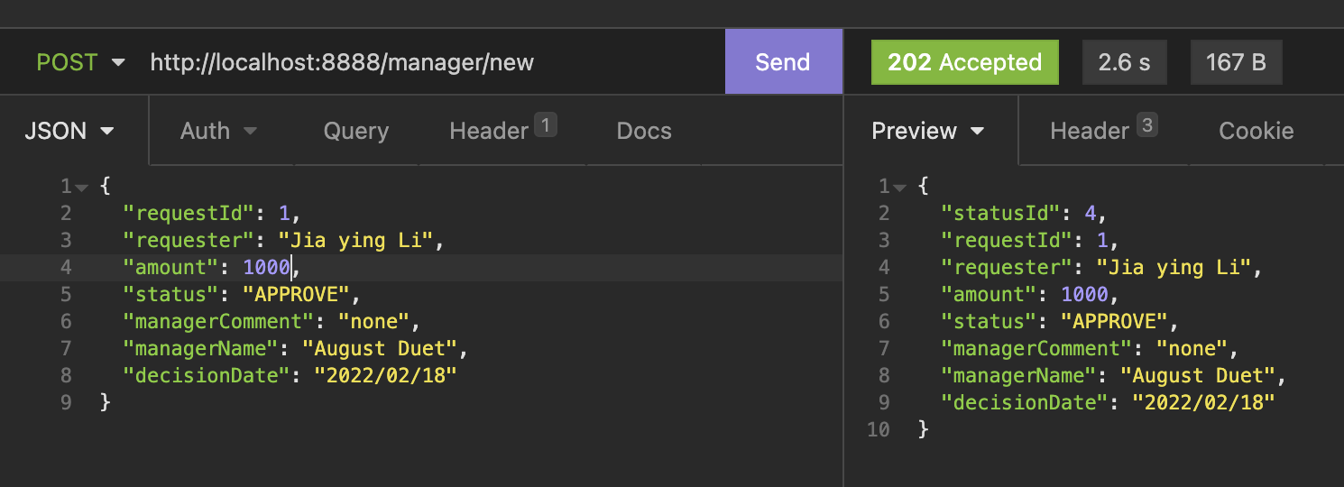
First API

Slide 4



Connecting with Database

Slide 5
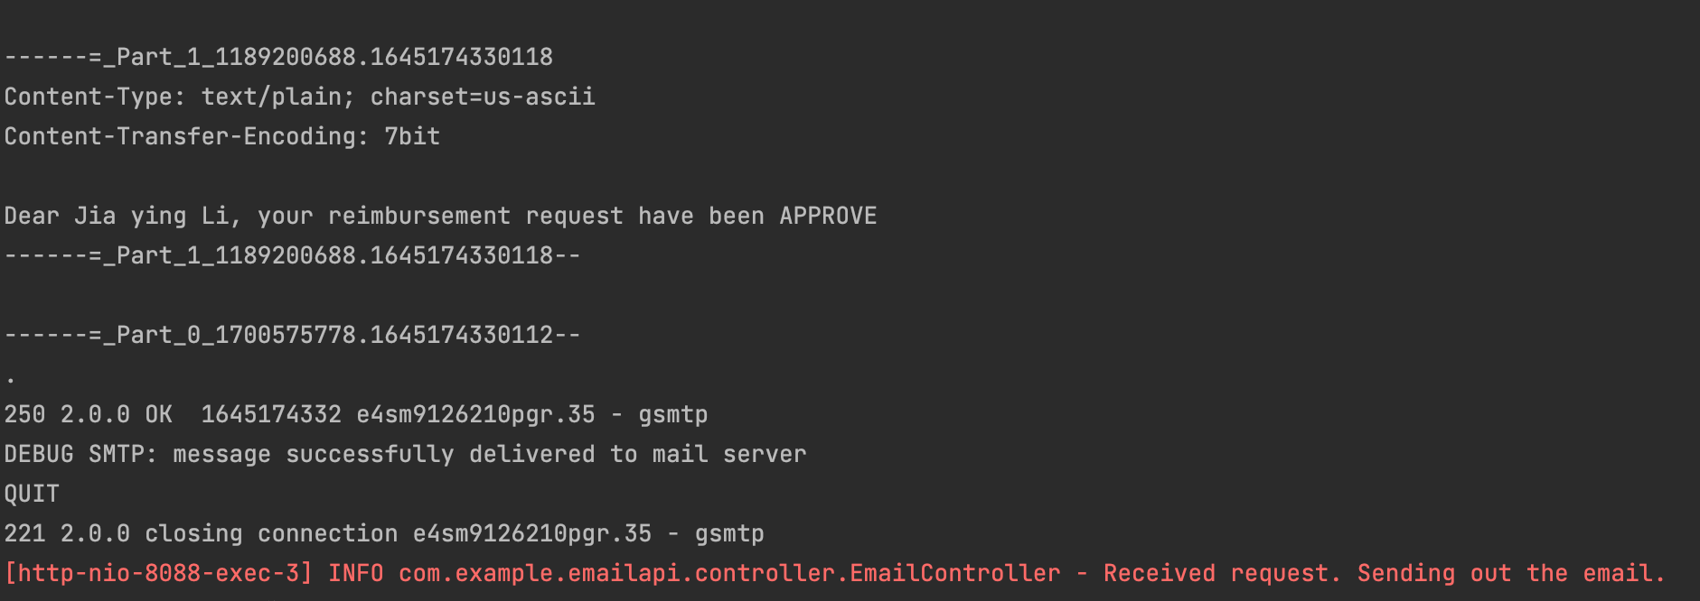
Second API

Slide 6






Unit Testing

