Slide 1
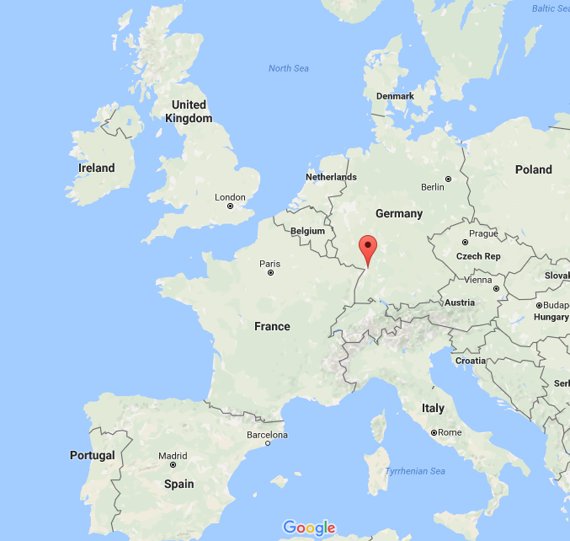
Gradual Verification
with Implicit Dynamic Frames
Master Thesis of
Johannes Bader
Karlsruhe Institute of Technology
Karlsruhe, Germany
Advised by
Assoc. Prof. Jonathan Aldrich
Carnegie Mellon University
Pittsburgh, USA
Assoc. Prof. Éric Tanter
University of Chile
Santiago, Chile

Slide 2
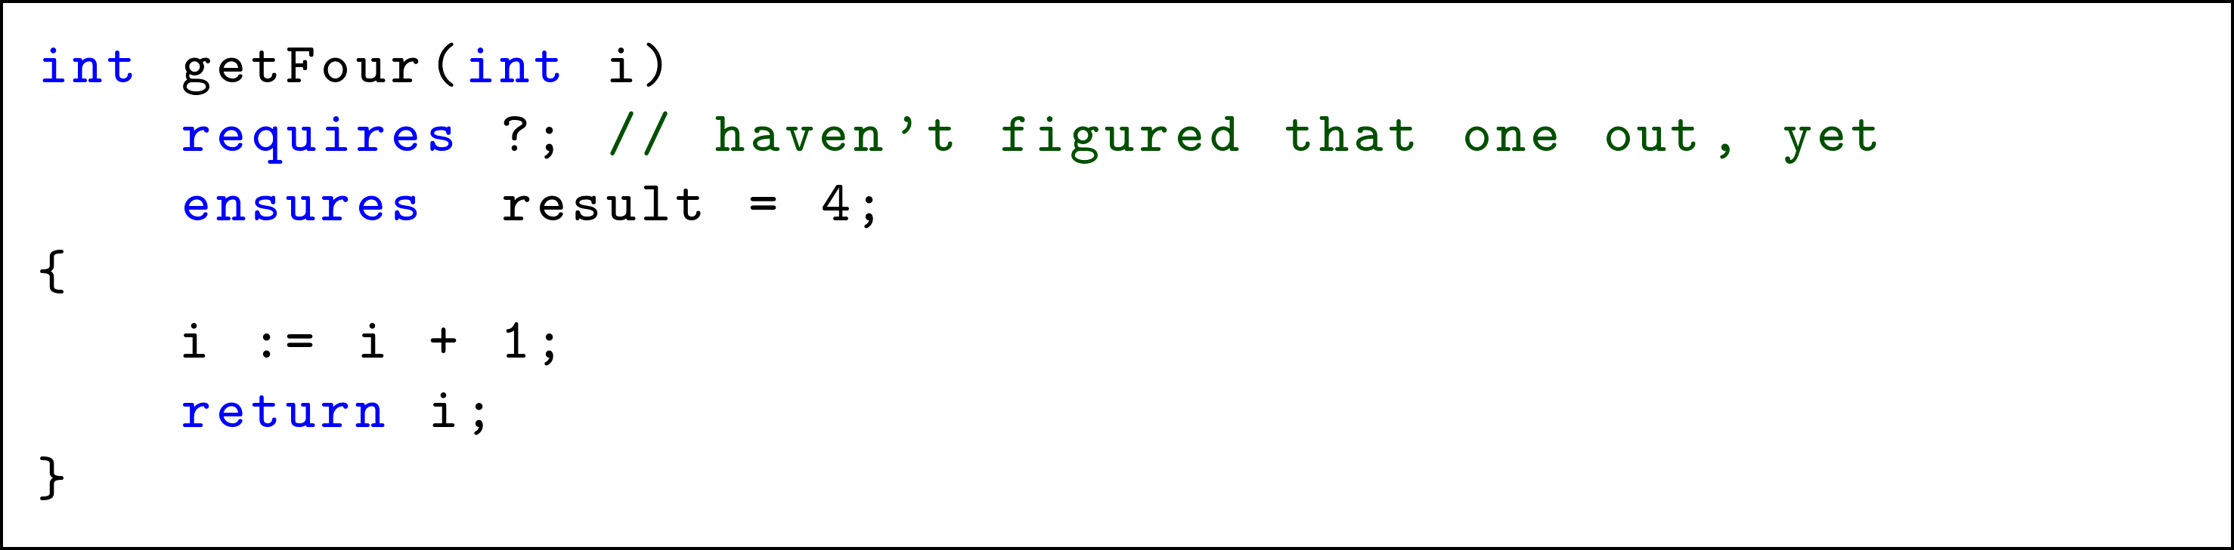
Gradual Verification
(with Implicit Dynamic Frames)

Slide 3
Motivation
Program verification (against some specification)
Two flavors: static & dynamic
// spec: callable only if (this.balance >= amount)
void withdrawCoins(int amount)
{
// business logic
this.balance -= amount;
}
Notes:
does NOT guarantee termination (partial correctness)

Slide 4
Dynamic Verification
runtime checks
testing techniques
guarantee compliance at runtime
// spec: callable only if (this.balance >= amount)
void withdrawCoins(int amount)
{
// business logic
this.balance -= amount;
}
void withdrawCoins(int amount)
{
assert this.balance >= amount;
// business logic
this.balance -= amount;
}

Slide 5
Dynamic Verification - Drawbacks
runtime checks
testing techniques
guarantee compliance at runtime
runtime overhead
additional efforts
pot. late detection
void withdrawCoins(int amount)
{
assert this.balance >= amount;
// business logic
this.balance -= amount;
}
void withdrawCoins(int amount)
requires this.balance >= amount;
{
// business logic
this.balance -= amount;
}
Notes:
industry addresses this problem by: removed on build

Slide 6
Static Verification
declarative
formal logic
guarantee compliance in advance
void withdrawCoins(int amount)
requires this.balance >= amount;
{
// business logic
this.balance -= amount;
}

Slide 7
Static Verification - Drawbacks
declarative
formal logic
guarantee compliance in advance
limited syntax
decidability
annotation pressure
void withdrawCoins(int amount)
requires this.balance >= amount;
ensures this.balance = old(this.balance) – amount;
{
// business logic
this.balance -= amount;
}
void withdrawCoins(int amount)
requires this.balance >= amount;
{
// business logic
this.balance -= amount;
}
Notes:
industry addresses this problem by (already a joke – it doesn’t address this problem because there is no static verification): often only warnings

Slide 8
Solution? Static + Dynamic
Means:
“relaxed” static verification (warnings on failure)
turn contracts into runtime assertions
Notable implementations:
Java with JML annotations
  “ESC/Java” for static verification
  “JML4c” for dynamic verification
Code Contracts for .NET (by RiSE, MSR)
Notes:
„Research in Software Engineering“ (MSR)

Slide 9
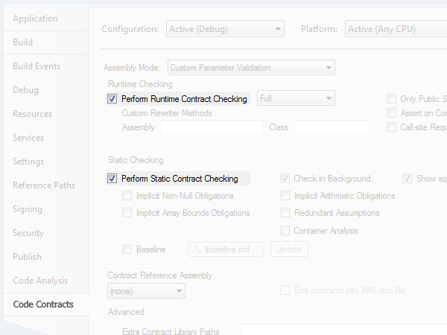
Solution? Static + Dynamic
Notes:
picture also shows what’s wrong with the approach: static and dynamic are considered independent, not really working together
Research: find good tests (directed dynamic verification)

Slide 10
Solution! Static ⊕ Dynamic
Typing
Typing
“Static Checking Where Possible,
Dynamic Checking When Needed”
(Erik Meijer)
// gradual typing
object eval(string exprCode)
{
…
}
…
string expr = "string.Concat(20, '+', 22)";
object res1 = eval(expr); // statically guaranteed
object res2 = eval((string)res1); // dyn guaranteed
object res3 = eval((string)res2); // dyn guaranteed 
// gradual typing
dynamic eval(string exprCode)
{
…
}
…
string expr = "string.Concat(20, '+', 22)";
dynamic res1 = eval(expr); // statically guaranteed
dynamic res2 = eval(res1); // dynamically guaranteed
dynamic res3 = eval(res2); // dynamically guaranteed 
void withdrawCoins(int amount)
requires this.balance >= amount;
{
…
}
…
acc.balance = 100;
acc.withdrawCoins(50); // statically guaranteed
acc.withdrawCoins(30); // dynamically guaranteed
acc.withdrawCoins(30); // dynamically guaranteed 
void withdrawCoins(int amount)
requires this.balance >= amount;
{
…
}
…
acc.balance = 100;
acc.withdrawCoins(50); // can prove acc.balance >= 50
acc.withdrawCoins(30); // can’t prove acc.balance >= 30
acc.withdrawCoins(30); // can’t prove acc.balance >= 30
Notes:
…gradual defined in terms of static system (+ casts or dyn. checks)… but also viewable as extension of dynamic
gradual typing taught us that solution is not to blindly combine approaches
AGT formalizes how to get from … to …

Slide 11
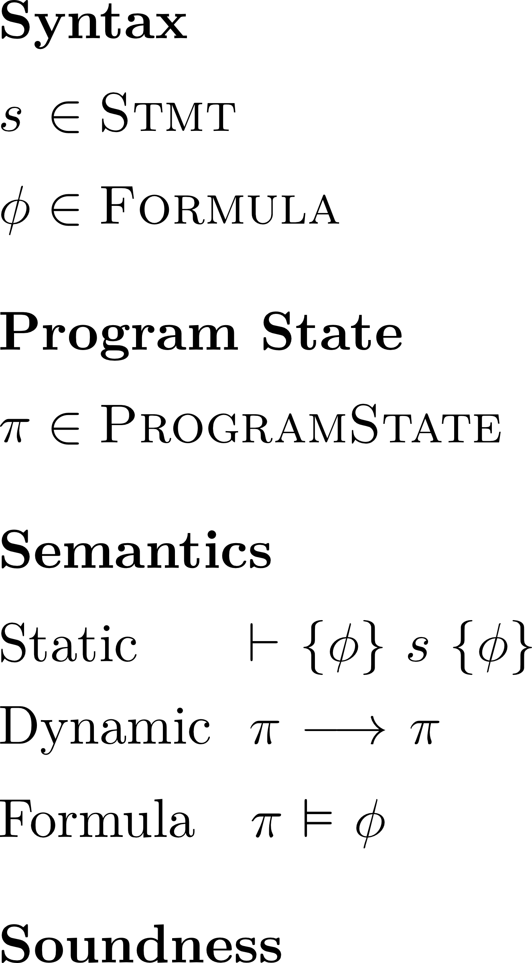
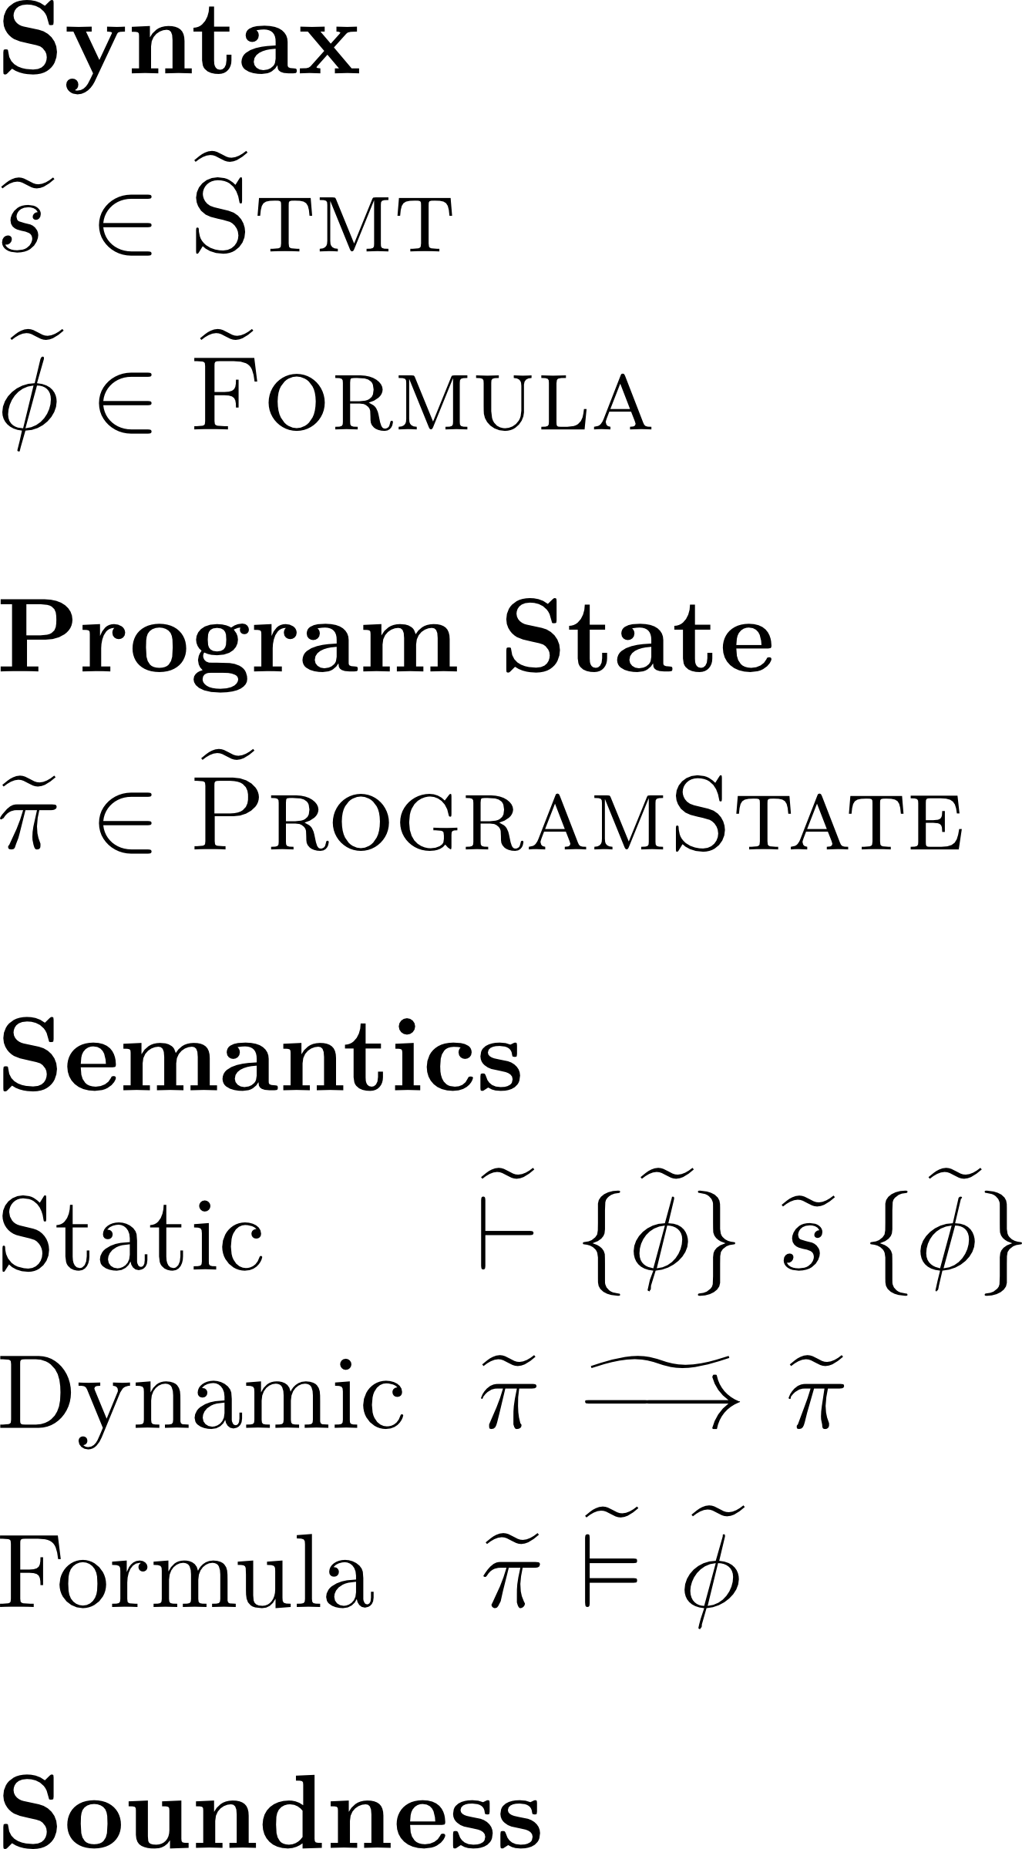
Approach
Gradualization
11
Notes:
define a gradually verified programming language in terms of a statically verified one (process called gradualization)
AGT

Slide 12
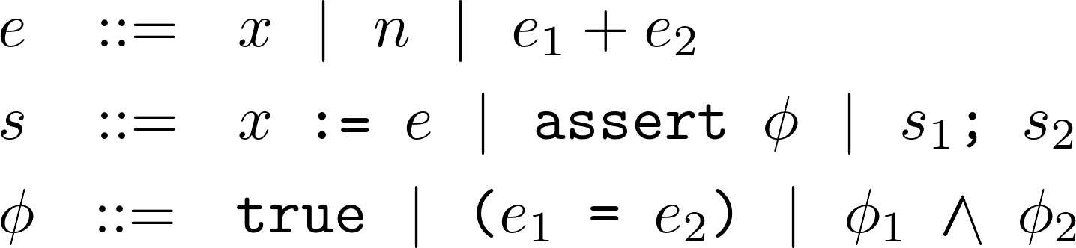
Statically Verified Language
12
Notes:
define a gradually verified programming language in terms of a statically verified one (process called gradualization)
AGT

Slide 13
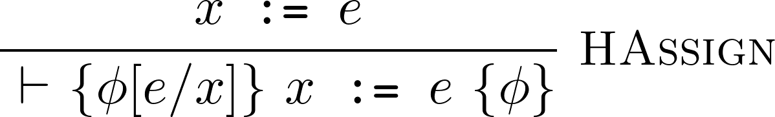
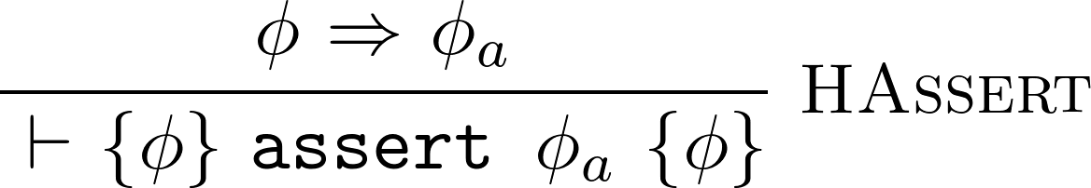
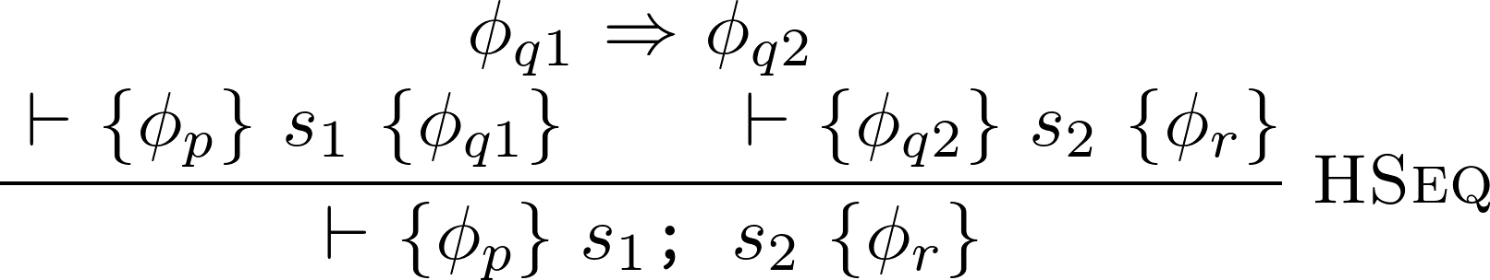
Statically Verified Language
13
Notes:
define a gradually verified programming language in terms of a statically verified one (process called gradualization)
AGT

Slide 14
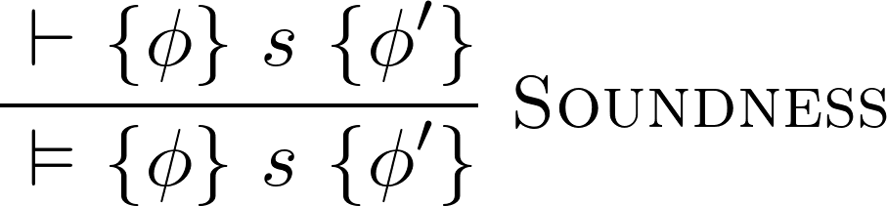
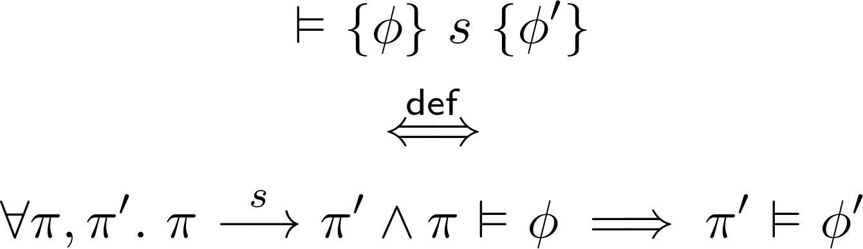
Statically Verified Language
14
Notes:
define a gradually verified programming language in terms of a statically verified one (process called gradualization)
AGT

Slide 15
Approach
Gradualization
15
Notes:
define a gradually verified programming language in terms of a statically verified one (process called gradualization)
AGT

Slide 16
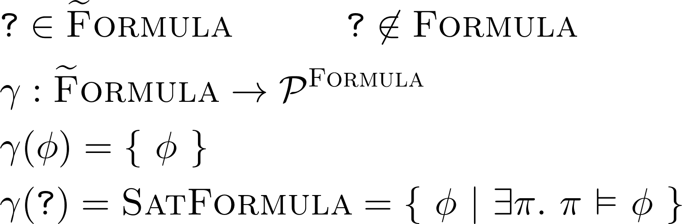
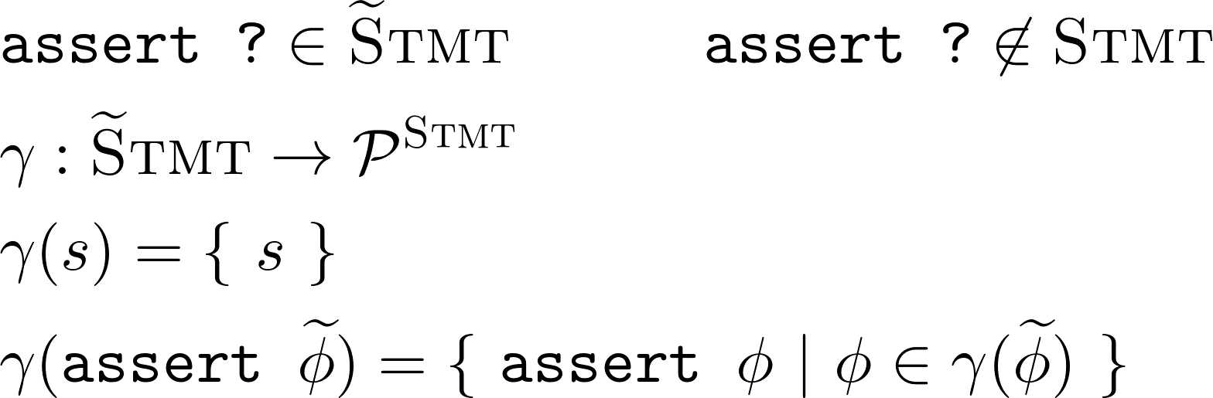
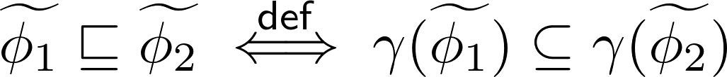
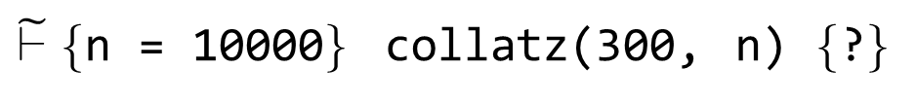
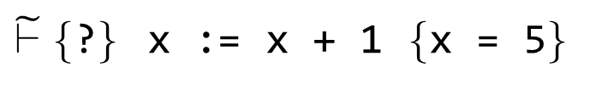
Gradualization – Goal 1/3
Introduction of wildcard formula ?
placeholder for arbitrary (satisfiable) formula
enables Hoare deduction despite incomplete information
enables gradual annotation of programs (? as default)
Formula Precision
$\tilde{⊢}\{$n = 10000$\}$ collatz(300, n) $\{$?$\}$
abstract
interpretation
$\tilde{⊢}\{$?$\}$ x := x + 1 $\{$x = 5$\}$
abstract
interpretation
16
Notes:
define a gradually verified programming language in terms of a statically verified one (process called gradualization)
this is design space
TODO: other sets

Slide 17
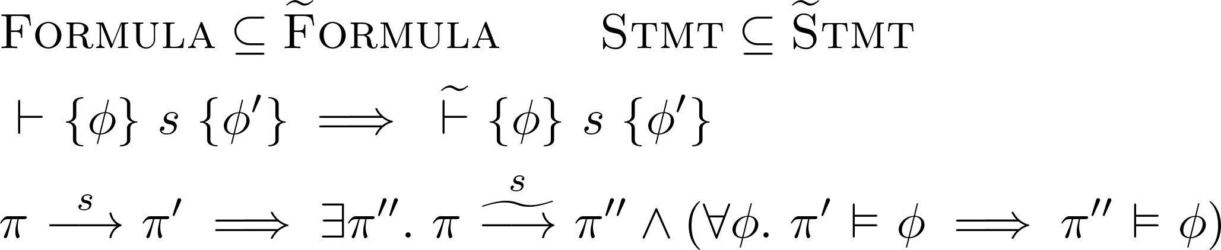
Gradualization – Goal 2/3
Compatibility with static language
don’t reject source code that was accepted before
observable behavior is not changed
static
dynamic
17
Notes:
define a gradually verified programming language in terms of a statically verified one (process called gradualization)

Slide 18
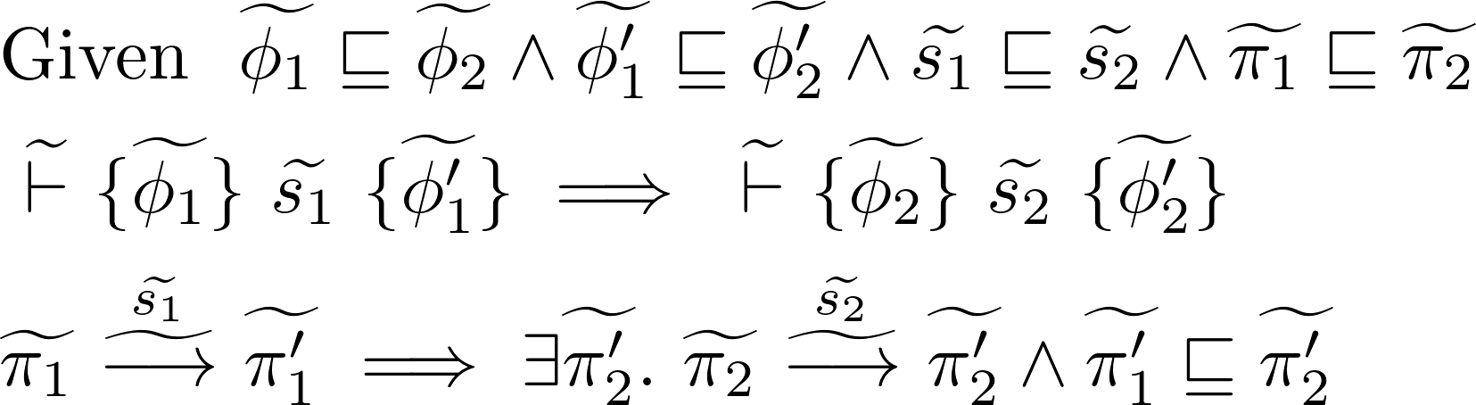
Gradualization – Goal 3/3
Gradual guarantee (Siek et al.), adapted
Reducing precision will not
introduce verification failure
change observable behavior
static
dynamic
18
Notes:
define a gradually verified programming language in terms of a statically verified one (process called gradualization)

Slide 19
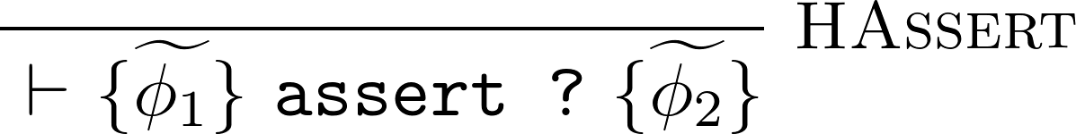
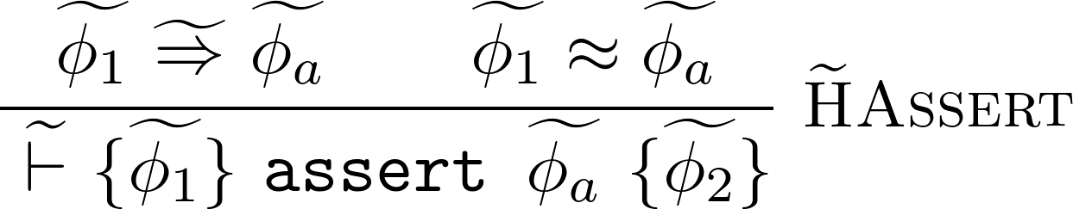
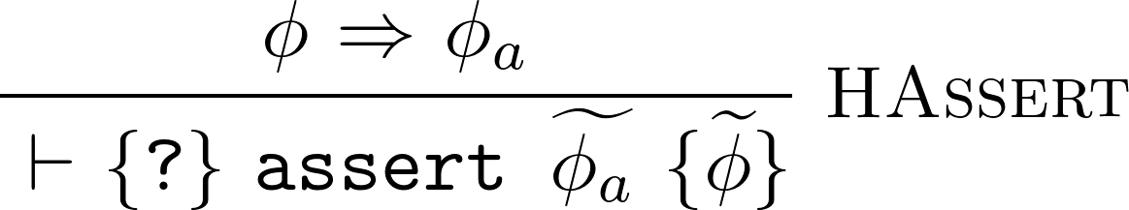
Gradual Predicate Lifting
Introduction
Monotonicity

Slide 20
Gradual Predicate Lifting
Introduction
Monotonicity
(Optimality)
⬄

Slide 21
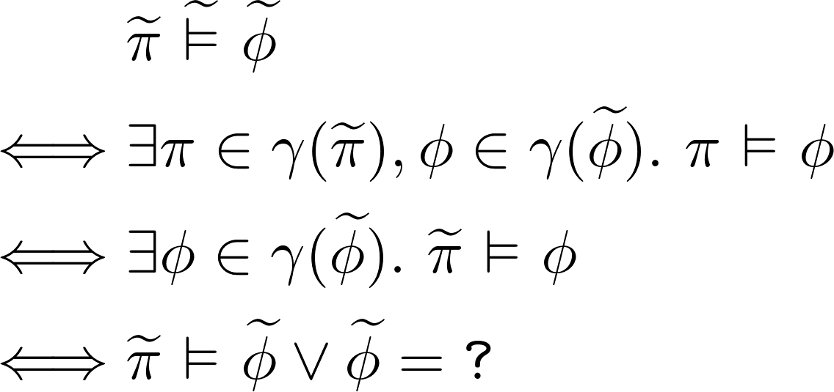
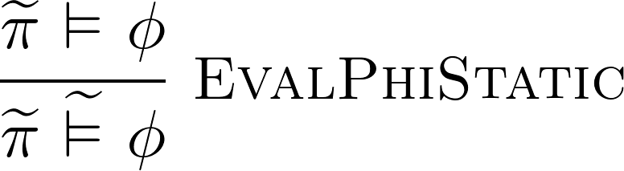
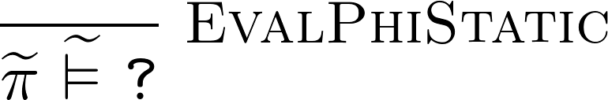
Gradual Predicate Lifting
⬄

Slide 22
Gradual Function Lifting
Introduction
Monotonicity
(Optimality)
⬄

Slide 23
Gradual Partial Function Lifting
Introduction
Monotonicity
(Optimality)
⬄

Slide 24
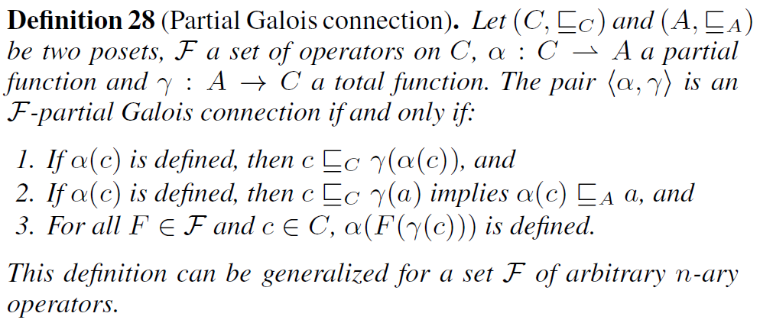
Bonus: { F }-partial Galois connection

Slide 25
Gradual Verification - Approach
Design
Space
Design
Space
Gradualization
Gradual
Guarantee
Abstract
Interpretation
Notes:
abstract interpretation – as we will see later doing so has very desirable properties

Slide 26
Gradual Verification - Approach
Design
Space
Design
Space
syntax extension
abstract interpretation
Gradual
Guarantee
Abstract
Interpretation
predicate lifting
partial function lifting
predicate lifting
Notes:
abstract interpretation – as we will see later doing so has very desirable properties

Slide 27
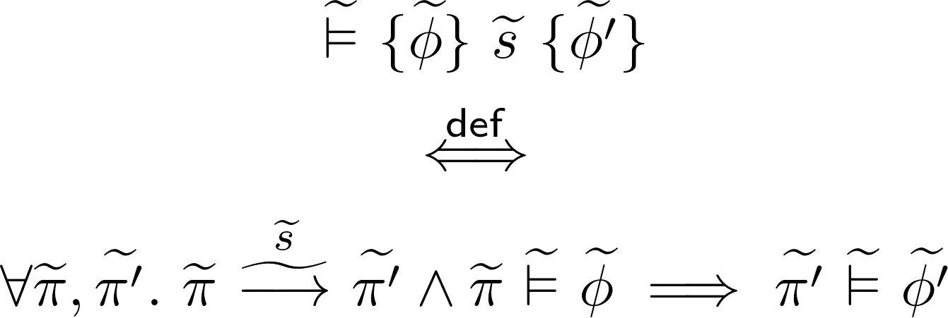
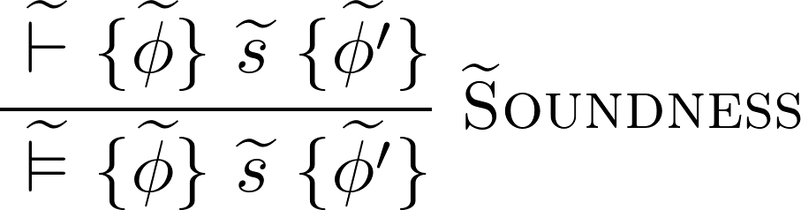
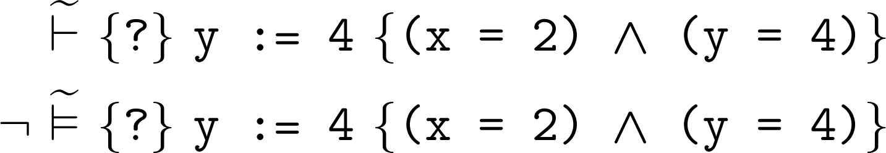
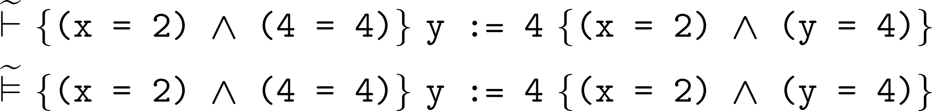
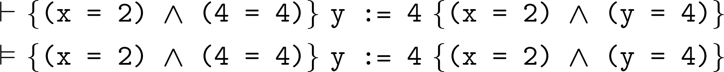
Gradual Soundness
Notes:
we want it to be deducible, but we don’t want it to be valid! (validity is a runtime property, no runtime behaves like that)
then again, it would be weird if this would work – it would mean that gradual verification had no runtime impact

Slide 28
Gradual Soundness
Notes:
we want it to be deducible, but we don’t want it to be valid! (validity is a runtime property, no runtime behaves like that)
then again, it would be weird if this would work – it would mean that gradual verification had no runtime impact

Slide 29
Implicit Dynamic Frames
Notes:
4

