Slide 1

Gradual Verification
with Implicit Dynamic Frames
Master Thesis of
Johannes Bader
Karlsruhe Institute of Technology
Karlsruhe, Germany
Jonathan Aldrich
Carnegie Mellon University
Pittsburgh, USA
Éric Tanter
University of Chile
Santiago, Chile

Slide 2
Gradual Verification
(with Implicit Dynamic Frames)
int getFour(int i)
requires ?; // haven't figured that one out, yet
ensures result = 4;
{
i = i + 1;
return i;
}
Notes:
there are challenges associated with IDF that we don’t have time to capute here
…but there will be a demo in the end, IDF

Slide 3
Motivation
Program verification (against some specification)
Two flavors: dynamic & static
// spec: callable only if (this.balance >= amount)
void withdrawCoins(int amount)
{
// business logic
this.balance -= amount;
}
Notes:
does NOT guarantee termination (partial correctness)

Slide 4
Dynamic Verification
runtime checks
testing techniques
guarantee compliance at runtime
// spec: callable only if (this.balance >= amount)
void withdrawCoins(int amount)
{
// business logic
this.balance -= amount;
}
void withdrawCoins(int amount)
{
assert this.balance >= amount;
// business logic
this.balance -= amount;
}

Slide 5
Dynamic Verification – Drawbacks
runtime checks
testing techniques
guarantee compliance at runtime
runtime overhead
additional efforts
pot. late detection
void withdrawCoins(int amount)
{
assert this.balance >= amount;
// business logic
this.balance -= amount;
}
Notes:
industry addresses this problem by: removed on build

Slide 6
Static Verification
declarative
formal logic
guarantee compliance in advance
void withdrawCoins(int amount)
requires this.balance >= amount;
{
// business logic
this.balance -= amount;
}
Notes:
[decl]: method contracts, loop invariants

Slide 7
Static Verification – Drawbacks
declarative
formal logic
guarantee compliance in advance
limited expressiveness
decidability
annotation overhead
void withdrawCoins(int amount)
requires this.balance >= amount;
ensures this.balance = old(this.balance) – amount;
{
// business logic
this.balance -= amount;
}
void withdrawCoins(int amount)
requires this.balance >= amount;
{
// business logic
this.balance -= amount;
}
Notes:
industry addresses this problem by (already a joke – it doesn’t address this problem because there is no static verification): often only warnings
[limited expr:] arbitrary library function calls

Slide 8
Solution? Static + Dynamic
“relaxed” static verification (warnings on failure)
turn contracts into runtime assertions (“patch”)
Notable implementations:
Java with JML annotations
“ESC/Java” for static verification
“JML4c” for dynamic verification
Code Contracts for .NET (by RiSE, MSR)
Notes:
„Research in Software Engineering“ (MSR)

Slide 9
Solution? Static + Dynamic
“relaxed” static verification (warnings on failure)
turn contracts into runtime assertions (“patch”)
Notes:
„Research in Software Engineering“ (MSR)

Slide 10
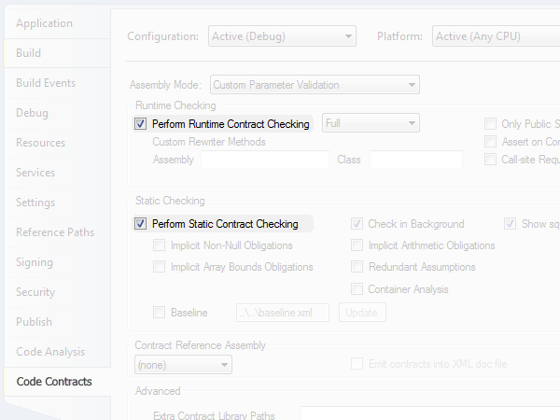
Solution? Static + Dynamic
Notes:
picture also shows what’s wrong with the approach: static and dynamic are treated like independent constructs, not really working together
Research: find good tests (directed dynamic verification)
better: use runtime checking to fix precisely the loopholes created by failure of static checking

Slide 11
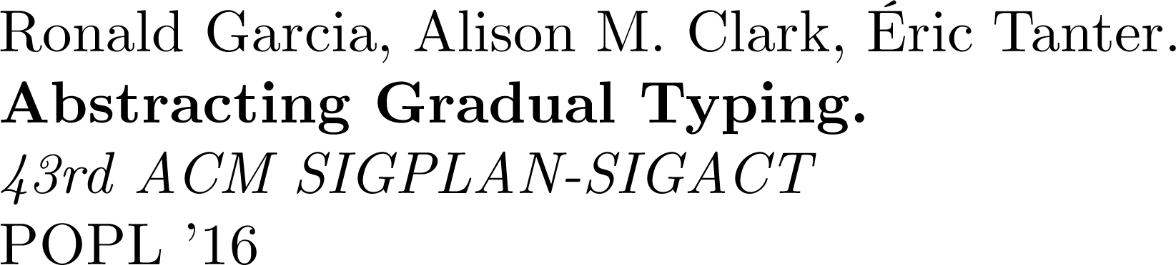
Solution! Static ⊕ Dynamic
Typing
Typing
“Static Checking Where Possible,
Dynamic Checking When Needed”
(Erik Meijer)
draw on recent advances in gradual typing
adapt methodology to verification setting
= Gradual Typing
// gradual typing
object eval(string exprCode)
{
…
}
…
string expr = "string.Concat(20, '+', 22)";
object res1 = eval(expr); // statically guaranteed
object res2 = eval((string)res1); // dyn guaranteed
object res3 = eval((string)res2); // dyn guaranteed 
// gradual typing
dynamic eval(string exprCode)
{
…
}
…
string expr = "string.Concat(20, '+', 22)";
dynamic res1 = eval(expr); // statically guaranteed
dynamic res2 = eval(res1); // dynamically guaranteed
dynamic res3 = eval(res2); // dynamically guaranteed 
void withdrawCoins(int amount)
requires this.balance >= amount;
{
…
}
…
acc.balance = 100;
acc.withdrawCoins(50); // statically guaranteed
acc.withdrawCoins(30); // dynamically guaranteed
acc.withdrawCoins(30); // dynamically guaranteed 
void withdrawCoins(int amount)
requires this.balance >= amount;
{
…
}
…
acc.balance = 100;
acc.withdrawCoins(50); // can prove acc.balance >= 50
acc.withdrawCoins(30); // can’t prove acc.balance >= 30
acc.withdrawCoins(30); // can’t prove acc.balance >= 30
Notes:
what I expect gradual verifier to do is inject runtime checks precisely for those two calls!
so, how to realize such a system? The clue is in this sentence:
interestingly, people have said that about types many years ago
gradual typing taught us that solution is not to blindly combine approaches
AGT formalizes how to get from … to …
BIG idea: abstract interpretation, gamma/alpha, once you understand those, everything else falls out (example: predicate lifting, what does this give us)
…give idea as diagram, maybe include the lifting operations

Slide 12




Abstracting Gradual Typing
Ronald Garcia, Alison M. Clark, and Éric Tanter
define gradual (type) system in terms of a pre-existing static one = “gradualization”
parts of a semantics affected by gradualization are expressible as
predicates/functions operating on types
Gradual System
gradualization
Static System
Notes:
example: static semantics may use this function AS PART of a proof for a conditional
[the parts]: other things like scoping rules don’t care about types and are thus not affected by gradualization

Slide 13




Abstracting Gradual Typing
Ronald Garcia, Alison M. Clark, and Éric Tanter
Gradual System
// gradual typing
object eval(string exprCode)
{
…
}
…
string expr = "string.Concat(20, '+', 22)";
object res1 = eval(expr); // statically guaranteed
object res2 = eval((string)res1); // dyn guaranteed
object res3 = eval((string)res2); // dyn guaranteed 
// gradual typing
dynamic eval(string exprCode)
{
…
}
…
string expr = "string.Concat(20, '+', 22)";
dynamic res1 = eval(expr); // statically guaranteed
dynamic res2 = eval(res1); // dynamically guaranteed
dynamic res3 = eval(res2); // dynamically guaranteed 
gradual
lifting
Static System
Notes:
task of a gradual semantics is to deal with gradual types (especially the unknown type) in a reasonable way
revious work has argued in terms of intuition what is reasonable or not.
AGT gives formal approach based on concepts of abstract interpretation, called…

Slide 14
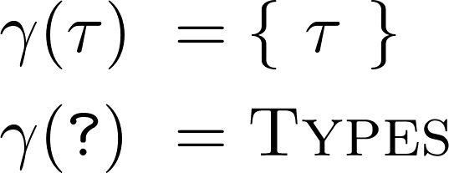





Abstracting Gradual Typing
Ronald Garcia, Alison M. Clark, and Éric Tanter
Gradual System
// gradual typing
object eval(string exprCode)
{
…
}
…
string expr = "string.Concat(20, '+', 22)";
object res1 = eval(expr); // statically guaranteed
object res2 = eval((string)res1); // dyn guaranteed
object res3 = eval((string)res2); // dyn guaranteed 
// gradual typing
dynamic eval(string exprCode)
{
…
}
…
string expr = "string.Concat(20, '+', 22)";
dynamic res1 = eval(expr); // statically guaranteed
dynamic res2 = eval(res1); // dynamically guaranteed
dynamic res3 = eval(res2); // dynamically guaranteed 
gradual
lifting
Static System
Notes:
…gradual defined in terms of static system (+ casts or dyn. checks)… but also viewable as extension of dynamic
gradual typing taught us that solution is not to blindly combine approaches
AGT formalizes how to get from … to …
BIG idea: abstract interpretation, gamma/alpha, once you understand those, everything else falls out (example: predicate lifting, what does this give us)
…give idea as diagram, maybe include the lifting operations

Slide 15
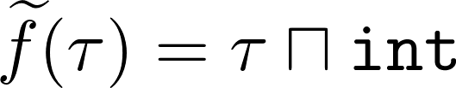
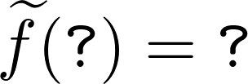

Abstracting Gradual Typing
Ronald Garcia, Alison M. Clark, and Éric Tanter
Gradual System
// gradual typing
object eval(string exprCode)
{
…
}
…
string expr = "string.Concat(20, '+', 22)";
object res1 = eval(expr); // statically guaranteed
object res2 = eval((string)res1); // dyn guaranteed
object res3 = eval((string)res2); // dyn guaranteed 
// gradual typing
dynamic eval(string exprCode)
{
…
}
…
string expr = "string.Concat(20, '+', 22)";
dynamic res1 = eval(expr); // statically guaranteed
dynamic res2 = eval(res1); // dynamically guaranteed
dynamic res3 = eval(res2); // dynamically guaranteed 
Static System
Notes:
key insight of this approach is that if alpha/gamma is Galois-connection, then the lifting implements a conservative approximation of the original reasoning
BIG idea: abstract interpretation, gamma/alpha, once you understand those, everything else falls out (example: predicate lifting, what does this give us)
…give idea as diagram, maybe include the lifting operations

Slide 16




Abstracting Gradual Typing
Ronald Garcia, Alison M. Clark, and Éric Tanter
Gradual System
// gradual typing
object eval(string exprCode)
{
…
}
…
string expr = "string.Concat(20, '+', 22)";
object res1 = eval(expr); // statically guaranteed
object res2 = eval((string)res1); // dyn guaranteed
object res3 = eval((string)res2); // dyn guaranteed 
// gradual typing
dynamic eval(string exprCode)
{
…
}
…
string expr = "string.Concat(20, '+', 22)";
dynamic res1 = eval(expr); // statically guaranteed
dynamic res2 = eval(res1); // dynamically guaranteed
dynamic res3 = eval(res2); // dynamically guaranteed 
Static System
Notes:
key insight of this approach is that if alpha/gamma is Galois-connection, then the lifting implements a conservative approximation of the original reasoning
BIG idea: abstract interpretation, gamma/alpha, once you understand those, everything else falls out (example: predicate lifting, what does this give us)
…give idea as diagram, maybe include the lifting operations

Slide 17



Abstracting Gradual Typing
Ronald Garcia, Alison M. Clark, and Éric Tanter
Gradual System
// gradual typing
object eval(string exprCode)
{
…
}
…
string expr = "string.Concat(20, '+', 22)";
object res1 = eval(expr); // statically guaranteed
object res2 = eval((string)res1); // dyn guaranteed
object res3 = eval((string)res2); // dyn guaranteed 
// gradual typing
dynamic eval(string exprCode)
{
…
}
…
string expr = "string.Concat(20, '+', 22)";
dynamic res1 = eval(expr); // statically guaranteed
dynamic res2 = eval(res1); // dynamically guaranteed
dynamic res3 = eval(res2); // dynamically guaranteed 
Static System
Notes:
key insight of this approach is that if alpha/gamma is Galois-connection, then the lifting implements a conservative approximation of the original reasoning
BIG idea: abstract interpretation, gamma/alpha, once you understand those, everything else falls out (example: predicate lifting, what does this give us)
…give idea as diagram, maybe include the lifting operations

Slide 18
How does this relate to Verification?
int getFour(int i)
requires ?; // haven't figured that one out, yet
ensures result = 4;
{
i = i + 1;
return i;
}
Types restrict, which values are valid for a certain variable
Formulas restrict, which program states are valid for a certain point during execution

Slide 19
Abstracting Gradual Typing
Ronald Garcia, Alison M. Clark, and Éric Tanter
Gradual System
// gradual typing
object eval(string exprCode)
{
…
}
…
string expr = "string.Concat(20, '+', 22)";
object res1 = eval(expr); // statically guaranteed
object res2 = eval((string)res1); // dyn guaranteed
object res3 = eval((string)res2); // dyn guaranteed 
// gradual typing
dynamic eval(string exprCode)
{
…
}
…
string expr = "string.Concat(20, '+', 22)";
dynamic res1 = eval(expr); // statically guaranteed
dynamic res2 = eval(res1); // dynamically guaranteed
dynamic res3 = eval(res2); // dynamically guaranteed 
Static System
Notes:
…gradual defined in terms of static system (+ casts or dyn. checks)… but also viewable as extension of dynamic
gradual typing taught us that solution is not to blindly combine approaches
AGT formalizes how to get from … to …
BIG idea: abstract interpretation, gamma/alpha, once you understand those, everything else falls out (example: predicate lifting, what does this give us)
…give idea as diagram, maybe include the lifting operations

Slide 20


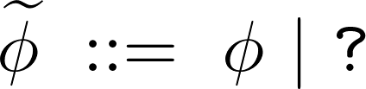

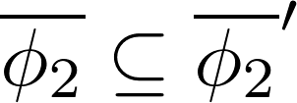
Abstracting Gradual Typing
Verification
Ronald Garcia, Alison M. Clark, and Éric Tanter
Gradual System
// gradual typing
object eval(string exprCode)
{
…
}
…
string expr = "string.Concat(20, '+', 22)";
object res1 = eval(expr); // statically guaranteed
object res2 = eval((string)res1); // dyn guaranteed
object res3 = eval((string)res2); // dyn guaranteed 
// gradual typing
dynamic eval(string exprCode)
{
…
}
…
string expr = "string.Concat(20, '+', 22)";
dynamic res1 = eval(expr); // statically guaranteed
dynamic res2 = eval(res1); // dynamically guaranteed
dynamic res3 = eval(res2); // dynamically guaranteed 
Static System
Notes:
this goes wrong
KEY INSIGHT: thanks to abstract interpretation we can define an entire semantics only in terms of a concretization&abstraction function

Slide 21
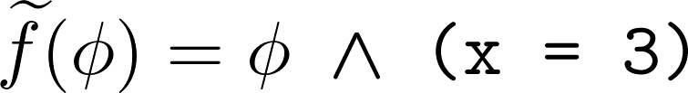

Abstracting Gradual Typing
Verification
Ronald Garcia, Alison M. Clark, and Éric Tanter
Gradual System
// gradual typing
object eval(string exprCode)
{
…
}
…
string expr = "string.Concat(20, '+', 22)";
object res1 = eval(expr); // statically guaranteed
object res2 = eval((string)res1); // dyn guaranteed
object res3 = eval((string)res2); // dyn guaranteed 
// gradual typing
dynamic eval(string exprCode)
{
…
}
…
string expr = "string.Concat(20, '+', 22)";
dynamic res1 = eval(expr); // statically guaranteed
dynamic res2 = eval(res1); // dynamically guaranteed
dynamic res3 = eval(res2); // dynamically guaranteed 
Static System
Notes:
this goes wrong
KEY INSIGHT: thanks to abstract interpretation we can define an entire semantics only in terms of a concretization&abstraction function

Slide 22
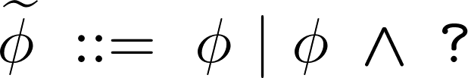
Abstracting Gradual Typing
Verification
Ronald Garcia, Alison M. Clark, and Éric Tanter
Gradual System
// gradual typing
object eval(string exprCode)
{
…
}
…
string expr = "string.Concat(20, '+', 22)";
object res1 = eval(expr); // statically guaranteed
object res2 = eval((string)res1); // dyn guaranteed
object res3 = eval((string)res2); // dyn guaranteed 
// gradual typing
dynamic eval(string exprCode)
{
…
}
…
string expr = "string.Concat(20, '+', 22)";
dynamic res1 = eval(expr); // statically guaranteed
dynamic res2 = eval(res1); // dynamically guaranteed
dynamic res3 = eval(res2); // dynamically guaranteed 
Static System
Notes:
this goes wrong
KEY INSIGHT: thanks to abstract interpretation we can define an entire semantics only in terms of a concretization&abstraction function

Slide 23
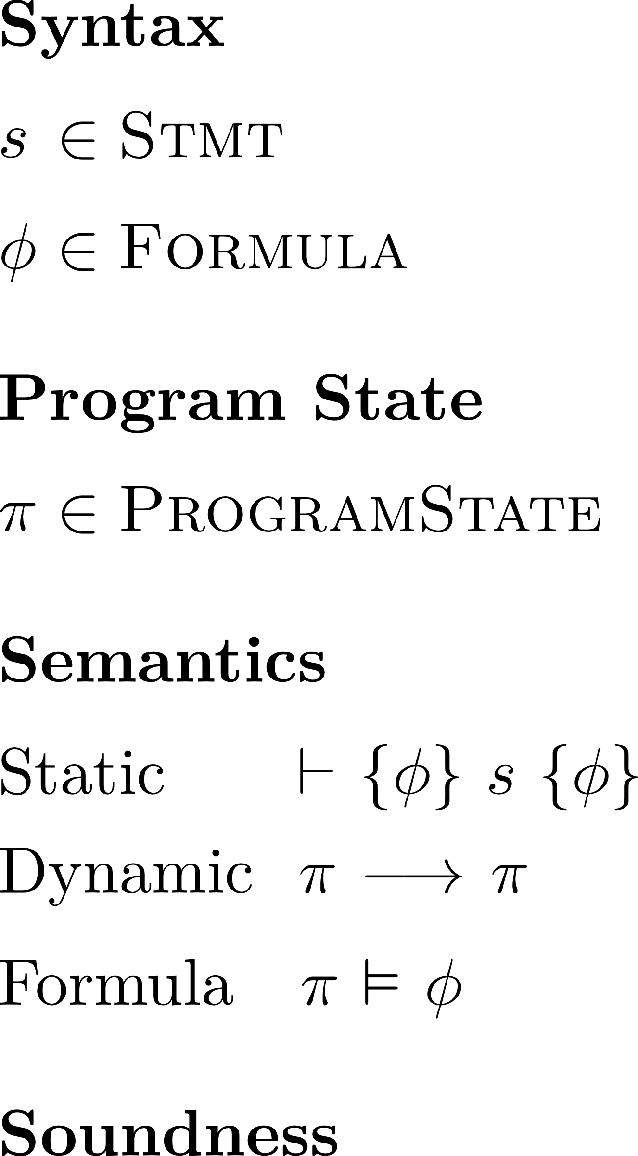
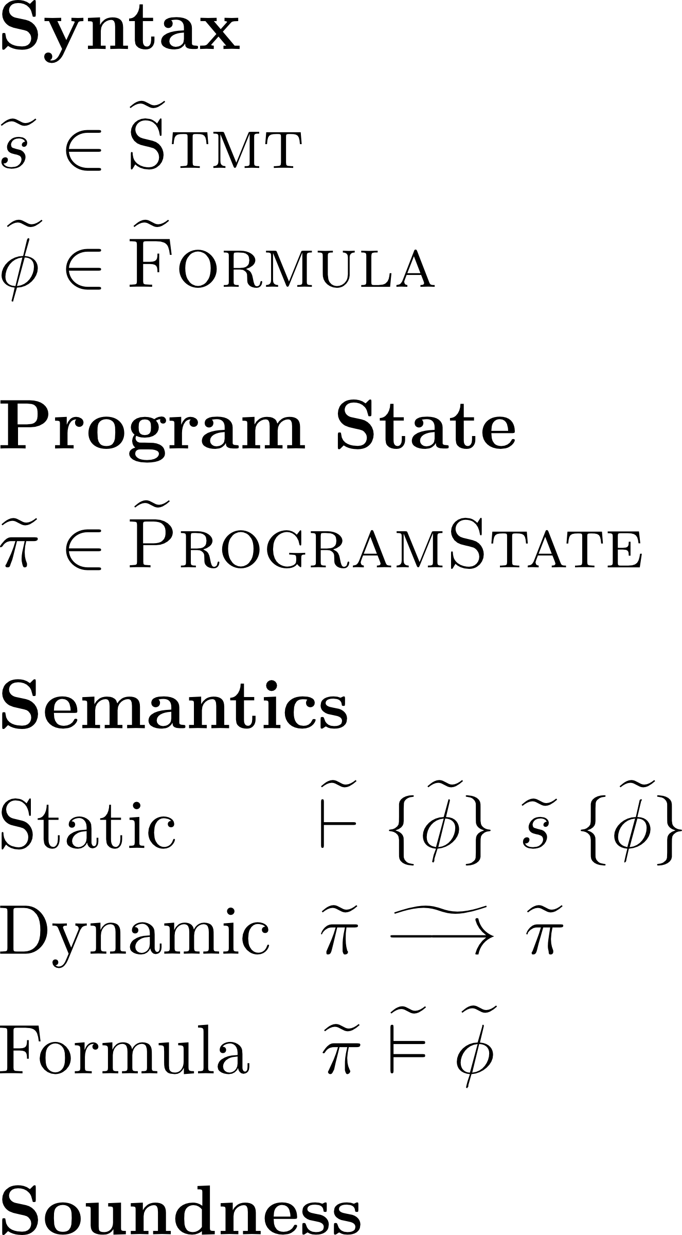
Gradualization – Overview
Gradualization
23
Notes:
define a gradually verified programming language in terms of a statically verified one (process called gradualization)

Slide 24
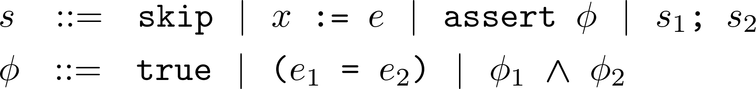
Gradualization – Starting Point
24
Notes:
for all my examples to make sense we need to briefly…

Slide 25
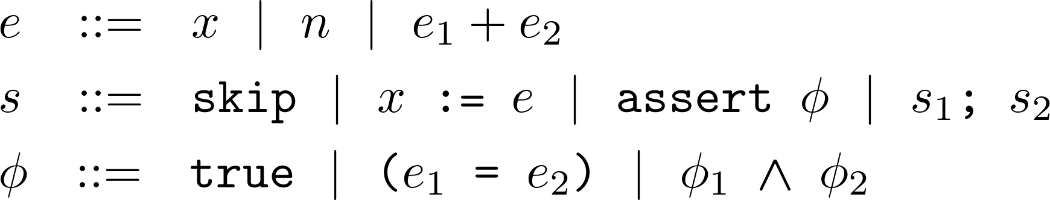
Gradualization – Starting Point
25
Notes:
for all my examples to make sense we need to briefly…

Slide 26
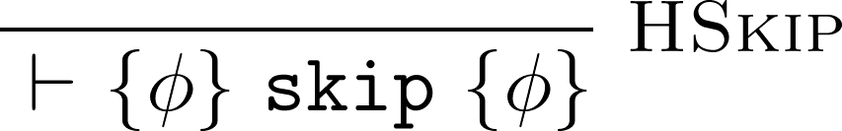
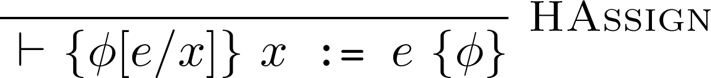
Gradualization – Starting Point
26
Notes:
define a gradually verified programming language in terms of a statically verified one (process called gradualization)
AGT

Slide 27
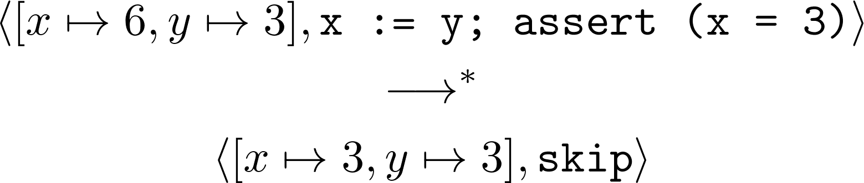
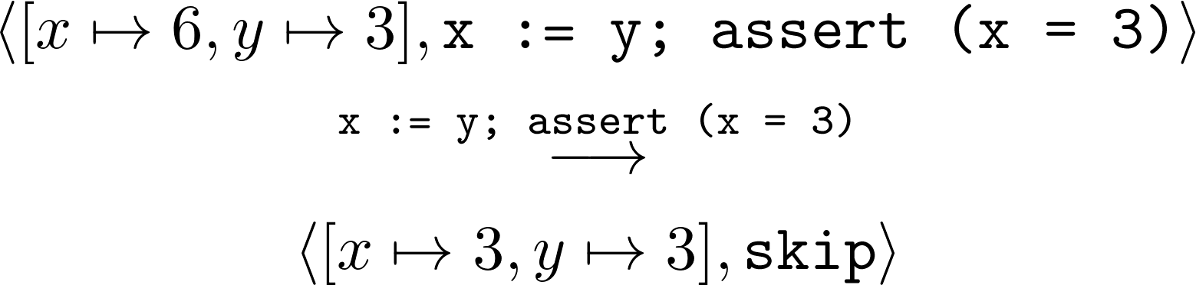
Gradualization – Starting Point
27
Notes:
define a gradually verified programming language in terms of a statically verified one (process called gradualization)
AGT

Slide 28
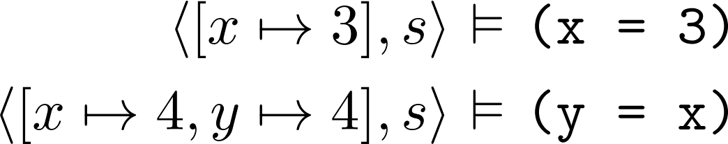
Gradualization – Starting Point
Natural definition of implication
28
Notes:
define a gradually verified programming language in terms of a statically verified one (process called gradualization)
AGT

Slide 29
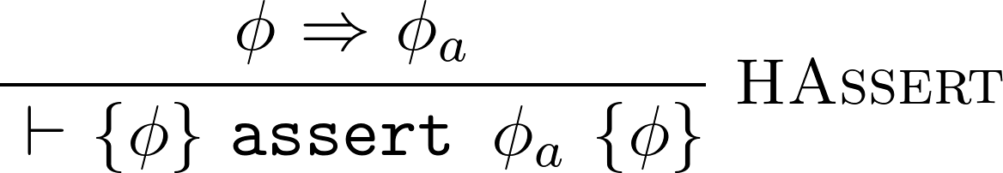
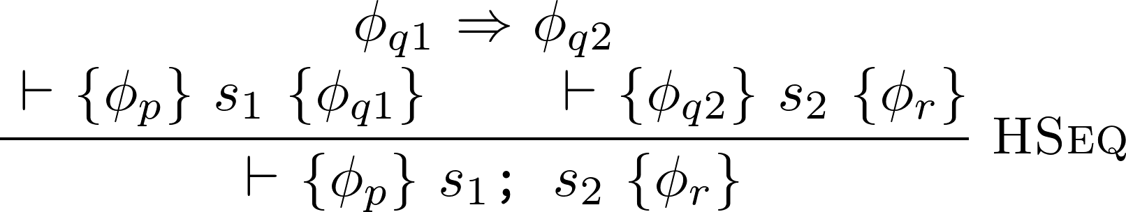
Gradualization – Starting Point
29
Notes:
define a gradually verified programming language in terms of a statically verified one (process called gradualization)
AGT

Slide 30
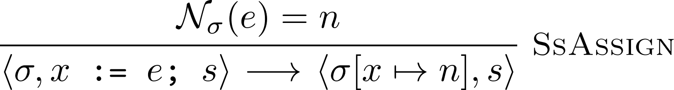
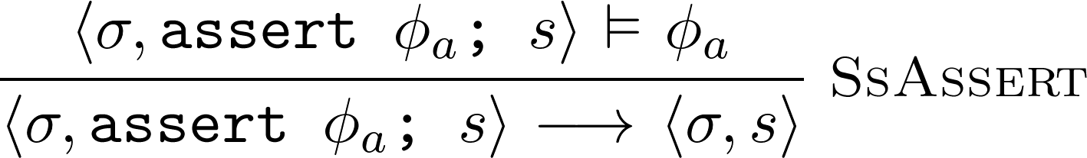
Gradualization – Starting Point
30
Notes:
define a gradually verified programming language in terms of a statically verified one (process called gradualization)
AGT

Slide 31
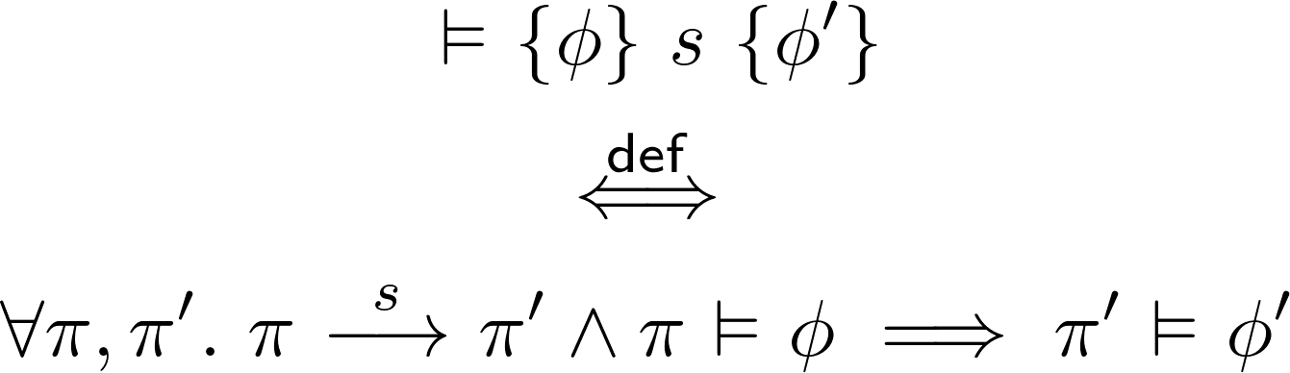
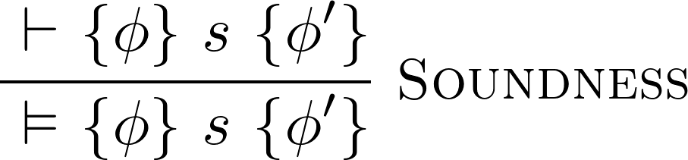
Gradualization – Starting Point
Validity of Hoare triples
31
Notes:
define a gradually verified programming language in terms of a statically verified one (process called gradualization)
AGT
weak soundness

Slide 32
Gradualization – Overview
Gradualization
32
Notes:
define a gradually verified programming language in terms of a statically verified one (process called gradualization)
AGT

Slide 33


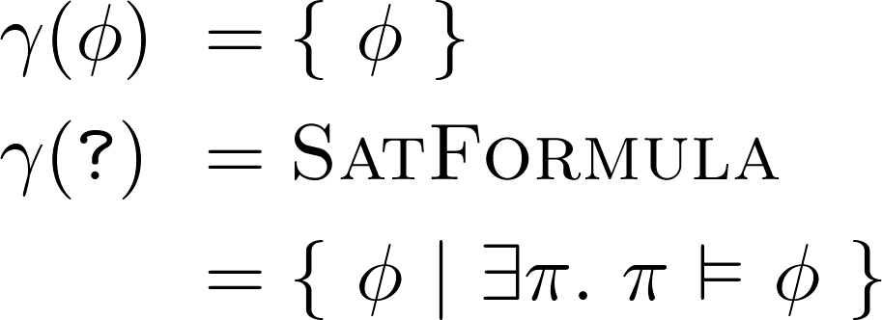
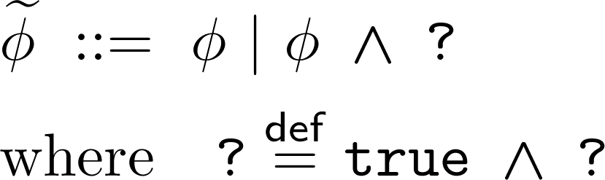

Gradualization – Approach
Design
Space
Design
Space
syntax extension
syntax extension
extension
Rules Implementation
Gradual
Guarantee
Abstract
Interpretation
Notes:
abstract interpretation – as we will see later doing so has very desirable properties

Slide 34

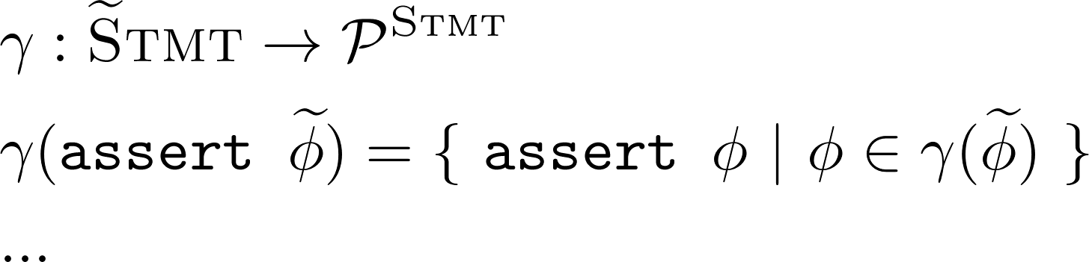
Gradualization – Approach
Design
Space
Design
Space
syntax extension
syntax extension
Rules Implementation
Gradual
Guarantee
Abstract
Interpretation
Notes:
abstract interpretation – as we will see later doing so has very desirable properties

Slide 35
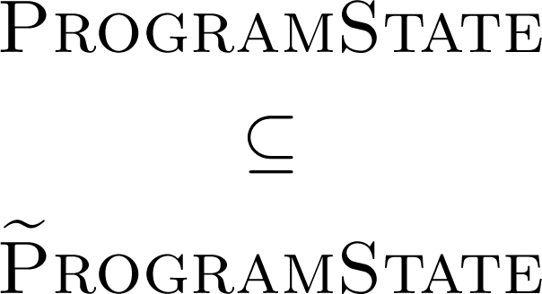

Gradualization – Approach
Design
Space
Design
Space
syntax extension
syntax extension
extension
Gradual
Guarantee
Abstract
Interpretation
Rules Implementation
Notes:
abstract interpretation – as we will see later doing so has very desirable properties

Slide 36
Gradual Lifting
Gradual System
// gradual typing
object eval(string exprCode)
{
…
}
…
string expr = "string.Concat(20, '+', 22)";
object res1 = eval(expr); // statically guaranteed
object res2 = eval((string)res1); // dyn guaranteed
object res3 = eval((string)res2); // dyn guaranteed 
// gradual typing
dynamic eval(string exprCode)
{
…
}
…
string expr = "string.Concat(20, '+', 22)";
dynamic res1 = eval(expr); // statically guaranteed
dynamic res2 = eval(res1); // dynamically guaranteed
dynamic res3 = eval(res2); // dynamically guaranteed 
Static System

Slide 37
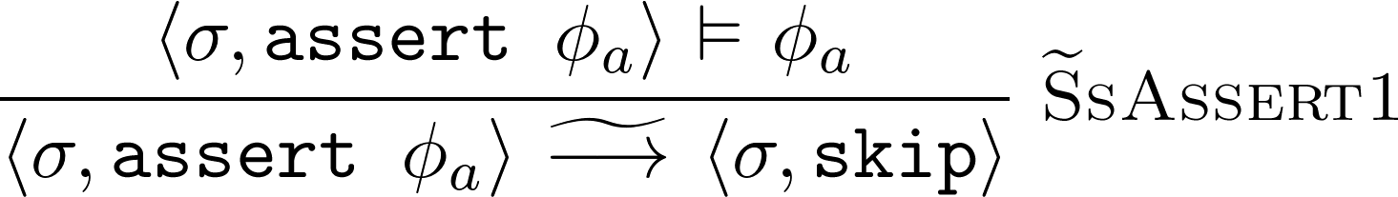
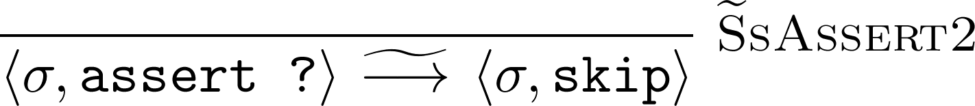






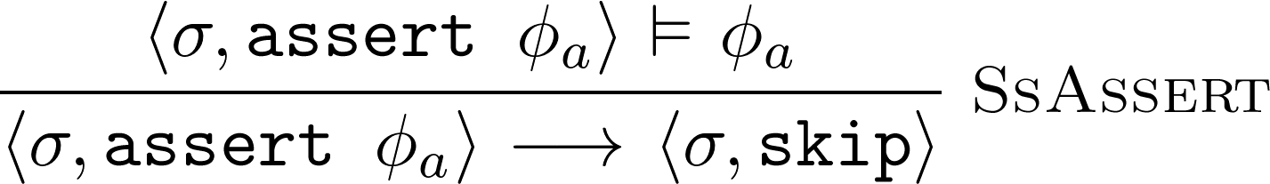
Gradual Lifting
Gradual System
// gradual typing
object eval(string exprCode)
{
…
}
…
string expr = "string.Concat(20, '+', 22)";
object res1 = eval(expr); // statically guaranteed
object res2 = eval((string)res1); // dyn guaranteed
object res3 = eval((string)res2); // dyn guaranteed 
// gradual typing
dynamic eval(string exprCode)
{
…
}
…
string expr = "string.Concat(20, '+', 22)";
dynamic res1 = eval(expr); // statically guaranteed
dynamic res2 = eval(res1); // dynamically guaranteed
dynamic res3 = eval(res2); // dynamically guaranteed 
Static System
Notes:
furthermore, this approach works for everything that has a concretization function!
e.g. gradual program states, we know a function with that signature

Slide 38





Gradual Lifting
Gradual System
// gradual typing
object eval(string exprCode)
{
…
}
…
string expr = "string.Concat(20, '+', 22)";
object res1 = eval(expr); // statically guaranteed
object res2 = eval((string)res1); // dyn guaranteed
object res3 = eval((string)res2); // dyn guaranteed 
// gradual typing
dynamic eval(string exprCode)
{
…
}
…
string expr = "string.Concat(20, '+', 22)";
dynamic res1 = eval(expr); // statically guaranteed
dynamic res2 = eval(res1); // dynamically guaranteed
dynamic res3 = eval(res2); // dynamically guaranteed 
Static System
Notes:
furthermore, this approach works for everything that has a concretization function!
e.g. gradual program states, we know a function with that signature

Slide 39


Gradual Lifting
Gradual System
// gradual typing
object eval(string exprCode)
{
…
}
…
string expr = "string.Concat(20, '+', 22)";
object res1 = eval(expr); // statically guaranteed
object res2 = eval((string)res1); // dyn guaranteed
object res3 = eval((string)res2); // dyn guaranteed 
// gradual typing
dynamic eval(string exprCode)
{
…
}
…
string expr = "string.Concat(20, '+', 22)";
dynamic res1 = eval(expr); // statically guaranteed
dynamic res2 = eval(res1); // dynamically guaranteed
dynamic res3 = eval(res2); // dynamically guaranteed 
Static System
Notes:
furthermore, this approach works for everything that has a concretization function!
e.g. gradual program states, we know a function with that signature

Slide 40
Gradual Verification - Approach
Design
Space
Design
Space
syntax extension
syntax extension
extension
Gradual
Guarantee
Abstract
Interpretation
predicate lifting
function lifting
predicate lifting
Notes:
abstract interpretation – as we will see later doing so has very desirable properties

Slide 41
Predicate Lifting in a Nutshell
lifting

Slide 42
Predicate Lifting in a Nutshell
lifting

Slide 43
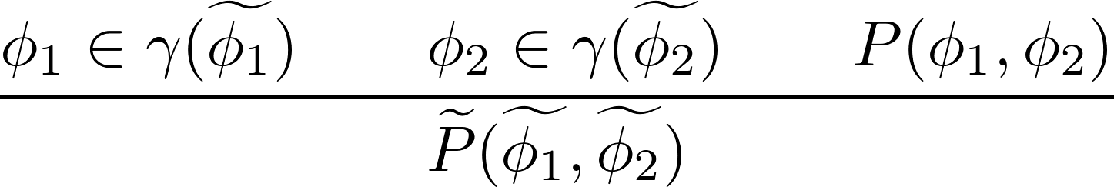
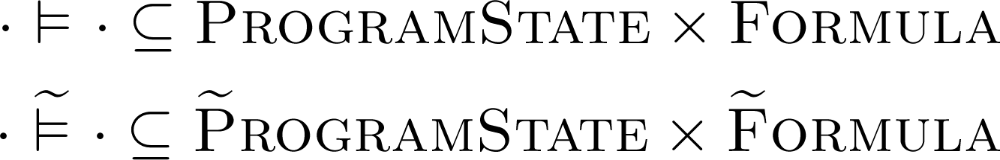
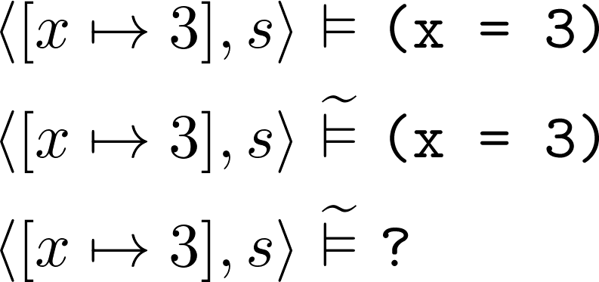
Predicate Lifting in a Nutshell
all gradually lifted predicates satisfy

Slide 44
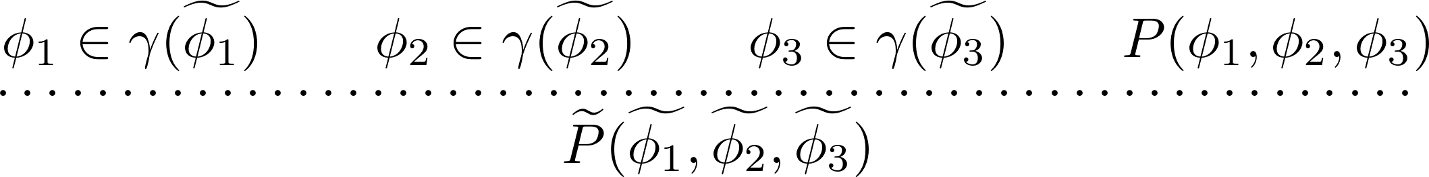
Predicate Lifting in a Nutshell
all gradually lifted predicates satisfy

Slide 45
Gradual Verification - Approach
Design
Space
Design
Space
syntax extension
syntax extension
extension
Gradual
Guarantee
Abstract
Interpretation
predicate lifting
function lifting
predicate lifting
Notes:
abstract interpretation – as we will see later doing so has very desirable properties

Slide 46

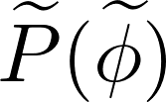


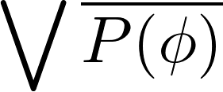


Gradual Lifting
Gradual System
// gradual typing
object eval(string exprCode)
{
…
}
…
string expr = "string.Concat(20, '+', 22)";
object res1 = eval(expr); // statically guaranteed
object res2 = eval((string)res1); // dyn guaranteed
object res3 = eval((string)res2); // dyn guaranteed 
// gradual typing
dynamic eval(string exprCode)
{
…
}
…
string expr = "string.Concat(20, '+', 22)";
dynamic res1 = eval(expr); // statically guaranteed
dynamic res2 = eval(res1); // dynamically guaranteed
dynamic res3 = eval(res2); // dynamically guaranteed 
Static System

Slide 47
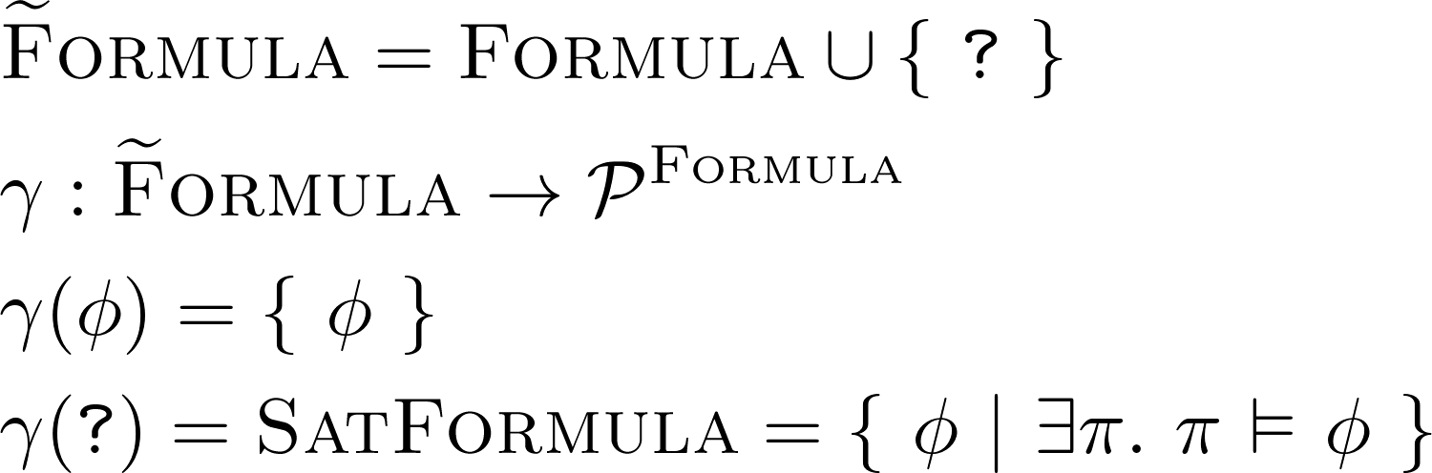
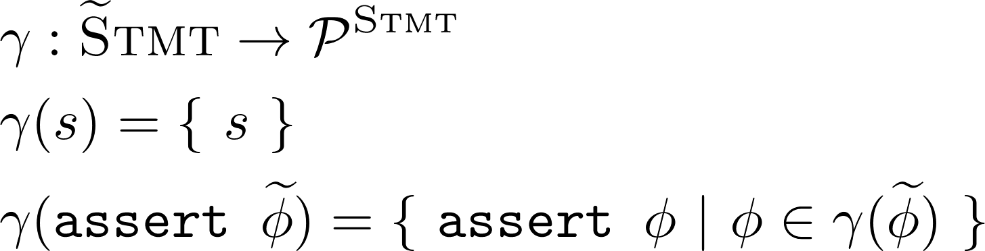
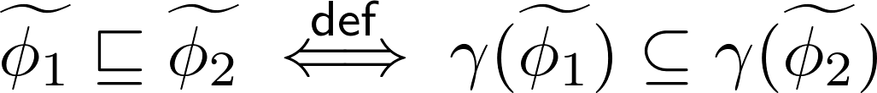
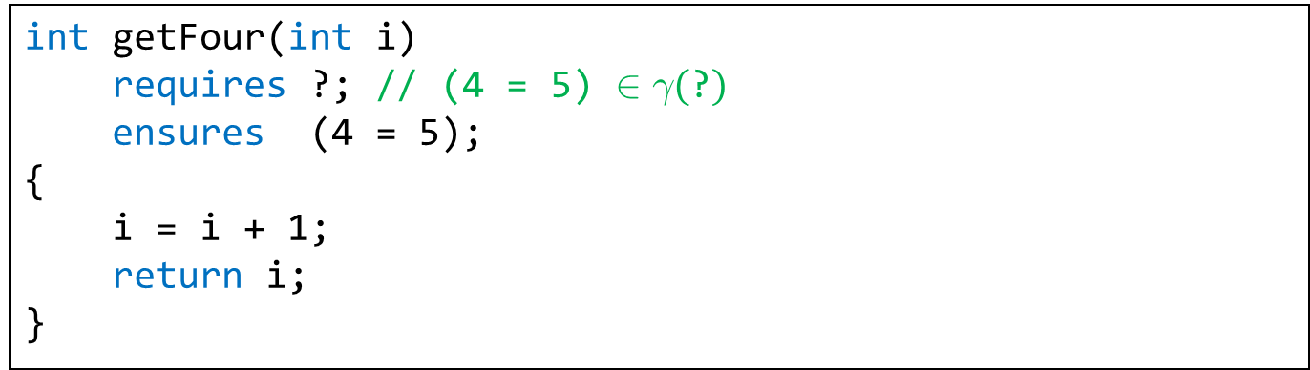
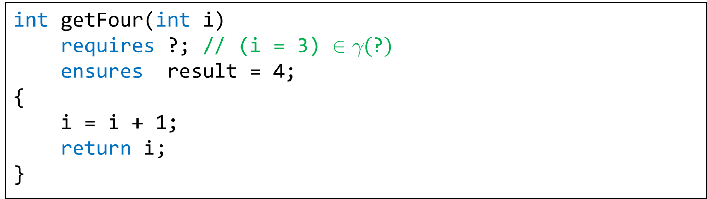
Gradualization – Goal 1/3
Introduction of wildcard formula ?
placeholder for arbitrary (satisfiable) formula
enables Hoare deduction despite incomplete information
enables gradual annotation of programs (? as default)
int getFour(int i)
requires ?; // (4 = 5) $∈γ(\text{?})$
ensures (4 = 5);
{
i = i + 1;
return i;
}
int getFour(int i)
requires ?; // haven't figured that one out, yet
ensures result = 4;
{
i = i + 1;
return i;
}
int getFour(int i)
requires ?; // (i = 3) $∈γ(\text{?})$
ensures result = 4;
{
i = i + 1;
return i;
}
Formula Precision
abstract
interpretation
abstract
interpretation
47
Notes:
this is design space
TODO: other sets

Slide 48
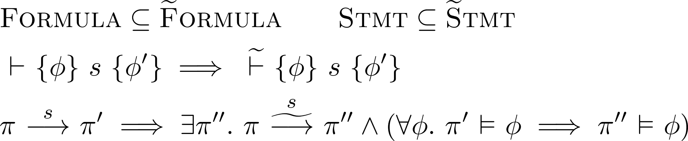
Gradualization – Goal 2/3
Compatibility with static language
don’t reject source code that was accepted before
observable behavior is not changed
static
dynamic
48

Slide 49
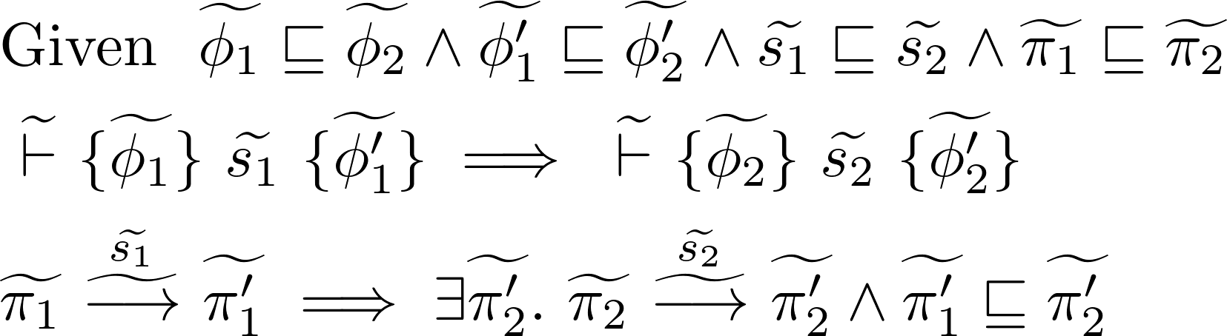
Gradualization – Goal 3/3
Gradual guarantee (Siek et al.), adapted
Reducing precision will not
introduce verification failure
change observable behavior
static
dynamic
49

Slide 50
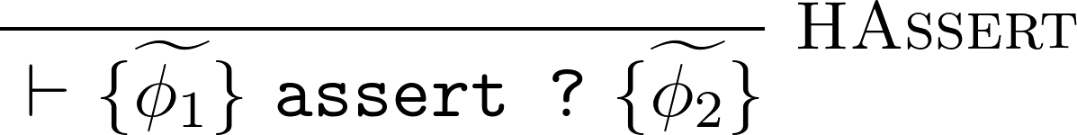
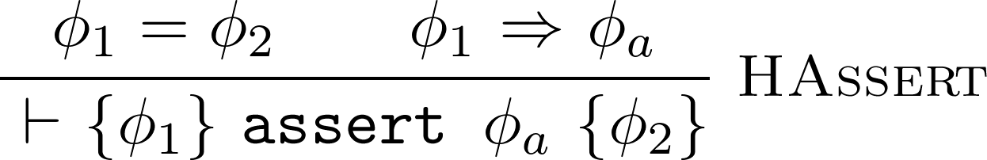
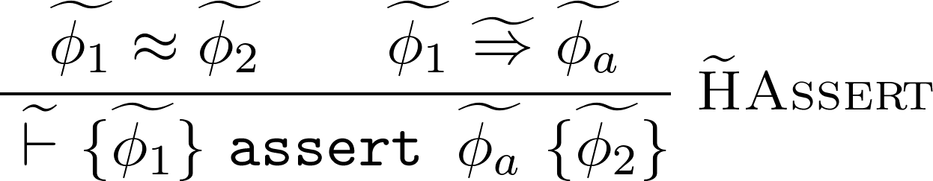
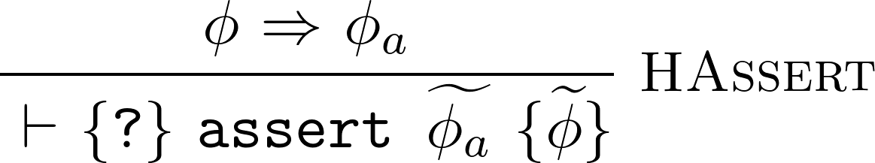
Gradual Predicate Lifting
Introduction
Monotonicity
Notes:
TODO animate deductive rule
make more loose thing more obvious, bullet point

Slide 51
Gradual Predicate Lifting
Introduction
Monotonicity
Notes:
TODO animate deductive rule
make more loose thing more obvious, bullet point

Slide 52
Gradual Predicate Lifting
Introduction
Monotonicity
this is only one way of many to lift HAssert!
Notes:
TODO animate deductive rule
make more loose thing more obvious, bullet point

Slide 53
Gradual Predicate Lifting
Introduction
Monotonicity
(Optimality)
⬄
Notes:
AGT! also gives this definition, but from completely different angle!
emphasize that all this is principal, gamma thing, big picture

Slide 54
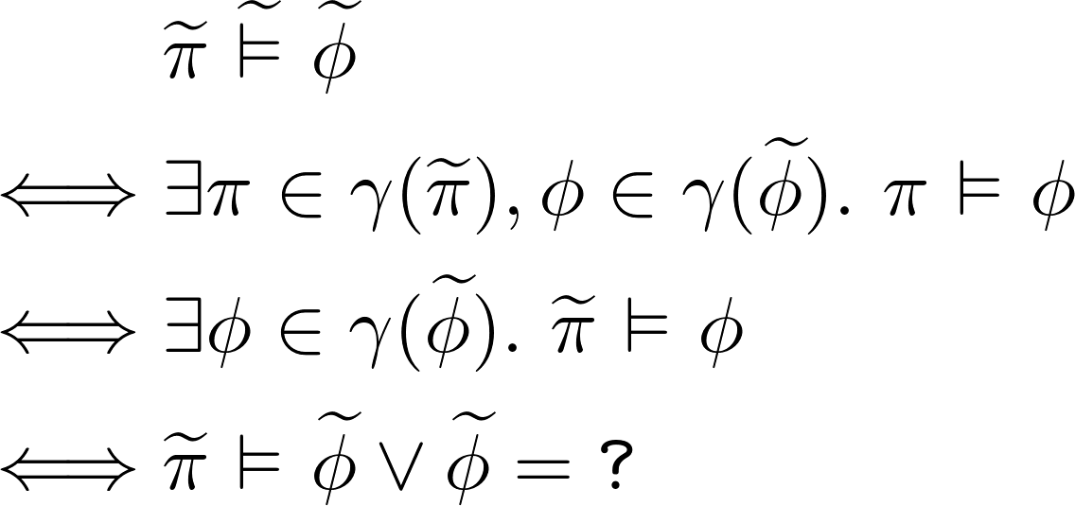
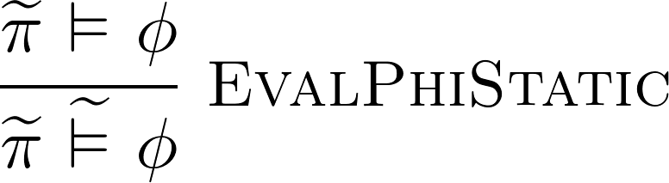

Gradual Predicate Lifting
⬄

Slide 55
Gradual Function Lifting
Introduction
Monotonicity
(Optimality)
⬄

Slide 56
Gradual (Partial) Function Lifting
Introduction
Monotonicity
(Optimality)
⬄

Slide 57

Gradual Partial Function Lifting
⬄

Slide 58

Bonus: { F }-partial Galois connection

Slide 59
Gradual Verification - Approach
Design
Space
Design
Space
Gradualization
Gradual
Guarantee
Abstract
Interpretation
Notes:
abstract interpretation – as we will see later doing so has very desirable properties

Slide 60
Gradual Verification - Approach
Design
Space
Design
Space
syntax extension
syntax extension
abstract interpretation
extension
Gradual
Guarantee
Abstract
Interpretation
predicate lifting
function lifting
predicate lifting
Notes:
abstract interpretation – as we will see later doing so has very desirable properties

Slide 61








Gradual Soundness
if it were true, we would have a
gradual system without runtime checks
Notes:
we want it to be deducible, but we don’t want it to be valid! (validity is a runtime property, no runtime behaves like that) – validity is about TRUTH
then again, it would be weird if this would work – it would mean that gradual verification had no runtime impact
how to interpret this new soundness rule?
RAC injection with every judgment!

Slide 62
Gradual Verification - Approach
Design
Space
Design
Space
syntax extension
syntax extension
extension
Gradual
Guarantee
Abstract
Interpretation
predicate lifting
function lifting
predicate lifting
runtime check injection
Notes:
abstract interpretation – as we will see later doing so has very desirable properties

Slide 63




Gradual Verification – Put to the Test
a)
“good” (information carried over)
b)
“too weak” (could prove invalid triples)
idea: try to be as precise as possible
c)
“too strict” (Hoare triple invalid)
idea: try to produce valid Hoare triple
if we could decide that we would not be here
Notes:
that gradual soundness is tautology seems weird, but it was last puzzle piece
so let’s put it to the test and play gradual verifier for a second
what stands out is that there are free variables
static verifier does NOT have those problems!
“as precise as possible, as long as valid Hoare triples” – pretty strong thing for a inference policy… if we could decide that, we wouldn’t be in a Hoare logic prove right now… and wouldn’t even need an inference policy
oh, and remember, for each of these judgments we have to insert a runtime assertion (c shows why)

Slide 64
Deterministic Lifting
don’t even present the gradual verifier with choices in the first place
treat static Hoare logic as (multivalued) function
…and then lift that function
Properties
can derive gradual lifting (that’s still what the verifier needs)
deterministic verifier
stronger, assertion-free notion of soundness
Notes:
[gradual lifting:] otherwise this is useless – remember, on user interface level, we’re still expected to implement a gradual lifting

Slide 65

Deterministic Lifting
treat static Hoare logic as (multivalued) function
…and then lift that function
Properties
can derive gradual lifting
stronger, assertion-free notion of soundness
deterministic verifier
free transitivity (no assertions to justify premises of )
Notes:
[gradual lifting:] otherwise this is useless – remember, on user interface level, we’re still expected to implement a gradual lifting

Slide 66

Deterministic Lifting
Introduction
Strength
Monotonicity
(Optimality)
Notes:
Strength rule: remember the idea to only make valid Hoare triples derivable? this is as close as it gets!

Slide 67


Deterministic Lifting – HAssign
Notes:
HSeq – 3 good news
lifting composite predicate corresponds to lifting components and the composing
these variables aren’t free anymore
deterministic lifting of implication is identity function

Slide 68


Deterministic Lifting
Introduction
Strength
Monotonicity
(Optimality)
Notes:
Strength rule: remember the idea to only make valid Hoare triples derivable? this is as close as it gets!

Slide 69


Deterministic Lifting – HAssert
Notes:
HSeq – 3 good news
lifting composite predicate corresponds to lifting components and the composing
these variables aren’t free anymore
deterministic lifting of implication is identity function

Slide 70
Deterministic Lifting
Introduction
Strength
Monotonicity
(Optimality)
Notes:
Strength rule: remember the idea to only make valid Hoare triples derivable? this is as close as it gets!

Slide 71




Deterministic Lifting – HSeq
Notes:
HSeq – 3 good news
lifting composite predicate corresponds to lifting components and the composing
these variables aren’t free anymore
deterministic lifting of implication is identity function

Slide 72
Deterministic Lifting
Introduction
Strength
Monotonicity
(Optimality)
Notes:
Strength rule: remember the idea to only make valid Hoare triples derivable? this is as close as it gets!

Slide 73
Thesis: Gradual Verification
Lemma 1:
One can apply the concepts of AGT to static verification.
Using gradual lifting (based on abstract interpretation) the semantics can be extended to deal with gradual formulas.
Soundness of the resulting system can be achieved by injecting a runtime check for every application of the gradual Hoare logic.

Slide 74
Thesis: Gradual Verification
Lemma 2:
The verifier is in a dilemma because of non-determinism of the gradual Hoare logic. More specifically, it can be hard to choose reasonable instantiations for free variables during proofs.
We propose “deterministic lifting”, an approach that obtains gradual functions from non-gradual predicates, thus removing any non-determinism associated with the use of predicates in Hoare logic.
Gradual liftings can be obtained from deterministic liftings, enabling the gradual verifier to make use of deterministic liftings.

Slide 75
Thesis: Gradual Verification
Lemma 3:
Based on deterministic liftings, we present a stronger notion of soundness, which does not rely on injection of runtime checks.
We give sufficient criteria for gradual verification systems to satisfy this stronger notion of soundness.

Slide 76

Deterministic Lifting
Obtaining a Gradual Lifting
1. obtain deterministic lifting
2. derive gradual lifting
Notes:
important result
optimality of one does not imply optimality of the other
thoare -> gthoare -> dgthoare

Slide 77


Deterministic Lifting
before
now
now with
Notes:
important result
optimality of one does not imply optimality of the other

Slide 78


Deterministic Lifting
Soundness
Soundness
very helpful for optimizations
y := 2
x := 3
assert (y = 2) ∧ (a = 5);
Notes:
as strong as static Hoare logic when it comes to actually believing the postcondition

Slide 79


Deterministic Lifting
Soundness
very helpful for optimizations
in the thesis:
criteria for gradual system to satisfy
criteria for a system with zero runtime overhead when all annotations are static
Notes:
as strong as static Hoare logic when it comes to actually believing the postcondition

Slide 80
Deterministic Lifting
Introduction
Strength
Monotonicity
(Optimality)
Notes:
Strength rule: remember the idea to only make valid Hoare triples derivable? this is as close as it gets!

Slide 81



Implicit Dynamic Frames

Slide 82
Demo http://olydis.github.io/GradVer/impl/HTML5/

