Slide 1

Gradual Verification
with Implicit Dynamic Frames
Master Thesis of
Johannes Bader
Karlsruhe Institute of Technology
Karlsruhe, Germany
Advised by
Jonathan Aldrich
Carnegie Mellon University
Pittsburgh, USA
Éric Tanter
University of Chile
Santiago, Chile

Slide 2
Gradual Verification
int getFour(int i)
requires ?; // haven't figured that one out, yet
ensures result = 4;
{
i = i + 1;
return i;
}

Slide 3
Motivation
Program verification (against some specification)
Two flavors: static & dynamic
// spec: callable only if (this.balance >= amount)
void withdrawCoins(int amount)
{
// business logic
this.balance -= amount;
}
Notes:
does NOT guarantee termination (partial correctness)

Slide 4
Dynamic Verification
runtime checks
testing techniques
guarantee compliance at runtime
// spec: callable only if (this.balance >= amount)
void withdrawCoins(int amount)
{
// business logic
this.balance -= amount;
}
void withdrawCoins(int amount)
{
assert this.balance >= amount;
// business logic
this.balance -= amount;
}

Slide 5
Dynamic Verification – Drawbacks
runtime checks
testing techniques
guarantee compliance at runtime
runtime overhead
additional efforts
pot. late detection
void withdrawCoins(int amount)
{
assert this.balance >= amount;
// business logic
this.balance -= amount;
}
Notes:
industry addresses this problem by: removed on build

Slide 6
Static Verification
declarative
formal logic
guarantee compliance in advance
void withdrawCoins(int amount)
requires this.balance >= amount;
{
// business logic
this.balance -= amount;
}

Slide 7
Static Verification – Drawbacks
declarative
formal logic
guarantee compliance in advance
limited expressiveness
decidability
annotation overhead
void withdrawCoins(int amount)
requires this.balance >= amount;
ensures this.balance = old(this.balance) – amount;
{
// business logic
this.balance -= amount;
}
void withdrawCoins(int amount)
requires this.balance >= amount;
{
// business logic
this.balance -= amount;
}
Notes:
industry addresses this problem by (already a joke – it doesn’t address this problem because there is no static verification): often only warnings

Slide 8
Solution? Static + Dynamic
Means:
“relaxed” static verification (warnings on failure)
turn contracts into runtime assertions
Notable implementations:
Java with JML annotations
“ESC/Java” for static verification
“JML4c” for dynamic verification
Code Contracts for .NET (by RiSE, MSR)
Notes:
„Research in Software Engineering“ (MSR)

Slide 9
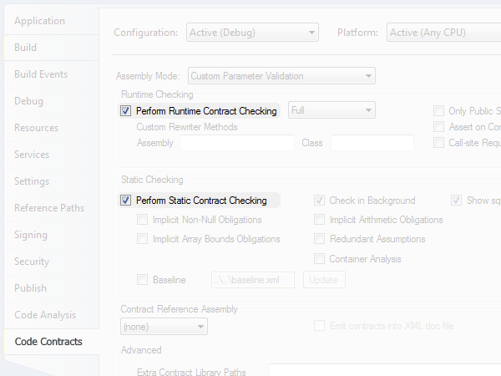
Solution? Static + Dynamic
Notes:
picture also shows what’s wrong with the approach: static and dynamic are considered independent, not really working together
Research: find good tests (directed dynamic verification)

Slide 10
Solution! Static ⊕ Dynamic
Typing
Typing
“Static Checking Where Possible,
Dynamic Checking When Needed”
(Erik Meijer)
draw on recent advances in gradual typing
Ronald Garcia, Alison M. Clark, and Éric Tanter.
"Abstracting gradual typing."
ACM SIGPLAN Notices 51.1 (2016): 429-442.
adapt methodology to static verification setting
// gradual typing
object eval(string exprCode)
{
…
}
…
string expr = "string.Concat(20, '+', 22)";
object res1 = eval(expr); // statically guaranteed
object res2 = eval((string)res1); // dyn guaranteed
object res3 = eval((string)res2); // dyn guaranteed 
// gradual typing
dynamic eval(string exprCode)
{
…
}
…
string expr = "string.Concat(20, '+', 22)";
dynamic res1 = eval(expr); // statically guaranteed
dynamic res2 = eval(res1); // dynamically guaranteed
dynamic res3 = eval(res2); // dynamically guaranteed 
void withdrawCoins(int amount)
requires this.balance >= amount;
{
…
}
…
acc.balance = 100;
acc.withdrawCoins(50); // statically guaranteed
acc.withdrawCoins(30); // dynamically guaranteed
acc.withdrawCoins(30); // dynamically guaranteed 
void withdrawCoins(int amount)
requires this.balance >= amount;
{
…
}
…
acc.balance = 100;
acc.withdrawCoins(50); // can prove acc.balance >= 50
acc.withdrawCoins(30); // can’t prove acc.balance >= 30
acc.withdrawCoins(30); // can’t prove acc.balance >= 30
Notes:
…gradual defined in terms of static system (+ casts or dyn. checks)… but also viewable as extension of dynamic
gradual typing taught us that solution is not to blindly combine approaches
AGT formalizes how to get from … to …

Slide 11
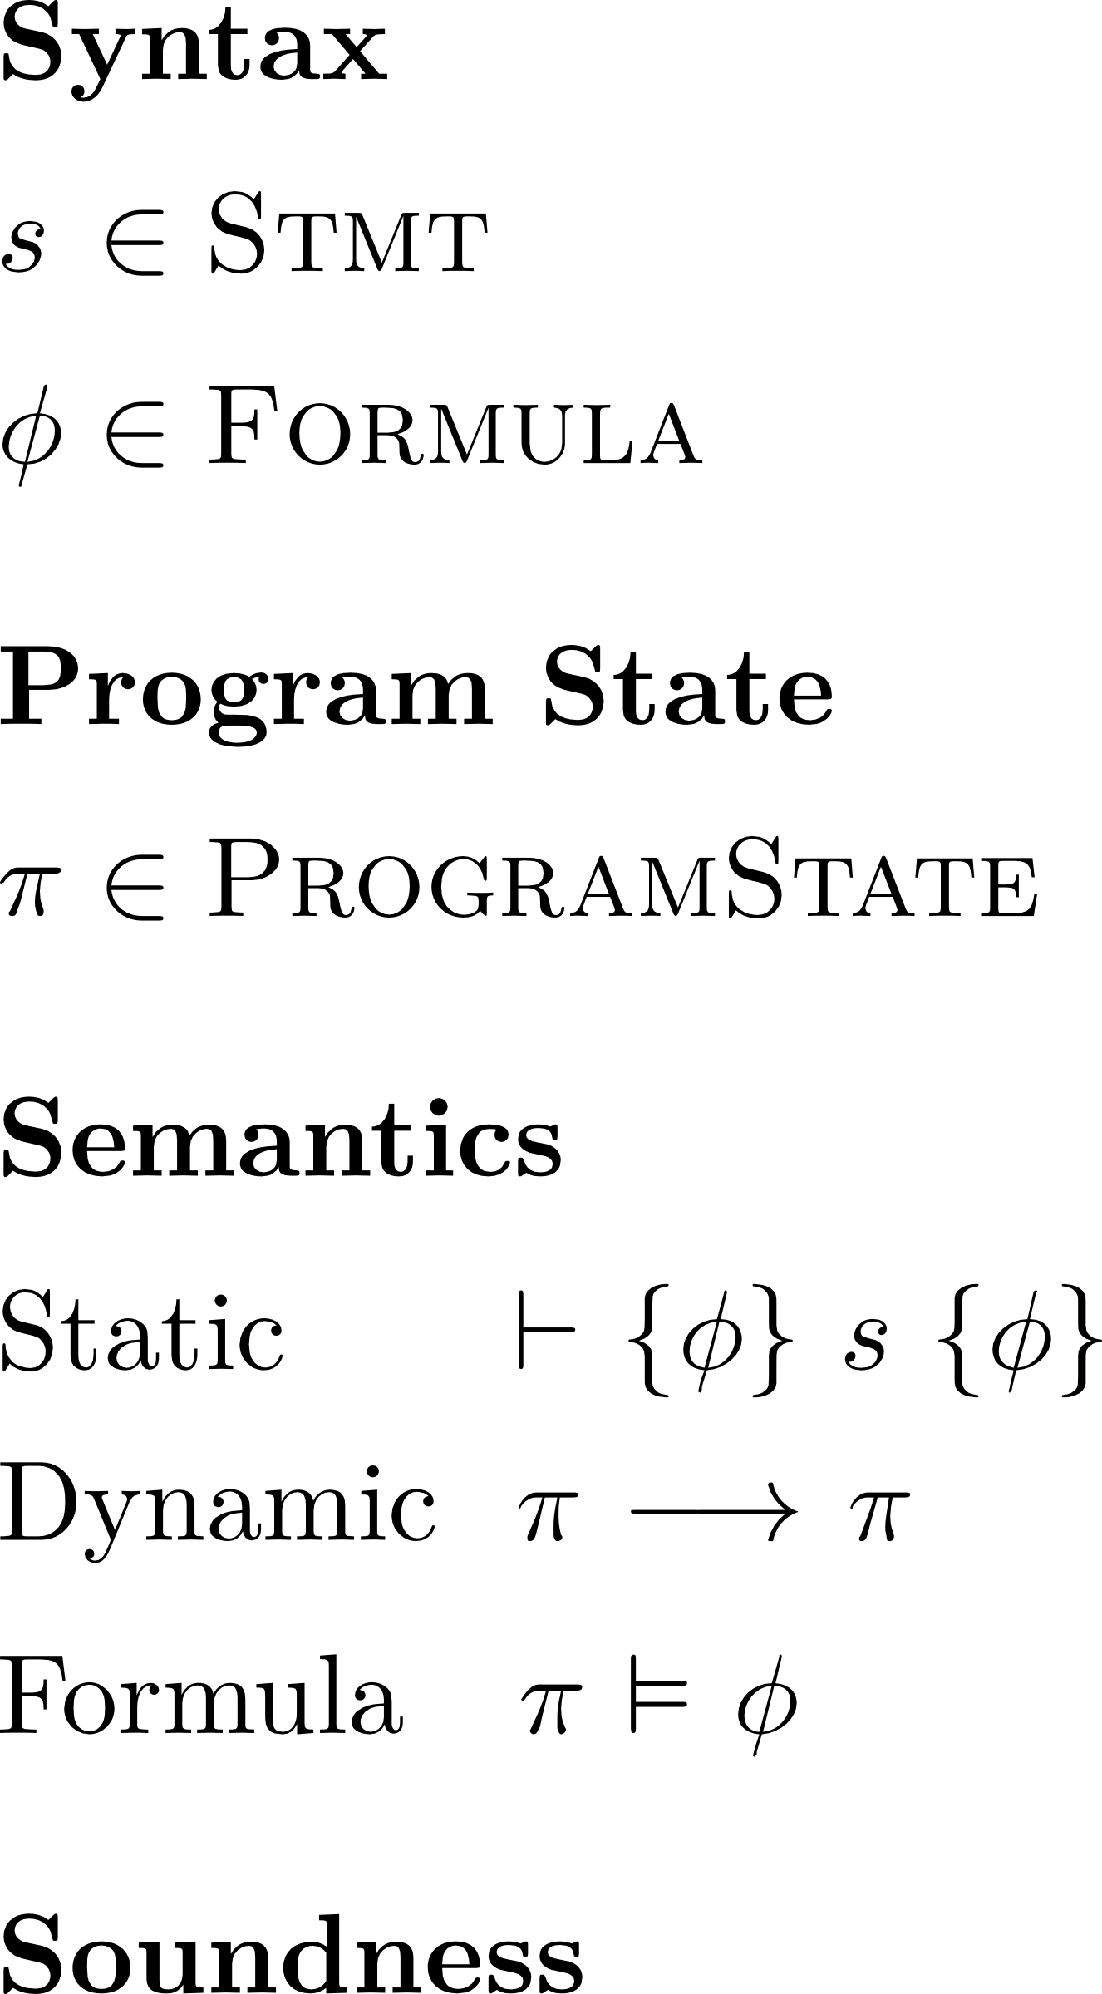
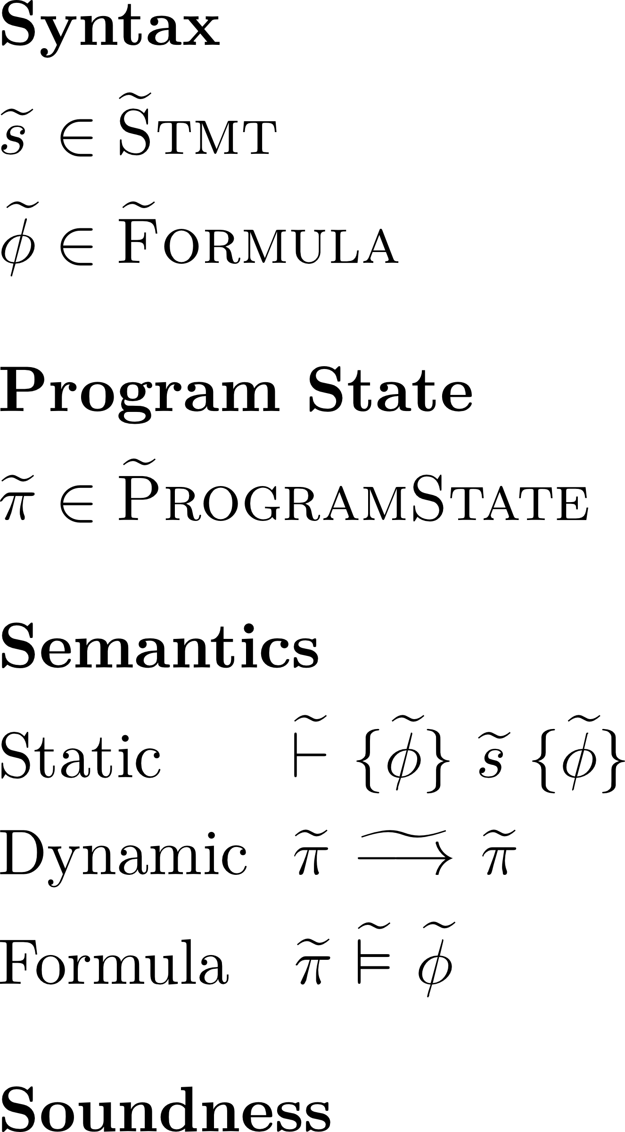
Approach
Gradualization
11
Notes:
define a gradually verified programming language in terms of a statically verified one (process called gradualization)
AGT

Slide 12
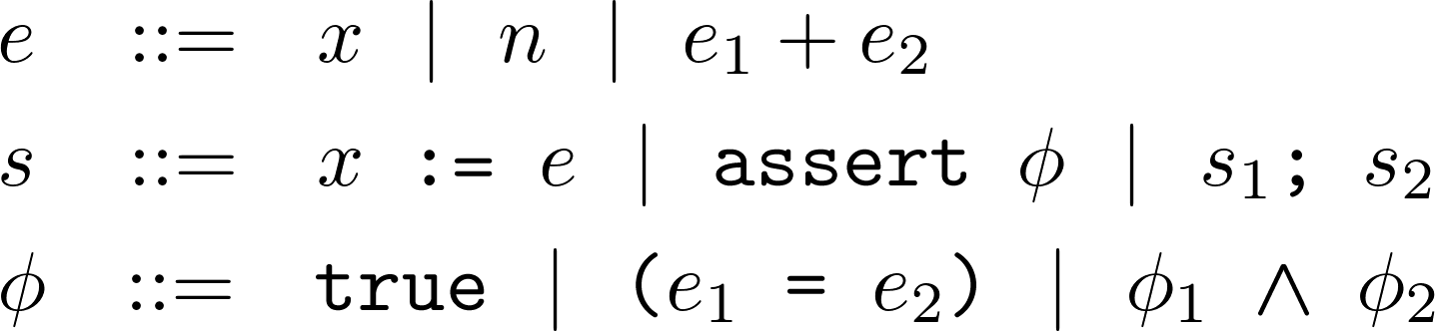
Gradualization – Starting Point
12
Notes:
define a gradually verified programming language in terms of a statically verified one (process called gradualization)
AGT

Slide 13
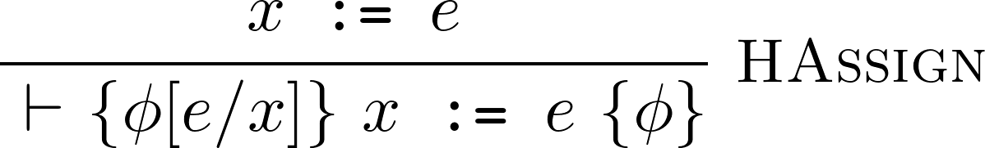
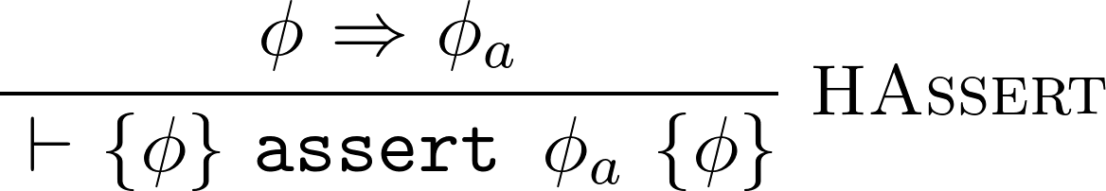
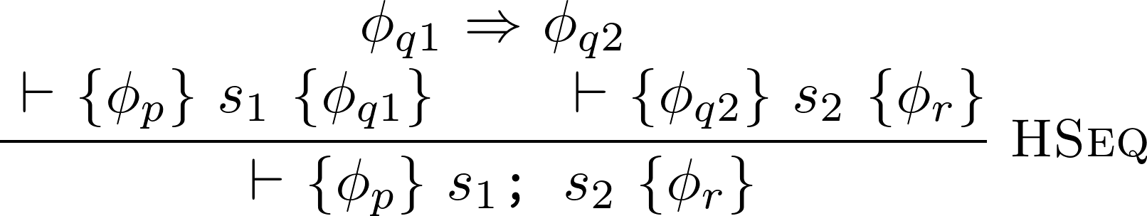
Gradualization – Starting Point
13
Notes:
define a gradually verified programming language in terms of a statically verified one (process called gradualization)
AGT

Slide 14
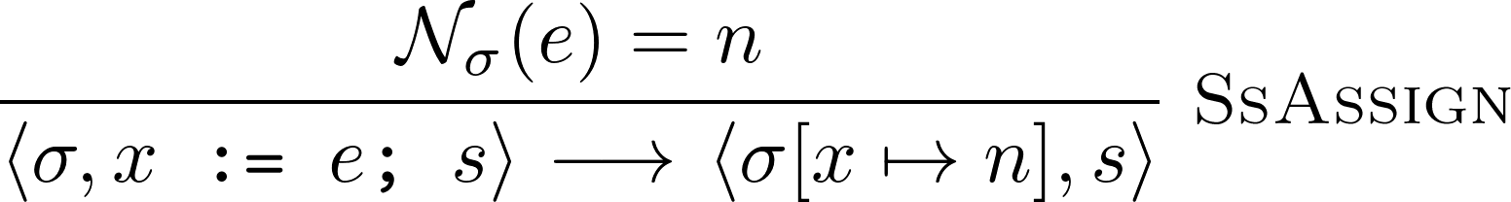
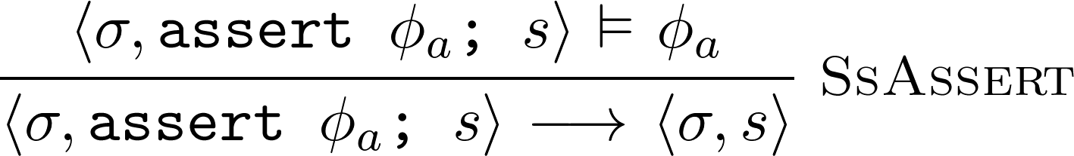
Gradualization – Starting Point
14
Notes:
define a gradually verified programming language in terms of a statically verified one (process called gradualization)
AGT

Slide 15
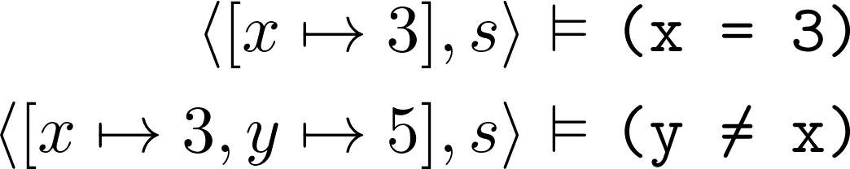
Gradualization – Starting Point
15
Notes:
define a gradually verified programming language in terms of a statically verified one (process called gradualization)
AGT

Slide 16
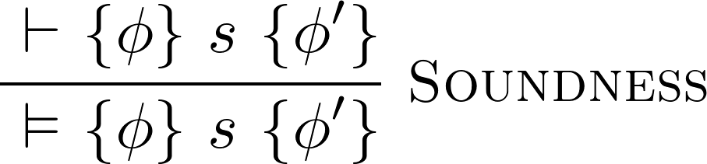
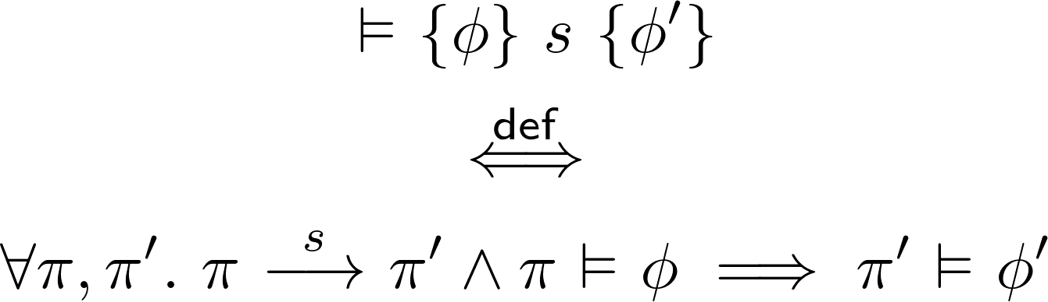
Gradualization – Starting Point
16
Notes:
define a gradually verified programming language in terms of a statically verified one (process called gradualization)
AGT
weak soundness

Slide 17
Gradualization – Overview
Gradualization
17
Notes:
define a gradually verified programming language in terms of a statically verified one (process called gradualization)
AGT

Slide 18
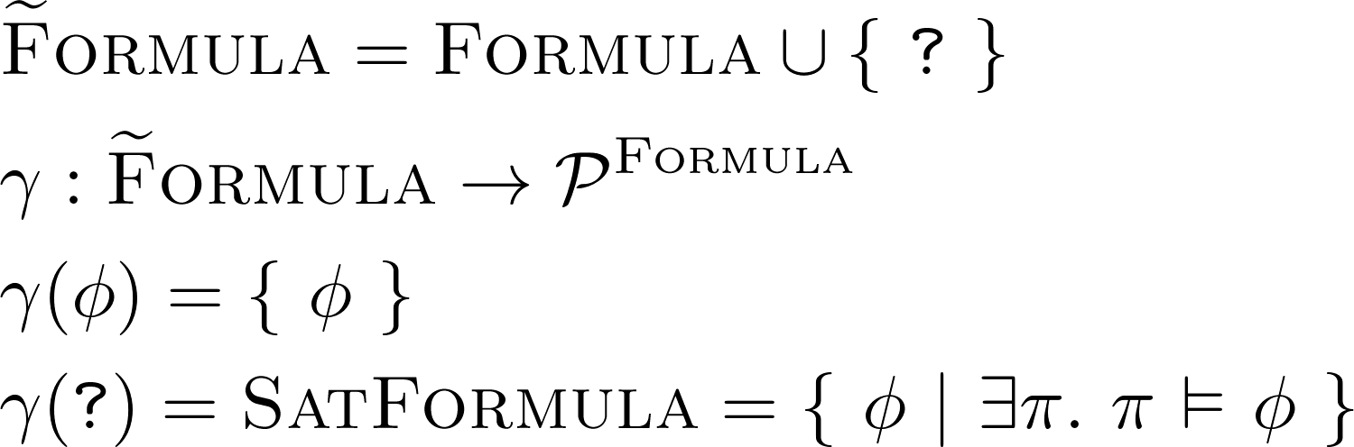
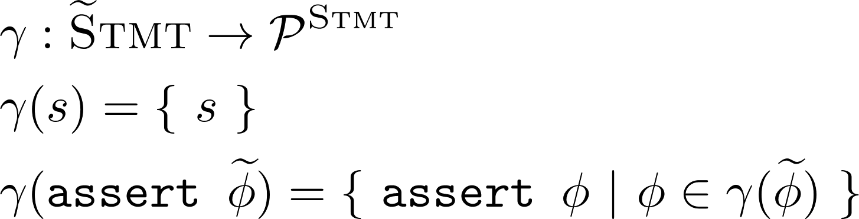
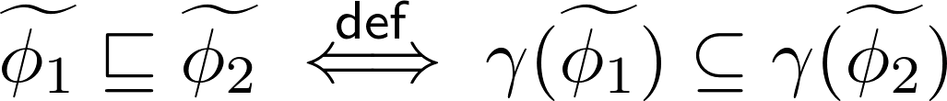
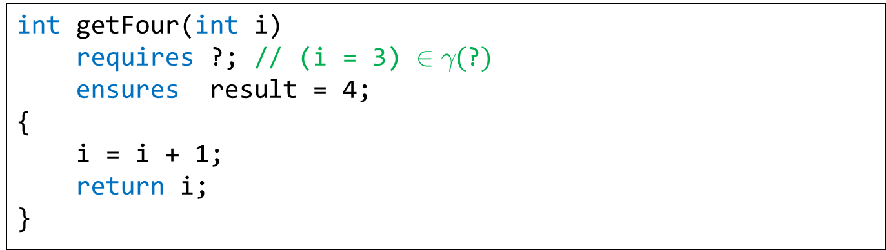
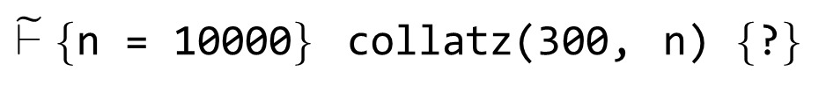
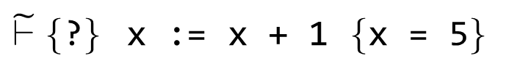
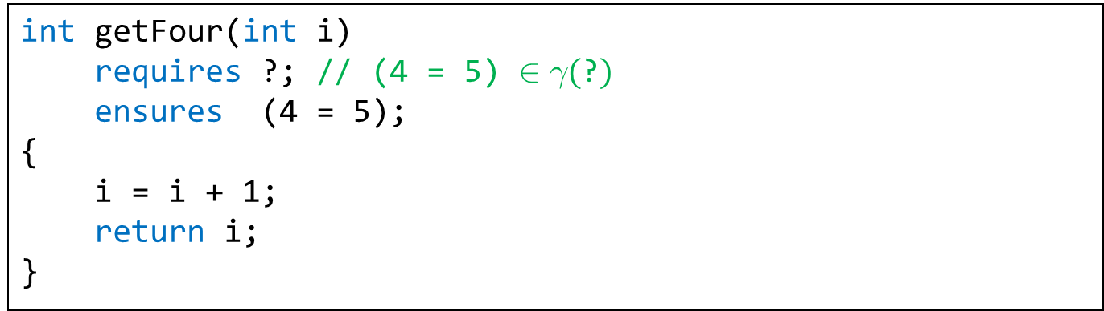
Gradualization – Goal 1/3
Introduction of wildcard formula ?
placeholder for arbitrary (satisfiable) formula
enables Hoare deduction despite incomplete information
enables gradual annotation of programs (? as default)
int getFour(int i)
requires ?; // (4 = 5) $∈γ(\text{?})$
ensures (4 = 5);
{
i = i + 1;
return i;
}
int getFour(int i)
requires ?; // haven't figured that one out, yet
ensures result = 4;
{
i = i + 1;
return i;
}
int getFour(int i)
requires ?; // (i = 3) $∈γ(\text{?})$
ensures result = 4;
{
i = i + 1;
return i;
}
Formula Precision
$\tilde{⊢}\{$n = 10000$\}$ collatz(300, n) $\{$?$\}$
abstract
interpretation
$\tilde{⊢}\{$?$\}$ x := x + 1 $\{$x = 5$\}$
abstract
interpretation
18
Notes:
this is design space
TODO: other sets

Slide 19
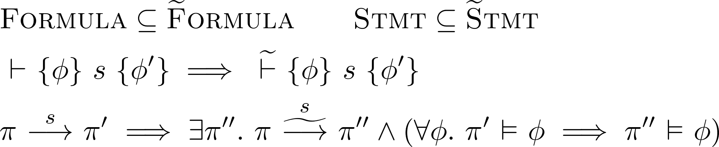
Gradualization – Goal 2/3
Compatibility with static language
don’t reject source code that was accepted before
observable behavior is not changed
static
dynamic
19

Slide 20
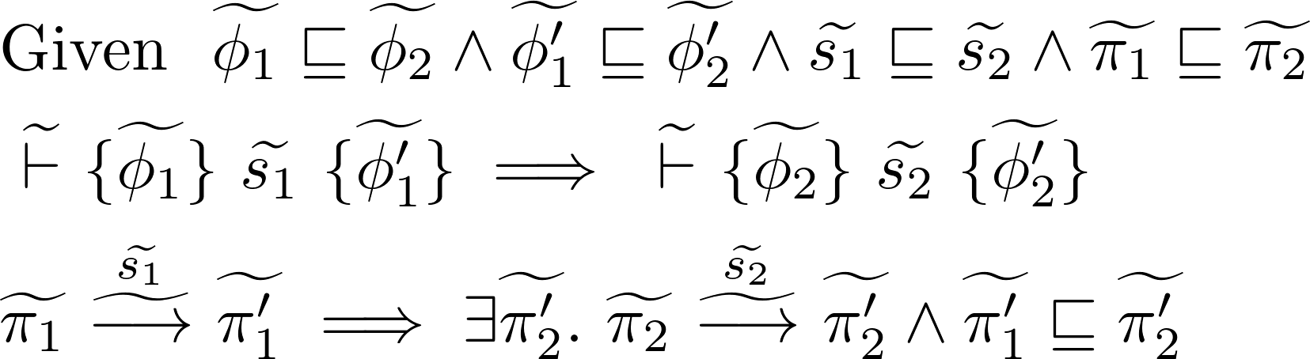
Gradualization – Goal 3/3
Gradual guarantee (Siek et al.), adapted
Reducing precision will not
introduce verification failure
change observable behavior
static
dynamic
20

Slide 21
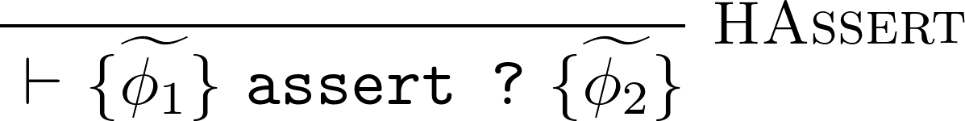
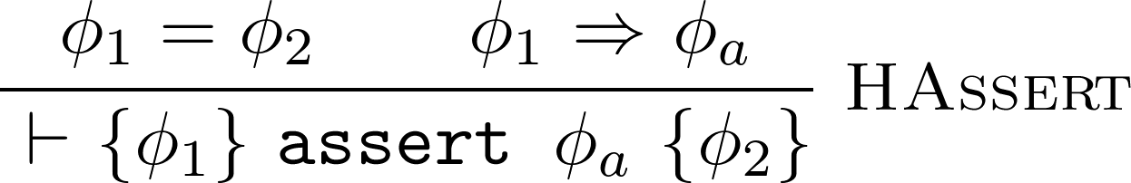
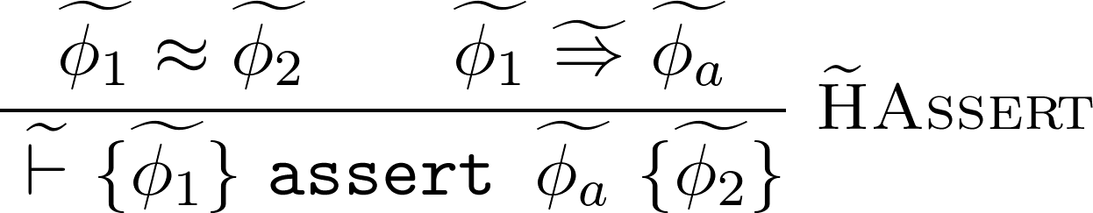
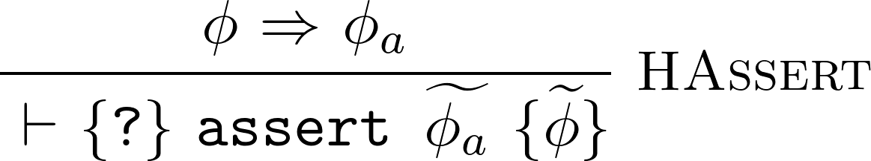
Gradual Predicate Lifting
Introduction
Monotonicity
Notes:
TODO animate deductive rule
make more loose thing more obvious, bullet point

Slide 22
Gradual Predicate Lifting
Introduction
Monotonicity
this is only one way of many to lift HAssert!
Notes:
TODO animate deductive rule
make more loose thing more obvious, bullet point

Slide 23
Gradual Predicate Lifting
Introduction
Monotonicity
(Optimality)
⬄
Notes:
AGT! also gives this definition, but from completely different angle!

Slide 24
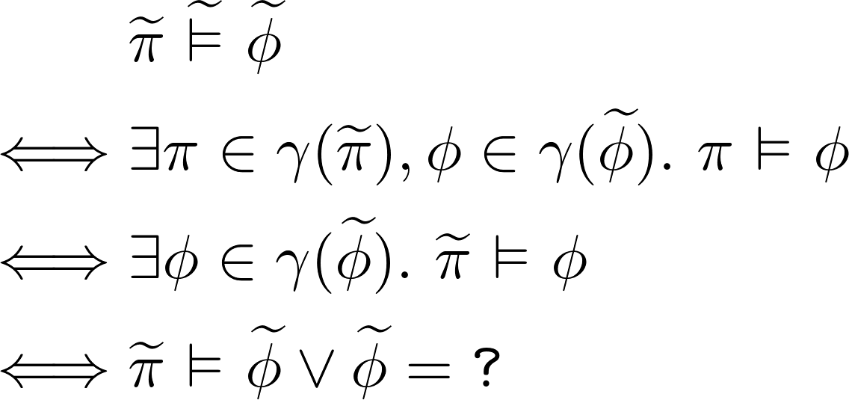
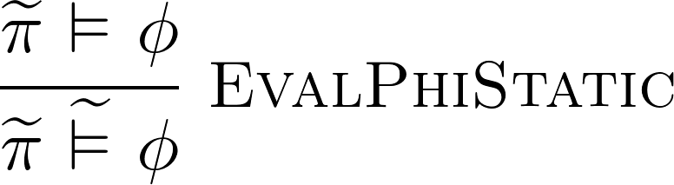
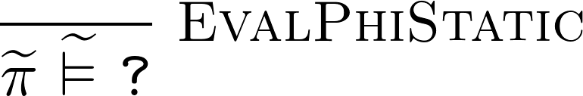
Gradual Predicate Lifting
⬄

Slide 25
Gradual Function Lifting
Introduction
Monotonicity
(Optimality)
⬄

Slide 26
Gradual Partial Function Lifting
Introduction
Monotonicity
(Optimality)
⬄

Slide 27
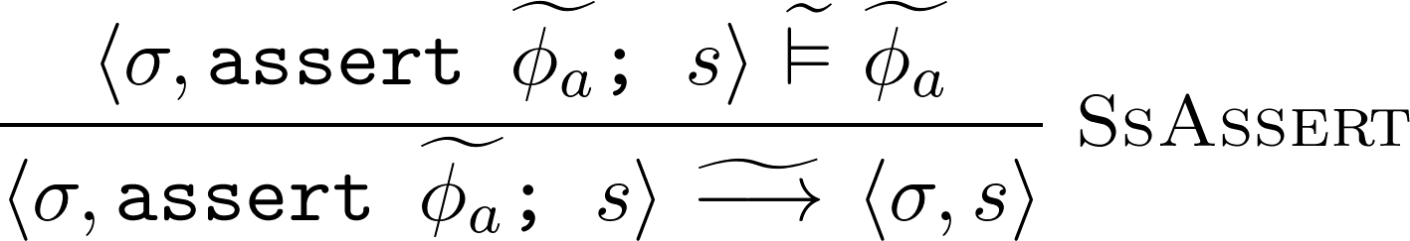
Gradual Partial Function Lifting
⬄

Slide 28
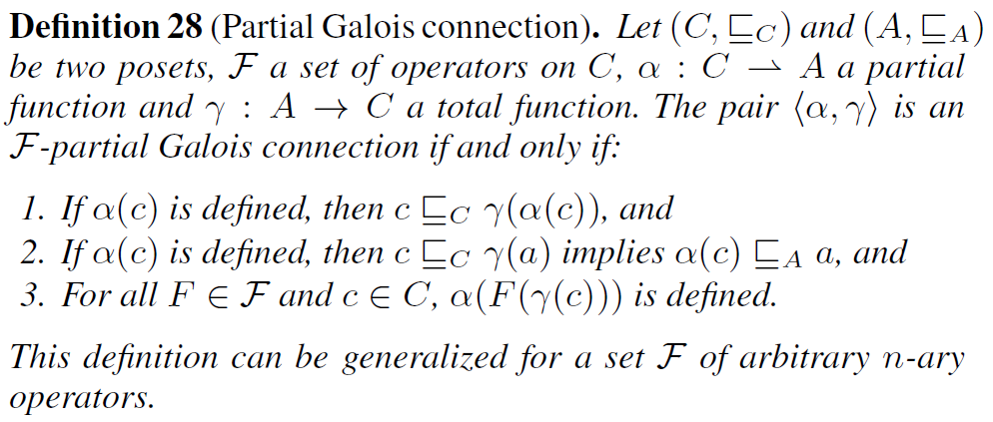
Bonus: { F }-partial Galois connection

Slide 29
Gradual Verification - Approach
Design
Space
Design
Space
Gradualization
Gradual
Guarantee
Abstract
Interpretation
Notes:
abstract interpretation – as we will see later doing so has very desirable properties

Slide 30
Gradual Verification - Approach
Design
Space
Design
Space
syntax extension
abstract interpretation
Gradual
Guarantee
Abstract
Interpretation
predicate lifting
function lifting
predicate lifting
Notes:
abstract interpretation – as we will see later doing so has very desirable properties

Slide 31
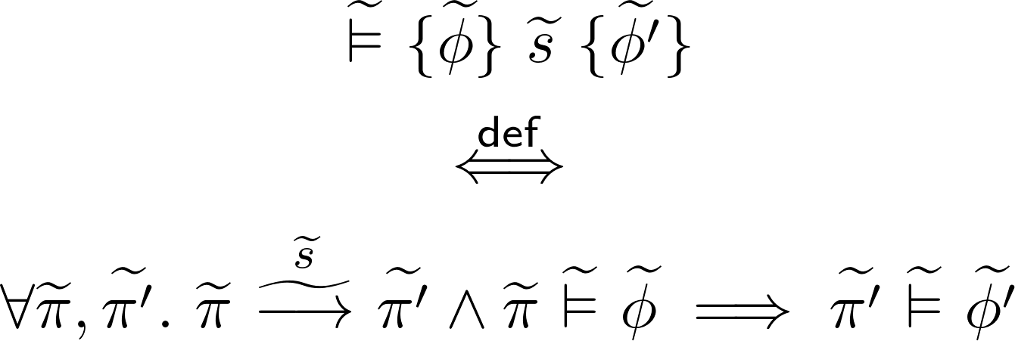
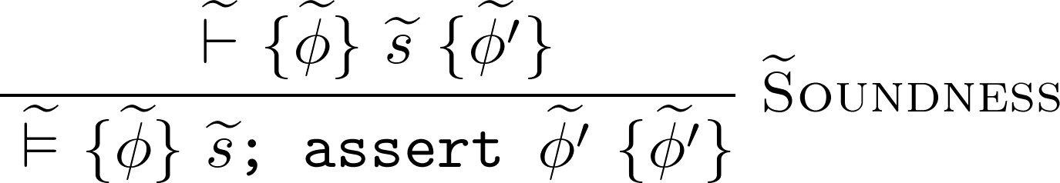
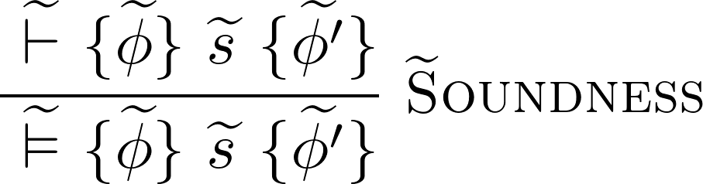
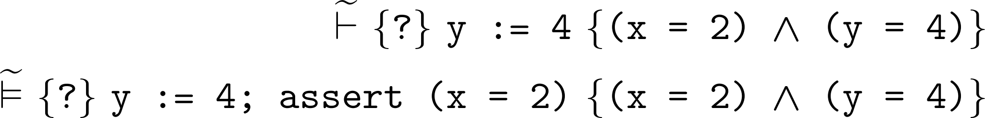
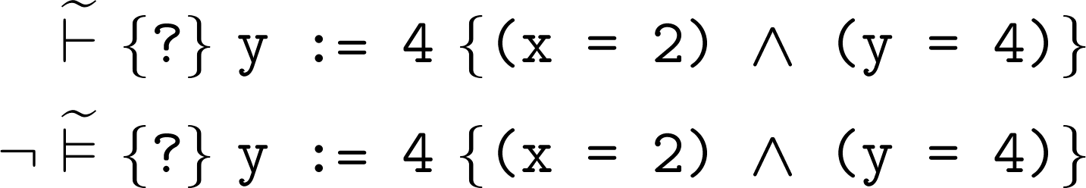
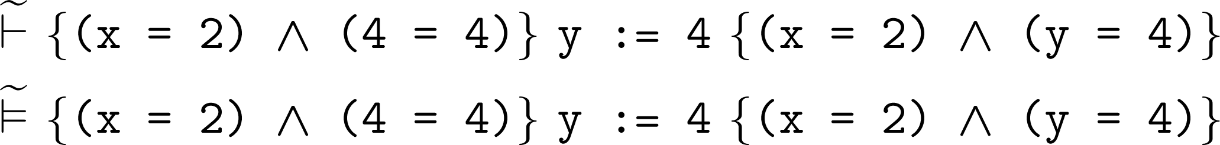
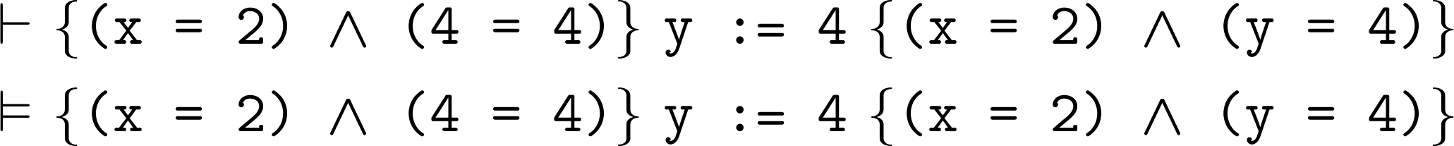
Gradual Soundness
Notes:
we want it to be deducible, but we don’t want it to be valid! (validity is a runtime property, no runtime behaves like that) – validity is about TRUTH
then again, it would be weird if this would work – it would mean that gradual verification had no runtime impact
how to interpret this new soundness rule?
RAC injection with every judgment!

Slide 32
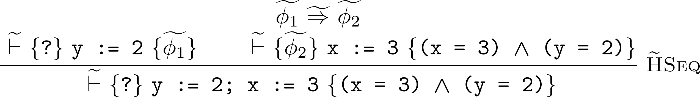
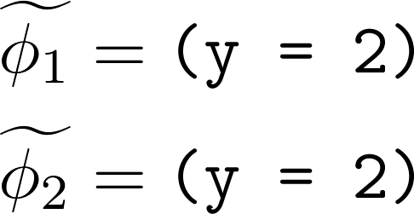
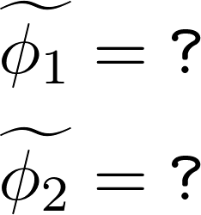
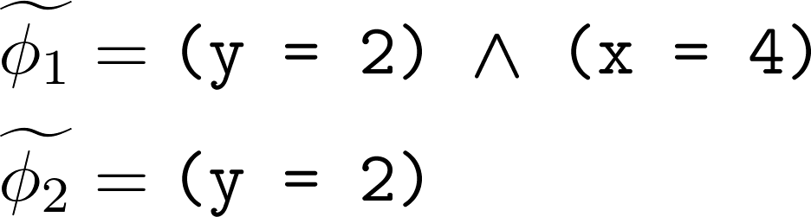
Gradual Verification – Put to the Test
a)
“good” (information carried over)
b)
“too weak” (could prove invalid triples)
idea: try to be as precise as possible
c)
“too strict” (Hoare triple invalid)
idea: try to produce valid Hoare triple
Notes:
that gradual soundness is tautology seems weird, but it was last puzzle piece
so let’s put it to the test and play gradual verifier for a second
what stands out is that there are free variables
static verifier does NOT have those problems!
“as precise as possible, as long as valid Hoare triples” – pretty strong thing for a inference policy… if we could decide that, we wouldn’t be in a Hoare logic prove right now… and wouldn’t even need an inference policy
oh, and remember, for each of these judgments we have to insert a runtime assertion (c shows why)

Slide 33

Deterministic Lifting
Idea: treat static Hoare logic as (multivalued) function
…and then lift that function
Properties
can derive gradual lifting
stronger, assertion-free notion of soundness
deterministic verifier
free transitivity (no assertions to justify premises of )
Notes:
[gradual lifting:] otherwise this is useless – remember, on user interface level, we’re still expected to implement a gradual lifting

Slide 34
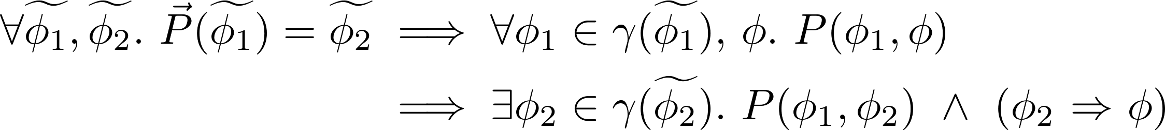
Deterministic Lifting
Introduction
Strength
Monotonicity
(Optimality)
Notes:
Strength rule: remember the idea to only make valid Hoare triples derivable? this is as close as it gets!

Slide 35
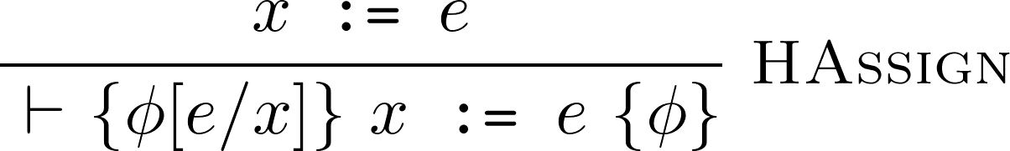
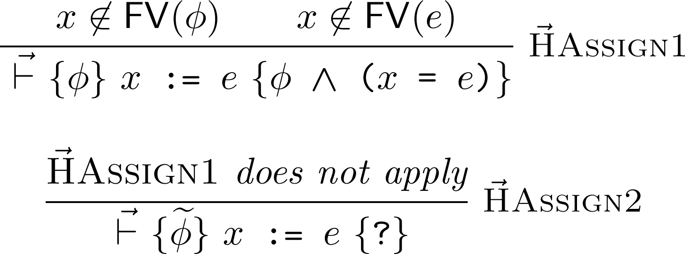
Deterministic Lifting – HAssign
Notes:
HSeq – 3 good news
lifting composite predicate corresponds to lifting components and the composing
these variables aren’t free anymore
deterministic lifting of implication is identity function

Slide 36
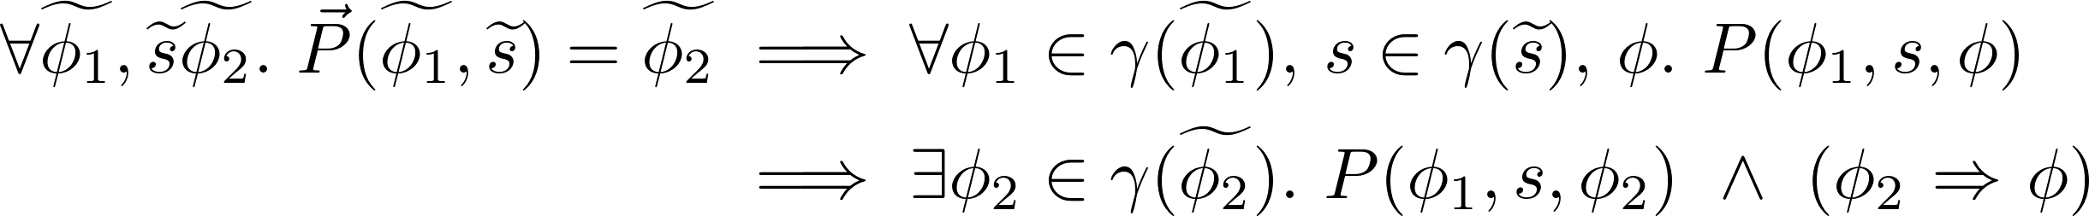
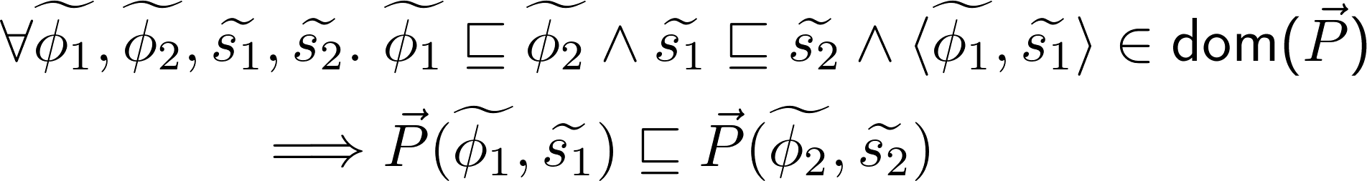
Deterministic Lifting
Introduction
Strength
Monotonicity
(Optimality)
Notes:
Strength rule: remember the idea to only make valid Hoare triples derivable? this is as close as it gets!

Slide 37
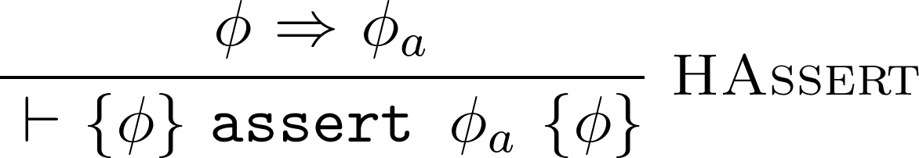
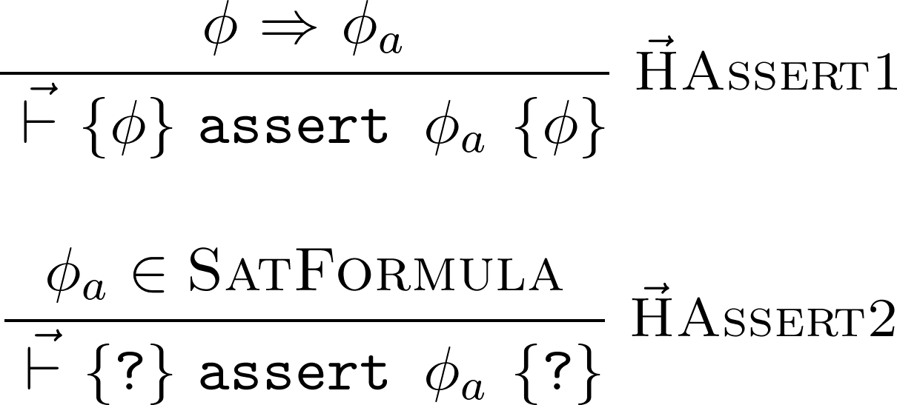
Deterministic Lifting – HAssert
Notes:
HSeq – 3 good news
lifting composite predicate corresponds to lifting components and the composing
these variables aren’t free anymore
deterministic lifting of implication is identity function

Slide 38
Deterministic Lifting
Introduction
Strength
Monotonicity
(Optimality)
Notes:
Strength rule: remember the idea to only make valid Hoare triples derivable? this is as close as it gets!

Slide 39

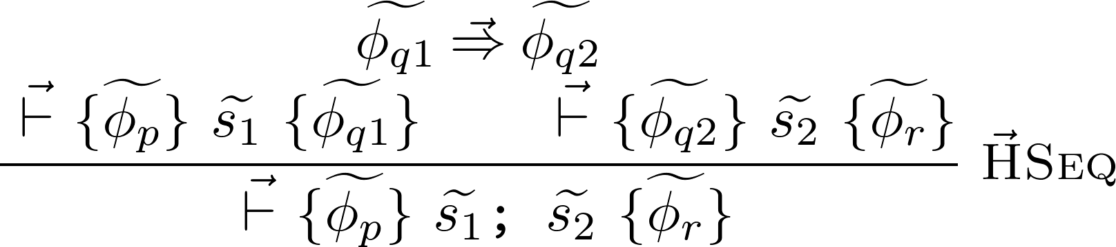
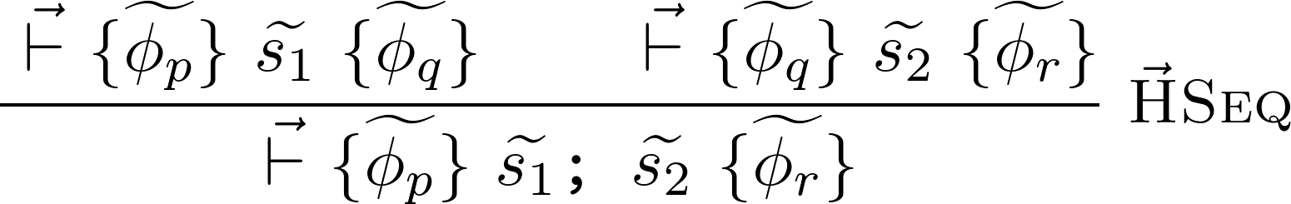
Deterministic Lifting – HSeq
Notes:
HSeq – 3 good news
lifting composite predicate corresponds to lifting components and the composing
these variables aren’t free anymore
deterministic lifting of implication is identity function

Slide 40
Deterministic Lifting
Introduction
Strength
Monotonicity
(Optimality)
Notes:
Strength rule: remember the idea to only make valid Hoare triples derivable? this is as close as it gets!

Slide 41

Deterministic Lifting
Obtaining a Gradual Lifting
Notes:
important result
optimality of one does not imply optimality of the other

Slide 42
Deterministic Lifting
Notes:
important result
optimality of one does not imply optimality of the other

Slide 43

Deterministic Lifting
Soundness
satisfiable (but not a tautology)
very helpful for optimizations
Notes:
optimality of one does not imply optimality of the other

Slide 44
Deterministic Lifting
Introduction
Strength
Monotonicity
(Optimality)
Notes:
Strength rule: remember the idea to only make valid Hoare triples derivable? this is as close as it gets!

Slide 45
Demo http://olydis.github.io/GradVer/impl/HTML5/

Slide 46
Deterministic Lifting

Slide 47




Implicit Dynamic Frames
Notes:
4

