Slide 1
Gradual Verification
with Implicit Dynamic Frames

Slide 2
Motivation
Program verification (against some specification)
Two flavors: static & dynamic
// spec: callable only if (this.balance >= amount)
void withdrawCoins(int amount)
{
// business logic
this.balance -= amount;
}
Notes:
does NOT guarantee termination

Slide 3
Dynamic Verification
runtime checks
testing techniques
guarantee compliance at runtime
// spec: callable only if (this.balance >= amount)
void withdrawCoins(int amount)
{
// business logic
this.balance -= amount;
}
void withdrawCoins(int amount)
{
assert this.balance >= amount;
// business logic
this.balance -= amount;
}

Slide 4
Dynamic Verification - Drawbacks
runtime checks
testing techniques
guarantee compliance at runtime
runtime overhead
additional efforts
pot. late detection
void withdrawCoins(int amount)
{
assert this.balance >= amount;
// business logic
this.balance -= amount;
}
void withdrawCoins(int amount)
requires this.balance >= amount;
{
// business logic
this.balance -= amount;
}
Notes:
industry addresses this problem by: removed on build

Slide 5
Static Verification
declarative
formal logic
guarantee compliance in advance
void withdrawCoins(int amount)
requires this.balance >= amount;
{
// business logic
this.balance -= amount;
}

Slide 6
Static Verification - Drawbacks
declarative
formal logic
guarantee compliance in advance
limited syntax
decidability
annotation pressure
void withdrawCoins(int amount)
requires this.balance >= amount;
ensures this.balance = old(this.balance) – amount;
{
// business logic
this.balance -= amount;
}
void withdrawCoins(int amount)
requires this.balance >= amount;
{
// business logic
this.balance -= amount;
}
Notes:
industry addresses this problem by (already a joke – it doesn’t address this problem because there is no static verification): often only warnings

Slide 7
Solution? Static + Dynamic
Means:
“relaxed” static verification (warnings on failure)
turn contracts into runtime assertions
Notable implementations:
Java with JML annotations
“ESC/Java” for static verification
“JML4c” for dynamic verification
Code Contracts for .NET (by RiSE, MSR)
Notes:
„Research in Software Engineering“ (MSR)

Slide 8
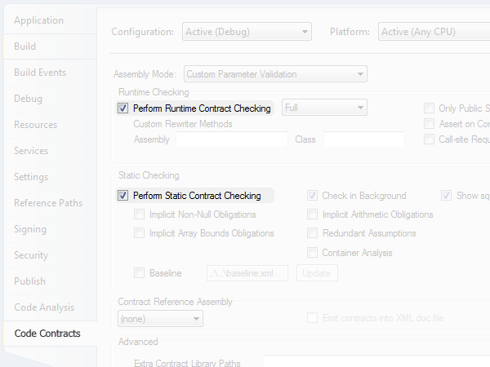
Solution? Static + Dynamic
Notes:
picture also shows what’s wrong with the approach: static and dynamic are considered independent, not really working together
Research: find good tests (directed dynamic verification)

Slide 9
Solution! Static ⊕ Dynamic
Typing
Typing
“Static Checking Where Possible,
Dynamic Checking When Needed”
(Erik Meijer)
// gradual typing
object eval(string exprCode)
{
…
}
…
string expr = "string.Concat(20, '+', 22)";
object res1 = eval(expr); // statically guaranteed
object res2 = eval((string)res1); // dyn guaranteed
object res3 = eval((string)res2); // dyn guaranteed 
// gradual typing
dynamic eval(string exprCode)
{
…
}
…
string expr = "string.Concat(20, '+', 22)";
dynamic res1 = eval(expr); // statically guaranteed
dynamic res2 = eval(res1); // dynamically guaranteed
dynamic res3 = eval(res2); // dynamically guaranteed 
void withdrawCoins(int amount)
requires this.balance >= amount;
{
…
}
…
acc.balance = 100;
acc.withdrawCoins(50); // statically guaranteed
acc.withdrawCoins(30); // dynamically guaranteed
acc.withdrawCoins(30); // dynamically guaranteed 
void withdrawCoins(int amount)
requires this.balance >= amount;
{
…
}
…
acc.balance = 100;
acc.withdrawCoins(50); // can prove acc.balance >= 50
acc.withdrawCoins(30); // can’t prove acc.balance >= 30
acc.withdrawCoins(30); // can’t prove acc.balance >= 30
Notes:
…gradual defined in terms of static system (+ casts or dyn. checks)… but also viewable as extension of dynamic
gradual typing taught us that solution is not to blindly combine approaches
AGT formalizes how to get from … to …

Slide 10
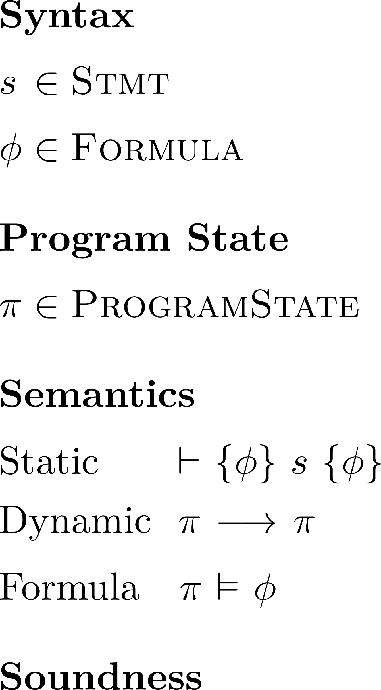
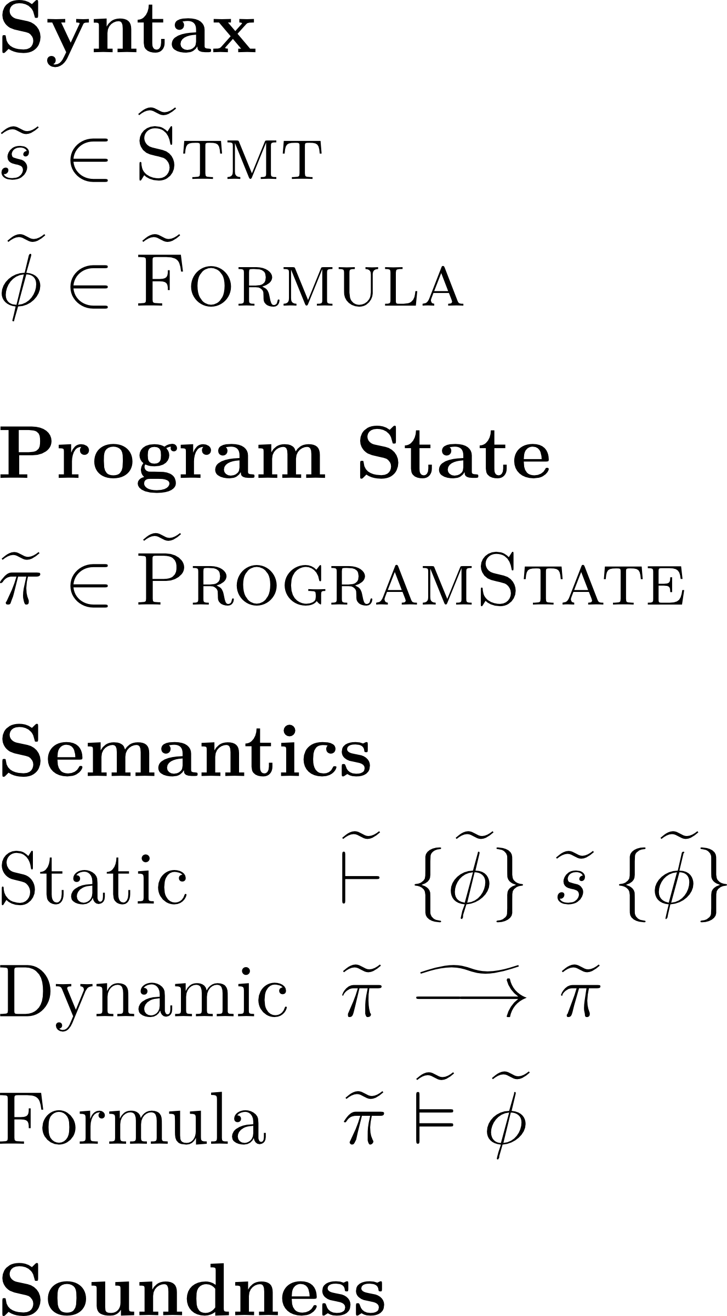
Approach
Gradualization
10
Notes:
define a gradually verified programming language in terms of a statically verified one (process called gradualization)
AGT

Slide 11



Statically Verified Language
$e ∷= x$ | $n$ | $e_{1} + e_{2}$
$s ∷= x$ := $e$ | assert $φ$ | $s_{1}$; $s_{2}$
$φ ∷=$true | ($e_{1}$ = $e_{2}$) | $φ_{1} ∧{ φ}_{2}$
= (Var $⇀$ Val) $×$ Stmt
11
Notes:
define a gradually verified programming language in terms of a statically verified one (process called gradualization)
AGT

Slide 12
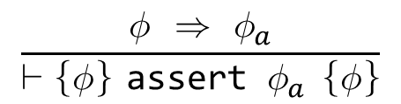
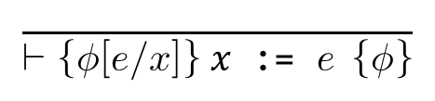
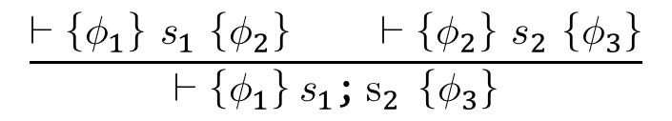
Statically Verified Language
$e ∷= x$ | $n$ | $e_{1} + e_{2}$
$s ∷= x$ := $e$ | assert $φ$ | $s_{1}$; $s_{2}$
$φ ∷=$true | ($e_{1}$ = $e_{2}$) | $φ_{1} ∧{ φ}_{2}$
$$\frac{ }{⊢\left\{φ\left[e/x\right]\right\} x\text{ := }e \left\{φ\right\}}$$
$$\frac{φ ⇒ φ_{a}}{⊢\left\{φ\right\} \text{assert} φ_{a} \left\{φ\right\}}$$
$$\frac{⊢\left\{φ_{1}\right\} s_{1} \left\{φ_{2}\right\} ⊢\left\{φ_{2}\right\} s_{2} \left\{φ_{3}\right\}}{⊢\left\{φ_{1}\right\} s_{1}\text{;} s_{2} \left\{φ_{3}\right\}}$$
12
Notes:
define a gradually verified programming language in terms of a statically verified one (process called gradualization)
AGT

Slide 13
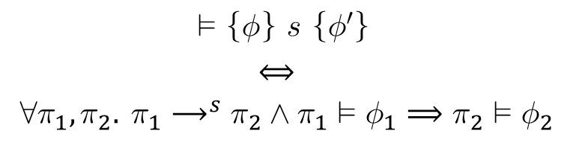
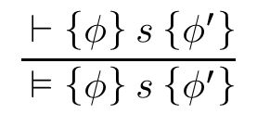
Statically Verified Language
$e ∷= x$ | $n$ | $e_{1} + e_{2}$
$s ∷= x$ := $e$ | assert $φ$ | $s_{1}$; $s_{2}$
$φ ∷=$true | ($e_{1}$ = $e_{2}$) | $φ_{1} ∧{ φ}_{2}$
$$\frac{ ⊢\left\{φ\right\} s \left\{φ^{′}\right\}}{ ⊨\left\{φ\right\} s \left\{φ^{′}\right\}}$$
$$⊨\left\{φ\right\} s \left\{φ^{′}\right\}$$
$$⟺$$
$$∀π_{1},π_{2}. π_{1}{\text{⟶}}^{s}π_{2}∧π_{1}⊨φ_{1}⟹π_{2}⊨φ_{2}$$
13
Notes:
define a gradually verified programming language in terms of a statically verified one (process called gradualization)
AGT

Slide 14
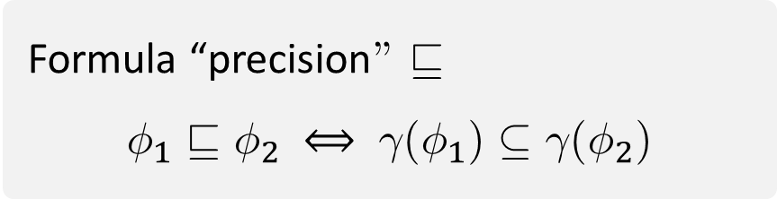
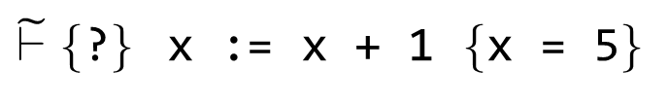


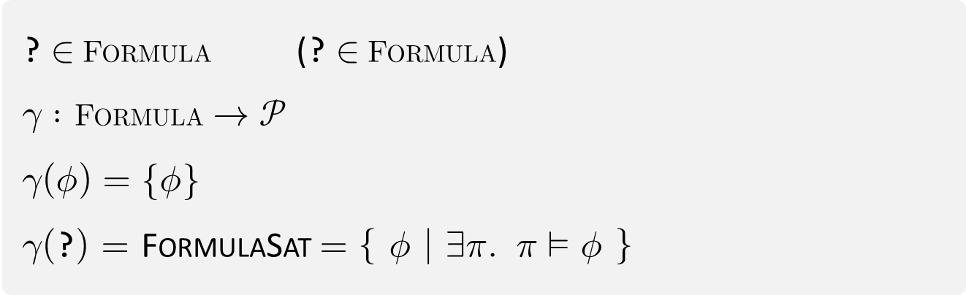

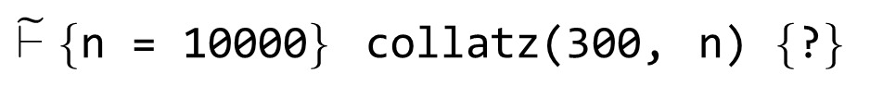

Gradualization – Goal 1/3
Introduction of wildcard formula ?
placeholder for arbitrary (satisfiable) formula
enables Hoare deduction despite incomplete information
enables gradual annotation of programs (? as default)
? $∈$ Formula (? $∈$ Formula)
$γ :$Formula $→𝒫$
$γ\left(φ\right)=\{φ\}$
$γ\left(\text{?}\right)=$ FormulaSat $=\left\{ φ | ∃π. π⊨φ \right\}$
$$/$$
$γ :$Stmt $→𝒫$
Statement “precision” $⊑$
$$s_{1}⊑s_{2} ⟺ γ(s_{1})⊆γ(s_{2})$$
$\tilde{⊢}\{$n = 10000$\}$ collatz(300, n) $\{$?$\}$
Stmt
Formula
Formula “precision” $⊑$
$$φ_{1}⊑φ_{2} ⟺ γ(φ_{1})⊆γ(φ_{2})$$
abstract
interpretation
$\tilde{⊢}\{$?$\}$ x := x + 1 $\{$x = 5$\}$
14
Notes:
define a gradually verified programming language in terms of a statically verified one (process called gradualization)
this is design space
TODO: other sets

Slide 15
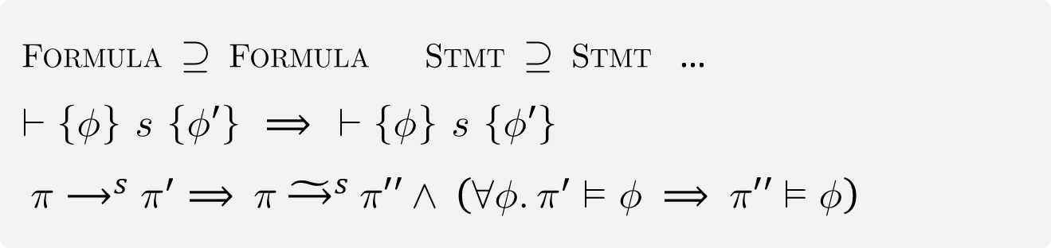



Gradualization – Goal 2/3
Compatibility with static language
don’t reject source code that was accepted before
observable behavior is not changed
static
dynamic
Formula$⊇$Formula Stmt$⊇$Stmt …
$⊢\left\{φ\right\} s \left\{φ′\right\} ⟹ ⊢\left\{φ\right\} s \left\{φ′\right\}$
$π{\text{⟶}}^{s}π^{′}⟹ π {\tilde{\text{⟶}}}^{s} π′′∧ \left(∀φ.π^{′}⊨φ ⟹ π′′⊨φ\right)$
15
Notes:
define a gradually verified programming language in terms of a statically verified one (process called gradualization)

Slide 16
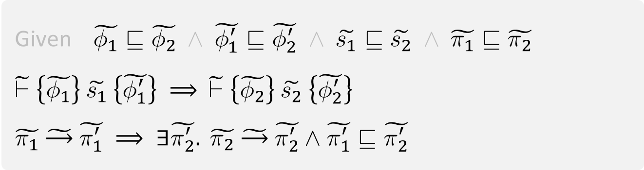
Gradualization – Goal 3/3
Gradual guarantee (Siek et al.), adapted
Reducing precision will not
introduce verification failure
change observable behavior
static
dynamic
Given $\tilde{φ_{1}}⊑\tilde{φ_{2}} ∧ \tilde{φ_{1}^{′}}⊑\tilde{φ_{2}^{′}} ∧ \tilde{s_{1}}⊑\tilde{s_{2}} ∧ \tilde{π_{1}}⊑\tilde{π_{2}}$
$\tilde{⊢}\left\{\tilde{φ_{1}}\right\} \tilde{s_{1}} \left\{\tilde{φ_{1}^{′}}\right\} ⟹ \tilde{⊢}\left\{\tilde{φ_{2}}\right\} \tilde{s_{2}} \left\{\tilde{φ_{2}^{′}}\right\}$
$\tilde{π_{1}} \tilde{\text{⟶}} \tilde{π_{1}^{′}} ⟹ ∃\tilde{π_{2}^{′}}. \tilde{π_{2}} \tilde{\text{⟶}} \tilde{π_{2}^{′}}∧\tilde{π_{1}^{′}}⊑\tilde{π_{2}^{′}}$
16
Notes:
define a gradually verified programming language in terms of a statically verified one (process called gradualization)

Slide 17
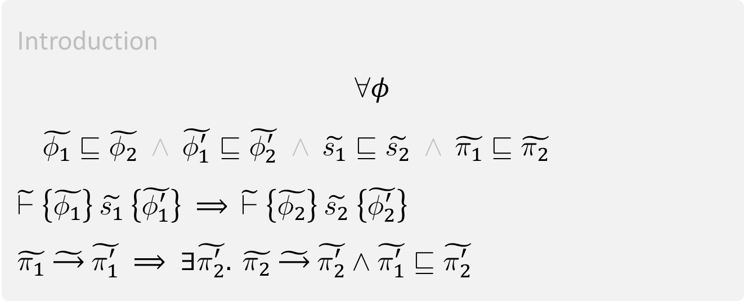
Gradual Predicate Lifting
Introduction
$$∀φ$$
$\tilde{φ_{1}}⊑\tilde{φ_{2}} ∧ \tilde{φ_{1}^{′}}⊑\tilde{φ_{2}^{′}} ∧ \tilde{s_{1}}⊑\tilde{s_{2}} ∧ \tilde{π_{1}}⊑\tilde{π_{2}}$
$\tilde{⊢}\left\{\tilde{φ_{1}}\right\} \tilde{s_{1}} \left\{\tilde{φ_{1}^{′}}\right\} ⟹ \tilde{⊢}\left\{\tilde{φ_{2}}\right\} \tilde{s_{2}} \left\{\tilde{φ_{2}^{′}}\right\}$
$\tilde{π_{1}} \tilde{\text{⟶}} \tilde{π_{1}^{′}} ⟹ ∃\tilde{π_{2}^{′}}. \tilde{π_{2}} \tilde{\text{⟶}} \tilde{π_{2}^{′}}∧\tilde{π_{1}^{′}}⊑\tilde{π_{2}^{′}}$

Slide 18





Gradual Verification - Goal
s
$e_{1}$ := $e_{2}$ | assert $\tilde{φ }$| … | $s_{1}$; $s_{2}$
? | true | ($e_{1}$ = $e_{2}$) | ($e_{1}$ ≠ $e_{2}$) | $φ_{1} ∧{ φ}_{2}$
s
(Var $⇀$ Val) $×$ Stmt
$⊢\{$x = 3$\}$ x := x + 1 $\{$x = 4$\}$
$⊢\{$ ? $\}$ x := x + 1 $\{$x = 4$\}$
$〈\text{x}↦3, \text{x}\text{ := }\text{x}\text{ + }\text{1; }\text{skip}〉 \text{⟶} 〈\text{x}↦4, \text{skip}〉$
$〈\text{x}↦3, \text{x}\text{ := }\text{x}\text{ + }\text{1; }\text{skip}〉 ⊨ \text{x}\text{ = 3}$
$$⊢\left\{φ_{1}\right\}s\left\{φ_{2}\right\}∧π_{1}{\text{⟶}}^{s}π_{2}∧π_{1}⊨φ_{1}⟹π_{2}⊨φ_{2}$$

Slide 19
Gradual Verification - Approach
Design
Space
Design
Space
Gradualization
Gradual
Guarantee
Abstract
Interpretation
Notes:
abstract interpretation – as we will see later doing so has very desirable properties

Slide 20
Gradual Verification - Rules
In

Slide 21
Gradual Verification

Slide 22

enough hand wavy motivation
$⊢\{$x = 3$\}$ x := x + 1 $\{$x = 4$\}$

Slide 23
Abstract Interpretation
Notes:
abstract interpretation: give meaning to gradual formulas in terms of static formulas

Slide 24
Notes:
4

