Slide 1
X Math

Slide 2
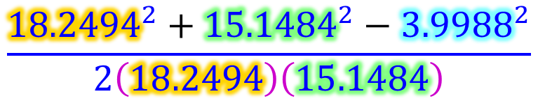
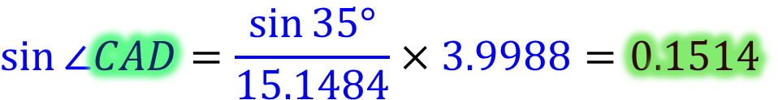
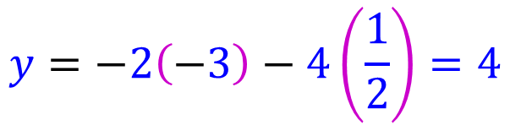
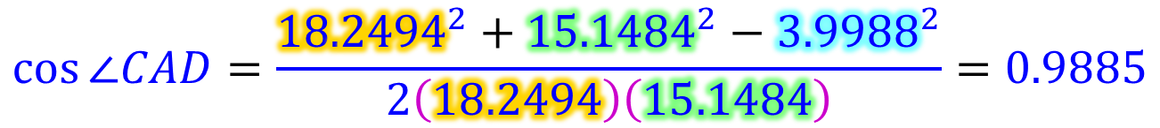
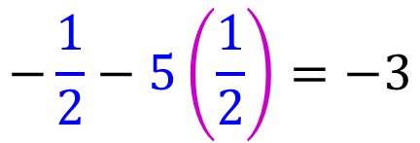
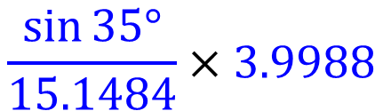
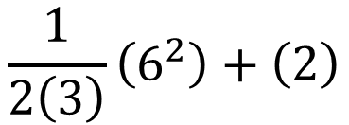
$$\frac{1}{2\left(3\right)}\left(6^{2}\right)+\left(2\right)$$
$$−\frac{1}{2}−5\left(\frac{1}{2}\right)=−3$$
$$\frac{\sin{35°}}{15.1484}×3.9988$$
$$\sin{∠CAD}=\frac{\sin{35°}}{15.1484}×3.9988=0.1514$$
$$y=−2\left(−3\right)−4\left(\frac{1}{2}\right)=4$$
$$\cos{∠CAD}=\frac{{18.2494}^{2}+{15.1484}^{2}−{3.9988}^{2}}{2\left(18.2494\right)\left(15.1484\right)}=0.9885$$
$$AC^{′}=\sqrt{{15.1484}^{2}+{3.9988}^{2}−2\left(15.1484\right)\left(3.9988\right)\cos{26.29°}}=11.6981$$
$$\frac{{18.2494}^{2}+{15.1484}^{2}−{3.9988}^{2}}{2\left(18.2494\right)\left(15.1484\right)}$$

Slide 3
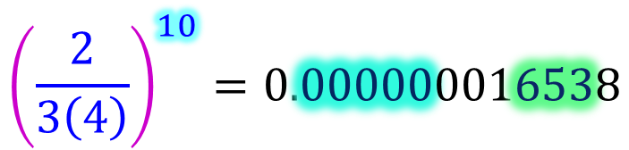
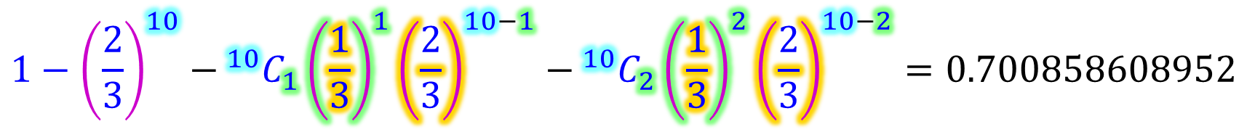
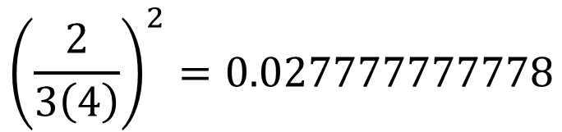
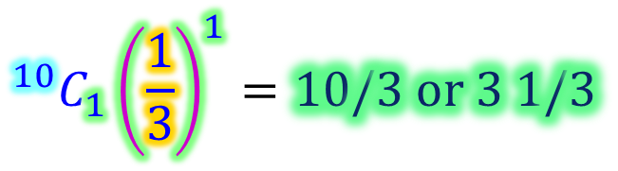
$$1−{\left(\frac{2}{3}\right)}^{10}−​^{10}C_{1}{\left(\frac{1}{3}\right)}^{1}{\left(\frac{2}{3}\right)}^{10−1}−​^{10}C_{2}{\left(\frac{1}{3}\right)}^{2}{\left(\frac{2}{3}\right)}^{10−2}=0.700858608952$$
$${\left(\frac{2}{3\left(4\right)}\right)}^{10}=0.000000016538$$
$${\left(\frac{2}{3\left(4\right)}\right)}^{2}=0.027777777778$$
$$​^{10}C_{1}{\left(\frac{1}{3}\right)}^{1}=10/3 or 3 1/3$$

Slide 4
y
4
2
x
-6
-4
-2
0
2
4
-2
-4

