Slide 1
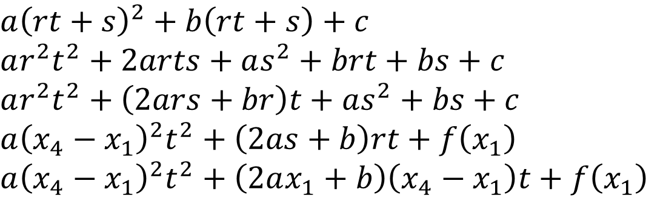
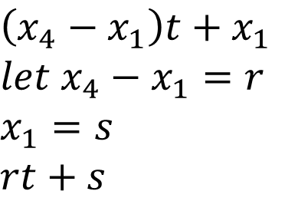
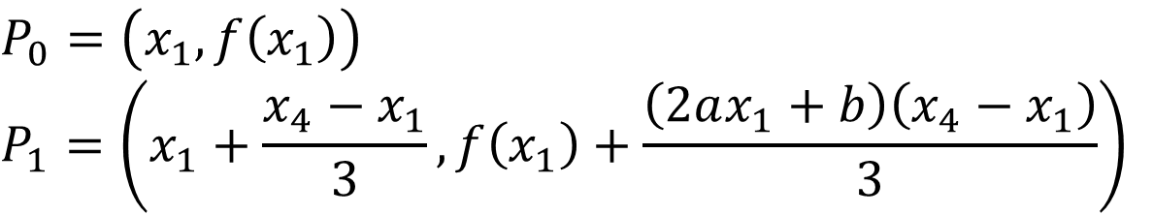
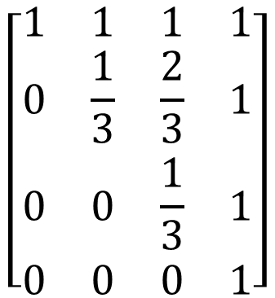
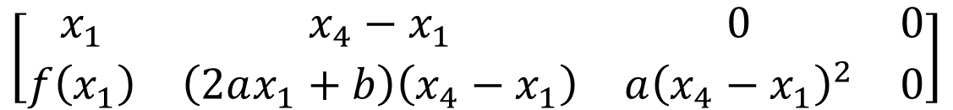
$$\left(x_{4}−x_{1}\right)t+x_{1}$$
$$let x_{4}−x_{1}=r$$
$$x_{1}=s$$
$$rt+s$$
$$a{\left(rt+s\right)}^{2}+b\left(rt+s\right)+c$$
$$ar^{2}t^{2}+2arts+as^{2}+brt+bs+c$$
$$ar^{2}t^{2}+\left(2ars+br\right)t+as^{2}+bs+c$$
$$a{\left(x_{4}−x_{1}\right)}^{2}t^{2}+\left(2as+b\right)rt+f\left(x_{1}\right)$$
$$a{\left(x_{4}−x_{1}\right)}^{2}t^{2}+\left(2ax_{1}+b\right)\left(x_{4}−x_{1}\right)t+f\left(x_{1}\right)$$
$$\left[\begin{matrix}x_{1} & x_{4}−x_{1} & 0 & 0 \\ f\left(x_{1}\right) & \left(2ax_{1}+b\right)\left(x_{4}−x_{1}\right) & a{\left(x_{4}−x_{1}\right)}^{2} & 0\end{matrix}\right]$$
$$\left[\begin{matrix}1 & 1 & 1 & 1 \\ 0 & \frac{1}{3} & \frac{2}{3} & 1 \\ 0 & 0 & \frac{1}{3} & 1 \\ 0 & 0 & 0 & 1\end{matrix}\right]$$
$$P_{0}=\left(x_{1},f\left(x_{1}\right)\right)$$
$$P_{1}=\left(x_{1}+\frac{x_{4}−x_{1}}{3},f\left(x_{1}\right)+\frac{\left(2ax_{1}+b\right)\left(x_{4}−x_{1}\right)}{3}\right)$$

Slide 2
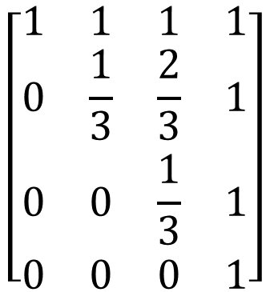
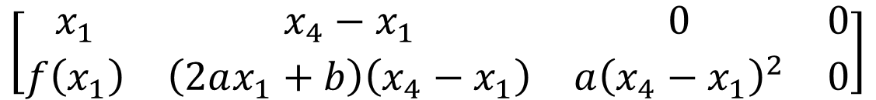
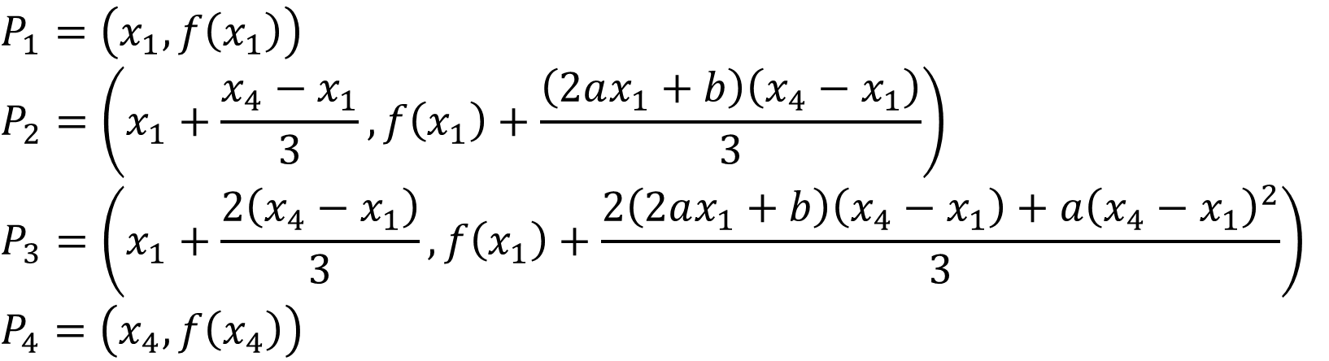
$$\left[\begin{matrix}x_{1} & x_{4}−x_{1} & 0 & 0 \\ f\left(x_{1}\right) & \left(2ax_{1}+b\right)\left(x_{4}−x_{1}\right) & a{\left(x_{4}−x_{1}\right)}^{2} & 0\end{matrix}\right]$$
$$\left[\begin{matrix}1 & 1 & 1 & 1 \\ 0 & \frac{1}{3} & \frac{2}{3} & 1 \\ 0 & 0 & \frac{1}{3} & 1 \\ 0 & 0 & 0 & 1\end{matrix}\right]$$
$$P_{1}=\left(x_{1},f\left(x_{1}\right)\right)$$
$$P_{2}=\left(x_{1}+\frac{x_{4}−x_{1}}{3},f\left(x_{1}\right)+\frac{\left(2ax_{1}+b\right)\left(x_{4}−x_{1}\right)}{3}\right)$$
$$P_{3}=\left(x_{1}+\frac{2\left(x_{4}−x_{1}\right)}{3},f\left(x_{1}\right)+\frac{2\left(2ax_{1}+b\right)\left(x_{4}−x_{1}\right)+a{\left(x_{4}−x_{1}\right)}^{2}}{3}\right)$$
$$P_{4}=\left(x_{4},f\left(x_{4}\right)\right)$$

Slide 3
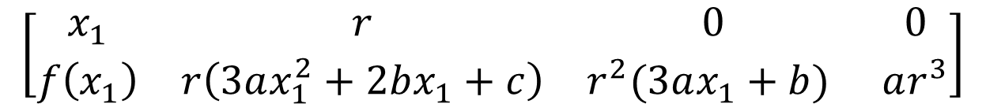
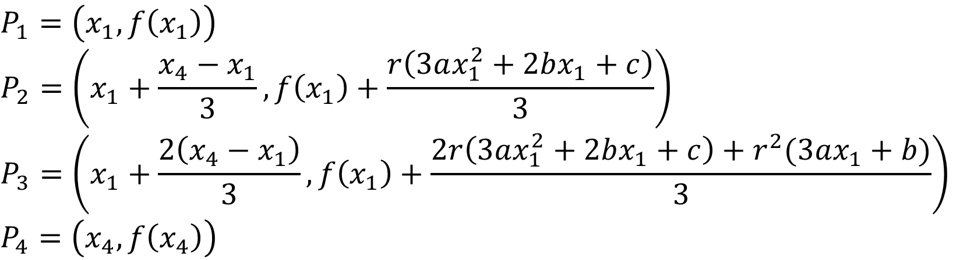
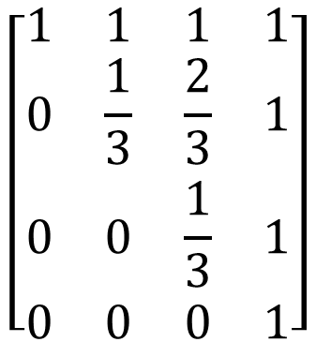
$$ar^{3}t^{3} \left(3as+b\right)r^{2}t^{2} \left(3as^{2}+2bs+c\right)rt f(x_{1})$$
$$\left[\begin{matrix}x_{1} & r & 0 & 0 \\ f\left(x_{1}\right) & r\left(3ax_{1}^{2}+2bx_{1}+c\right) & r^{2}(3ax_{1}+b) & ar^{3}\end{matrix}\right]$$
$$\left[\begin{matrix}1 & 1 & 1 & 1 \\ 0 & \frac{1}{3} & \frac{2}{3} & 1 \\ 0 & 0 & \frac{1}{3} & 1 \\ 0 & 0 & 0 & 1\end{matrix}\right]$$
$$P_{1}=\left(x_{1},f\left(x_{1}\right)\right)$$
$$P_{2}=\left(x_{1}+\frac{x_{4}−x_{1}}{3},f\left(x_{1}\right)+\frac{r\left(3ax_{1}^{2}+2bx_{1}+c\right)}{3}\right)$$
$$P_{3}=\left(x_{1}+\frac{2\left(x_{4}−x_{1}\right)}{3},f\left(x_{1}\right)+\frac{2r\left(3ax_{1}^{2}+2bx_{1}+c\right)+r^{2}(3ax_{1}+b)}{3}\right)$$
$$P_{4}=\left(x_{4},f\left(x_{4}\right)\right)$$

