Slide 1
Screening the polymer flooding using artificial-neural-network (ANN)
Department of Petroleum Engeneering
Petroleum Data Analytics
Prepared by: Aibek M., Olzhas S.
2023

Slide 2
Outline
Work on previous mistakes
Forward looking NN
Inverse design NN
Conclusion
2

Slide 3
Topic Description
The research topic is about using Artificial-Neural-Network to solve two kinds of reservoir engineering problems in polymer flooding:
Forward-looking problems: prediction of the project response surface and fluid productions, pressure responses.
Inverse project design problems: prediction of the required design parameters to achieve the optimal project outcome.
3

Slide 4
Literature Review
Screening and optimization of polymer flooding projects using artificial-neural-network (ANN) based proxies (Sun & Ertekin, 2020);
Assisted Design of Polymer-Gel Floods in Naturally Fractured Reservoirs Using Neuro-Simulation Based Models (Al-Ghazal & Ertekin, 2018);
Data Analysis and Updated Screening Criteria for Polymer Flooding Based on Oilfield Data (Saleh et al., 2014b);
4

Slide 5
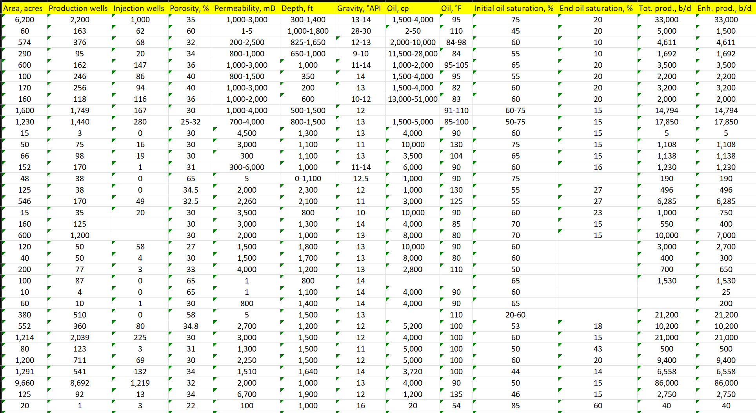
Work on previous mistakes: addition of new variables
Area, acres
Num. prod. wells
Num. inj. wells
Porosity, %
Permeability, md
Depth, ft
Gravity, °API
Oil viscosity, cp
Temperature, °F
Satur., % start
Satur., % end
Tot.prod., b/d
Enh.prod., b/d
Figure 1. Part of collected data
5

Slide 6
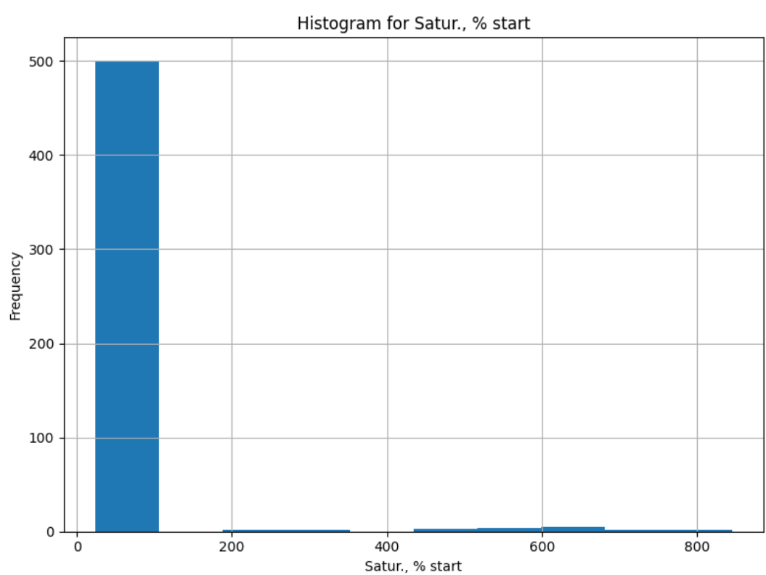
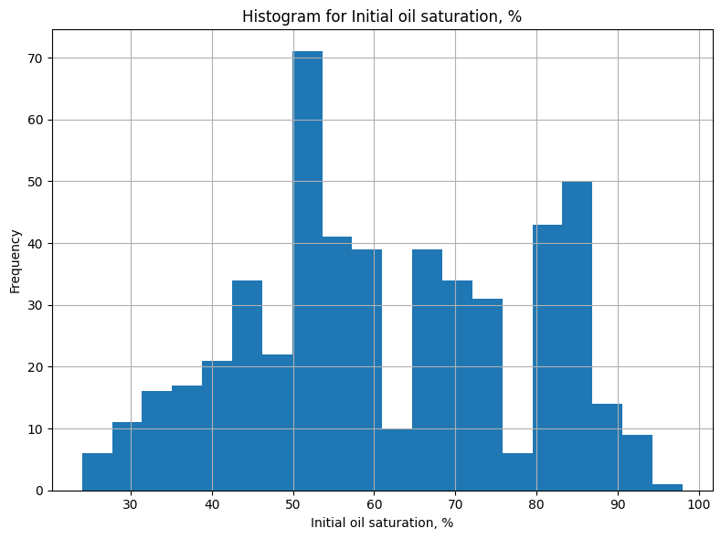
Work on previous mistakes: preprocessing mistakes
On final stage of this project the errors from previous presentation were fixed, where several variables had not reasonable values, now all the values make sense;
In order to build the reverse design ANN, the additional columns of number of production and injection wells were added.
Figure 2. Improvement on the column of Initial oil saturation, %
6

Slide 7
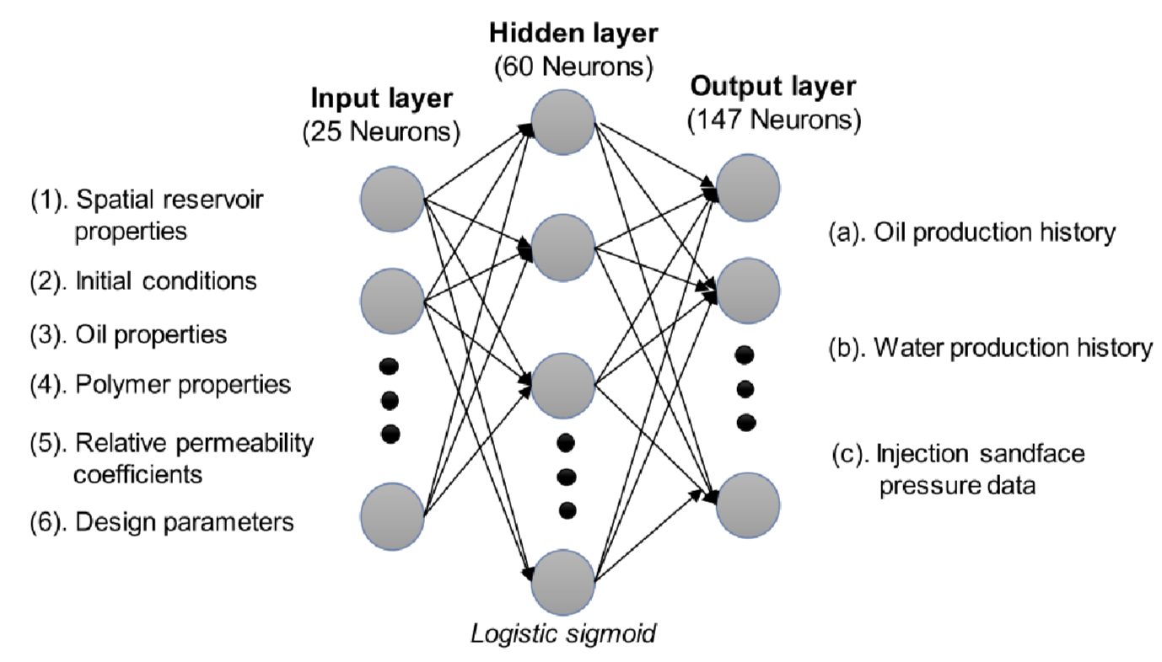
Forward-looking ANN implementation
Input parameters: 'Area, acres', 'Porosity, %', 'Permeability, mD', 'Depth, ft', 'Gravity, °API', 'Oil viscosity, cp', 'Oil temperature, °F', 'Initial oil saturation, %', 'End oil saturation, %'
Output parameters: 'Tot. prod., b/d', 'Enh. prod., b/d'
Figure 3. Forward looking ANN
Sun, Q., & Ertekin, T. (2020). Screening and optimization of polymer flooding projects using artificial-neural-network (ANN) based proxies. Journal of Petroleum Science and Engineering, 185, 106617. https://doi.org/10.1016/j.petrol.2019.106617
7

Slide 8
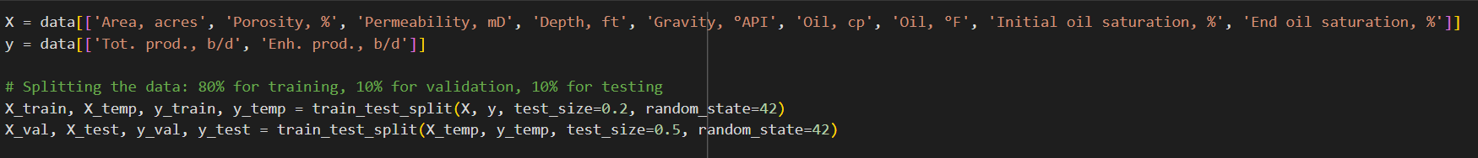
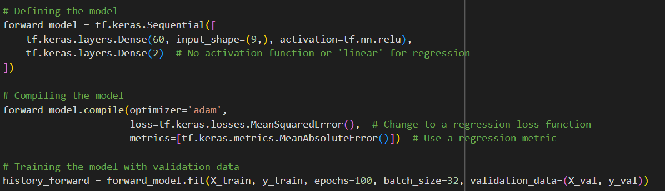
Forward-looking ANN implementation: first attempt
Defining input and output parameters, train-validation-test set splitting
Model definition, compiling and training
8

Slide 9
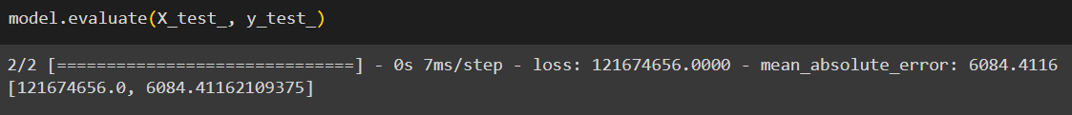

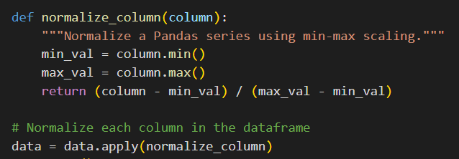
Forward-looking ANN implementation: need for normalization
Due to having observed a big loss value, data normalization has to be introduced.
9

Slide 10
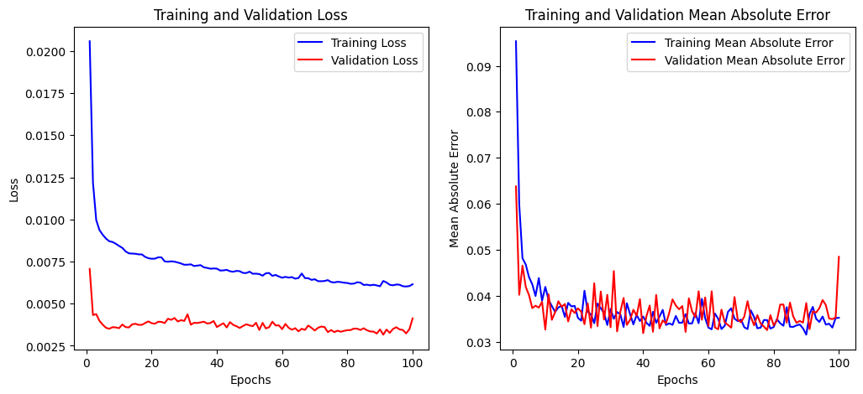
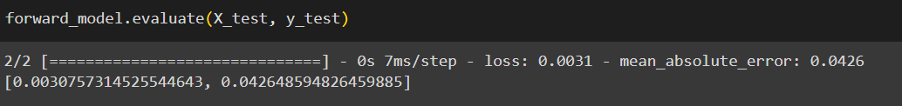
Forward-looking ANN implementation: first result
.
10

Slide 11
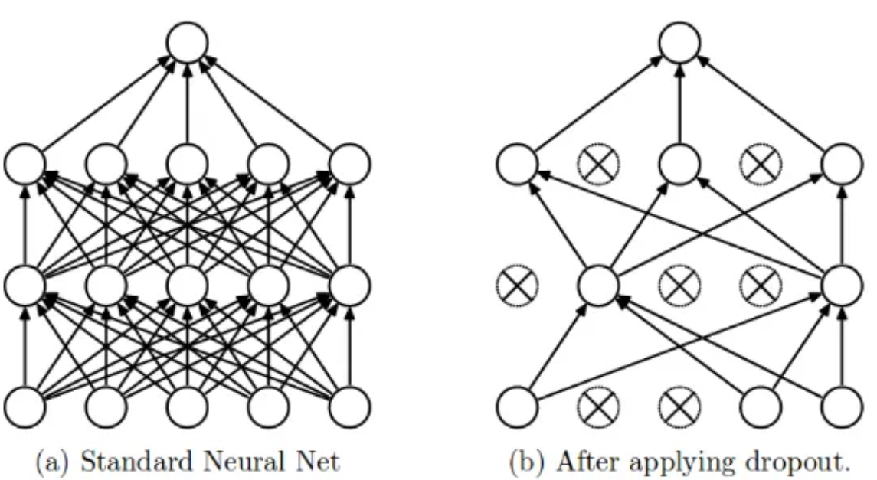
Forward-looking ANN implementation: improvement
In order to increase the model performance, the following variations of the original model (learning rate = 0.001) are introduced:
Model with decreased learning rate (0.0005);
Model with increased learning rate (0.005);
Model with Dropout layer;
Model with additional Hidden layer.
Figure 4. Dropout applied to standard NN
Yadav, H. (2023, May 31). Dropout in neural networks - towards data science. Medium. https://towardsdatascience.com/dropout-in-neural-networks-47a162d621d9
11

Slide 12
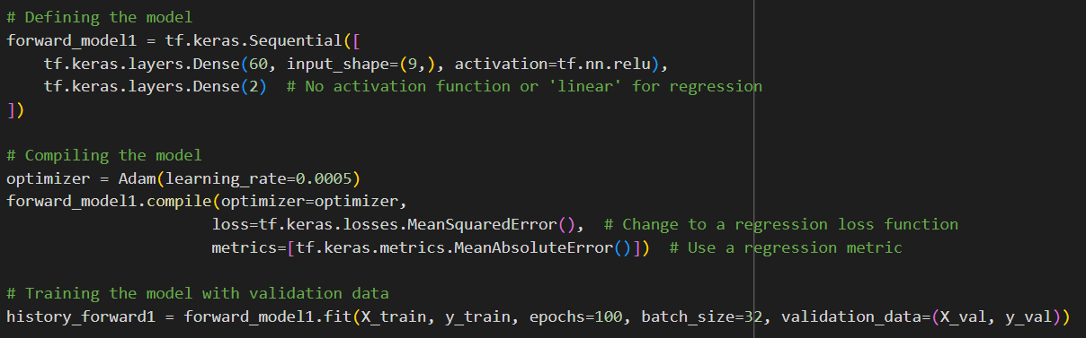
Forward-looking ANN implementation: model with decreased learning rate
12

Slide 13
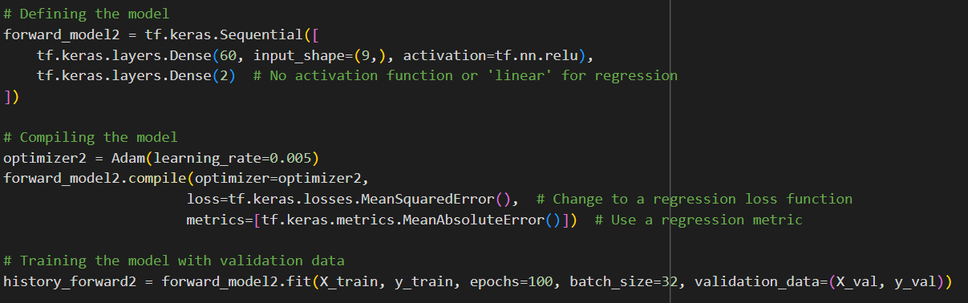
Forward-looking ANN implementation: model with increased learning rate
13

Slide 14
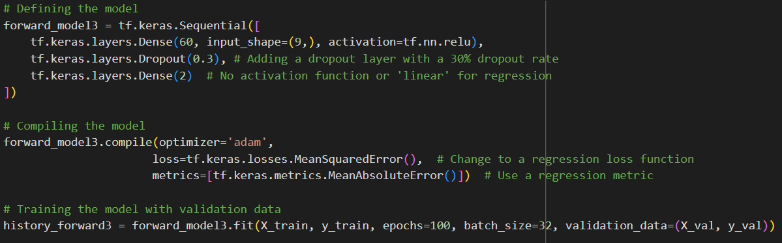
Forward-looking ANN implementation: model with Dropout layer
14

Slide 15
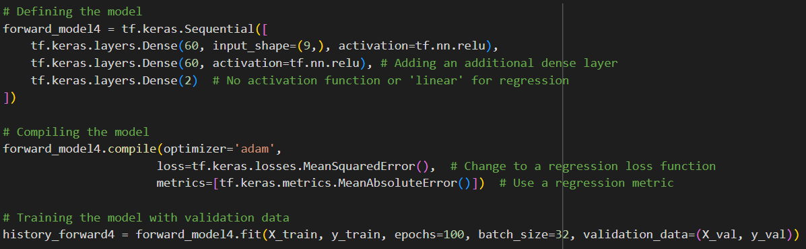
Forward-looking ANN implementation: model with additional hidden layer
15

Slide 16
Forward-looking ANN implementation: performance evaluation
Table 1. Performance evaluation on forward-looking ANN
Model | Loss (MSE) | Metric (MAE)
Original | 0.0025 | 0.0283
Learning rate = 0.0005 | 0.0020 | 0.0251
Learning rate = 0.005 | 0.0025 | 0.0270
Dropout layer | 0.0018 | 0.0237
Additional Hidden Layer | 0.0023 | 0.0269
16

Slide 17
Forward-looking ANN: feature importances
Feature | Feature importance
Area, acres | 10.817078
Porosity, % | 10.004011
Permeability, mD | 9.383964
Depth, ft | 8.717274
Gravity, °API | 10.34064
Oil, cp | 10.360503
Oil, °F | 9.036829
Initial oil saturation, % | 9.131155
End oil saturation, % | 9.208746
(feature importance computed as the sum of absolute weights for each feature)
Table 2. Feature importances of the forward-looking ANN model
16

Slide 18
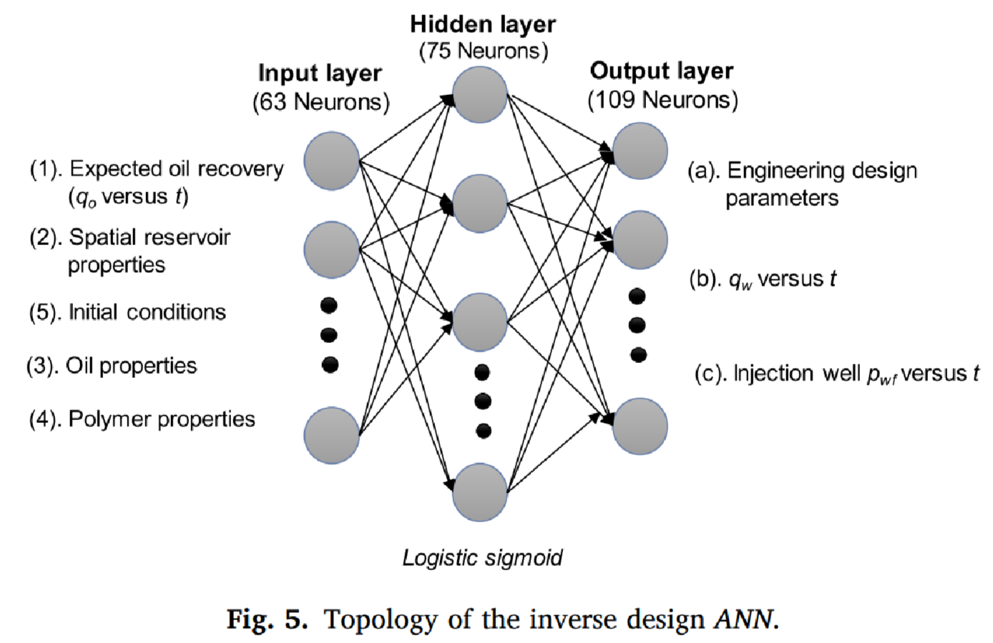
Inverse design ANN implementation
Input parameters: 'Area, acres', 'Permeability, mD', 'Depth, ft', 'Gravity, °API', 'Oil, cp', 'Oil, °F', 'Initial oil saturation, %', 'End oil saturation, %'
Output parameters: 'Production wells', 'Injection wells'
Figure 5. Inverse design ANN
Sun, Q., & Ertekin, T. (2020). Screening and optimization of polymer flooding projects using artificial-neural-network (ANN) based proxies. Journal of Petroleum Science and Engineering, 185, 106617. https://doi.org/10.1016/j.petrol.2019.106617
17

Slide 19
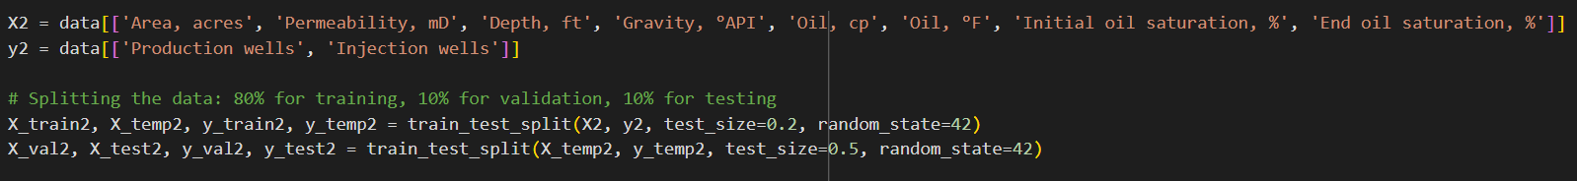
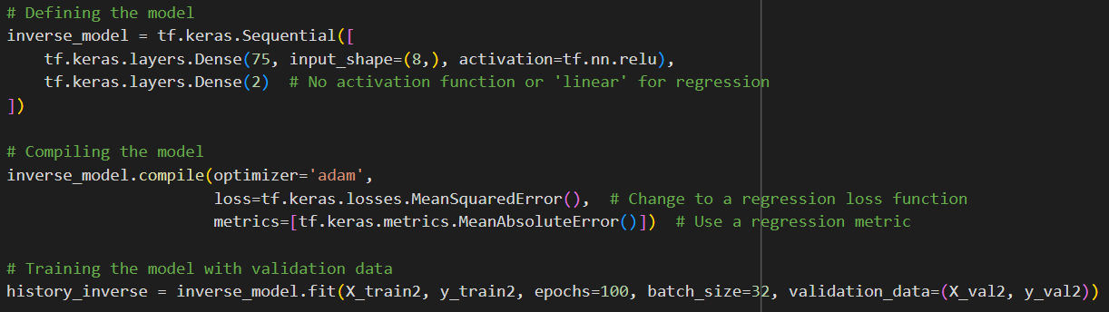
Inverse design ANN implementation: first attempt
Defining input and output parameters, train-validation-test set splitting
Model definition, compiling and training
18

Slide 20
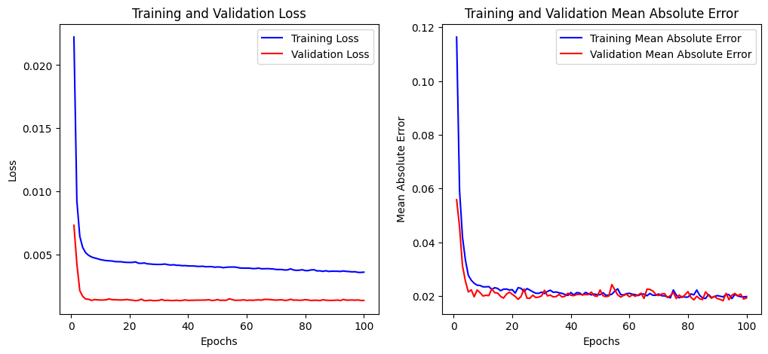
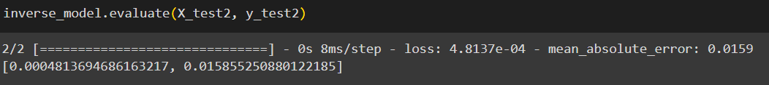
Inverse design ANN implementation: first result (with normalization)
.
19

Slide 21
Inverse design ANN implementation: improvement
In order to increase the model performance, the following variations of the original model (learning rate = 0.001) are introduced, as in forward-looking NN case:
Model with decreased learning rate (0.0005);
Model with increased learning rate (0.005);
Model with Dropout layer;
Model with additional Hidden layer.
Figure 6. Dropout applied to standard NN
Yadav, H. (2023, May 31). Dropout in neural networks - towards data science. Medium. https://towardsdatascience.com/dropout-in-neural-networks-47a162d621d9
20

Slide 22
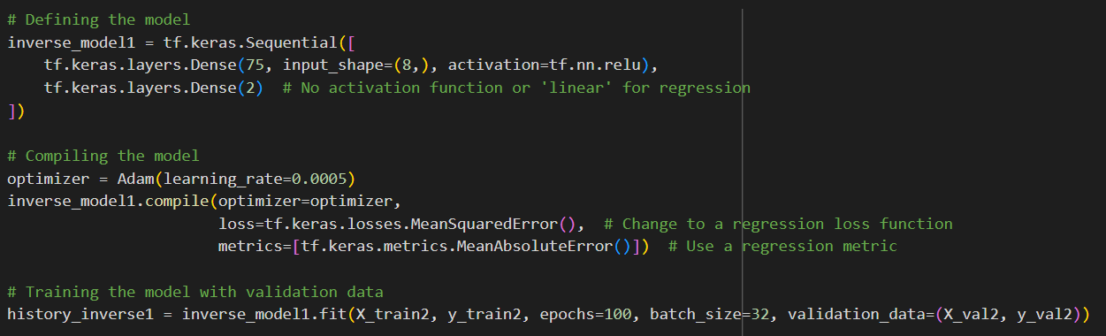
Inverse design ANN implementation: model with decreased learning rate
22

Slide 23
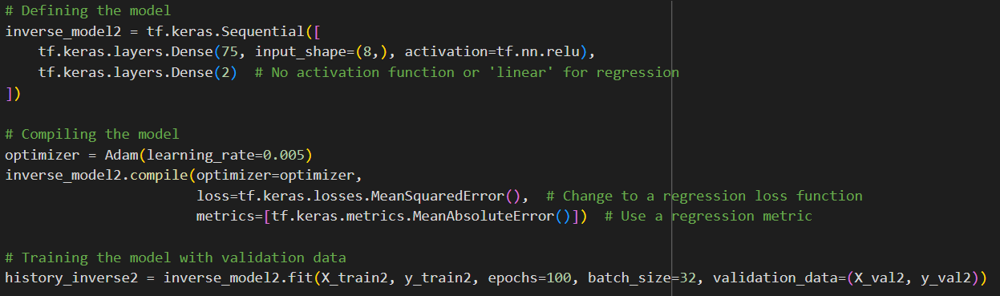
Inverse design ANN implementation: model with increased learning rate
21

Slide 24
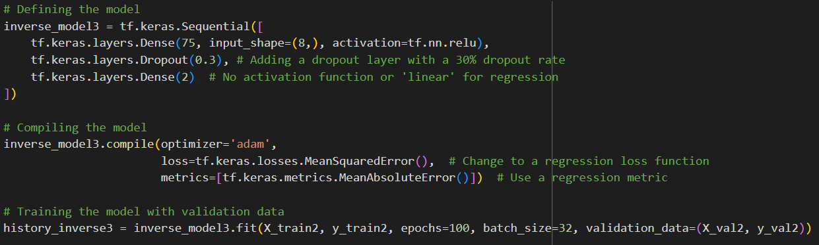
Inverse design ANN implementation: model with Dropout layer
23

Slide 25
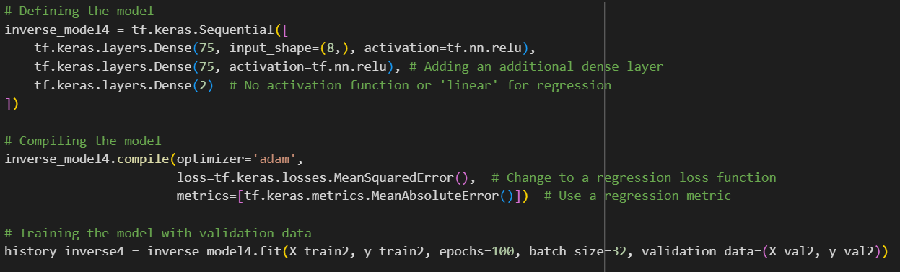
Inverse design ANN implementation: model with additional hidden layer
24

Slide 26
Inverse design ANN implementation: performance evaluation
Table 3. Performance evaluation on inverse design ANN
Model | Loss (MSE) | Metric (MAE)
Original | 4.8650e-04 | 0.0161
Learning rate = 0.0005 | 5.3721e-04 | 0.0157
Learning rate = 0.005 | 5.3789e-04 | 0.0159
Dropout layer | 4.4322e-04 | 0.0142
Additional Hidden Layer | 5.2291e-04 | 0.0183
25

Slide 27
Inverse design ANN: feature importances
Feature | Feature importance
Area, acres | 16.155445
Permeability, mD | 11.574677
Depth, ft | 10.208289
Gravity, °API | 12.66232
Oil viscosity, cp | 11.0673065
Oil temperature, °F | 11.692806
Initial oil saturation, % | 10.390817
End oil saturation, % | 11.689111
(feature importance computed as the sum of absolute weights for each feature)
Table 4. Feature importances of the inverse design ANN model
16

Slide 28
Conclusion
Forward-looking ANN and Inverse design ANN models for screening polymer flooding were implemented along with their variations with different learning rate, additional Dropout or hidden layers. Loss (mean-squared-error) and metric (mean-absolute-error) values were obtained and models were compared using them.
To further improve our work, it is planned to use combination of the model improvement suggestions that indeed increase the model performance, to deduce even bigger progress. These new models will be included in the final report.
26

