Slide 1
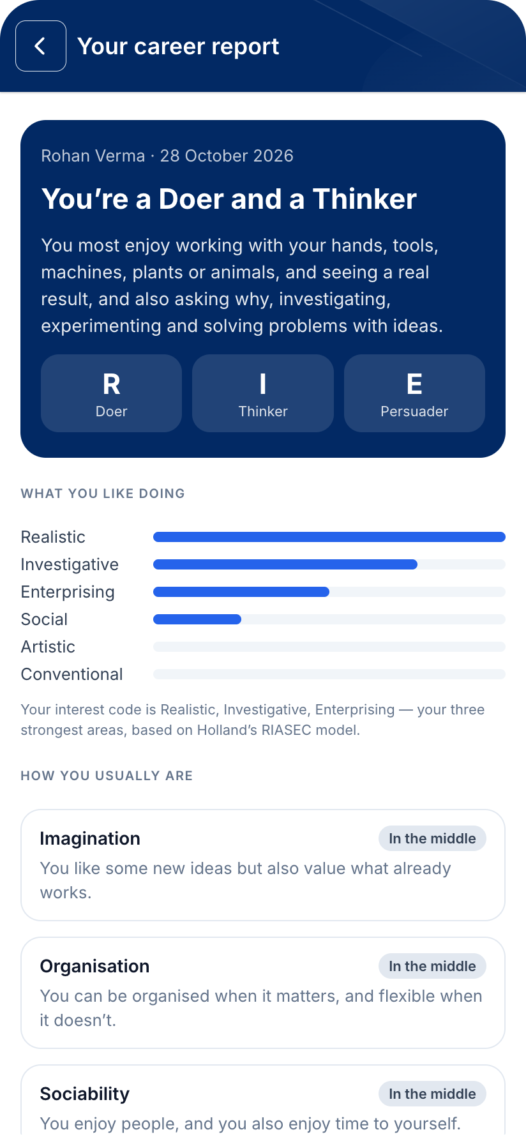
Every student deserves a career conversation
HPC Career — the Holistic Progress Card that becomes every student’s career passbook: a 10-minute test, a report they can read, real routes from Class 10, and a record of their whole journey.
Code for a Billion 2026 · Impact area 01 · Education
Notes:
HPC Career puts career guidance inside the Holistic Progress Card. A student takes a ten-minute test on a phone, gets a report they can actually read, and sees real careers with the route to each from Class 10. Their teacher sees the whole class.

Slide 2
Crores of students choose a stream with almost no guidance
24.8 crore
93%
< 1 in 10
students in Indian schools
of 10,000 students surveyed knew only 7 career options — out of about 250
low-income Class 9–12 students had ever received career guidance (9.36%)
UDISE+ 2023-24
Mindler survey, 2019
Bharat Career Aspiration Report 2024
Sources: Ministry of Education, UDISE+ 2023-24 · Mindler survey of 10,000 students aged 14–21 (2019) · Bharat Career Aspiration Report 2024, UNICEF YuWaah & iDreamCareer (4,968 students, 25 states)
Notes:
India has about 24.8 crore school students. In one survey of ten thousand students, 93 percent knew only seven career options, out of roughly 250. And among low-income students in Classes 9 to 12, fewer than one in ten had ever received any career guidance.

Slide 3




The big decision comes at 15, mostly on advice from home
Who students say shapes their career choice
30%
Family members — the top influence
NEP 2020 replaced marks-only report cards with the Holistic Progress Card
13%
School teachers
PARAKH sent the HPC to every state in 2023. It describes the whole child — but it stops short of the question every Class 10 student faces: what next?
Most others: friends, marks and what relatives did
Sources: Bharat Career Aspiration Report 2024 (UNICEF YuWaah & iDreamCareer) · NCERT PARAKH Holistic Progress Card, shared with states and UTs in September 2023
Notes:
The stream decision comes at fifteen, and it is mostly made on advice from home: family is the top influence, teachers a distant second. Meanwhile, NEP 2020 replaced marks-only report cards with the Holistic Progress Card. It describes the whole child, but it does not yet help with the question every Class 10 student faces: what next?

Slide 4
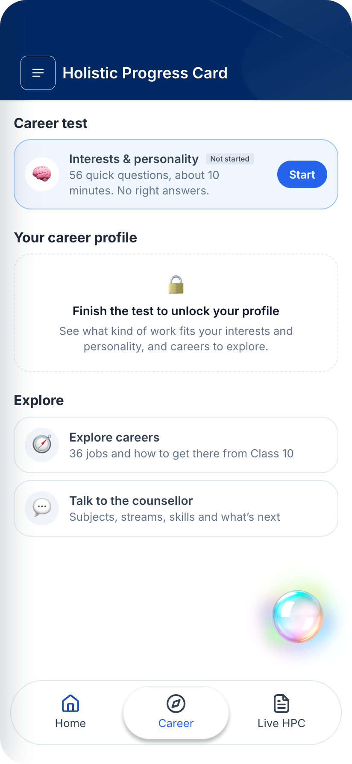




HPC Career: the progress card that helps students choose what’s next
Career test
A report they can read
56 quick questions on interests and personality, about 10 minutes, one per screen.
An interest code, strengths, six careers that fit and the next steps.
Explore careers
Ask the counsellor
36 careers with the route to each from Class 10 in India.
A chat for questions about streams, subjects and exams.
Plus a class view for teachers — who has finished, and where the class’s interests lie.
Notes:
HPC Career adds a Career tab to the progress card. Students take a short test, read a report written for them, explore careers with real Indian routes, and can ask a counsellor chat about streams and exams. Teachers get a class view.

Slide 5
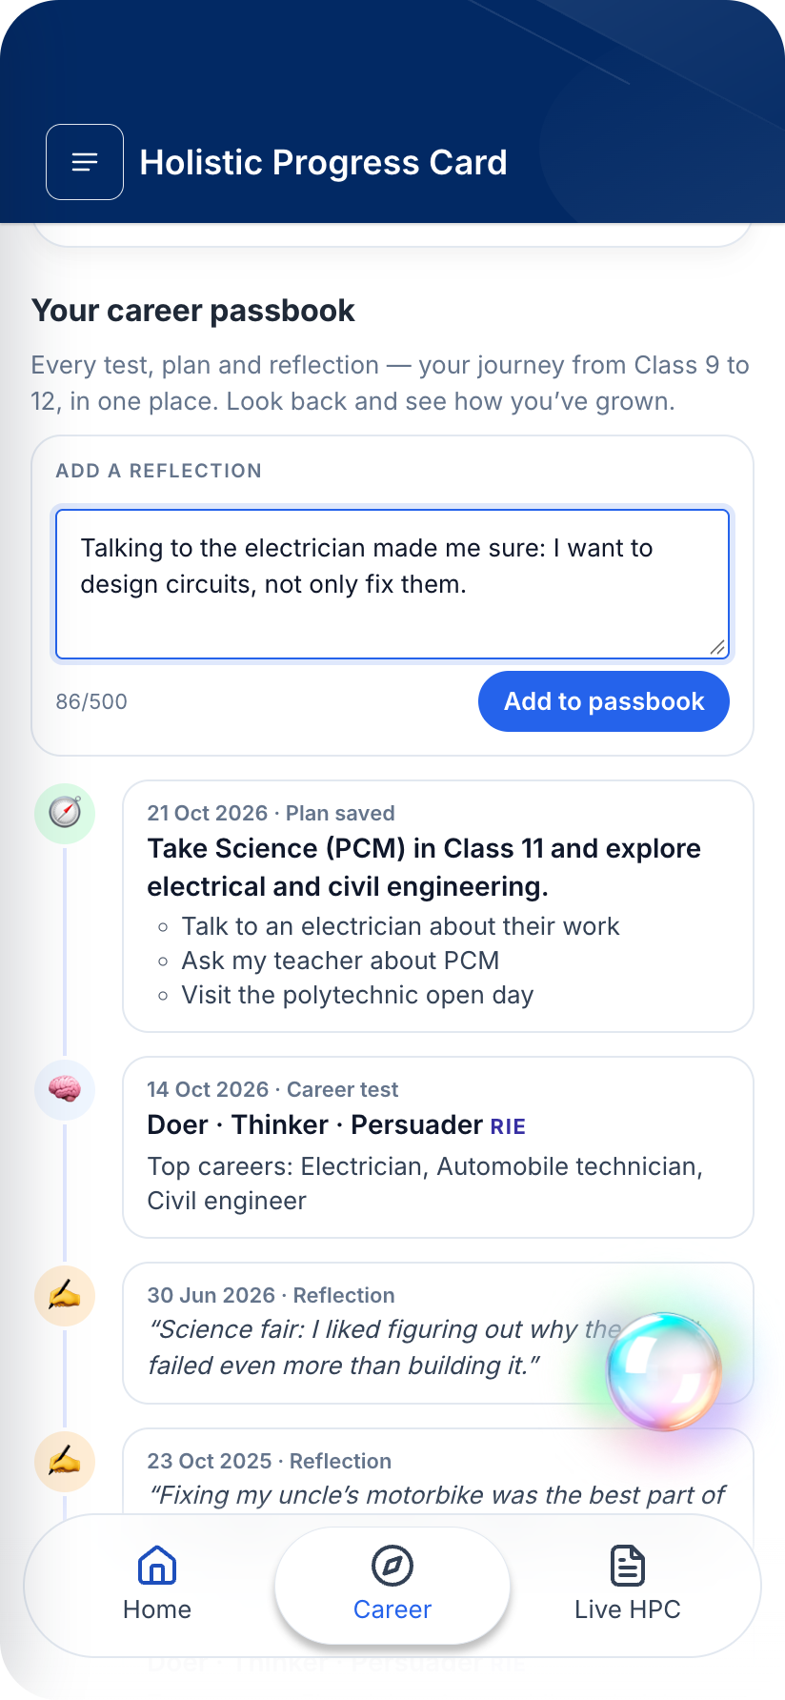

HPC becomes every student’s career passbook
Just as a bank passbook records every deposit, HPC Career records every step of a student’s career journey — from Class 9 to Class 12.
Every test, year after year
Watch interests grow and change from Class 9 to 12.
Every plan they make
Goals and next steps, saved and seen by their teacher.
Their own reflections
What they learnt about themselves, in their own words.
Students look back, see how they have grown, and decide with evidence — not guesswork.
Notes:
HPC becomes every student’s career passbook. Just as a bank passbook records every deposit, it records every step of the career journey: each test, year after year, every plan they make, and their own reflections. From Class 9 to 12, students can look back, see how they have grown, and decide with evidence rather than guesswork.

Slide 6
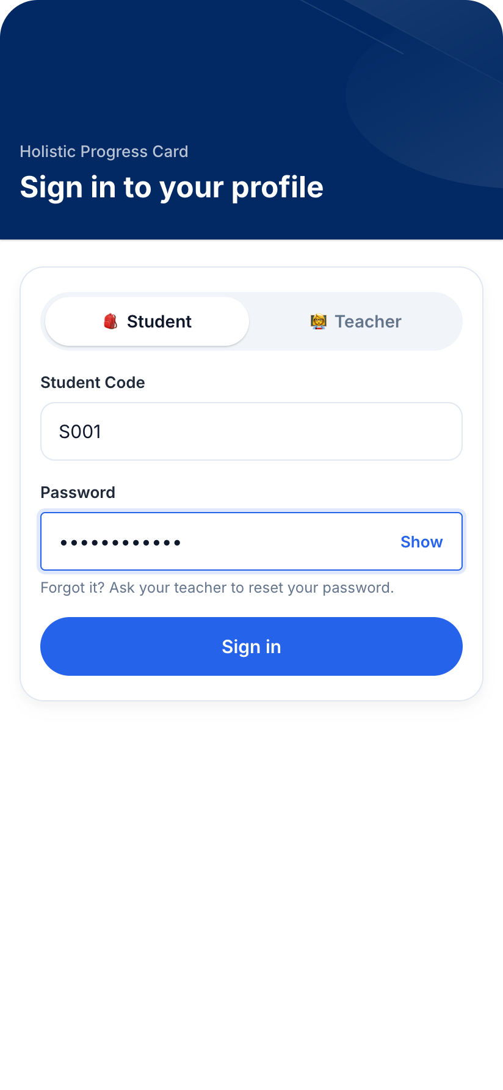
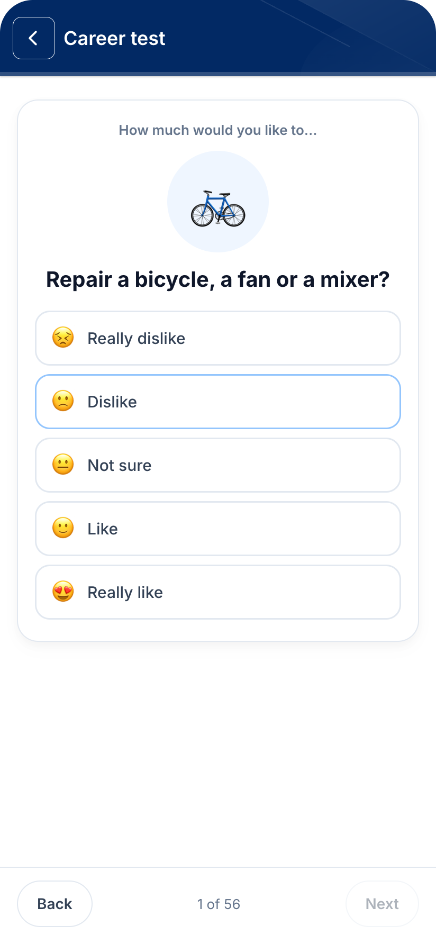
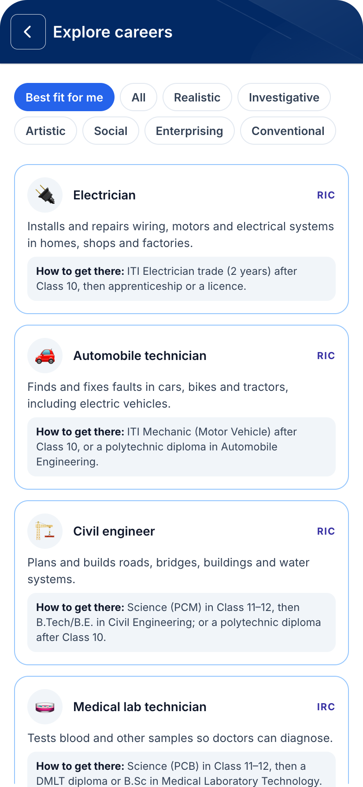
A student’s journey in four steps
1
2
3
4
Sign in
Take the test
Read the report
Explore careers
With the code the school gives
One question per screen
Interest code and strengths
Best fit first, with routes
Notes:
Here is the whole journey. The student signs in with the code their school gives them, takes the test one question at a time, reads their report, and explores careers sorted by how well they fit.

Slide 7
RIASEC: six ways people like to work
Holland’s model: people thrive in work that matches what they enjoy. A student’s three strongest types become their interest code.
R
Realistic
Doer
I
Investigative
Thinker
A
Artistic
Creator
Tools, machines, the outdoors
Science and solving problems
Art, words, music and design
Electrician · Civil engineer
Doctor · Data analyst
Designer · Architect
S
Social
Helper
E
Enterprising
Persuader
C
Conventional
Organiser
Teaching, caring, helping people
Leading, selling, starting things
Order, numbers and detail
Teacher · Nurse
Entrepreneur · Lawyer
Accountant · Bank officer
Based on John Holland’s theory of vocational choice (RIASEC). The app’s 36 interest questions are original and not yet validated.
Notes:
The interest half of the test uses Holland’s RIASEC model, one of the most widely used ideas in career guidance. People thrive in work that matches what they enjoy, and interests fall into six types: Realistic doers, Investigative thinkers, Artistic creators, Social helpers, Enterprising persuaders and Conventional organisers. A student’s three strongest types become their interest code.

Slide 8
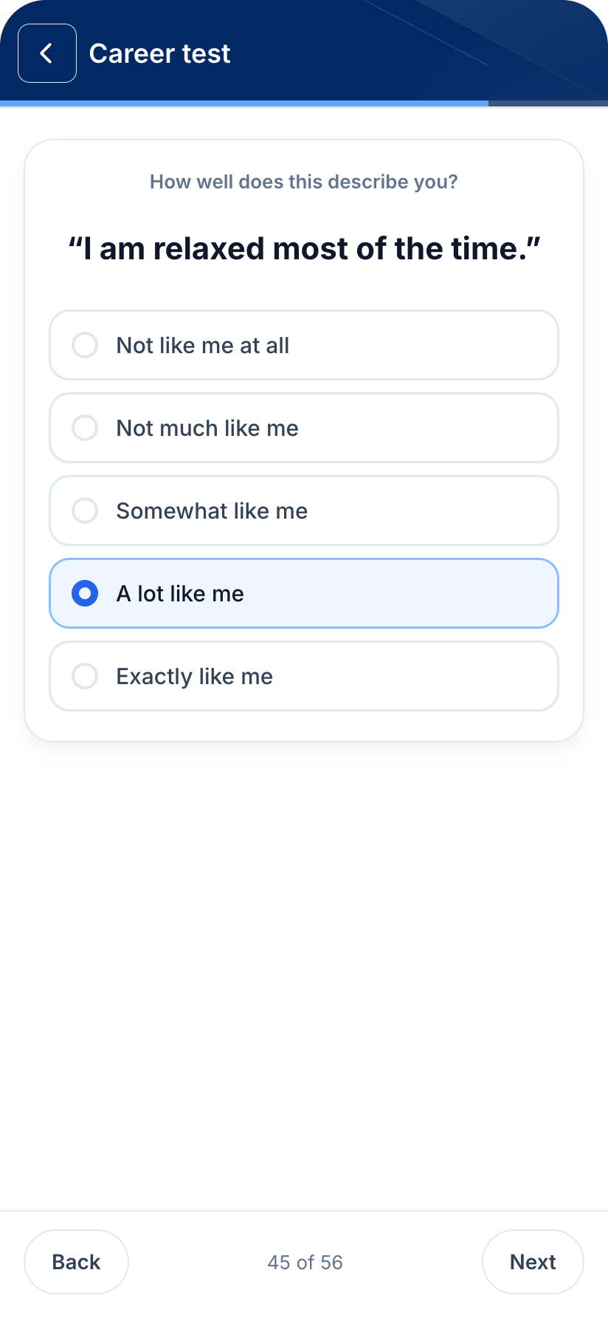



The test: 56 questions, about 10 minutes
36 interest questions
Six per RIASEC type, about everyday activities — repairing a fan, helping a child study.
20 personality questions
The Mini-IPIP Big Five, from the public-domain International Personality Item Pool.
Made for a shared phone
Big tap targets, an emoji per activity, progress kept through a reload or a phone call.
Scored on the server
The phone sends answers; the server scores and saves them, so nobody can edit a result.
Notes:
The test has 56 questions and takes about ten minutes. Thirty-six interest questions, six for each RIASEC type, ask about everyday activities. Twenty personality questions come from the public-domain Mini-IPIP. It is built for a shared phone, and it is scored only on the server.

Slide 9

Psychometrics, done responsibly
What we measure
How it is scored
Safeguards
Interests: 36 everyday activities, six per RIASEC type, from “really dislike” to “really like”.
Personality: the Big Five, with the 20-item public-domain Mini-IPIP.
Each type scores the share of “really like” it got; the top three form the interest code.
Careers are ranked by how well their RIASEC code matches the student’s.
Scored on the server only.
No ranking against other students.
Every trait framed as a strength; Neuroticism shown as Calmness.
Flags “same answer to everything”.
Called a starting point, not a verdict.
Notes:
Psychometrics means measuring interests and personality with carefully worded questions, and we do it responsibly. Interests come from 36 everyday activities; personality from the public-domain Mini-IPIP, a short form of the Big Five. Scores show more or less for this student, never a ranking against others; every trait is a strength; and the report calls itself a starting point, not a verdict.

Slide 10
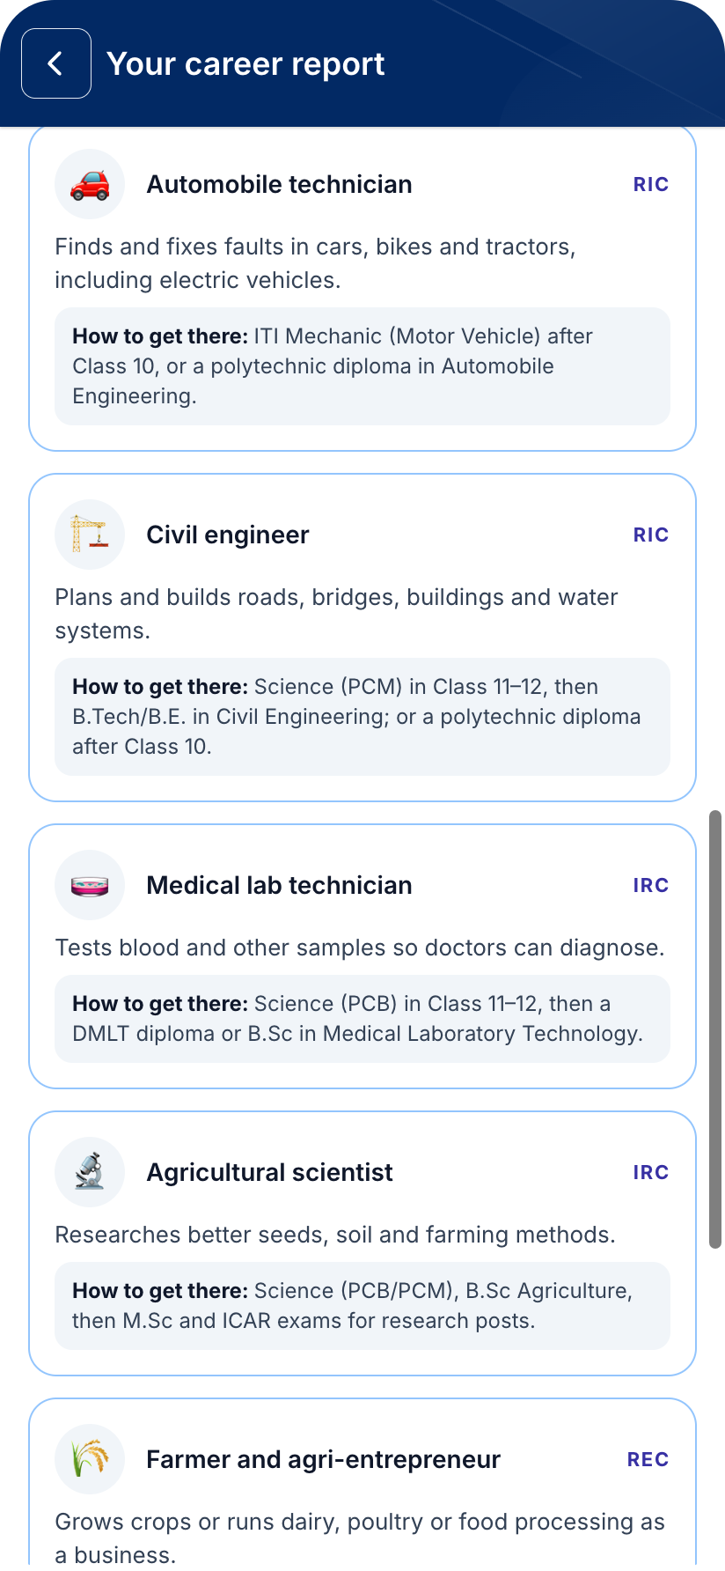
A report written for the student, not the counsellor
1
Their interest code
e.g. Creator · Helper · Thinker, with what each means.
2
Strengths, never weaknesses
Every level of every trait is a way of being that suits some work. Neuroticism is shown as Calmness.
3
Six careers that fit
Each with what the job is and how to get there from Class 10.
4
Next steps — and a printout
What to do this month, and a print-ready page to discuss at home.
Notes:
The report is written for the student. It names their interest code, describes their personality as strengths, lists six careers that fit with the route to each, and ends with next steps. It prints cleanly so the family can discuss it together.

Slide 11




How it guides a student, step by step
1
Discover
2
Understand
3
Explore
Take the 10-minute test on any phone.
See their interest code and strengths in plain words.
36 careers ranked by fit, each with the route from Class 10.
4
Plan
5
Talk
6
Reflect
Choose next steps for this year and save the plan.
Print the report; discuss it with family and teachers.
Write in the passbook; retake each year and see how they have grown.
Every step is recorded in the student’s career passbook.
Notes:
Here is how it guides a student. Discover their interests with the test. Understand their code and strengths in plain words. Explore thirty-six careers ranked by fit, each with the route from Class 10. Make a plan for this year. Talk it through with family and teachers using the printed report. And reflect in the passbook, coming back each year to see how they have grown.

Slide 12
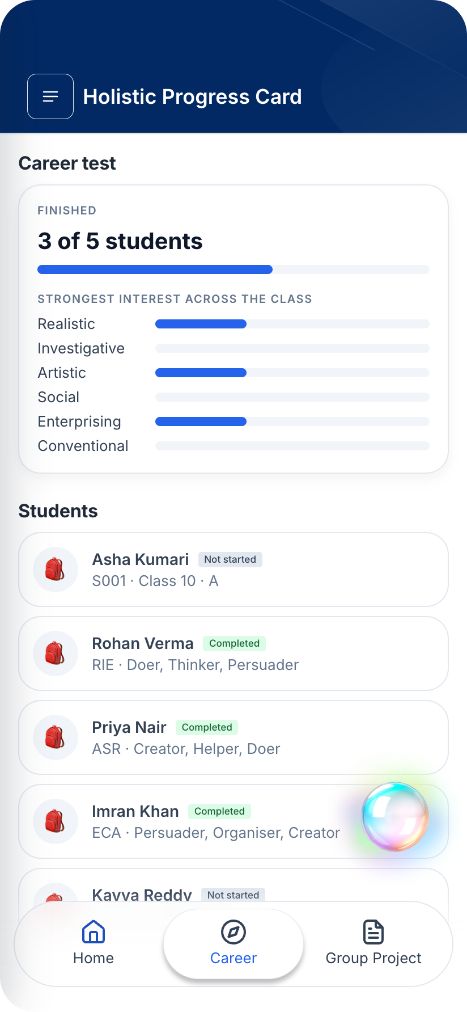
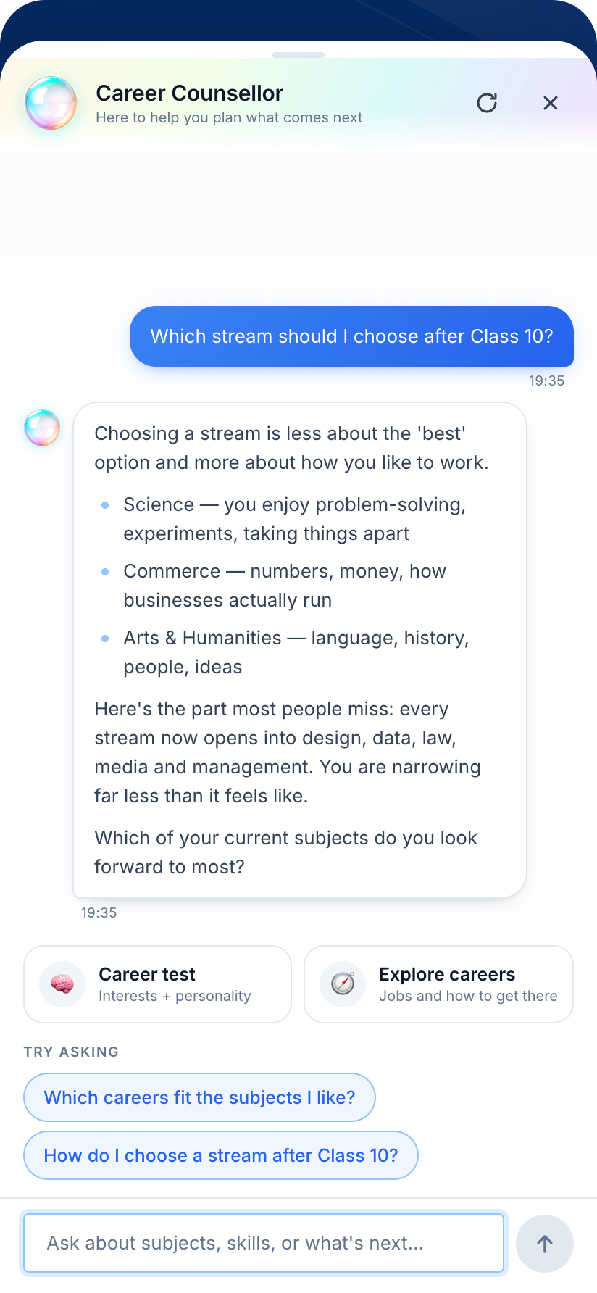

Teachers see the whole class at a glance
Who has finished
Follow up with the students who haven’t.
Where the class’s interests lie
Plan career talks, visits and subject choices around them.
Each student’s code
A ready starting point for a one-to-one or a parent meeting.
Class view · counsellor chat
Notes:
Teachers see who has finished, where the class’s interests lie, and each student’s interest code: a ready starting point for a one-to-one or a parent meeting. Students can also ask the counsellor chat about streams and exams.

Slide 13



Simple to run, open by design
Phone app
One small server
Scoring module
React, works on any phone browser. Sessions live in the tab only.
Express API: sign-in, results, class view, counsellor stream.
Test items, scoring and report wording. Unit-tested.
Safe by default
Accounts & results
Counsellor
Hashed passwords, a 5-try lock, signed sessions, pages gated by role.
One JSON file to start; swap in a database later.
Scripted in the app; the AgentFoundry agent plugs in here.
Open source under MIT · github.com/om-1115/hpc-career-agent · 23 automated tests for scoring, the API and the agent’s tools
Notes:
It is simple to run: a phone web app, one small server, and a scoring module with unit tests. Accounts and results start in a single file. The counsellor is scripted today, with one function where an AI model plugs in. Passwords are hashed, accounts lock after five wrong tries, and every page is gated by role.

Slide 14


Honest about what a 10-minute test can say
A starting point
Strength-based language
The report says so on the page. The interest questions are new and not yet validated.
No trait is a flaw. Scores show more or less for this student, not a ranking.
Open content
Private by default
Personality items are public domain; interest items, careers and wording are ours and MIT-licensed.
Only the student and their teacher see a result. Nothing is kept on a shared phone after sign-out.
Notes:
We are honest about what a ten-minute test can say. The report calls itself a conversation starter. Every trait is described as a strength. The personality items are public domain and everything else is open source. Only the student and their teacher see a result.

Slide 15
How we will show impact
Size
Severity
Quality
Proven impact
Built for any school with a phone and a browser — the 24.8 crore students in Indian schools.
A stream chosen at 15 shapes the next decade; fewer than 1 in 10 low-income students get guidance today.
Tested scoring and API, accessible screens, works on a shared phone, open source.
A pilot school: students who finish, reports discussed at home, teacher use in subject choice.
Mapped to the Code for a Billion judging criteria: size, severity, quality of the solution and proven impact (25% each)
Notes:
Here is how we map to the four judging criteria. The size is every school student in India. The severity is a stream chosen at fifteen with almost no guidance. Quality comes from tested, accessible, open code. And for proven impact, we will pilot in a school and measure completion, conversations at home and teacher use.

Slide 16



What comes next
Now
Built and evaluated
Next
Then
Built and open
An AI counsellor agent
Into the app, then a pilot
Hindi and more languages
Test, report, careers, counsellor, teacher view.
In AgentFoundry: reads the result, finds careers, saves a plan. All 10 evals pass.
Agent in the app’s chat, then a partner school, measuring use and outcomes.
The test, report and careers in regional languages.
Notes:
It is built and open now. In progress: the counsellor becomes an AI agent, built in AgentFoundry, that reads the student’s result, finds careers and saves a plan. Next, a pilot with a partner school to measure real use and outcomes. Then Hindi and other Indian languages.

Slide 17
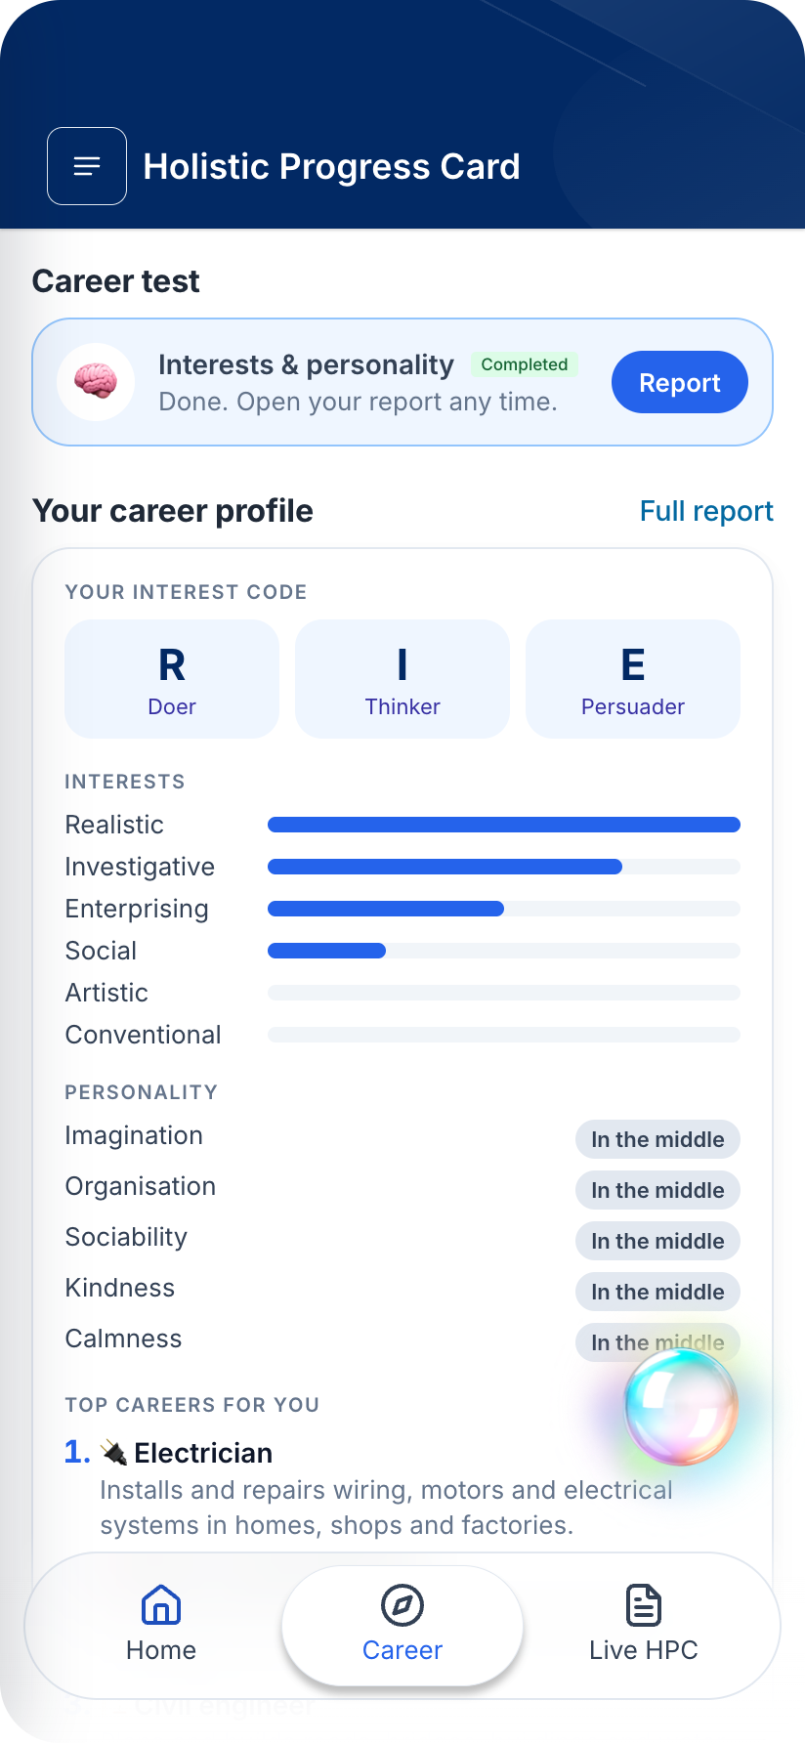
Try it today
github.com/om-1115/hpc-career-agent
npm run seed:demo, then sign in as student S001 / student-demo or teacher T001 / teacher-demo
Open source · MIT · Code for a Billion 2026
Notes:
HPC Career is open source. Clone it, seed the demo school, and sign in as a student or a teacher. Every student deserves a career conversation, and this puts one in their pocket.

