Slide 1
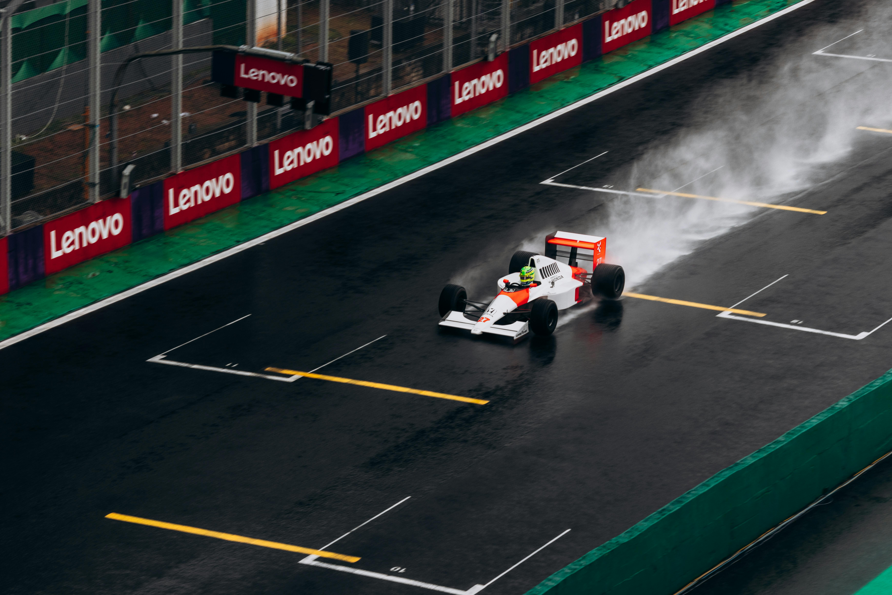

Programming assessment Presentation
A comprehensive analysis on Formula 1 data from 1950-2024

Slide 2
An introduction to Formula 1 data
Formula 1 is the pinnacle of motorsport, with races held worldwide since 1950 and the fastest cars competing on iconic circuits.
Over 75 years, regulation changes, safety improvements and technological advances have transformed performance, making historical comparisons challenging.
Points systems have evolved from the original 8-6-4-3-2 format in the 1950s to today’s 25-18-15-12-10-8-6-4-2-1 system, shaping how success is measured.
Modern data analysis reveals performance patterns, driver dominance and circuit-specific trends that were previously hidden.
This project combines race results, qualifying data and driver standings from 1950–2024 to uncover new insights into Formula 1 history.
Notes:
Expand on some of these points, such as how these weren’t the only two points systems used and there used to be a point for fastest lap used in different eras.
Potentially talk about the data used and where it was from. I used raw data from Kaggle which was scraped from an F1 data API, whilst scraping some of my own f1 data myself.

Slide 3
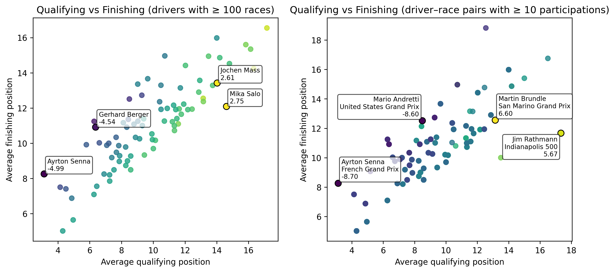
Qualifying vs Race Performance Analysis
Qualifying vs Race Performance
Qualifying shows raw pace, but race results reveal true performance under pressure.
Some drivers consistently finish higher than their grid position.
Certain drivers overperform at specific circuits.
Minimum race thresholds improve the reliability of the analysis.
Notes:
This analysis compares qualifying and finishing positions to identify drivers who consistently outperform expectations, highlighting race craft beyond pure speed.
By applying experience thresholds, requiring at least 100 career races and 10 appearances at a circuit, the results focus on meaningful patterns such as consistent overperformers and track specialists, rather than random variation.
For one of the best drivers of all time it is a surprise that senna has lost so many positions. I will explore this in the next slides’ analysis of finishing positions heatmap.

Slide 4
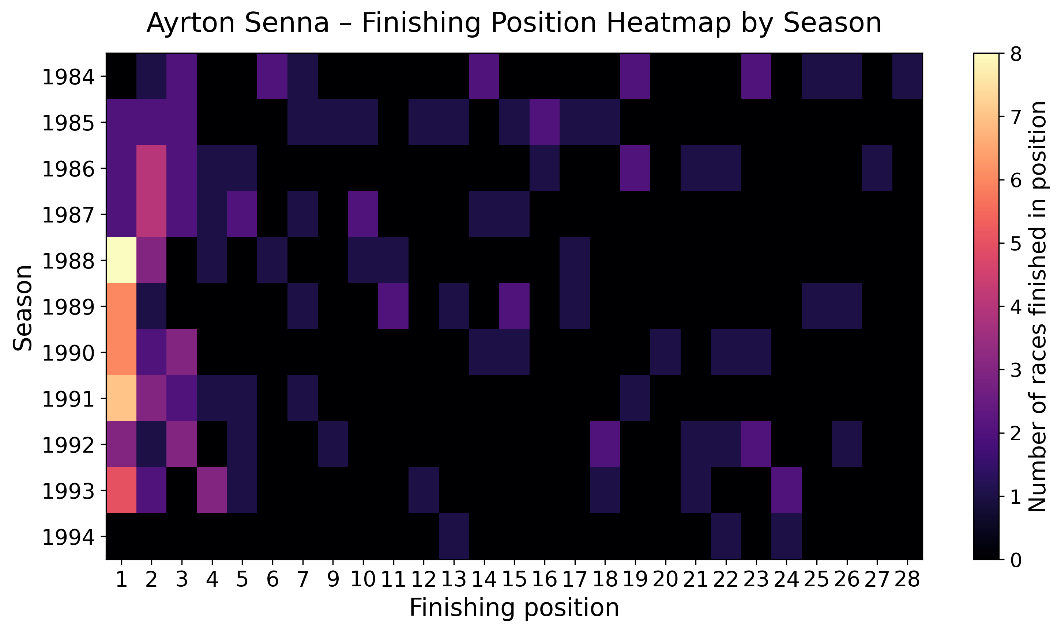
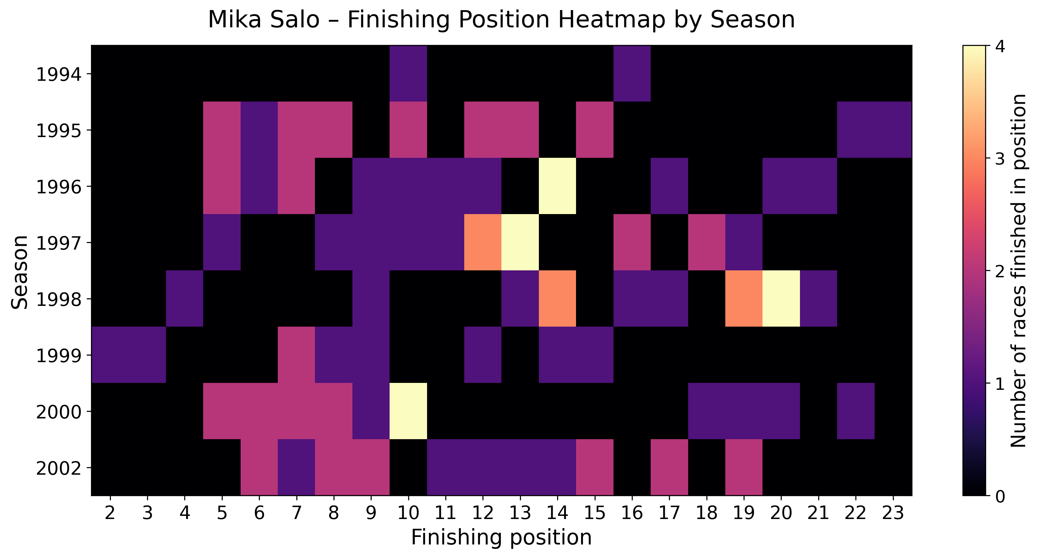
Top Underperformer vs Top Overperformer Heatmap Analysis
Key Observations
Elite consistency: Senna’s results cluster around top finishing positions across seasons.
Midfield variability: Salo’s finishes spread widely across the grid.
Distribution matters: Heatmaps reveal long-term patterns hidden by averages.
Outliers matter: Senna’s heatmap shows several extreme results, thus supporting why he appears to lose positions from qualifying despite overall dominance.
Notes:
These heatmaps build on the previous slide by moving from average position changes to the full distribution of finishing results, allowing us to compare consistency and variability in race performance over time.
Senna’s heatmap shows several extreme outliers, such as retirements and poor finishes, which help explain why his average positions lost from qualifying appear higher despite his overall dominance, while Salo’s more evenly spread results reflect the typical variability of a midfield career.

Slide 5
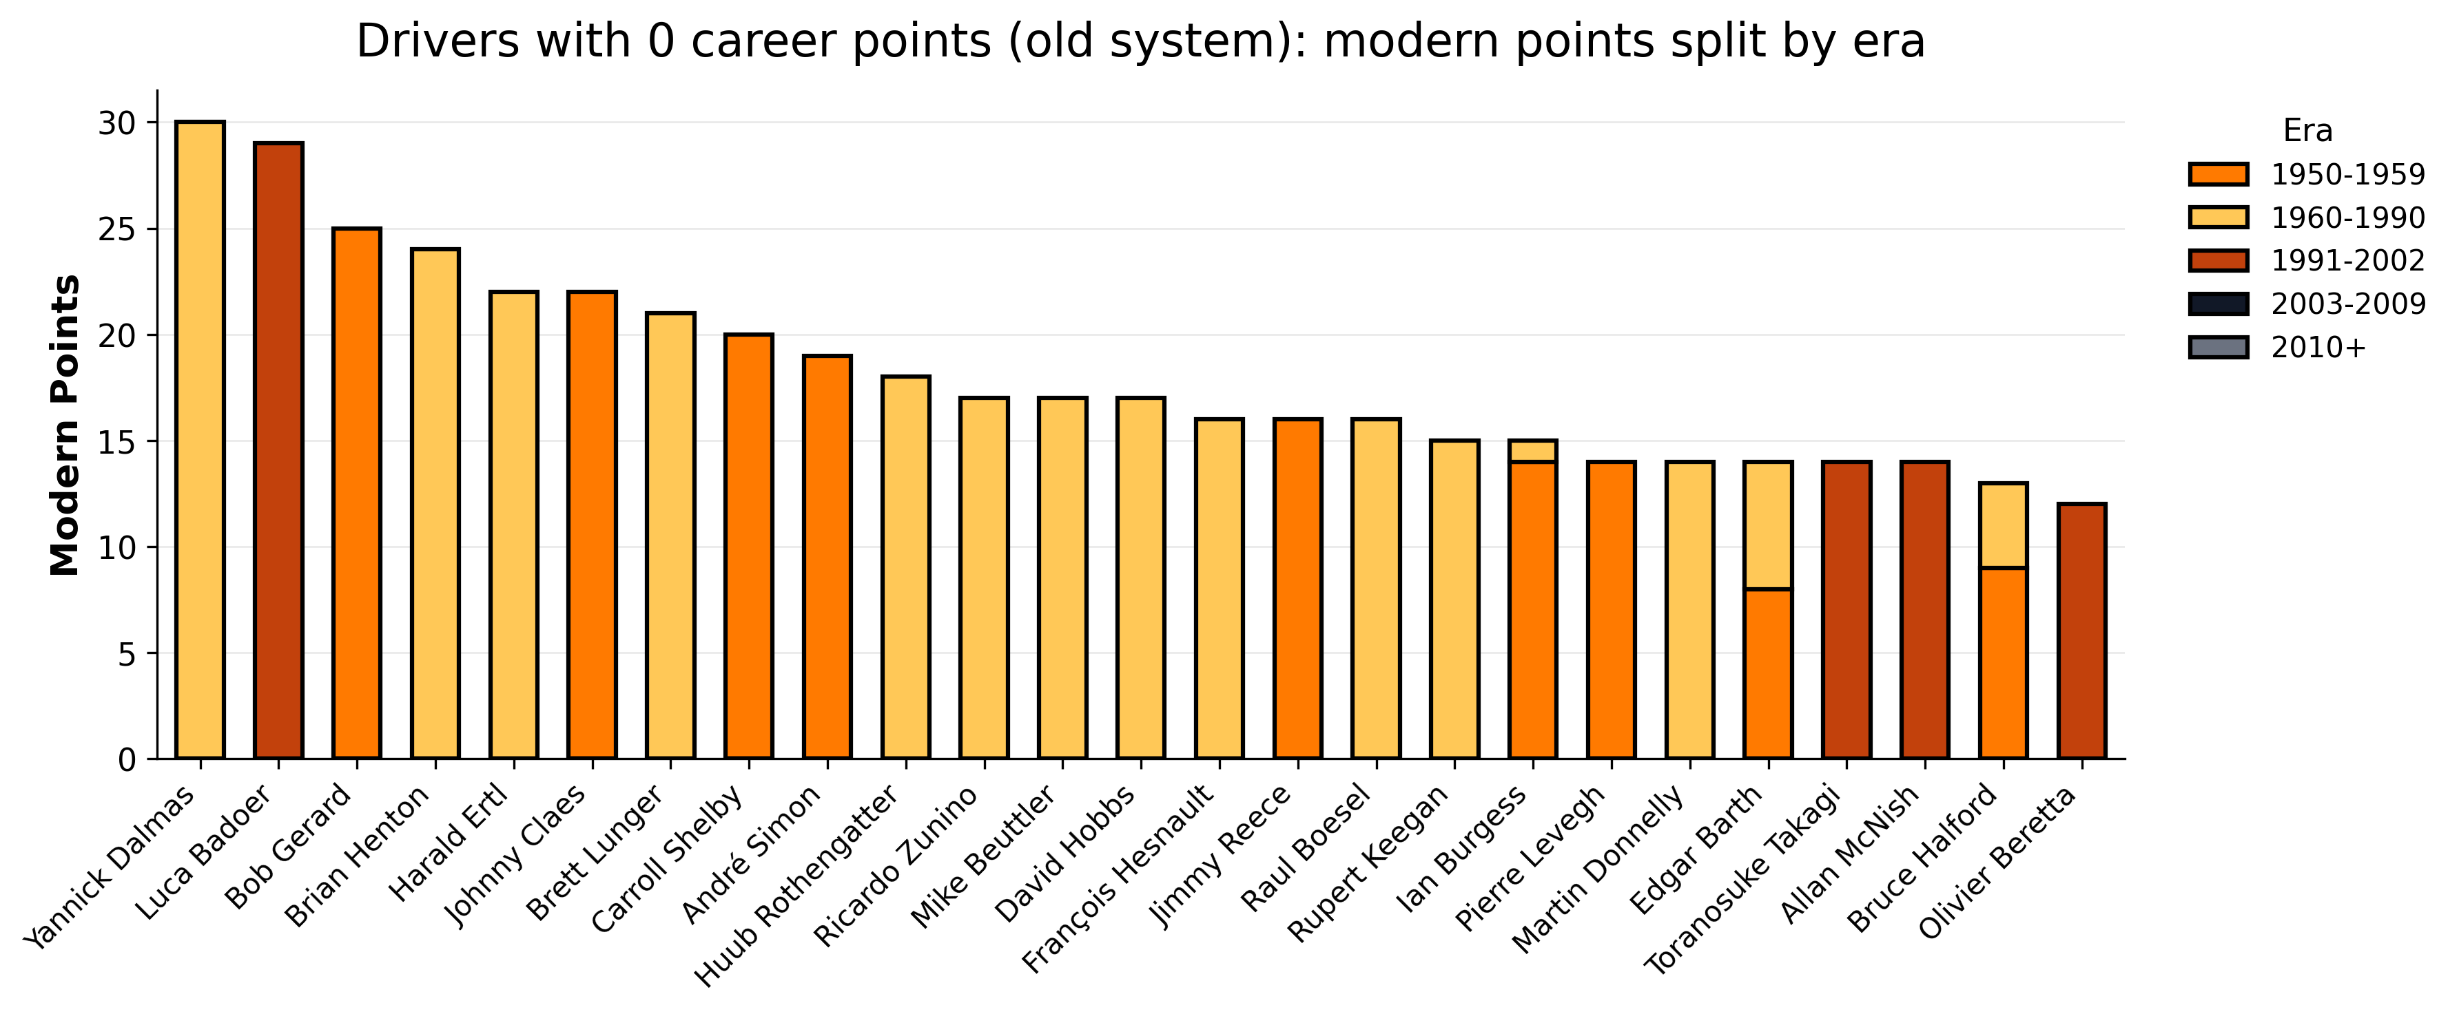
The Impact of the Modern Points System on the Careers of Non-Scoring Drivers
Key Findings
Hidden scorers: Several drivers who never earned points historically would score under today’s system.
System matters: Changes in scoring dramatically reshape career totals.
Era effects: Midfield drivers from earlier eras would benefit most from modern rules.
Notes:
This analysis reapplies the modern Formula 1 points system to historical race results to test whether drivers who never scored points under older systems would be rewarded today.
The results show that scoring rules strongly influence how careers are judged, with several midfield drivers gaining recognition they never received under earlier systems.

Slide 6
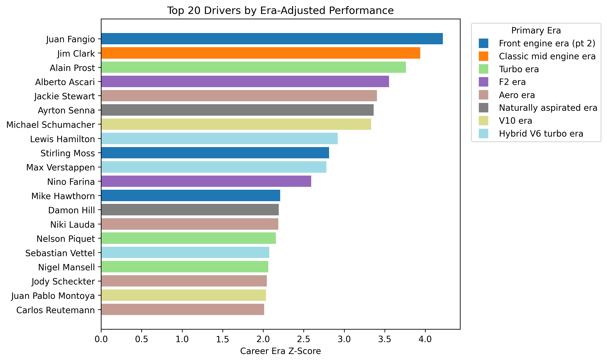
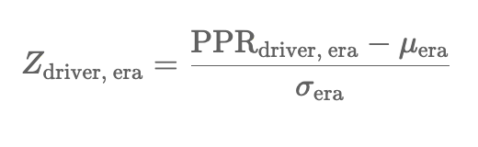
How dominant was this driver relative to the races available in their era?
Why use era-adjusted Z-scores?
Raw F1 statistics aren’t comparable across history due to changes in race counts, points systems and reliability.
Era-adjusted Z-scores measure performance relative to competitors, not absolute totals.
This allows fair comparison of dominance across different eras.
A Z-score of +1 means a driver performed one standard deviation above the average driver in their era.
Notes:
Era-adjusted Z-scores standardise driver performance within each era, removing inflation caused by modern scoring systems and longer seasons.
Rather than testing statistical significance, this approach provides a clear, descriptive way to compare dominance in different competitive contexts.

Slide 7
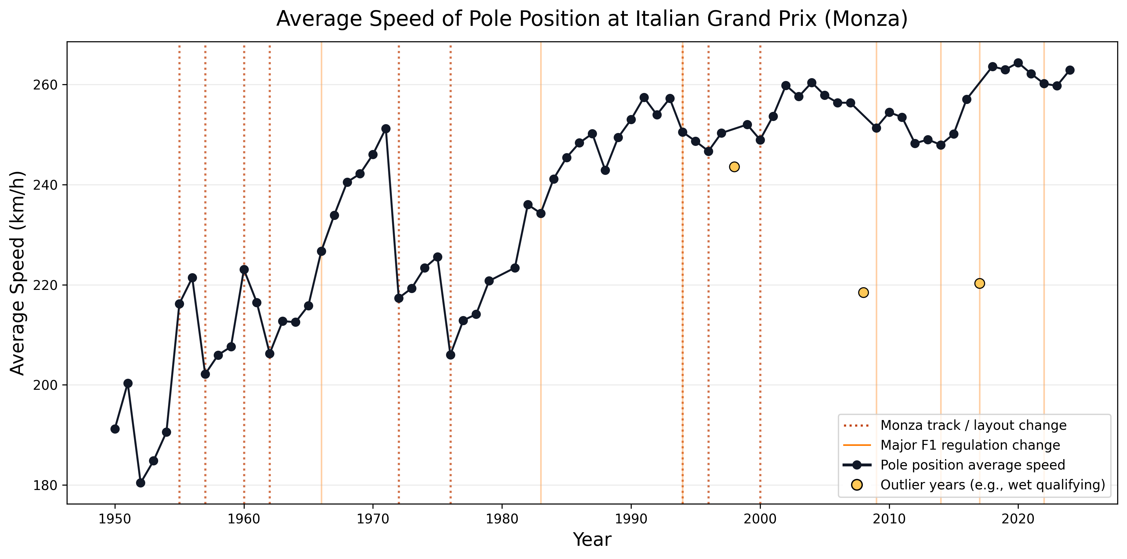
The Evolution of fastest lap at the Italian Grand Prix (Monza)
Why use average speed instead of lap time?
Because track length has changed over time, lap times aren’t directly comparable across seasons.
Using average speed (distance ÷ lap time) provides a fair, layout-independent performance metric.
Pole speeds rise steadily, reflecting aerodynamic and engine advances from 1950-2024.
Notes:
The overall upward trend reflects major advances in car technology, while the vertical markers show how regulation and layout changes often create sudden shifts in performance.
The highlighted wet years explain short-term drops, showing how conditions can temporarily override car pace.

Slide 8
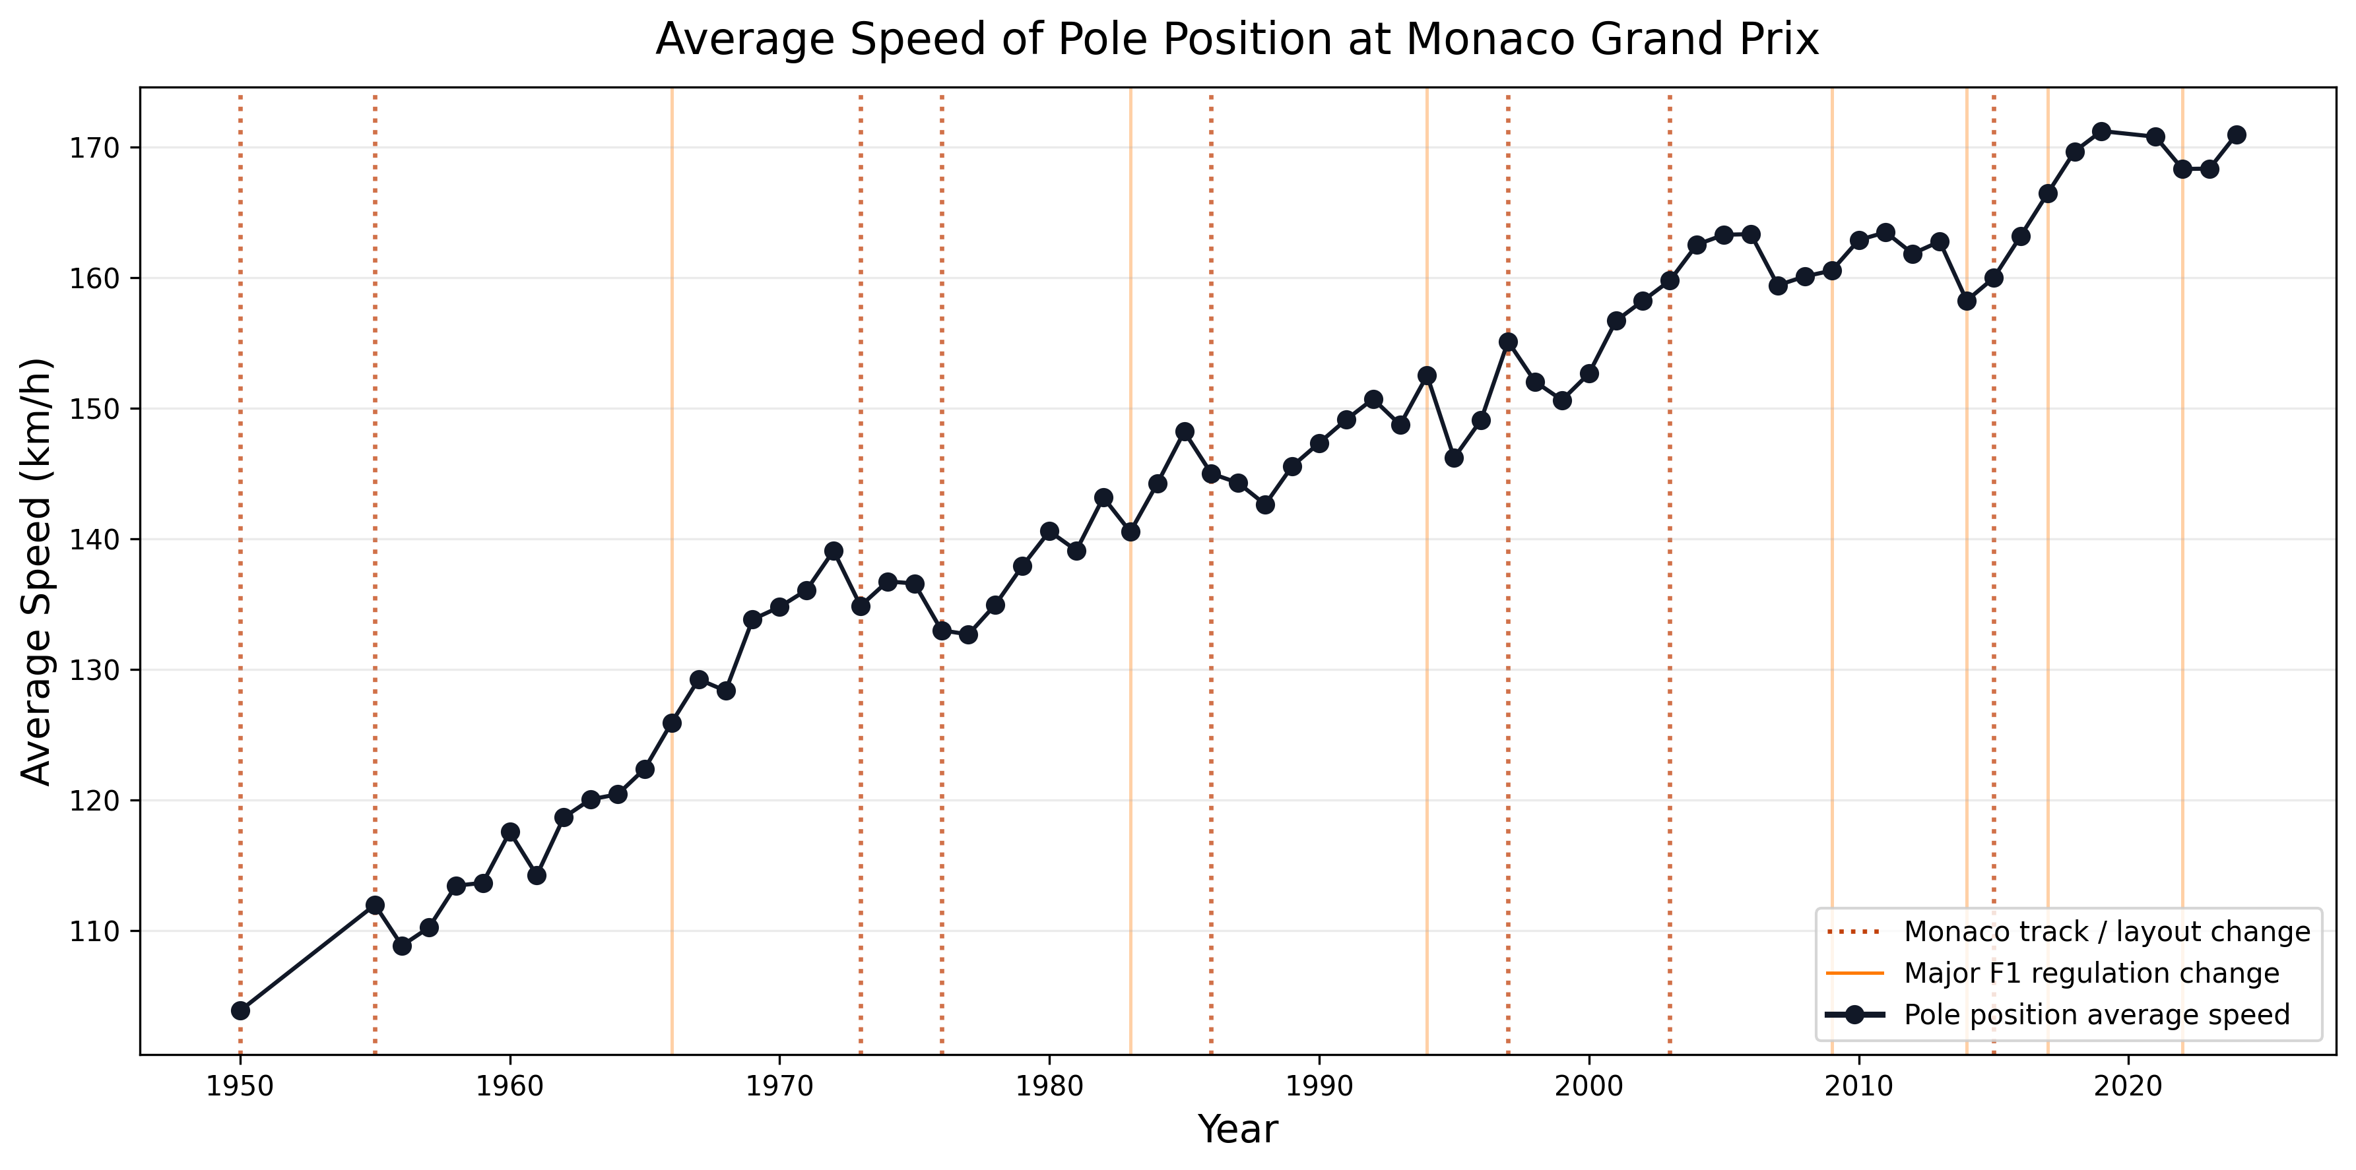
The Evolution of fastest lap at the Monaco Grand Prix
Using Monaco to isolate car performance from track changes
Monaco’s layout has remained relatively unchanged, making it ideal for isolating true performance trends.
Because the circuit is so consistent, changes in average speed mainly reflect car development, not track redesign.
This allows us to see how Formula 1 has genuinely evolved over time, independent of layout effects.
Notes:
Unlike Monza, Monaco’s layout has changed very little over time, which makes it a useful control case.

Slide 9
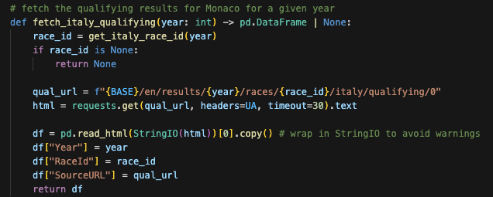
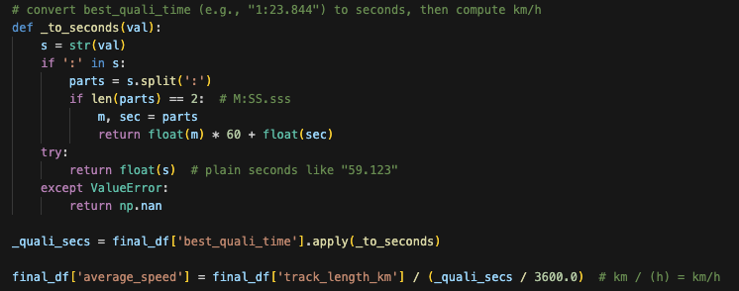
Challenges with my code
I filled the gap in pre-1994 qualifying data by scraping historic results and merging them with the modern dataset.
Qualifying times appeared in multiple formats, so I converted them into seconds to enable reliable speed calculations and fair comparison across different circuit layouts.
Notes:
One of the main challenges was that early qualifying data wasn’t available in a consistent format, so I had to scrape historical results and integrate them with the modern dataset.
Another challenge was handling lap times stored as strings in different formats. I wrote a conversion function to standardise everything into seconds, which made it possible to calculate average speed and compare performance fairly across different circuits and eras.

Slide 10
Thank you for listening!

