Slide 1
British Airways
Insights of Reviews

Slide 2
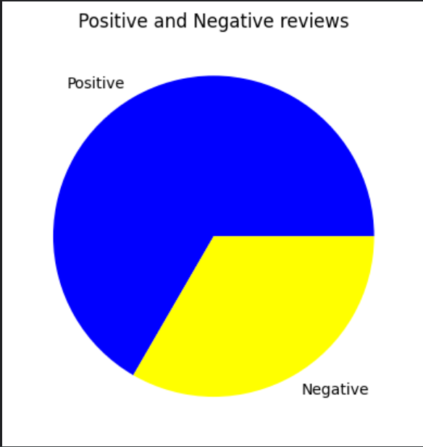
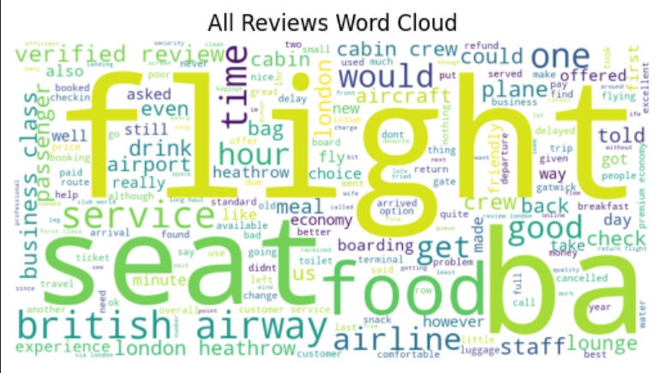
Insights
Positive reviews: 1333 Negative reviews: 667

