Slide 1
British Airways
Predicting customer buying behavior

Slide 2
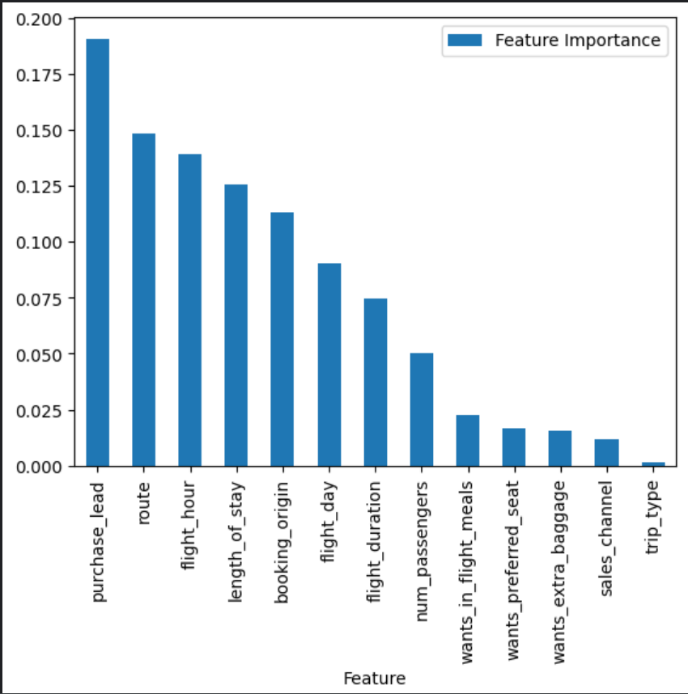
Some of thefeatures highly correlated with the target: Feature Importance:
purchase_lead
length_of_stay
route
booking_origin
flight_day
flight_hour
Data was trained on RandomForestClassifier.
Highest accuracy was obtained when trained on all features.
85%

