Slide 1



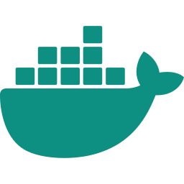


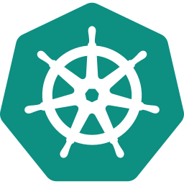



Expense Tracker
DEVOPS CAPSTONE PROJECT
FastAPI
React
PostgreSQL
From git push to a monitored Kubernetes cluster: tests, security gates, containers, CI/CD, Terraform, Helm, Argo CD and Prometheus + Grafana.
Docker
GitHub Actions
Terraform
Om Malviya
Roll No 24BCS10448
github.com/om-malviya/expense-tracker-devops
Kubernetes
Prometheus
Argo CD
Notes:
Hi, I am Om Malviya, roll number 24BCS10448, and this is my DevOps capstone: an Expense Tracker. The app itself is deliberately small, a FastAPI and PostgreSQL backend with a React dashboard, so the focus is the delivery chain around it. In the next ten slides I will walk from the code through testing, security gates, the CI/CD pipeline, Terraform, Kubernetes with Helm, GitOps with Argo CD, and monitoring.

Slide 2
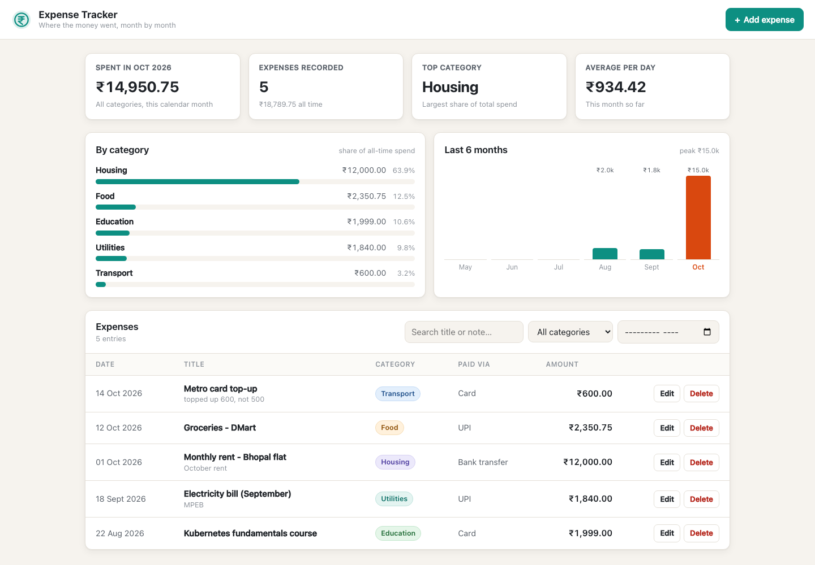
The problem and what I built
OVERVIEW
The problem
At month-end I want to know how much I spent, on what, and how it compares with earlier months.
What I built
FastAPI REST API: CRUD, filters, summary
PostgreSQL 16, schema managed by Alembic
React dashboard: KPIs, categories, 6-month trend
Filter by category, month or free text
Add, edit and delete with validated forms
Responsive, with loading and error states
Dashboard at localhost:3000, served by nginx from the Docker Compose stack
Notes:
The problem is a personal one: at the end of every month I want to know where my money went. So I built a single-user expense ledger with a FastAPI REST API, PostgreSQL managed by Alembic migrations, and a React dashboard with KPI cards, a category breakdown and a six-month trend. The app is small on purpose, so every DevOps layer around it stays easy to reason about.

Slide 3









One tool per job, from code to cluster
TECH STACK
App
FastAPI · React 18 · Vite 7 · served by nginx
Data
PostgreSQL 16 · SQLAlchemy 2 · Alembic migrations
Quality & Security
pytest · ruff · Bandit · pip-audit · Gitleaks · Trivy
Containers
Docker multi-stage builds · Compose · non-root images
CI/CD
GitHub Actions · GHCR images tagged with the git SHA
IaC
Terraform 1.16 · AWS VPC + EKS 1.31 (ap-south-1)
Orchestration
Kubernetes (k3s, EKS) · Helm · Traefik Ingress · HPA
Observability
Prometheus · Grafana · Alertmanager · ServiceMonitor
GitOps
Argo CD: automated sync, prune, self-heal
Notes:
Here is the stack, grouped by job. The app is FastAPI, React and PostgreSQL; quality and security come from pytest, ruff, Bandit, pip-audit, Gitleaks and Trivy. Images are built with Docker and shipped by GitHub Actions to GHCR, Terraform describes the AWS VPC and EKS cluster, Helm deploys to Kubernetes, kube-prometheus-stack gives me Prometheus and Grafana, and Argo CD adds the GitOps path.

Slide 4






How a request flows through the cluster
ARCHITECTURE
Kubernetes cluster · k3s locally, EKS on AWS
namespace expense-tracker · Pod Security: restricted
/
Frontend
nginx · 2 pods · :8080
ConfigMap + Secret
app settings · DATABASE_URL
HTTP
Ingress
Traefik
host expense.local
Browser
expense.local
/api
Backend API
FastAPI · 2 → 4 pods (HPA)
SQL
PostgreSQL 16
StatefulSet + PVC
namespace monitoring · kube-prometheus-stack
Alertmanager
5 alert rules
Prometheus
scrapes /metrics every 15 s
Grafana
API overview dashboard
Notes:
This is the runtime architecture. The browser hits the Traefik Ingress on expense.local, which sends slash to the nginx frontend and slash api to the FastAPI backend, and the backend talks to PostgreSQL running as a StatefulSet with a persistent volume. Config comes from a ConfigMap and a Secret, and the namespace enforces the restricted Pod Security profile. In the monitoring namespace, Prometheus scrapes the backend's metrics endpoint every 15 seconds, Grafana visualises it and Alertmanager receives the five alert rules.

Slide 5







GitHub Actions: five jobs, one security gate
CI/CD
backend-test 21 s
ruff + pytest (20 tests)
build-scan-push 1 m 43 s
docker build both images
deploy 5 s
helm lint, then helm upgrade --install with the SHA tag
main branch only
frontend-build 8 s
npm ci, build, npm audit
Trivy gate on both images: fails on HIGH/CRITICAL
git push
or PR to main
SARIF upload to GitHub
security-static 23 s
Bandit, pip-audit, Gitleaks
push to GHCR as :<git-sha> (+ :latest on main)
What actually happened on the first push
Run 1 failed after 29 s
Gitleaks: my own DB-URL rule matched a README example
Fix in commit ec416e2
Placeholders in the docs + allow-list; the rule stays on
Run 2 green in 2 m 21 s
All 5 jobs passed; images pushed with the SHA tag
Notes:
Every push or pull request to main runs this workflow. Three jobs run in parallel: backend tests with ruff and pytest, the frontend build with npm audit, and static security checks. Only if all three pass does build-scan-push build both images, run the Trivy gate, and push them to GHCR tagged with the git commit SHA; the deploy job then lints the Helm chart and deploys that exact tag. My real first run actually failed on Gitleaks, because my own connection-string rule matched an example in the README; I fixed the docs instead of disabling the rule, and the next run went green in 2 minutes 21 seconds.

Slide 6

Security checks at every stage
DEVSECOPS
0
Gates in the pipeline
Runtime hardening
Gitleaks
secrets, scanned over full git history
Non-root users
uid 10001 (API) and 101 (nginx)
HIGH / CRITICAL fixable CVEs
Bandit
Python static analysis (SAST)
pip removed
not present in the runtime image
in both images at the Trivy gate
pip-audit --strict
known CVEs in Python dependencies
Read-only root filesystem
emptyDirs only where writes are needed
Backend: Debian 13.7, 87 OS + 30 Python packages
Frontend: Alpine 3.24.2, 70 OS packages
A fixable HIGH/CRITICAL CVE turns the job red and nothing reaches GHCR.
npm audit
JS dependencies, fails on HIGH+
Drop ALL capabilities
no privilege escalation, seccomp default
Trivy
both images, blocks the push
Pod Security: restricted
enforced on the namespace
Notes:
Security is built into the pipeline rather than added at the end. Gitleaks, Bandit, pip-audit and npm audit run before any image is built, and Trivy then scans both images and fails the job on any fixable HIGH or CRITICAL CVE, so a vulnerable image never reaches the registry. On the green run both images came back with zero findings. At runtime the containers are non-root, pip is removed, the root filesystem is read-only, all capabilities are dropped, and the namespace enforces the restricted Pod Security profile so a regression is rejected at admission.

Slide 7
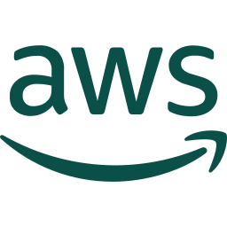

Terraform: AWS VPC + EKS in ap-south-1
INFRASTRUCTURE AS CODE
region ap-south-1 (Mumbai)
61
resources to add
terraform plan
0 to change, 0 to destroy
VPC 10.30.0.0/16 · 2 availability zones
EKS 1.31
control plane
Public subnet · 1a
10.30.101.0/24
Public subnet · 1b
10.30.102.0/24
init, fmt and validate pass; plan ran offline against LocalStack
NAT gateway
ELB-tagged
Internet gateway
Cost control
Private subnet · 1a
10.30.1.0/24
Private subnet · 1b
10.30.2.0/24
IAM · OIDC · KMS
IRSA for EBS CSI
One NAT gateway shared by both AZs
t3.medium nodes: min 1, desired 2, max 3
~5–6 USD/day: destroy after each demo
node · t3.medium
node · t3.medium
init
fmt + validate
plan
apply
check console
destroy
Notes:
Terraform describes the AWS side: a VPC with two public and two private subnets across two availability zones, one NAT gateway, and an EKS 1.31 cluster with a managed node group of t3.medium nodes, using the community VPC and EKS modules. Init, fmt and validate pass, and terraform plan comes out at 61 resources to add. The workflow is plan, apply, check the VPC and cluster in the console, then destroy; because the cluster costs roughly 5 to 6 dollars a day, I keep a single NAT gateway, cap the node group at three, and destroy as soon as the demo is over.

Slide 8
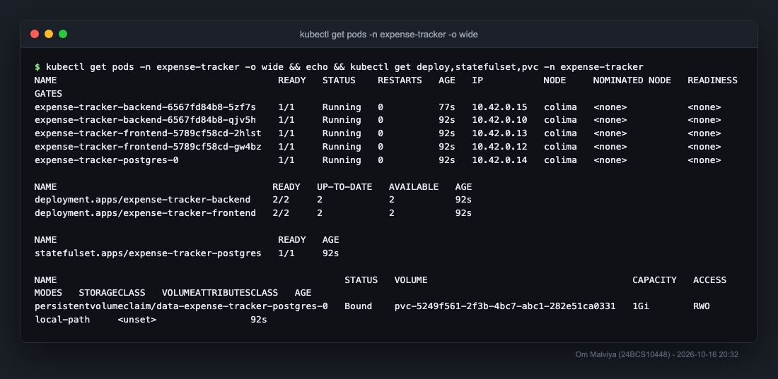





One Helm chart, deployed by git SHA
KUBERNETES + HELM
Deployments
backend + frontend, 2 replicas each, probes
StatefulSet
PostgreSQL 16 with a 1 Gi PVC
ClusterIP Services
backend :8000, frontend :80, postgres
Ingress
expense.local: /api → backend, / → frontend
HPA
backend 2 → 4 pods at 60 % CPU
2 → 4
backend pods under load
528 %
peak CPU vs 60 % target
9,000
requests in 180 s, 0 failed
ConfigMap · Secret · ServiceMonitor
config, DATABASE_URL, metrics scrape
Notes:
The whole application ships as one Helm chart: two Deployments with two replicas each, PostgreSQL as a StatefulSet with a persistent volume, ClusterIP Services, an Ingress that routes slash api to the backend and everything else to the frontend, plus an HPA and a ServiceMonitor. Images are always pulled from GHCR by the git SHA tag, never latest. To prove the autoscaler, I ran a three-minute load test: CPU went from 22 to 528 percent of the 60 percent target, the backend scaled from 2 to 4 pods, and all 9,000 requests succeeded.

Slide 9


Argo CD: Git is the source of truth
GITOPS
git push
pull
sync
Commit
GitHub main
Argo CD
Cluster
change image tag or replicas
in values-gitops.yaml
desired state,
reviewed and versioned
polls the repo every 3 min,
renders the Helm chart
namespace
expense-tracker-gitops
self-heal: drift is detected and reverted
Two delivery paths
Push: the CI deploy job runs helm upgrade with the SHA tag
Pull: Argo CD inside the cluster follows main, no kubeconfig in CI
Sync policy: automated · prune · selfHeal
A deployment is a commit; a rollback is a git revert
kubectl scale or a deleted pod is put back to match Git
Notes:
Argo CD adds a pull-based delivery path. The desired state is the Helm chart plus values-gitops.yaml on the main branch; Argo CD runs inside the cluster, watches the repo and syncs the expense-tracker-gitops namespace to match. So a deployment is just a commit that bumps the image tag or the replica count. Sync is automated with prune and self-heal, which means if someone scales a deployment by hand or deletes a pod, Argo CD detects the drift and puts the cluster back to what Git says.

Slide 10
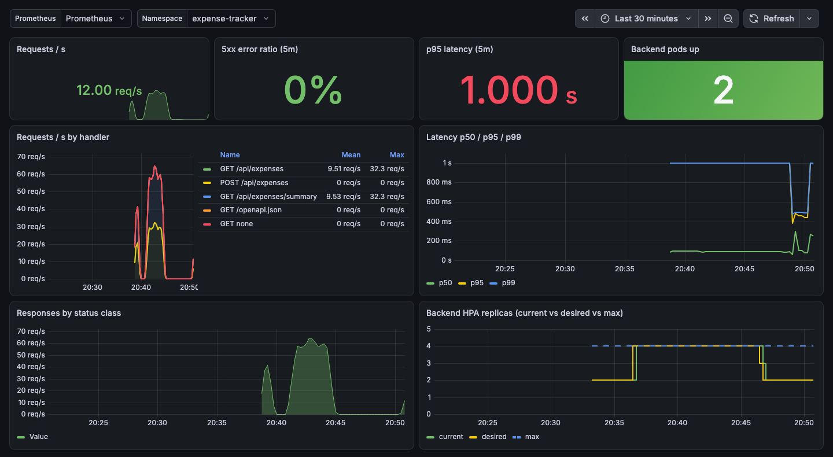

Prometheus + Grafana on live app metrics
OBSERVABILITY
Targets: UP
ServiceMonitor scrapes every backend pod
PromQL I used
up{namespace="expense-tracker"}
sum(rate(http_requests_total[5m]))
histogram_quantile(0.95, …)
5xx ratio · HPA replicas
5 alert rules
16
metric families
15 s
scrape interval
8
Grafana panels
0 %
5xx under load
BackendDown · CrashLooping · HighErrorRate · HighLatencyP95 · HpaAtMax
Notes:
For monitoring I installed kube-prometheus-stack. The backend exposes a metrics endpoint, and a ServiceMonitor from my Helm chart makes Prometheus scrape every backend pod every 15 seconds; the targets page shows them all up. The Grafana dashboard is provisioned from the repo and shows request rate, error ratio, p95 latency and HPA replicas; this capture is from the load test, where you can see the replicas go from 2 to 4. I also wrote five alert rules, and during the load test the p95-latency and HPA-at-max alerts went to pending, which is exactly what they are for.

Slide 11
Key learnings
WRAP-UP
1
Scanners read your docs too
2
Config keys can fail silently
Thank you
Run 1 failed: my Gitleaks rule matched a README example. I fixed the docs and kept the rule.
ignore-unfixed at the top level of trivy.yaml did nothing (44 HIGH, exit 1); it goes under vulnerability.
Questions?
3
pip is attack surface
4
Monitors select Services
Removed pip, setuptools and wheel from the runtime image, and upgraded the nginx base to 1.30.
My ServiceMonitor used pod labels and found no target; Helm revision 2 fixed the selector.
Om Malviya
Roll No 24BCS10448
5
PSA restricted is a free test
6
HPA needs requests + patience
github.com/om-malviya/
expense-tracker-devops
It forced runAsNonRoot, seccomp and drop ALL on every container, Postgres included.
~1.5 min of FailedGetResourceMetric at first; never set replicas while the HPA owns them.
Notes:
To close, six things that actually went wrong or surprised me. My own secret-scanning rule failed the first pipeline run, a misplaced Trivy key was silently ignored, pip itself was carrying CVEs, my first ServiceMonitor selected pod labels instead of Service labels, the restricted Pod Security profile forced proper hardening everywhere, and the HPA needed CPU requests and some patience before it had metrics. Thank you for listening; I am happy to take questions.

