Slide 1
Fridge2Fit
Solving obesity, one picture at a time.
Om Raheja

Slide 2

Who am I?
High school sophomore from WWP North
Programming in C++ with Arduino since 4th grade.
Developed a strong interest in Artificial Intelligence earlier this year.
Currently conducting research at Rutgers University with Professor Yifeng Zhang on an LLM agent operating system.

Slide 3
Preface

Slide 4
Obesity & Overweight Rates
Obesity rate
Overweight rate
21.2%
47.5%
(Children 12-19)
(Children 12-19)

Slide 5
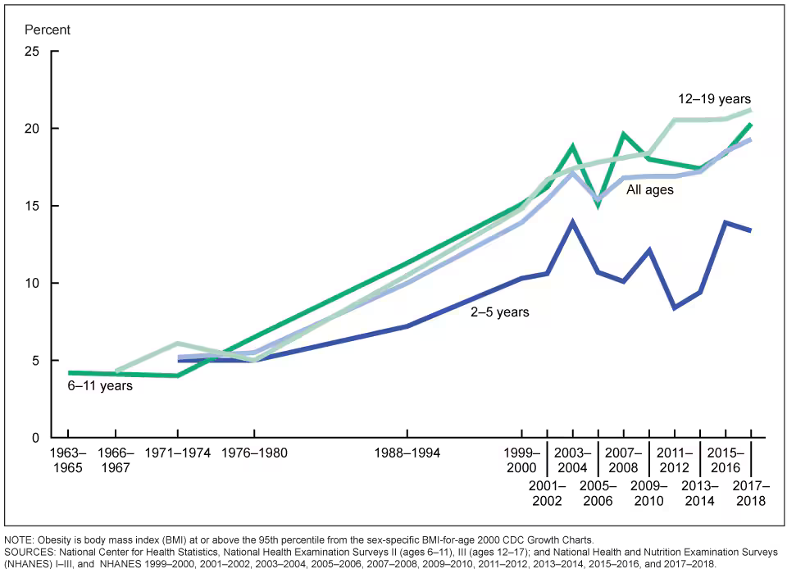
Obesity Rate Change
Courtesy of CDC.gov

Slide 6
Lorem & Ipsum
1/3
Of daily energy is contributed to by unhealthy snacking.
One
Extra meal’s worth of calories is contributed by unhealthy snacking across the nation.
58%
Of adults want to eat healthier.

Slide 7

The Idea
01
Take a picture of your fridge
Mobile Camera Application
02
Upload it and list foods
Model that can recognize images (CNN with splicing)
03
Generate recipes
Fine-tuned generative AI

Slide 8
My Model
User Modifications
Input Image
aicook-lcv4d/3
Ingredients
llama3-8b-8192
Output Recipes

Slide 9
Technologies Used
AICook Dataset
LLaMa 8B
Roboflow
Groq
Node.js
Express (helpers such as multer, mime-types)
Axios

Slide 10
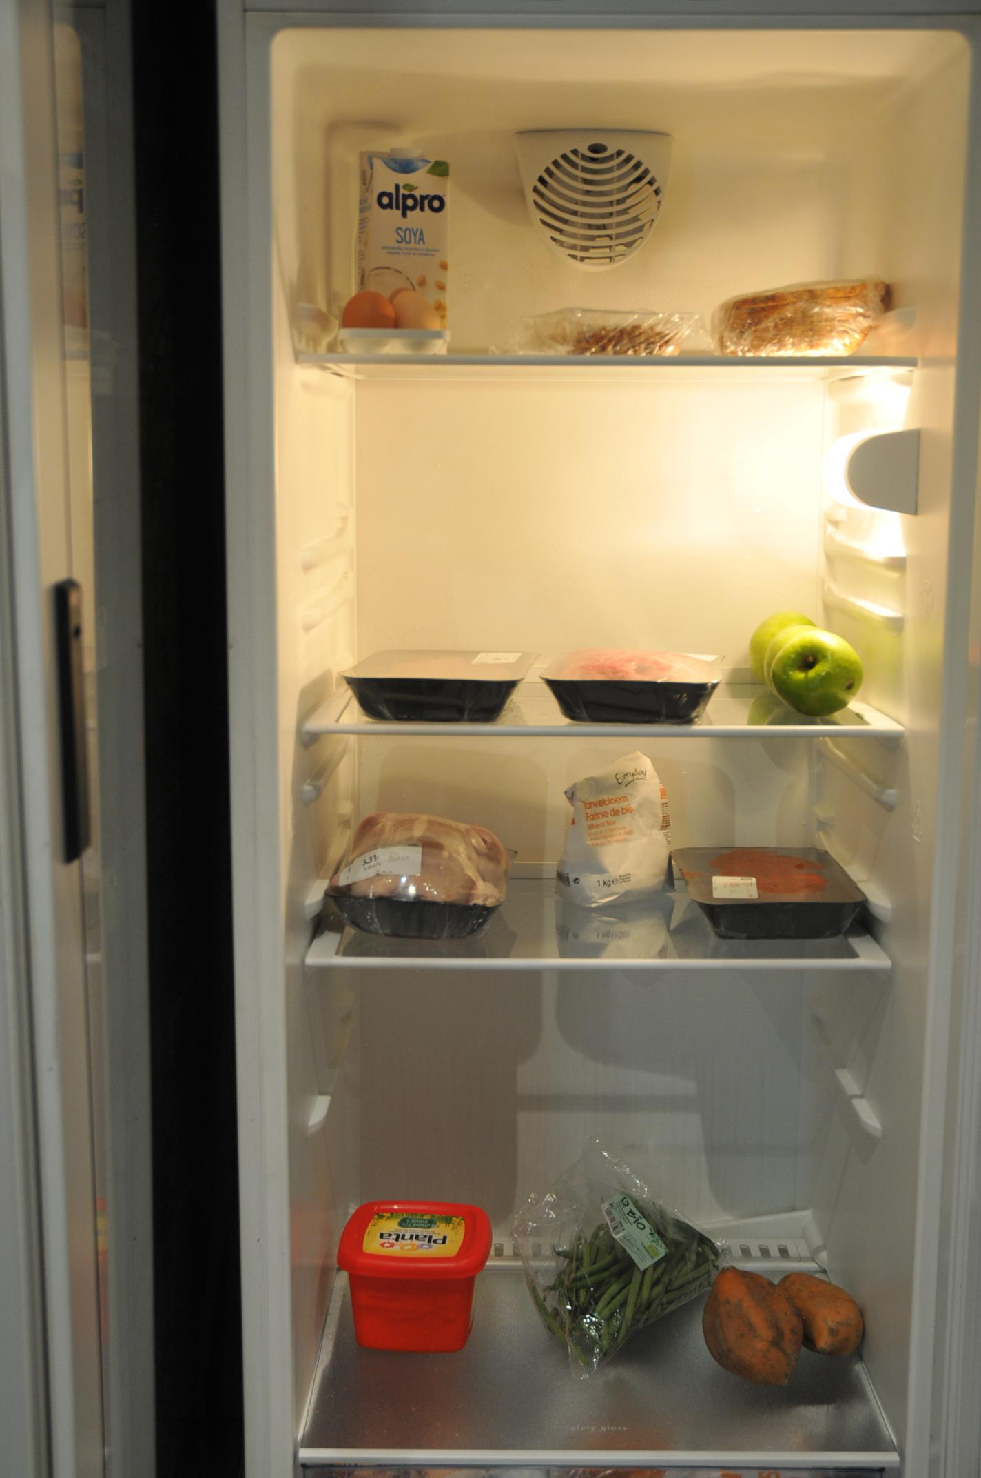
Demo

Slide 11
Limitations
AI cannot reliably detect covered items
Small dataset (unreliable)
Cannot be embedded easily into fridge (without multiple cameras)

Slide 12
References
Njike, Valentine Yanchou, et al. “Snack Food, Satiety, and Weight.” Advances in Nutrition, vol. 7, no. 5, 1 Sept. 2016, pp. 866–878, www.ncbi.nlm.nih.gov/pmc/articles/PMC5015032/, https://doi.org/10.3945/an.115.009340.
Archive, View Author, et al. American Adults Eat Extra Meal Each Day in Junk Food: Study. 17 Dec. 2023, nypost.com/2023/12/17/lifestyle/american-adults-eat-extra-meal-each-day-in-junk-food-study/. Accessed 18 May 2024.
Pew Research Center. “1. Public Views about Americans’ Eating Habits.” Pew Research Center Science & Society, Pew Research Center Science & Society, Dec. 2016, www.pewresearch.org/science/2016/12/01/public-views-about-americans-eating-habits/.

Slide 13
Thank you!
Growing Liberty by Budi Aryo @tokofoss

